Slide 1
Buckling Method for Composite Cylinders
Under Axial Loading and External Pressure
Plínio R. Santos

Slide 2
Load Case
P
F

Slide 3
Formulation
Ritz Method for Stability Analysis of Composite Cylinders
Potential of the external load

Slide 4
--
*
*

Slide 5
--
In the equilibrium

Slide 6
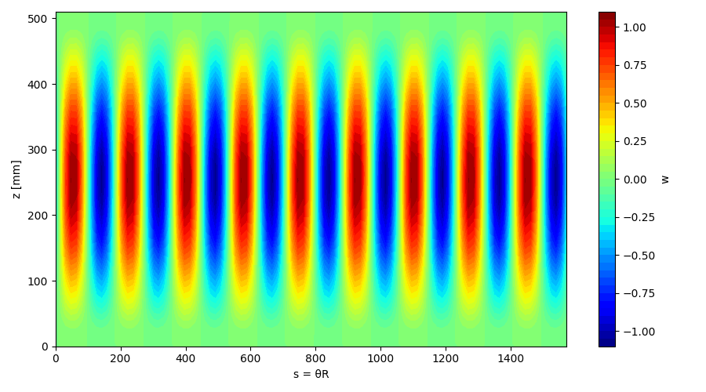
Results
P_cr [kN]: -10.2379
pressure_cr [MPa]: -0.0521

Slide 7
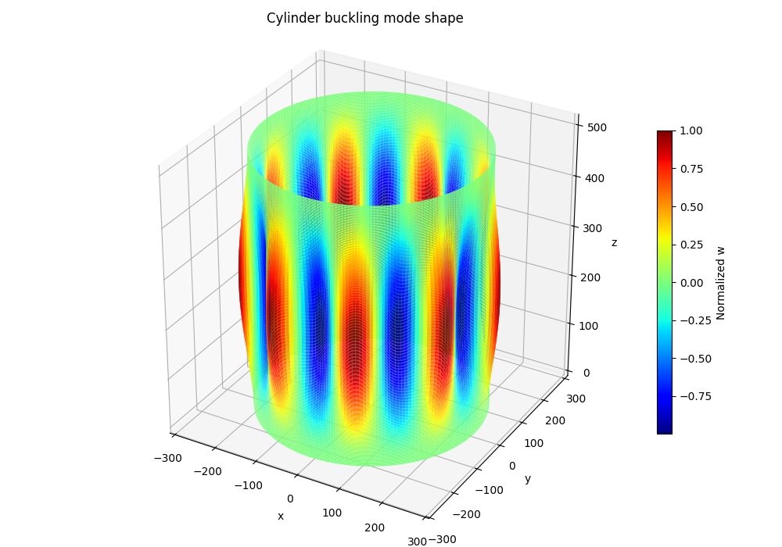
Results
P_cr [kN]: -10.2379
pressure_cr [MPa]: -0.0521

Slide 8
References
P. R. Santos and M. V. Donadon, “A semi-analytical model for buckling and stress
analyses of pressurized composite cylinders,” Journal of the Brazilian Society of
Mechanical Sciences and Engineering, vol. 45, no. 9, Sep. 2023, doi: 10.1007/s40430-
023-04350-3.
P. R. dos Santos and M. V. Donadon, “A semi-analytical model for buckling and stress
analyses of pressurized composite cylinders,” Proceedings of the 6th Brazilian
Conference on Composite Materials, pp. 65–70, 2022, doi: 10.29327/566492
P. R. Santos, M. V Donadon, and M. A. Arbelo, “A Semi-Analytical Model for
Stability Analyses of Composite Cylinders Accounting for Loading and Geometrical
Imperfections Effects,” in Proceedings of the 7th Brazilian Conference on Composite
Materials (BCCM), Universidade de Brasília, 2024, pp. 324–331

