Slide 1
Making .NET Projects Open-Source-Friendly
HeadspringLabs GitHub Organization
Migrating to GitHub
Creating NuGet Packages
Integrating with SymbolSource

Slide 2
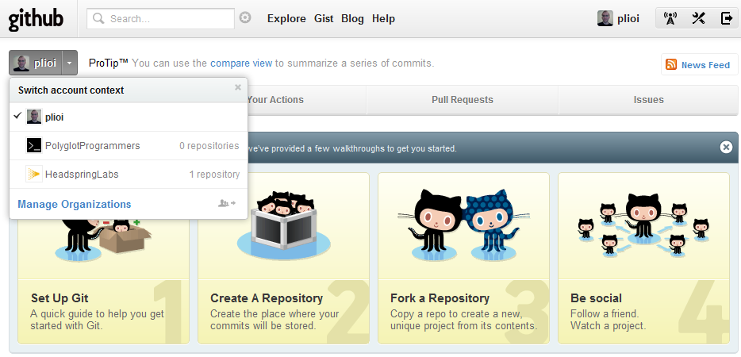
GitHub User Context

Slide 3
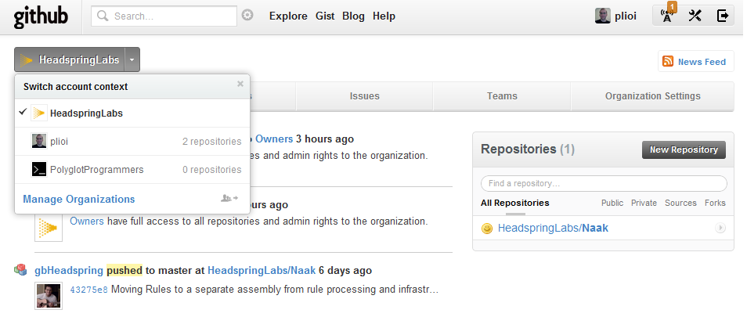
Headspring Context

Slide 4
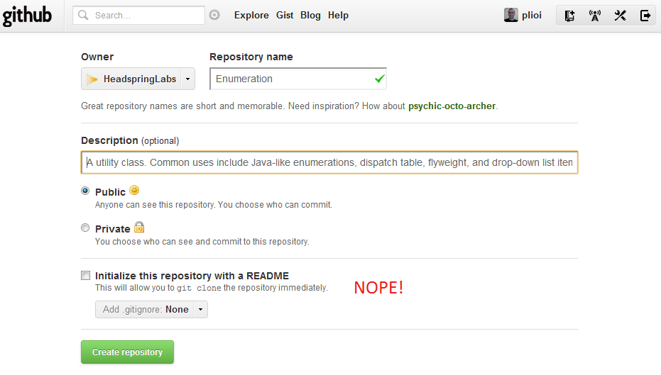
Create Repository

Slide 5
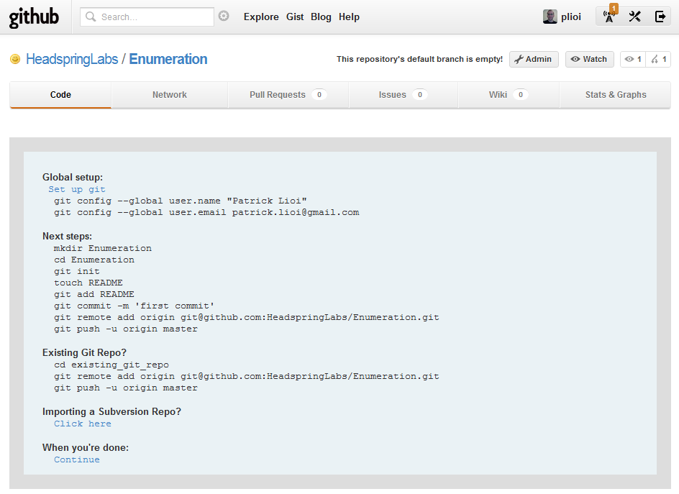
Successfully Created Repository

Slide 6
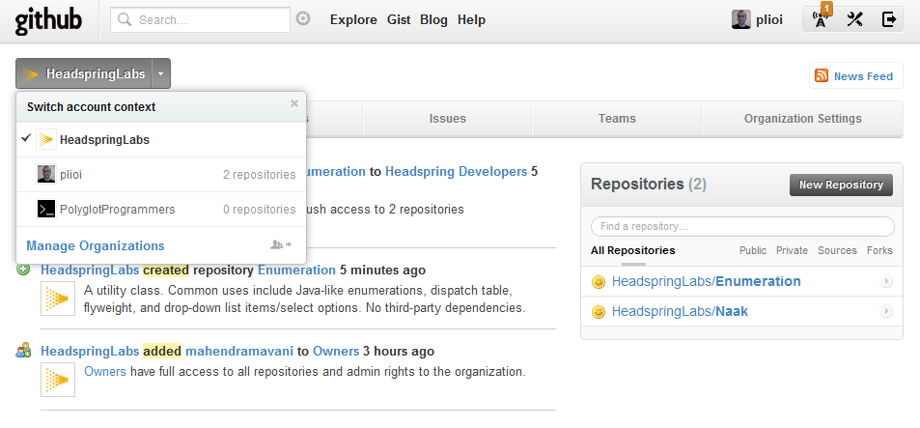
New Repo Within Organization

Slide 7
Installing Hg-Git
Ignore most advice online. It’s easier now that TortoiseHg includes “dulwich” bindings.
$ hg clone https://bitbucket.org/durin42/hg-git
Add to C:\Users\<username>\mercurial.ini:
[extensions]
bookmarks =
hggit = C:\<path>\<to>\hg-git\hggit
$ hg help hggit

Slide 8
Migrating & Fixing History
Update and run migrate_hg_to_git.sh
Hg clone
Converts local .hg to .git
Fixes history of committer identity
Pushes to GitHub
http://www.headspring.com/2012/03/migrating-from-bitbucket-to-github

Slide 9
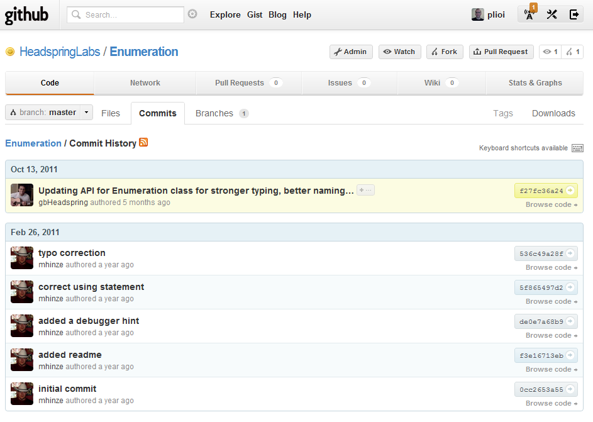
Migrated with History

Slide 10
Enumeration NuGet Package
$ git clone git@github.com:HeadspringLabs/Enumeration.git
$ cd Enumeration
$ nuget spec
=> Created local file Package.nuspec
=> Renamed to Enumeration.nuspec
=> Populated it for 1.0.4.
$ nuget pack Enumeration.nuspec
=> Creates Enumeration.1.0.4.nupkg
=> Try it out in a “Local Package Source”.

Slide 11
Publishing Content Files
<files>
<file src="Enumeration.cs" target="content\Headspring\Enumeration.cs" />
<file src="LICENSE.txt" target="content\Headspring\LICENSE.txt" />
</files>
“content” files will be dropped directly into the target project’s code folder.

Slide 12
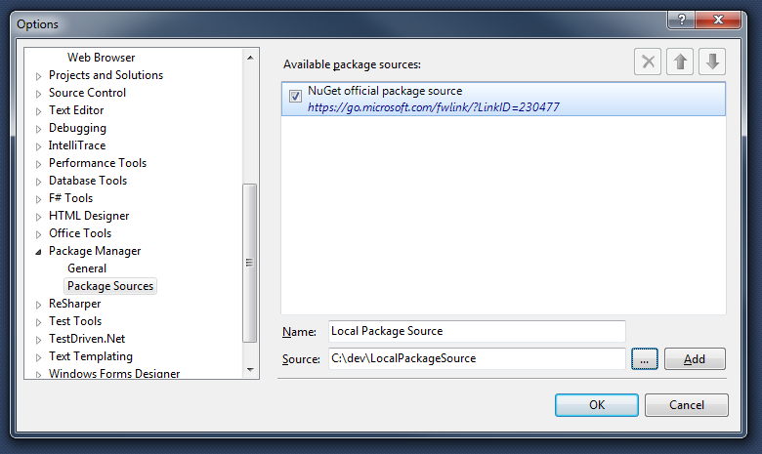
Create Local NuGet Package Source

Slide 13
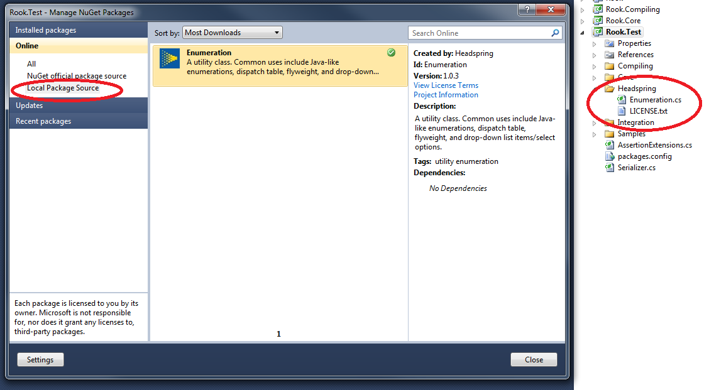
Install from Local Package Source

Slide 14
Pushing to NuGet.org
$ nuget pack Enumeration.nuspec
$ nuget push Enumeration.1.0.4.nupkg
$ del Enumeration.1.0.4.nupkg

Slide 15
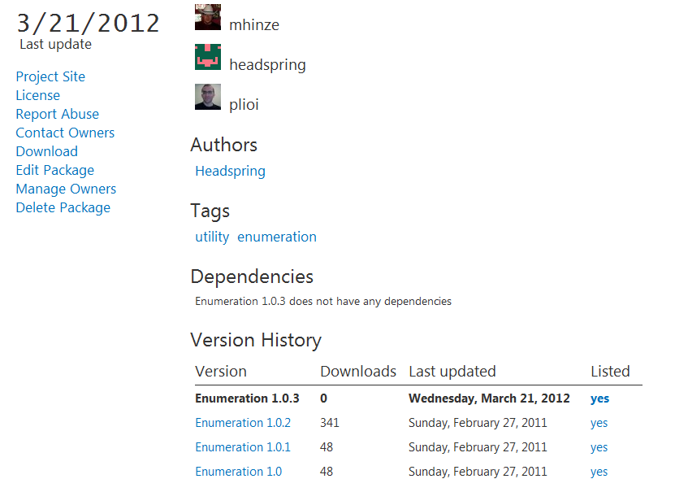
Successfully Uploaded Package

Slide 16
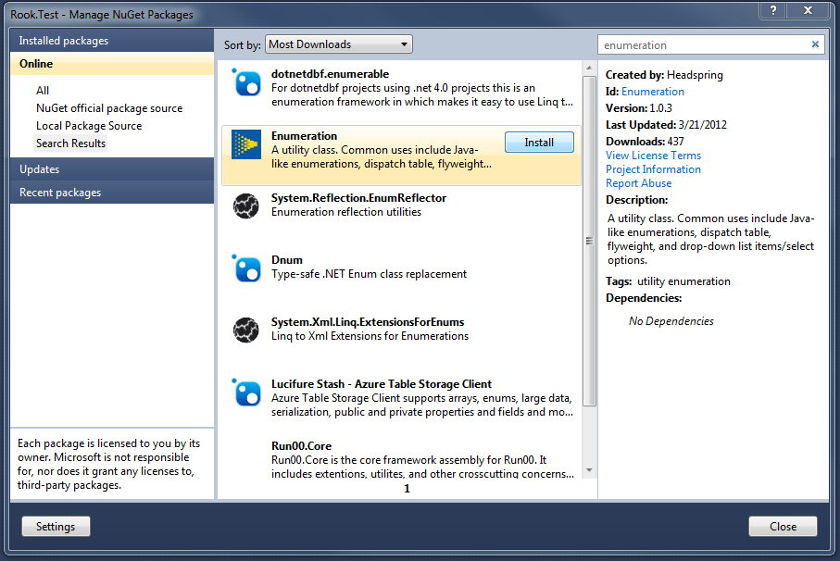
Install from Official Package Source

Slide 17
Packaging Libraries (1st Attempt)
<files>
<file src="$package_dir\*.dll" target="lib\net40" />
</files>
“lib” files are assumed to be DLLs, and installing the package will add them as references in the target project.

Slide 18
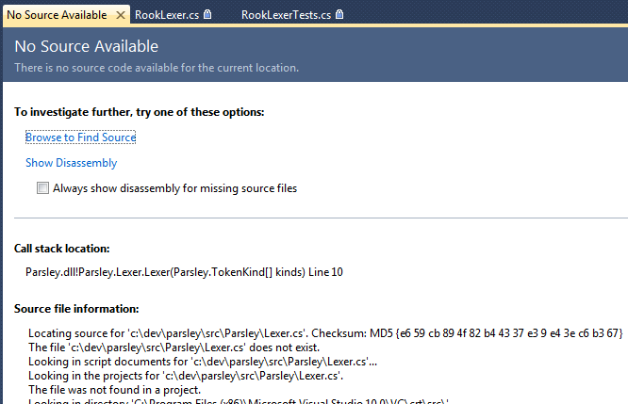
Thud

Slide 19
Improved Nuspec with Symbols
<files>
<file src="$package_dir\*.dll" target="lib\net40" />
<file src="$package_dir\*.pdb" target="lib\net40" />
<file src="$source_dir\**\*.cs" target="src" />
</files>
$ nuget pack Parsley.nuspec –Symbols
=> Produces familiar project.version.nupkg for DLLs.
=> Produces project.version.symbols.nupkg for all files.
$ nuget push Parsley.0.0.2.nupkg
=> Pushes the first nupkg to nuget.org.
=> Pushes the second nupkg to symbolsource.org.

Slide 20
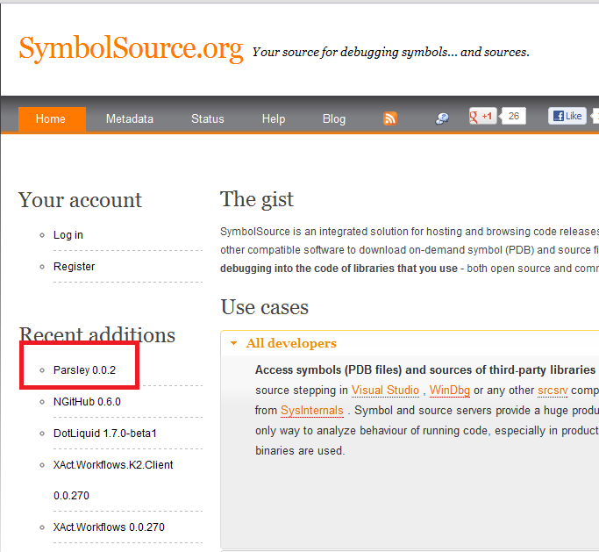
Successfully Uploaded to SymbolSource

Slide 21
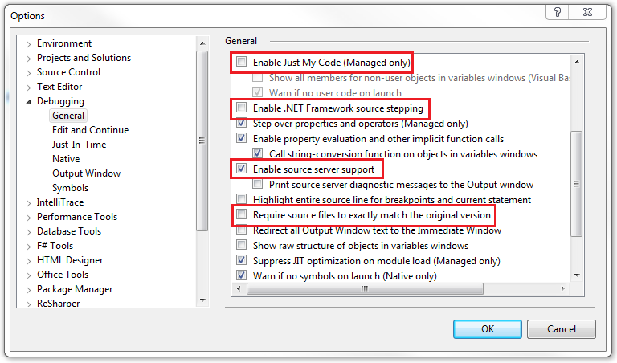
Configure Debugger for SymbolSource
You may want to revert these later. Note the defaults!

Slide 22
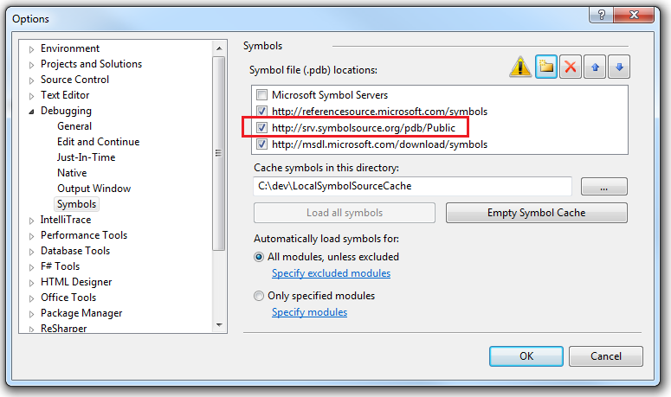
Symbol Path Configuration

Slide 23
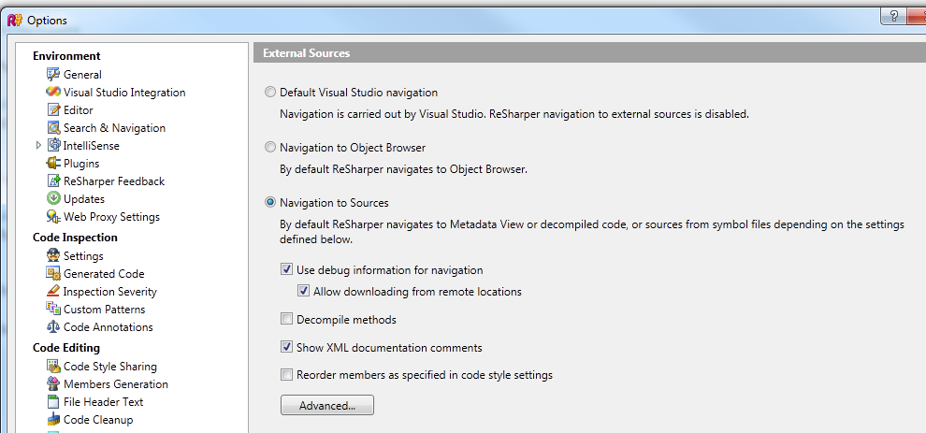
ReSharper – Navigate to Sources

