Slide 1


Slide 2


Slide 3
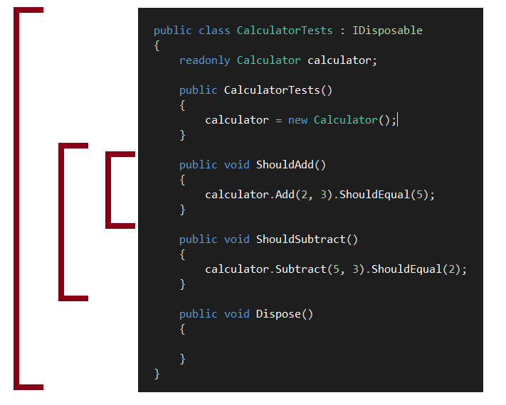
Custom behaviors wrap each test case, each instance, or each class.

Slide 4
@plioi
https://github.com/plioi/fixie
http://plioi.github.io/fixie
http://www.nuget.org/packages/Fixie

