Slide 1
Text Parsing with Parsley
History
The 3 phases of a parser
JSON example
Calculator example

Slide 2
3 Phases
1) Lexer / Tokenizer Phase:
(char sequence, prioritized regexes) => token sequence
2) Parser Phase:
(token sequence, grammar) => abstract syntax tree
3) Abstract Syntax Tree Traversal

Slide 3
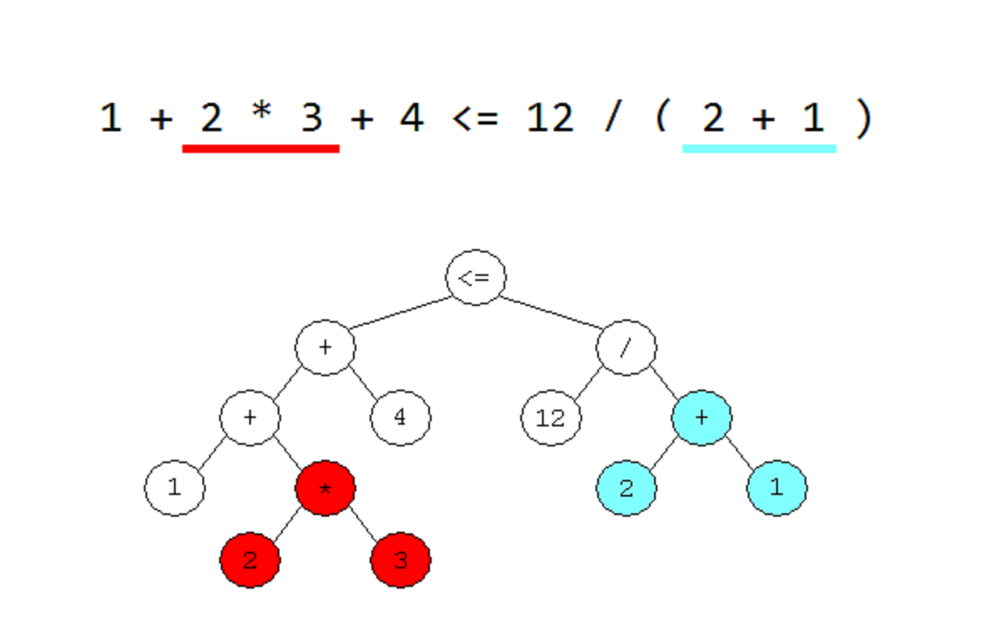
Abstract Syntax Trees

Slide 4
