Slide 1

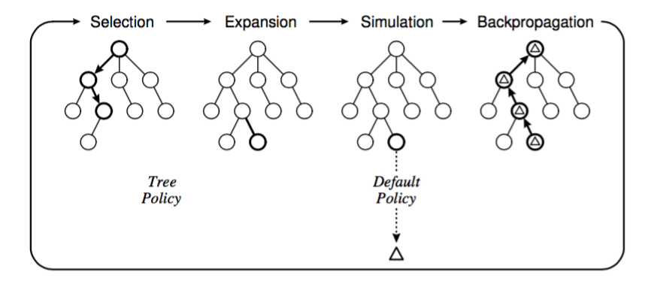
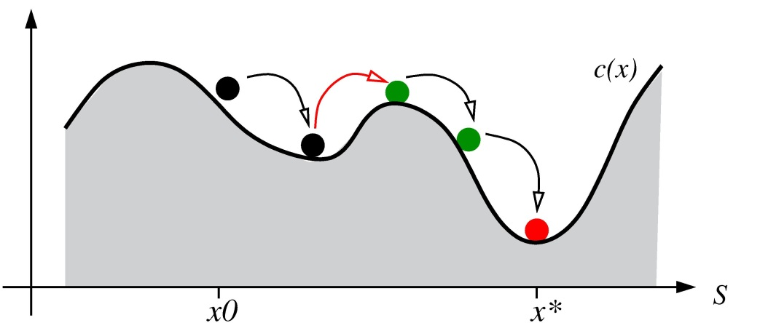
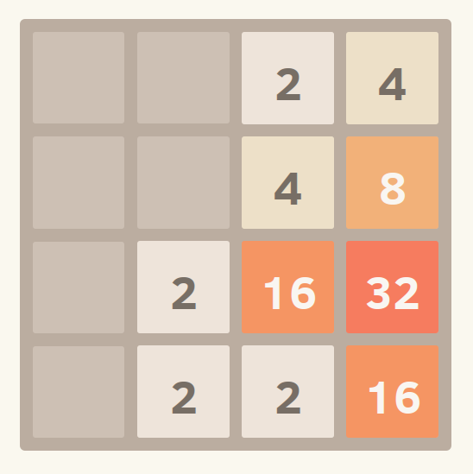
Application of Monte Carlo Tree Search to 2048
Paul Lisker | plisker@college.harvard.edu
Ahmed Ahmed | ahmedahmed@college.harvard.edu
CS 182 : Artificial Intelligence
Fall 2016
Introduction
Monte Carlos Tree Search (MCTS) is a class of algorithms for finding optimal choices in a decision space by taking random sample simulations and building a search tree according to their results. We apply MCTS to the popular puzzle game 2048, and compare and analyze its performance when compared with other successful AI solutions to the puzzle.
Monte Carlo Tree Search (MCTS) has been the subject of large portion of AI research in the past decade, initially spurred in 2006 by its successful application to the game Go, AI research on which had been stagnant for some time. A key feature of MCTS is that it doesn’t require any domain-specific knowledge of the game it is applied to, a fact which has lead to MCTS becoming a popular algorithmic choice from general game playing.
The popular board game 2048, developed by Gabrielle Cirulli, presents an interesting AI challenge because many very good heuristic search solutions have been published. We aim to develop an algorithm derived from MCTS that can be competitive with such algorithms.
blah blah blah
Figure 3. The four steps of in iteration of MCTS: (1) the selection of a an expandable node on some tree policy (2) the expansion of children of the selected (3) simulation from those child nodes until the game’s completion, and (4) back propagation of the resulting reward of said simulation to all expanded nodes that were ancestors of the simulation.
Approach
Conclusions
Expected Results
blah blah blah
Implement a MCTS AI to play vanilla 2048 and evaluate its performance compared to other competitive AI.
Refine MCTS AI by including 2048-specific heuristics in the simulation policy as well applying general MCTS optimizations. Then, re-compare this (hopefully) improved AI to others.
Apply our MCTS implementation to a class of generalizations of the standard 2048 game in order to demonstrate the non-context-specific nature of the algorithm, and to analyze its performance with changes in the decision space.
blah blah blah
blah blah blah
Figure 2. And all about Figure 2.
Citations and Links
.
Figure 1. A snapshot of a game of 2048.
John A. Paulson School of Engineering and Applied Sciences

