Slide 1
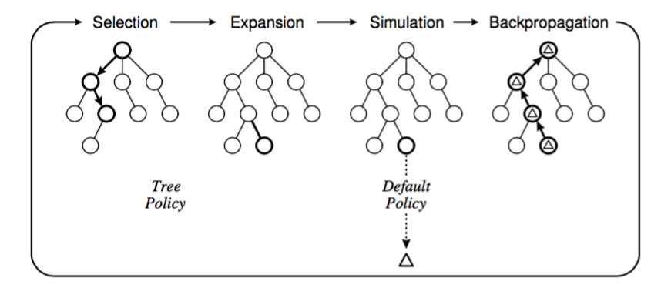
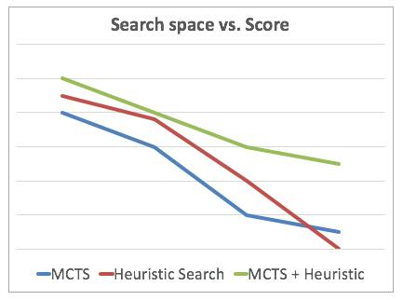
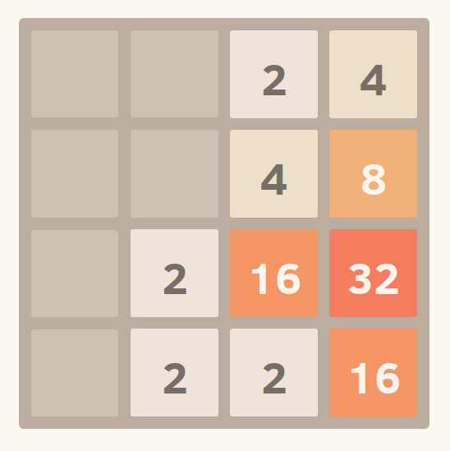
General Game Playing Agents for the Puzzle 2048
Paul Lisker | plisker@college.harvard.edu
Ahmed Ahmed | ahmedahmed@college.harvard.edu
CS 182 : Artificial Intelligence
Fall 2016
Introduction
General Game Playing is a subfield of Artificial Intelligence that seeks to develop agents that are capable of playing many games rather than being tailored and limited to particular game. A popular approach includes Monte Carlos Tree Search (MCTS), a class of algorithms for finding optimal choices in a decision space by taking random sample simulations and building a search tree according to their results. We apply MCTS to the domain of games including the popular puzzle game 2048, analyze its performance, and compare it to other successful AI approaches.
General Game Playing (GGP) has been a popular subject of AI research, particularly over the past decade. A notable GGP algorithm is Monte Carlo Tree Search (MCTS), notable in part by its successful application in 2006 to the game Go, a game that had confounded researchers for some time. A key feature of MCTS is that it does not require any domain-specific knowledge of the game to which it is applied; this fact has led MCTS becoming a popular algorithmic choice.
The domain of games similar to and including 2048, a popular game developed by Gabrielle Cirulli, presents an interesting AI challenge. Heuristic search solutions have been published for 2048. We aim to develop an algorithm derived from MCTS that can be competitive with such algorithms across game variations.
blah blah blah
Figure 2. The four steps of in iteration of MCTS: (1) the selection of a an expandable node on some tree policy (2) the expansion of children of the selected (3) simulation from those child nodes until the game’s completion, and (4) back propagation of the resulting reward of said simulation to all expanded nodes that were ancestors of the simulation.
Figure 3. Here we show what we expect the performance in terms of average score of pure MCTS, heuristic search, and MCTS + heuristic implementations, when running time is kept constant. We expect MCTS + heuristic to have an advantage in as the search space grows very large due to the combined effect of sampling and heuristics leading to increased scalability.
Approach
Results
Implement a MCTS AI to play 2048 and variations and evaluate its performance against heuristic agents.
Assess the success of the algorithm across variations of the game 2048, including (a) different grid sizes, (b) different score systems, (c) different tile-spawning schemes.
Refine MCTS AI by including 2048-domain specific heuristics in the simulation policy as well applying general MCTS optimizations. Then, re-compare this improved AI to others.
Assess the success of the MCTS to each game variation and seek to better its performance overall.
blah blah blah
Baseline: a run-through of one thousand simulations of traditional 2048 play revealed an average score of 1087 and a highest tile of 256. In comparison, one thousand simulations of gameplay there is a ranking of preferred moves resulted in an average score of 2530 and a highest tile of 512. With such a simple change, the score duplicated and a greater tile was achieved. Clearly, the game is ripe for better game-playing agents.
MCTS should succeed in improving upon the baseline for each of the various variations. Particularly, it is likely to succeed more in games with low stochastic variation; the more a simulated move is representative of future success, the greater the likelihood that the MCTS agent selects the optimal move.
MCTS plus heuristic implementations should have a significant improvement over simply MCTS. 2048 games have a short- and long-term trade-off, where seeking short-term gains is not a viable long-term solution given that maximizing score in any given move can destroy the tiling order necessary for a long-term goal. Therefore, a MCTS agent with heuristics should be more successful and less computationally taxing.
Goals: the best published solution of 2048 via heuristic search resulted in 100% win rate of at least 8192, with 36% of simulations successfully reaching the 32,768 tile. However, most other algorithms did not win 2048 every time, winning with around 90% win rate. This is therefore our goal for the traditional version. For non-traditional versions, we will compare the GGP algorithm to a preferred-move approach to quantify improvement over the baseline.
Citations and Links
Browne, C.B., Powley, E., Whitehouse, D., Lucas, S.M., Cowling, P.I., Rohlfshagen, P., Tavener, S., Perez, D., Samothrakis, S. and Colton, S., 2012. A survey of monte carlo tree search methods. IEEE Transactions on Computational Intelligence and AI in Games, 4(1), pp.1-43.
Play 2048 in your browser: https://gabrielecirulli.github.io/2048/
Basic 2048 implementation from: Rixner, Scott, et. al. “Principles of Computing” course on coursera
“What is the optimal algorithm for the game 2048?”: http://stackoverflow.com/questions/22342854/what-is-the-optimal-algorithm-for-the-game-2048
Figure 1. A snapshot of a game of 2048.
John A. Paulson School of Engineering and Applied Sciences

