Slide 1

Give Back at Seattle GiveCamp
October 14-16, 2016 seattlegivecamp.org

Slide 2
What is GiveCamp?
Seattle GiveCamp is a weekend-long hackathon, Oct 14-16, where software professionals donate their time to create custom software for non-profit organizations
Seattlegivecamp.org

Slide 3
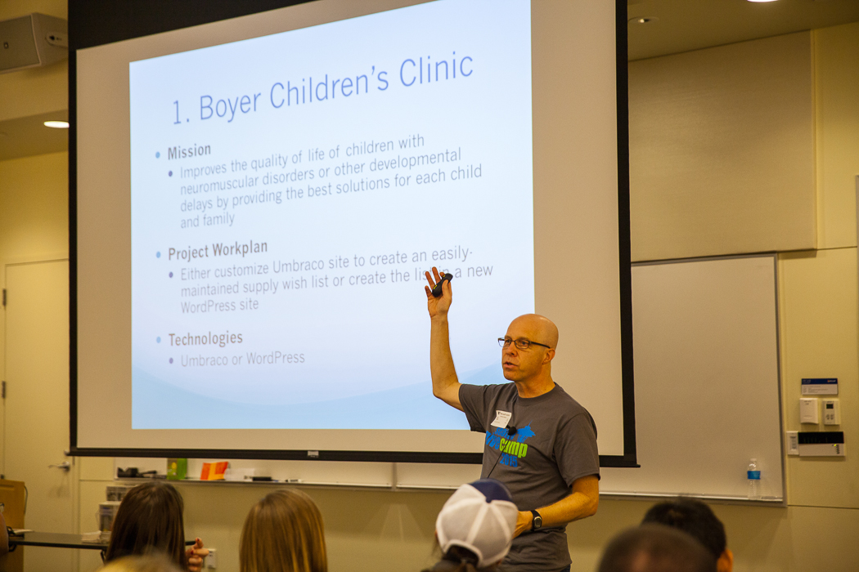
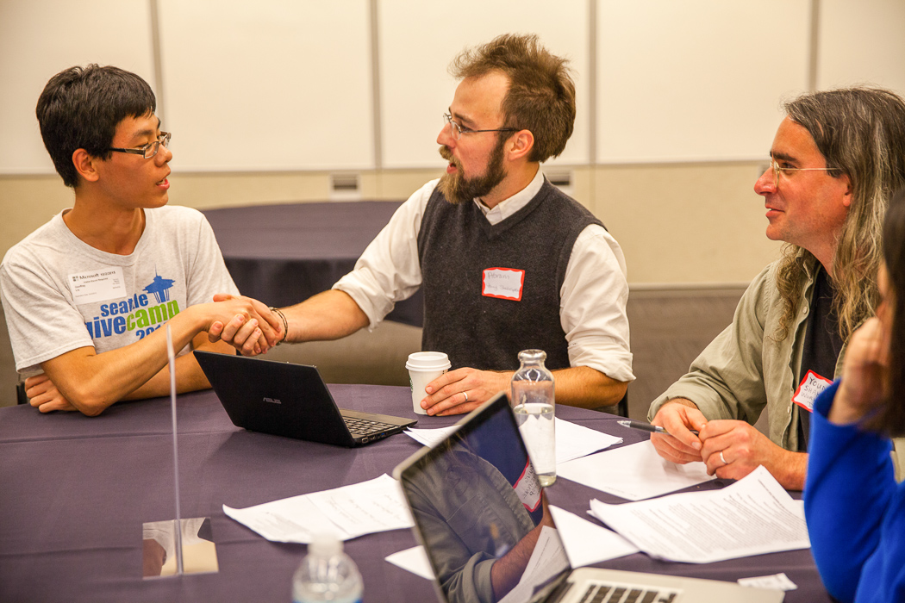

Slide 4
Who Do We Help?
Groups like these from our 2015 GiveCamp…
Hunger Intervention Program
OneWorld Now!
Boyer Children’s Clinic
Changes Parent Support Network
East African Community Services
Environment Science Center
Facing Homelessness
Global Foundation For Children With Hearing Loss
Green Plate Special
KCSARC (King County Sexual Assault Resource Center)
La Leche League of Washington
Listen and Talk
Many Lights Foundation
Meadowbrook Community CARE
North Helpline
Page Ahead Children's Literacy Program
Puget Sound Old Lesbians Organizing for Change
PUP Dog Rescue
Queer Foundation
Rotary First Harvest
Seavuria
TB Photovoice
Washington State Parks Foundation
Young Shakespeare
Workshop Youth in Focus

Slide 5
Who Do We Need?
Information professionals…
Experience with…
ASP.NET, PHP, Ruby, …
HTML, CSS, AngularJS, jQuery, …
Mobile app dev including iPhone, Android, …
SalesForce
Little Green Light
Facebook, Twitter, Social Media, …
Wordpress, Wix, Weebly, …
C#, VB, Java, MS Access, …
Other stuff we forgot to mention…
Willingness to be flexible!
All roles
Software developers, project managers, web designers, social media experts, testers, database pros, …

Slide 6
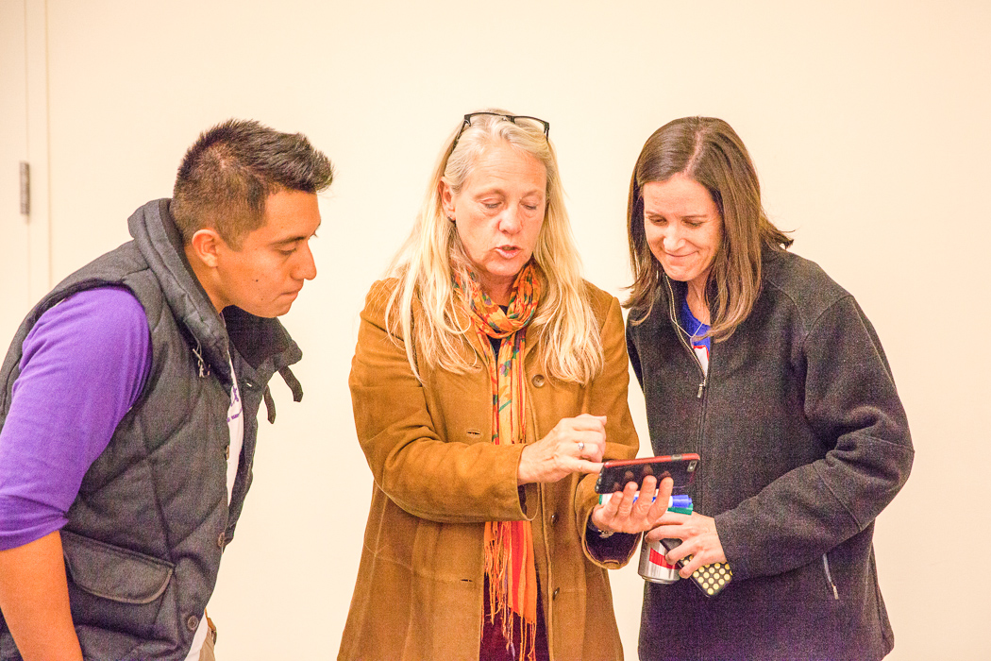
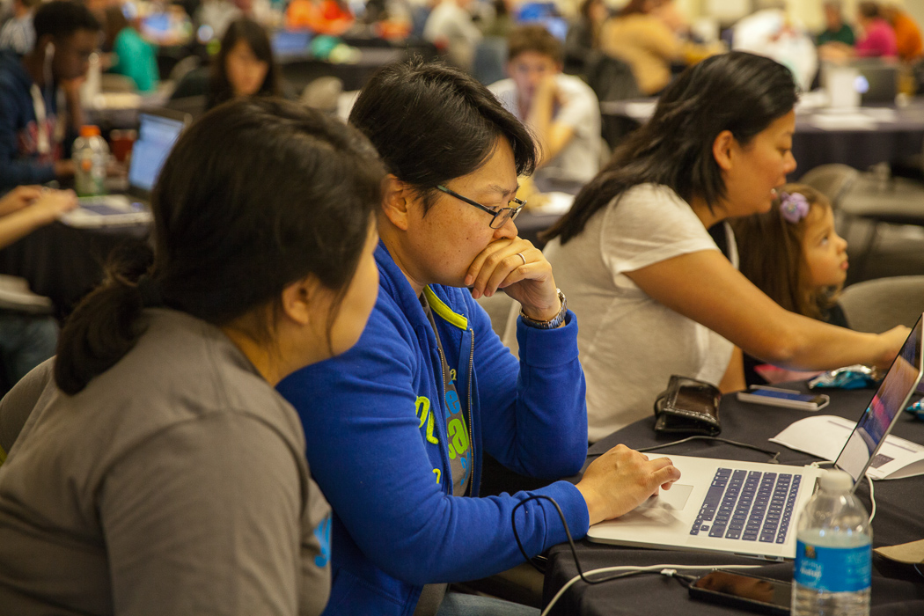
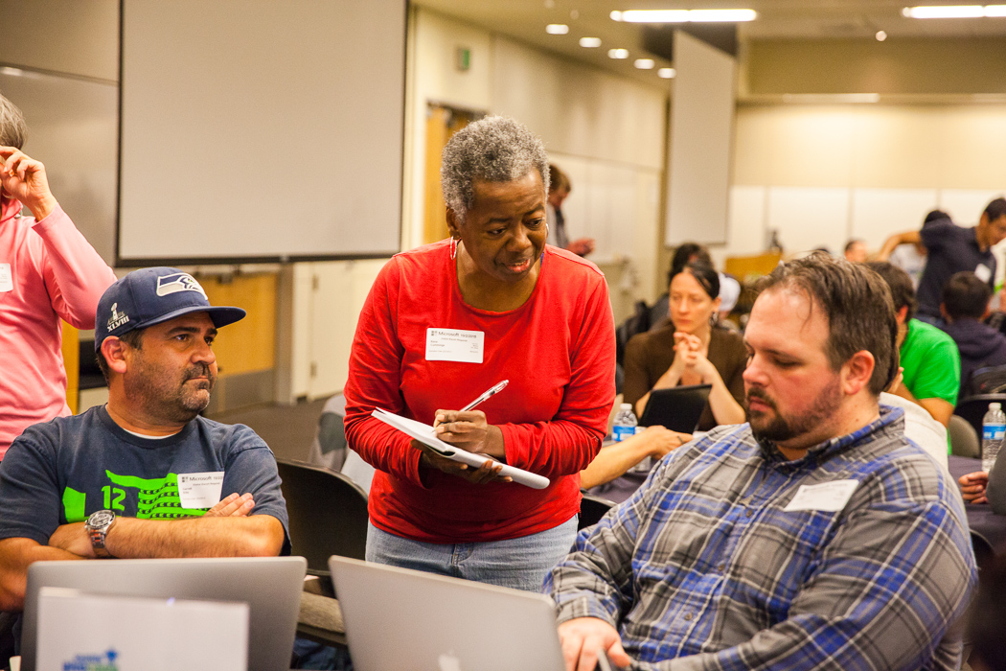
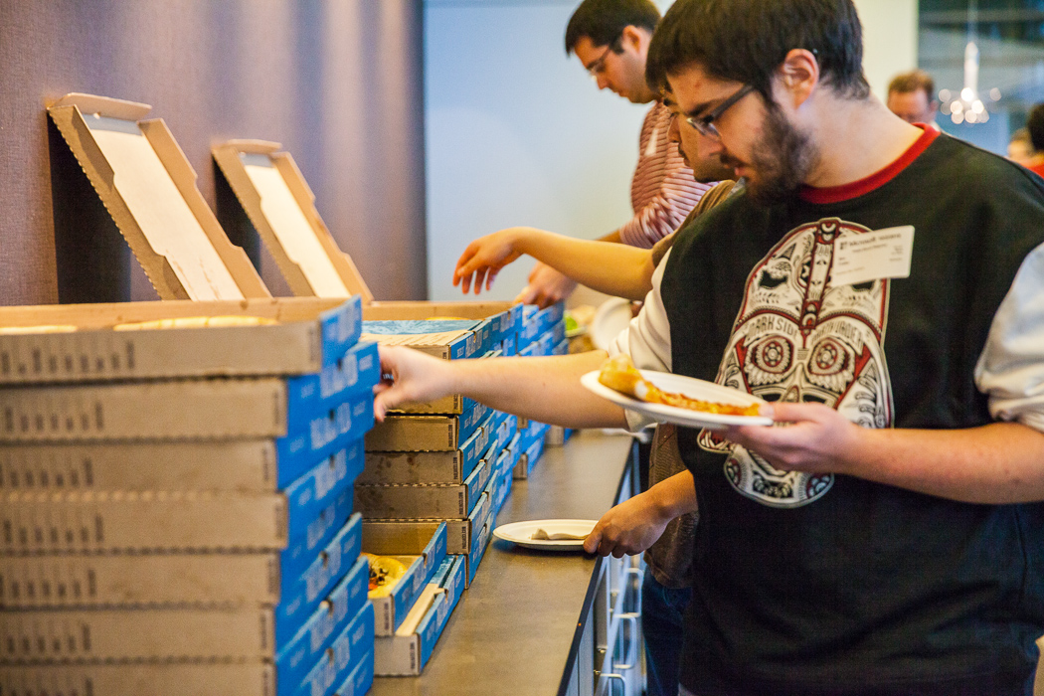

Slide 7
Volunteering
When?
Fri (6pm)–Sun (6pm), Oct 14-16, 2016
You can commit to 1-3 days
Where?
Microsoft Commons, Redmond
Free food and drink and a place to crank out killer apps for good
How?
Go to seattlegivecamp.org and click on the Volunteer link

Slide 8
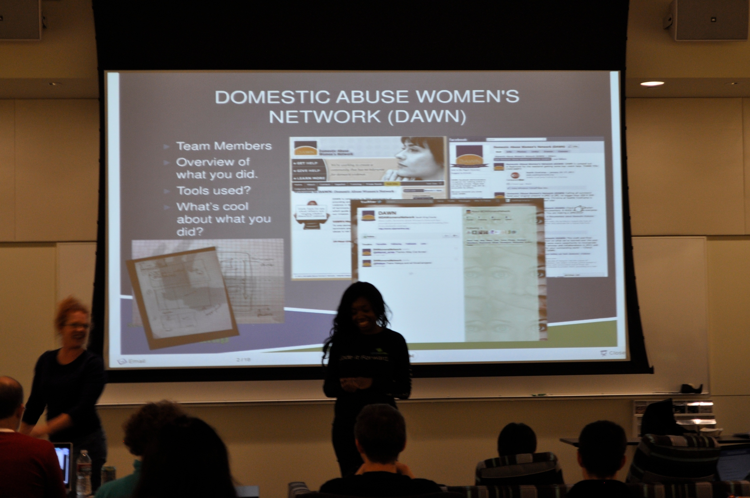

Slide 9
Thank You!
Seattlegivecamp.org

