Slide 1

Give Back at Seattle GiveCamp
October 14-16, 2016 seattlegivecamp.org

Slide 2
What is GiveCamp?
Seattle GiveCamp is a weekend-long hackathon, Oct 14-16, where software professionals donate their time to create custom software for non-profit organizations
Seattlegivecamp.org

Slide 3
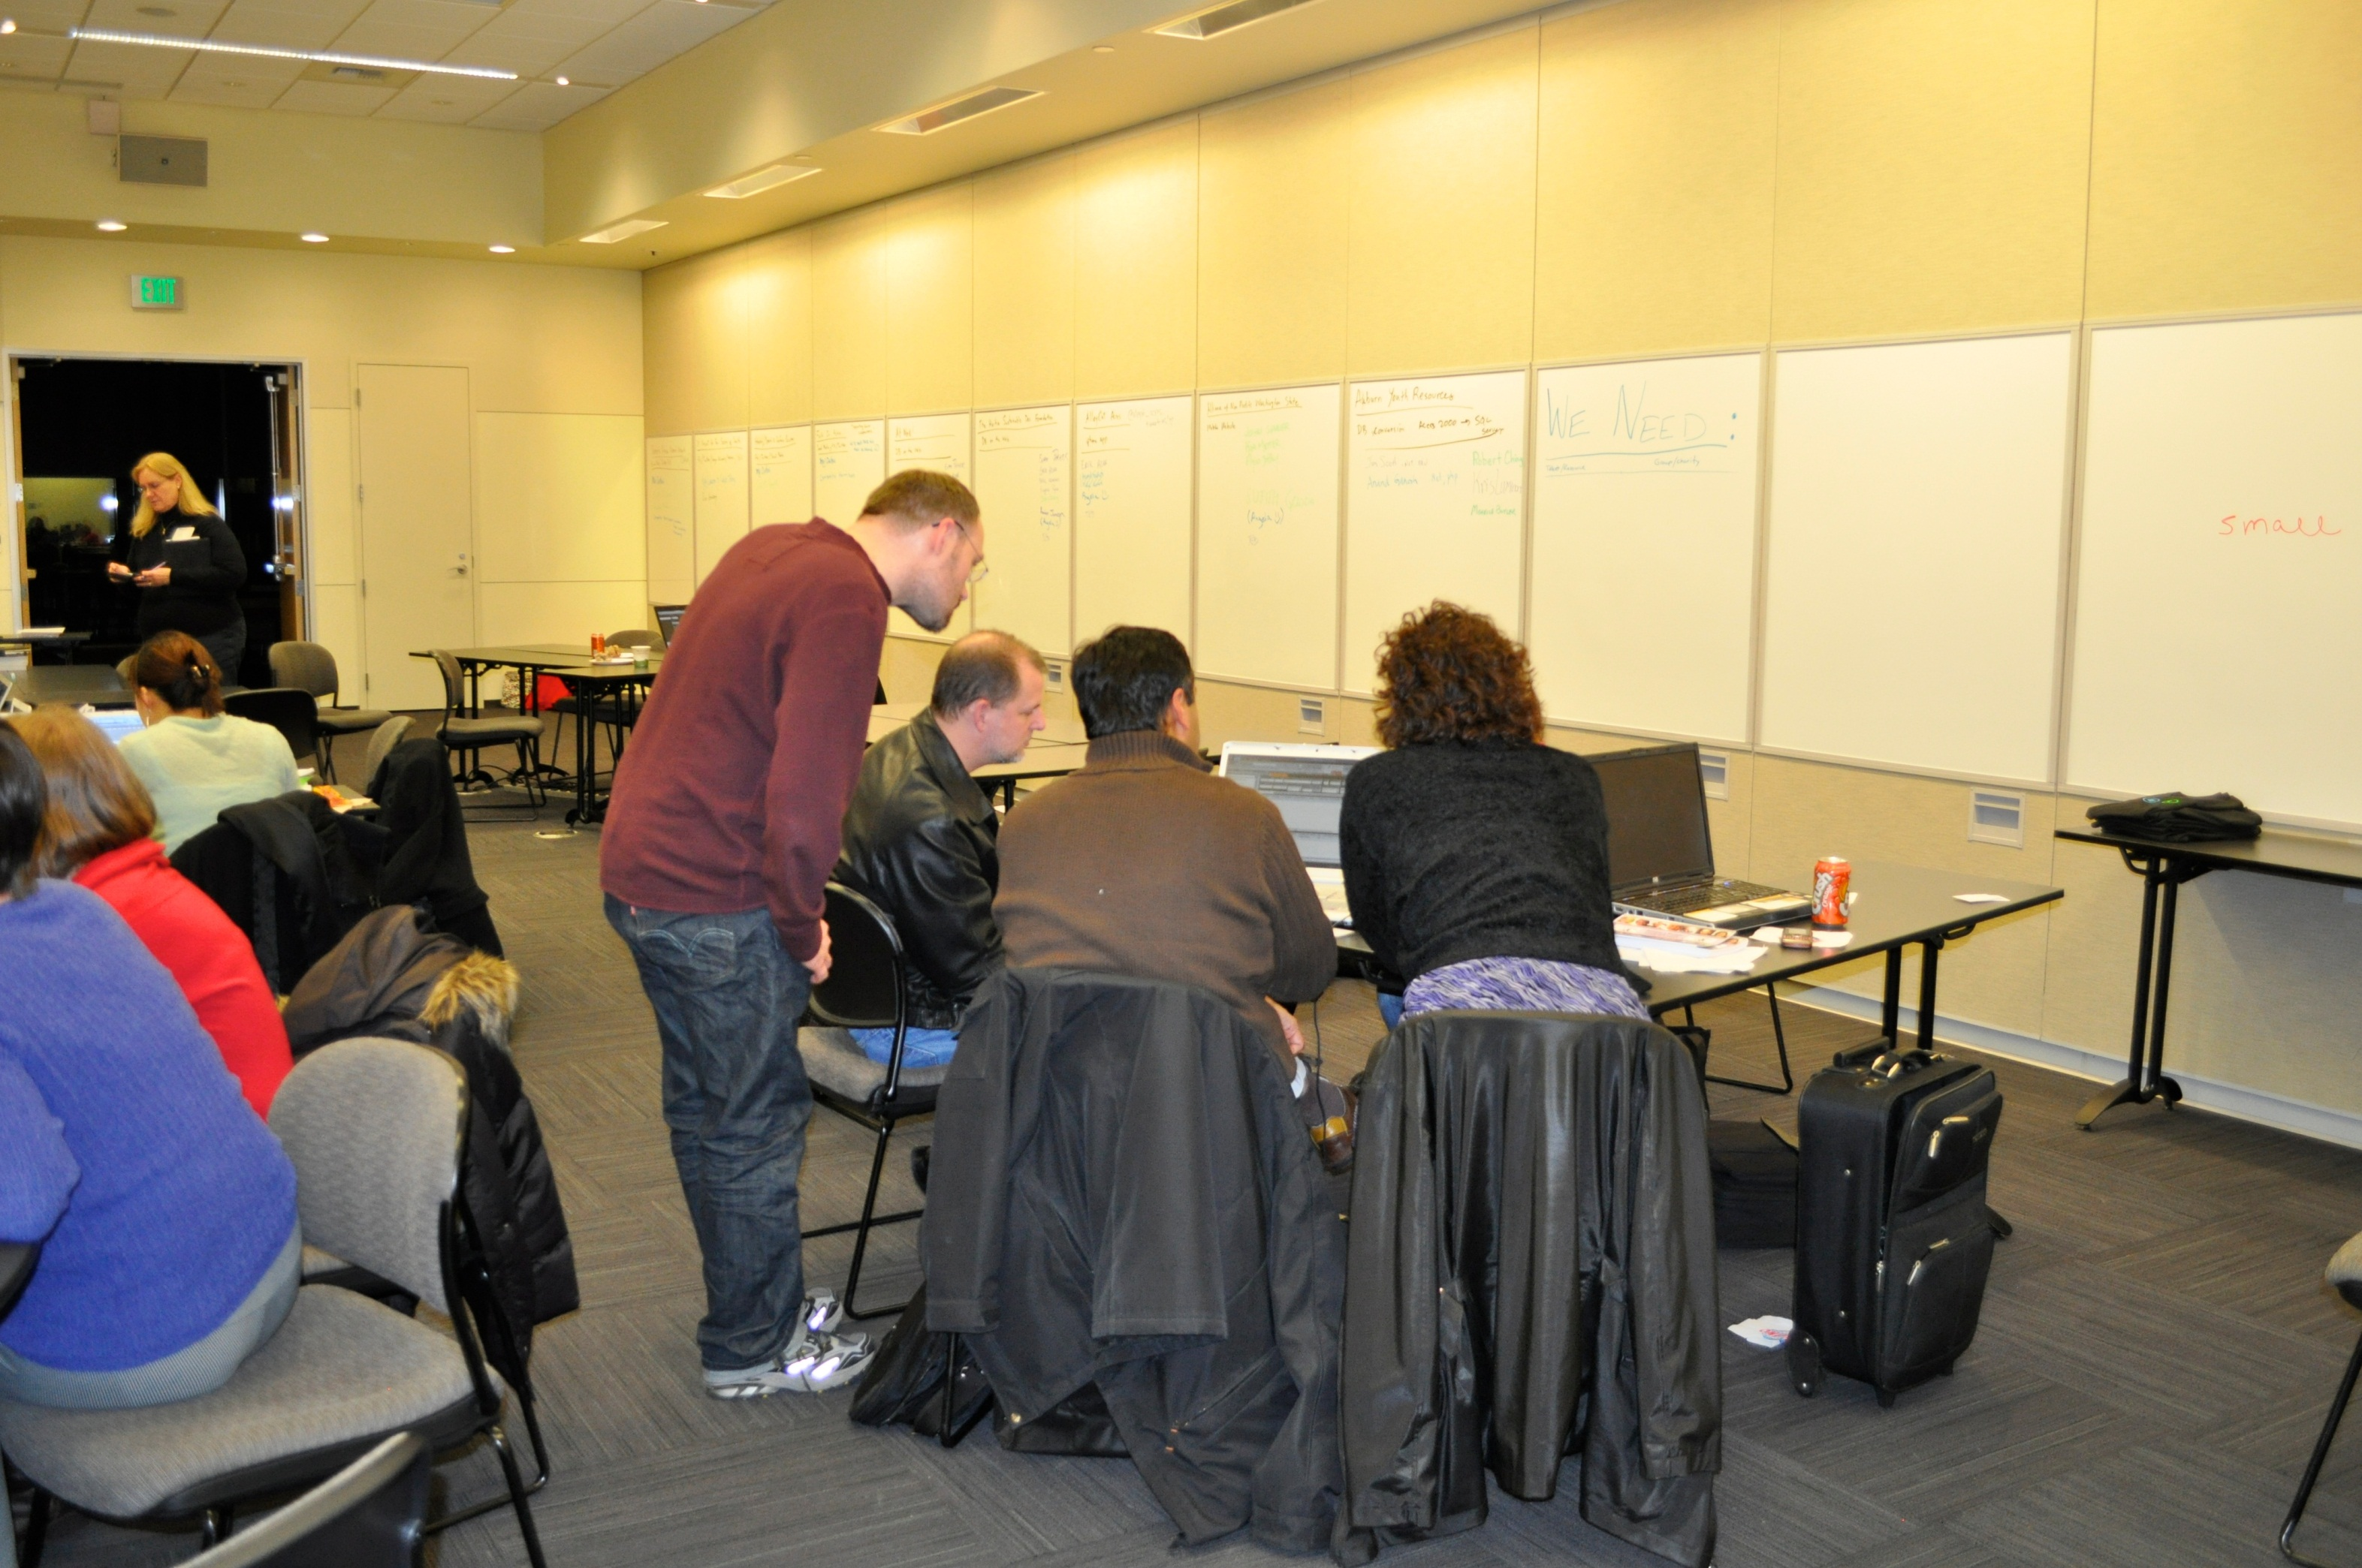

Slide 4
Who Do We Need?
Information professionals…
Experience with…
ASP.NET, PHP, Ruby, …
HTML, CSS, AngularJS, jQuery, …
Mobile app dev including iPhone, Android, …
SalesForce
Little Green Light
Facebook, Twitter, Social Media, …
Wordpress, Wix, Weebly, …
C#, VB, Java, MS Access, …
Other stuff we forgot to mention…
Willingness to be flexible!
All roles
Software developers, project managers, web designers, social media experts, testers, database pros, …

Slide 5
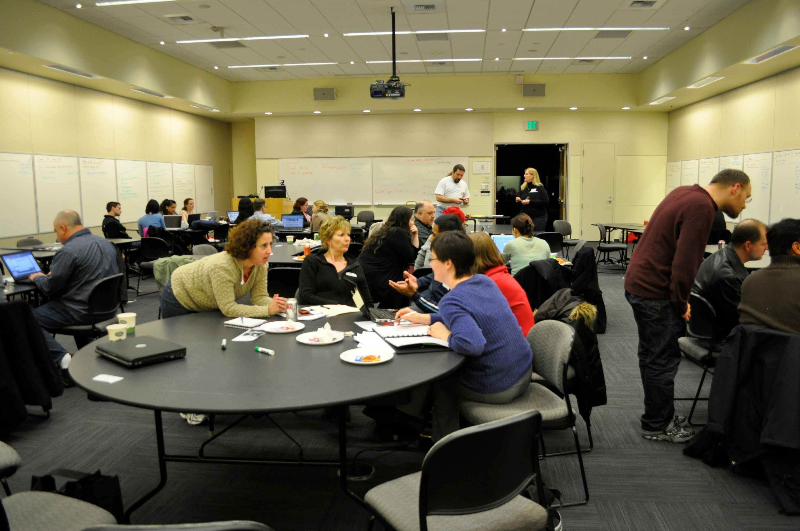

Slide 6
Volunteering
When?
Fri (6pm)–Sun (6pm), Oct 14-16, 2016
You can commit to 1-3 days
Where?
Microsoft Commons, Redmond
Free food and drink and a place to crank out killer apps for good
How?
Go to seattlegivecamp.org and click on the Volunteer link

Slide 7
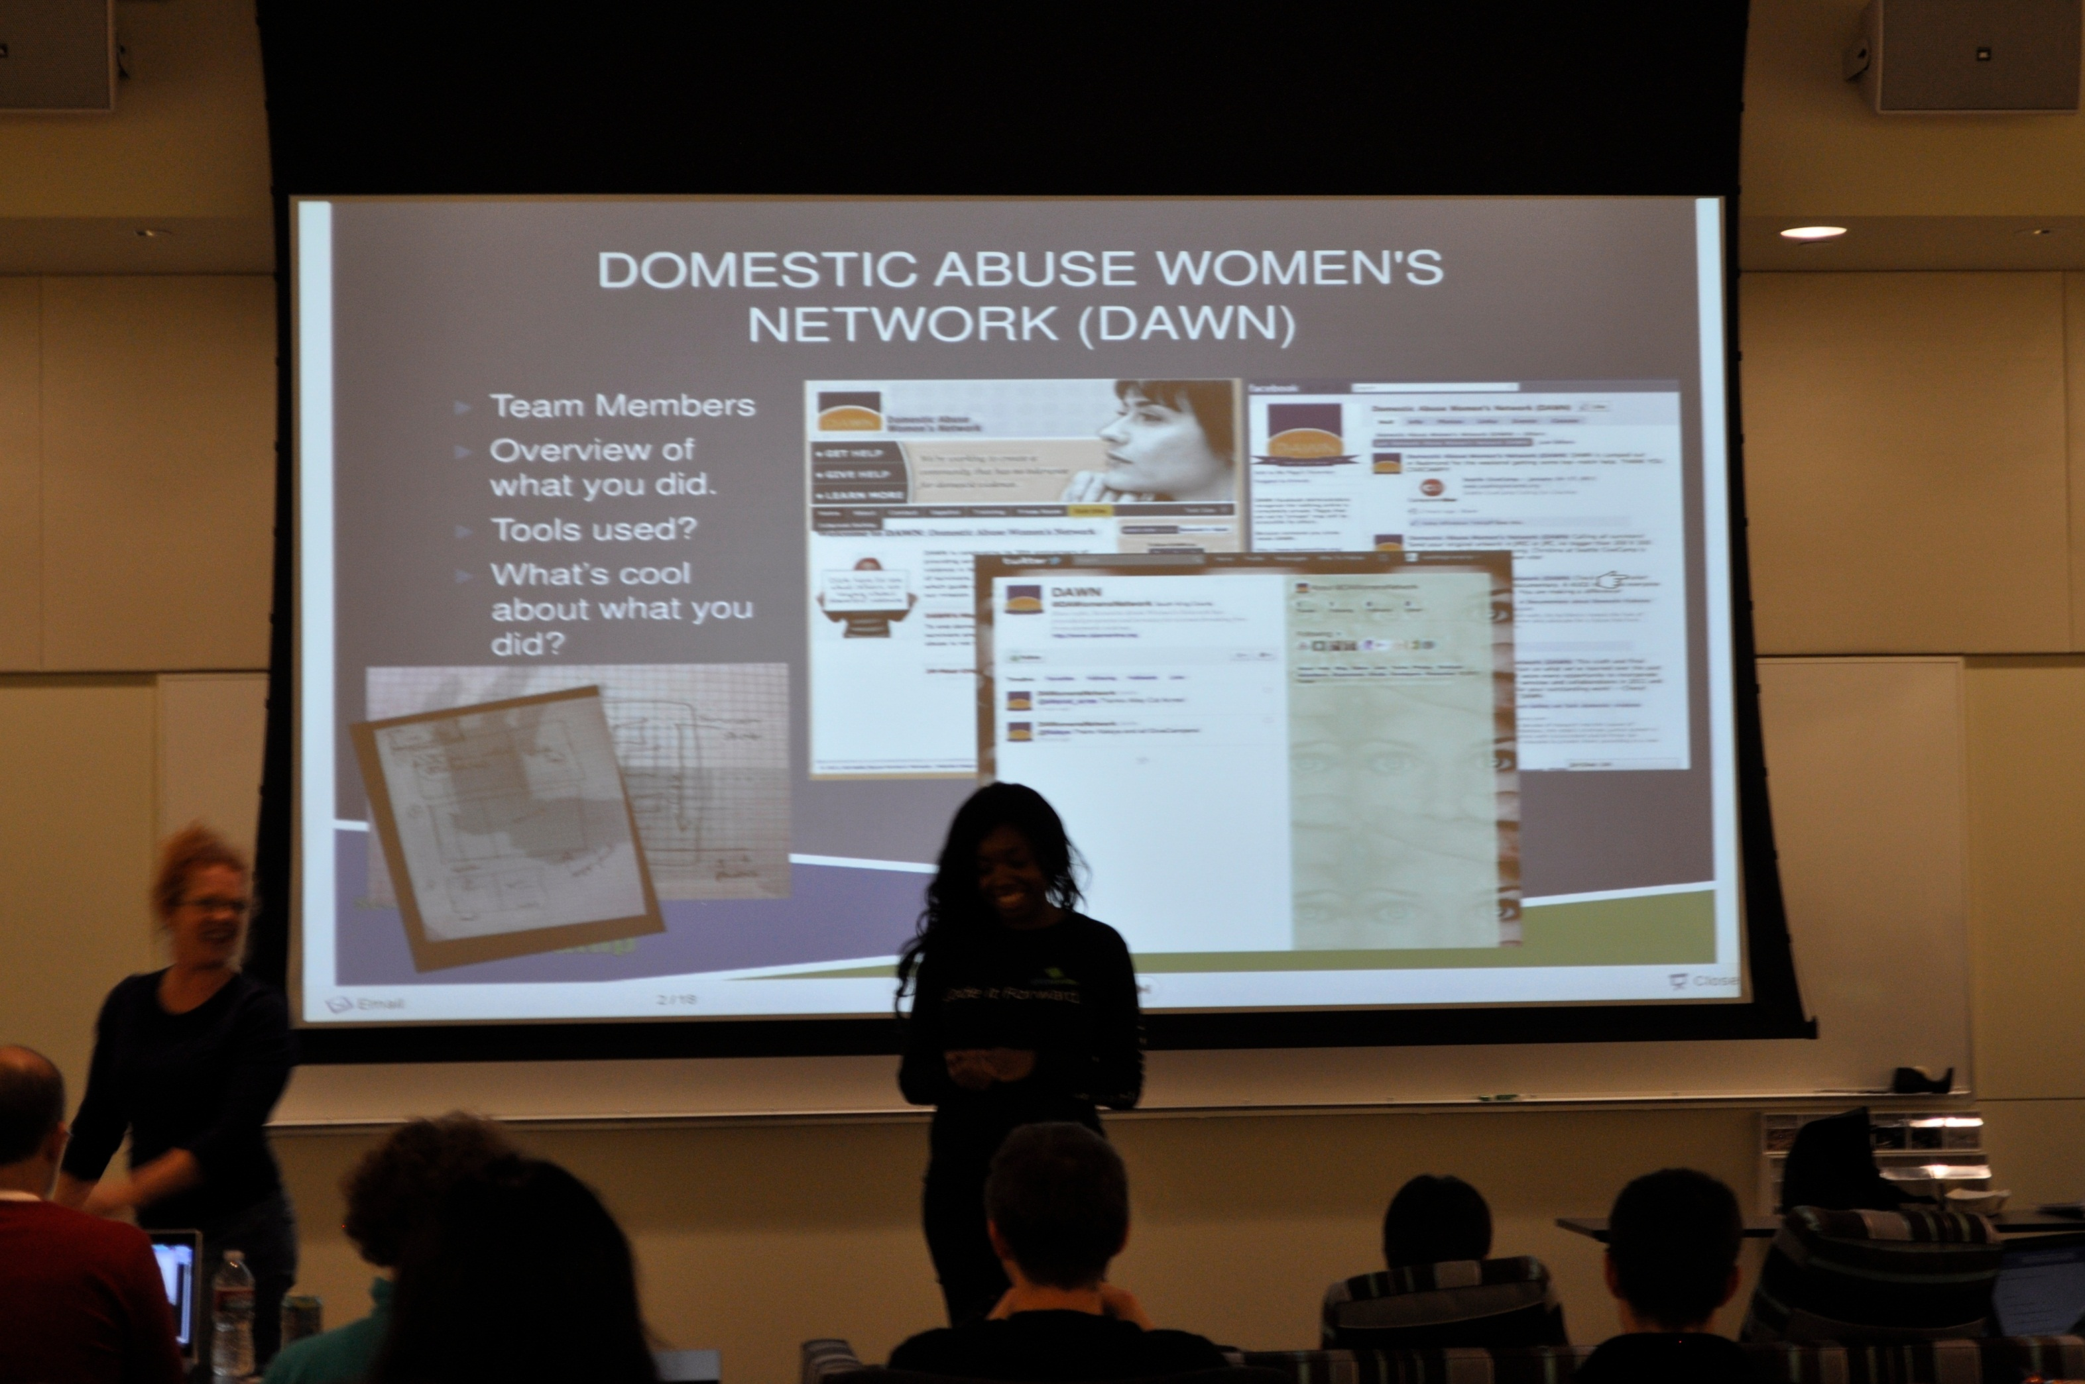

Slide 8
Thank You!
Seattlegivecamp.org

