Slide 1

Influxdb-metrics-checker An open source plugin for Sensu by Juan Cerezuela (@PliyoSan)

Slide 2
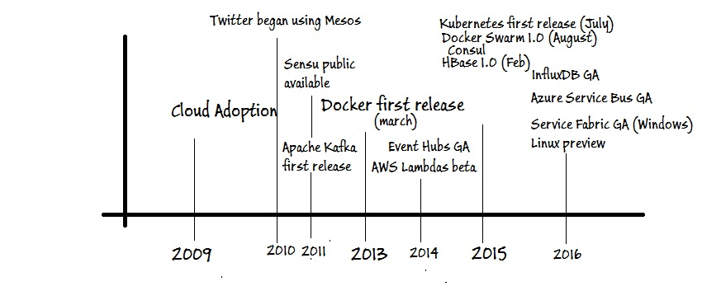
Timeline of the market

Slide 3
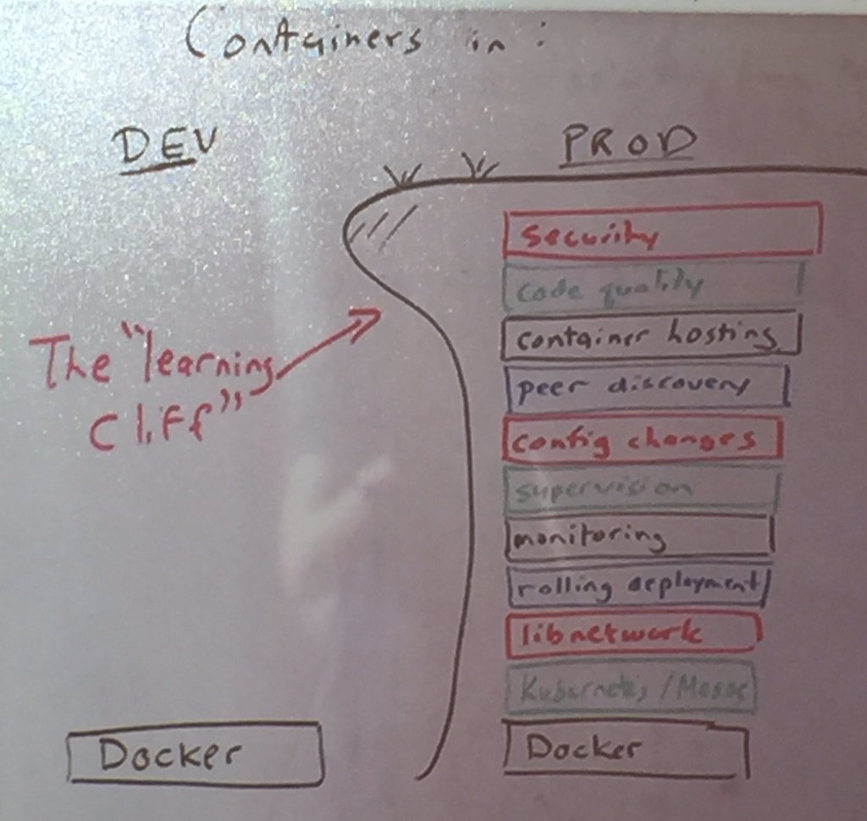
Background Story
How everything started?
We started using Metrics and the way we develop changed.
We had post mortems and in all of them we raised the same issues:
“It would be amazing to get alerted when a metric just drops”.
So we needed Sensu they said, and when it arrived all the fun started.
We are here

Slide 4






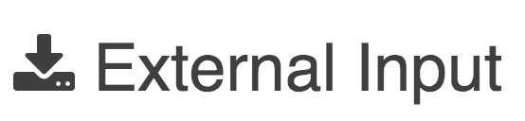
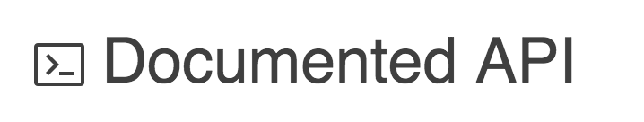

Sensu
A new generation single monitoring platform for your entire business.

Slide 5
Sensu Plugins
What is a Sensu Plugin?
Sensu plugins provide executable scripts or other programs that can be used as:
1. Sensu Checks (ie: to monitor server resources, services, and application health).
2. Sensu Handlers (to send notifications or perform other actions based on Sensu events).
3. Sensu mutators (to modify event data prior to handling).

Slide 6

Sensu Plugins
How much is going to cost me?
The Sensu Plugin project is a community-powered open source software project that is organized by members of the Sensu community, in collaboration with the Sensu development team. So it’s free.

Slide 7
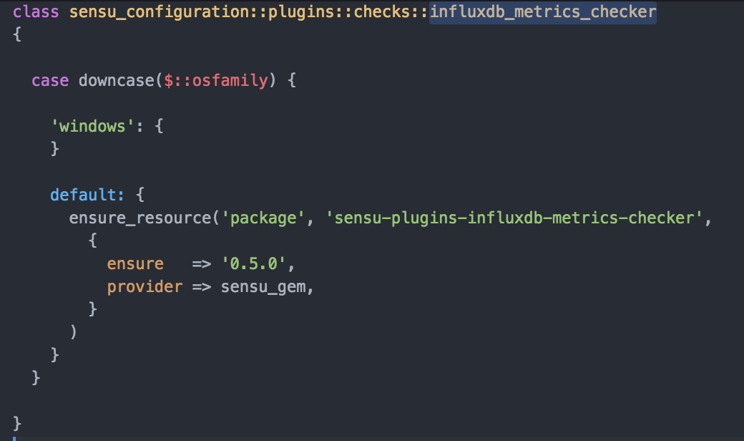
Sensu Plugins
How can I plug them to Sensu?
Install the plugin that you are looking for, ex: sensu-lugins-influxdb-metrics-checker

Slide 8
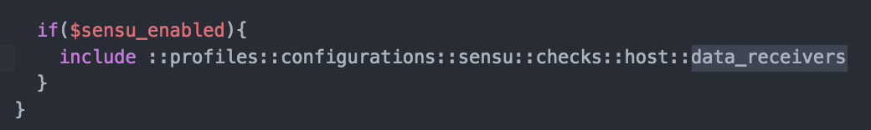
Sensu Plugins
How can I plug them to Sensu?
Create a profile for them
Include that profile in the role where you want to execute them

Slide 9
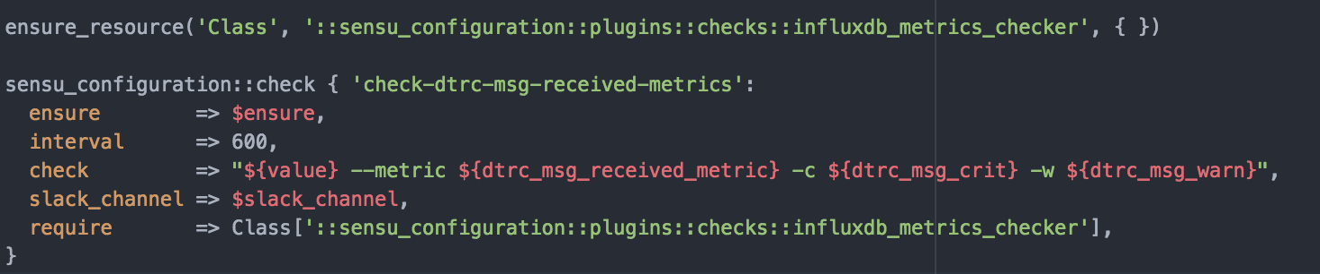
Sensu Plugins
How do they look like?
3. Set them up in your profile

Slide 10
Sensu Plugins Specification
But, what do I need to do them?
Simply follow this spec
For handlers and mutators: Accept input/data via STDIN For checks: Output data to STDOUT or STDERR. Produce an exit status code to indicate state:
0 indicates Ok
1 indicates WARNING
2 indicates CRITICAL
Optionally able to parse command line arguments to modify plugin behavior.

Slide 11
What programming languages are supported?
Any that can satisfy the Sensu Plugin Specification. (So almost any language in the world). plugins written in programming languages other than Ruby will require the corresponding runtime to be installed in order for the plugin to run.

Slide 12
Installing plugins
Use sensu-install to install Sensu Plugins.
http://sensu-plugins.io/docs/installation_instructions.html
https://github.com/sensu-plugins
When using puppet, go to
/etc/sensu/conf.d/checks/[name] to verify that your installation was successful

Slide 13
Deep dive inside Influxdb-metrics-checker

Slide 14
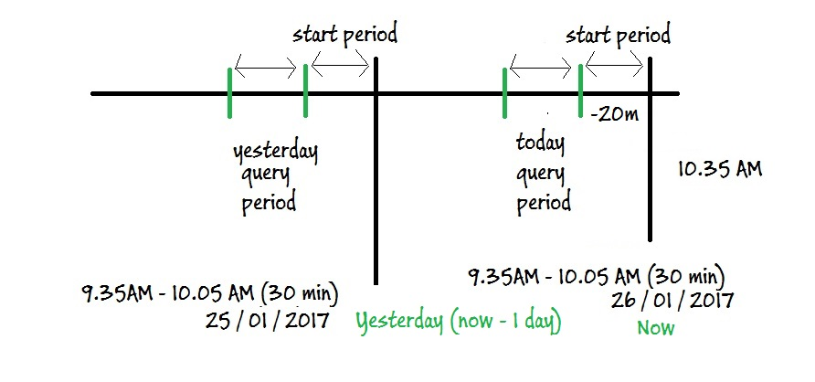
We query influxdb

Slide 15

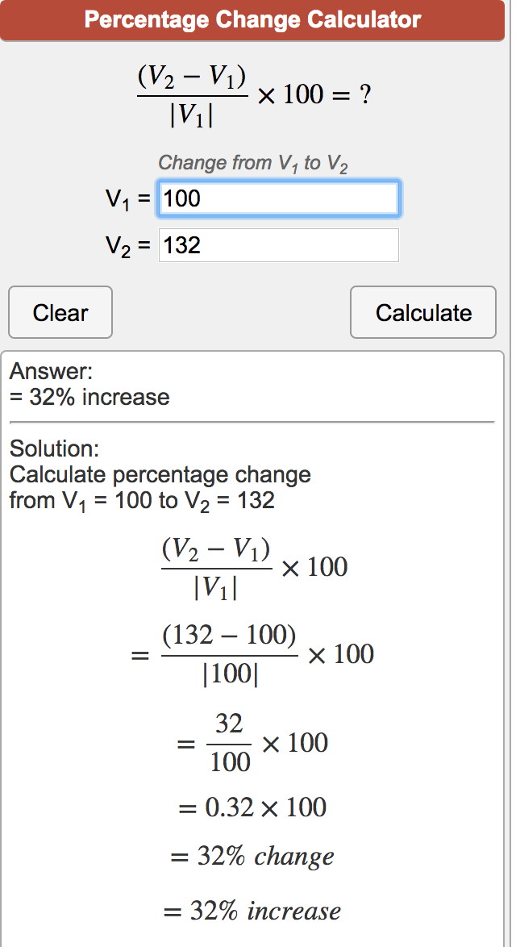
Algorithm applied
Now
“Percentage of Change”
Before
“Percentage of Difference”

Slide 16
What can we do with Influx DB?

Slide 17
Show me the code!
https://github.com/pliyosenpai/sensu-plugins-influxdb-metrics-checker
https://github.com/pliyosenpai/presentations

Slide 18
What’s next?
Incident Management:
Pragmatic Alert Correlation in Modern Production Environments (Elik Eizenberg)

Slide 19

THANKS!

