Slide 1

Service Bus Scaling Queue Systems
By Juanjo Cerezuela, Software Craftsman at VeInteractive
@ PliyoSenpai

Slide 2
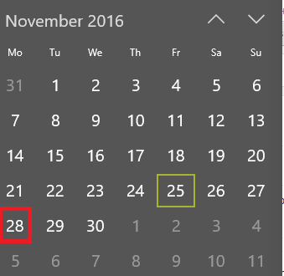

How all this journey started
1. Get ready for milestones
25th of November: Black Friday
28th of November: Cyber mondays
Stats from 2015:

Slide 3
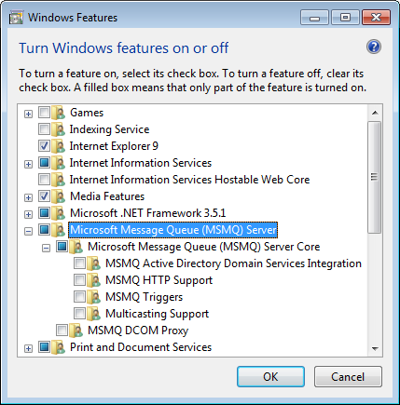
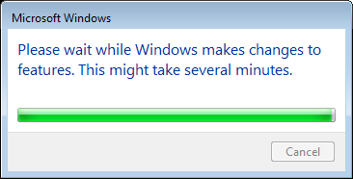
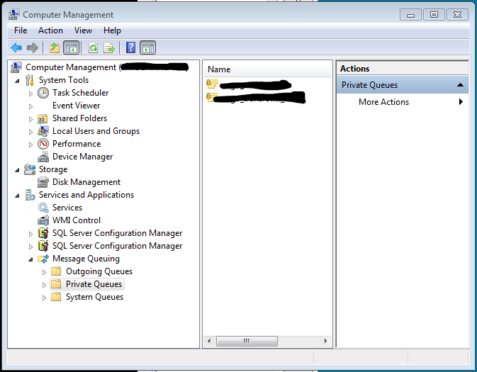
How all this journey started
2. Embrace Infrastructure as Code (What you don’t want to see)

Slide 4
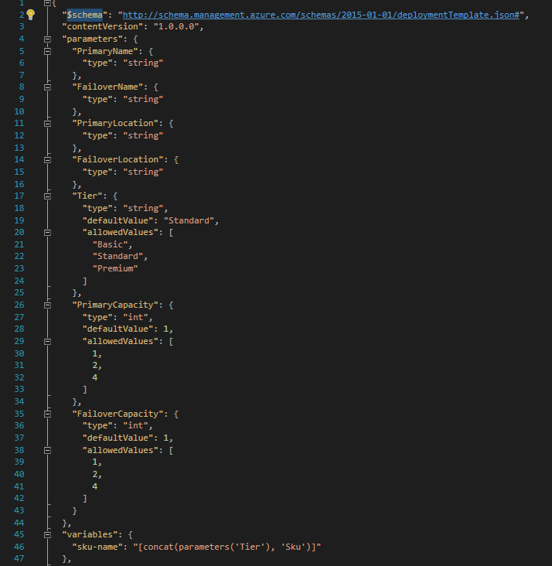
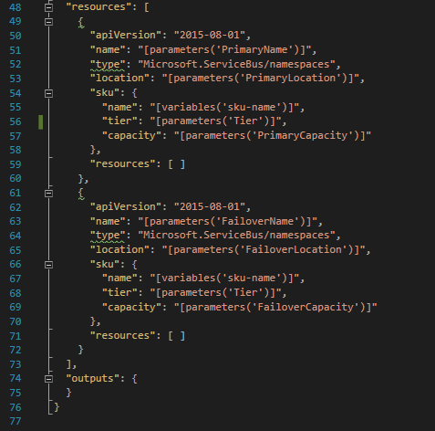
How all this journey started
2. Embrace Infrastructure as Code (What you want to see. Ex: 77 lines of code)

Slide 5
What is Service Bus
Azure Service Bus Messaging is an asynchronous messaging cloud platform that enables you to send data between decoupled systems. Microsoft offers this as a service, which means that you do not need to host any of your own hardware in order to use it.

Slide 6
What is Service Bus
Queue:
A Service Bus queue is an entity in which messages are stored. Queues are particularly useful when you have multiple applications, or multiple parts of a distributed application that need to communicate with each other. The queue is similar to a distribution center in that multiple products (messages) are received and then sent from that location.
Side note: different from Azure Queues.

Slide 7
What is Service Bus
Topics and Subscriptions:
A topic can be visualized as a queue and when using multiple subscriptions, it becomes a richer messaging model; essentially a one-to-many communication tool. This publish/subscribe model (or pub/sub) enables an application that sends a message to a topic with multiple subscriptions to have that message received by multiple applications.

Slide 8
What is Service Bus
Relay
The relay service provides the ability to transparently host and access WCF services from anywhere. In other words, this enables hybrid applications that run in both an Azure datacenter and an on-premises enterprise environment.

Slide 9
What is Service Bus
Event Hubs
The fundamental difference between EventHubs and Topics is - TOPICS offer per-message semantics - but, EventHubs - Offers Stream Semantics - you should not expect any per-message semantics with EventHub. For Ex: Per message Duplicate detection, Receive confirmation per message (topics have a Message.Complete to ack Msg received) - are all Topic features. EventHubs narrows down the feature set to give a high throughput solution.

Slide 10
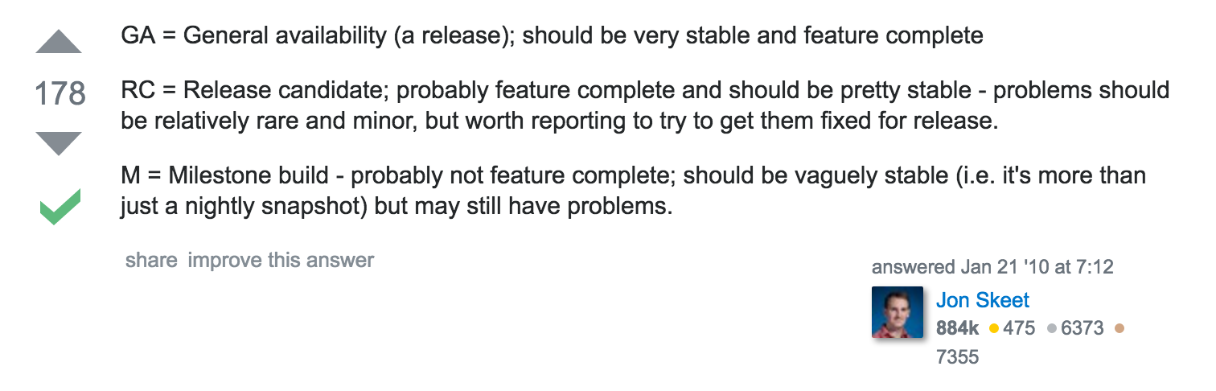
What is Service Bus
Premium Service Bus reached GA on 15th of July.
What means GA?

Slide 11
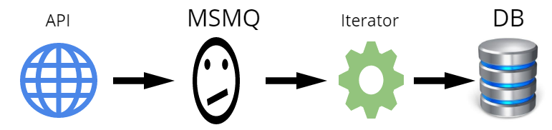
Our previous architecture
All this was in the same machine : (

Slide 12
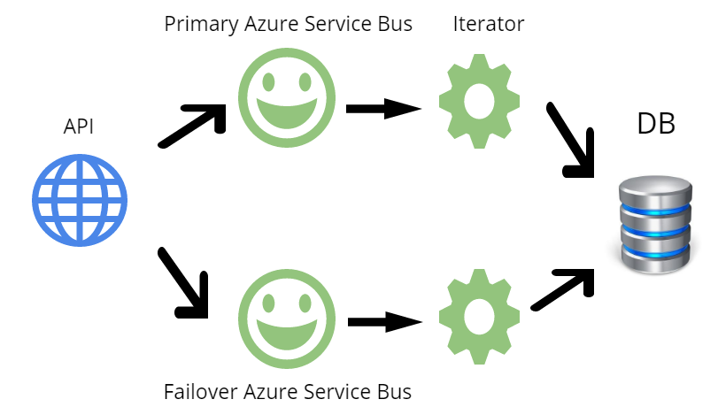
Our current architecture
Isolated clusters of Apis and Iterators, so they failure of one set doesn’t impact the others.

Slide 13
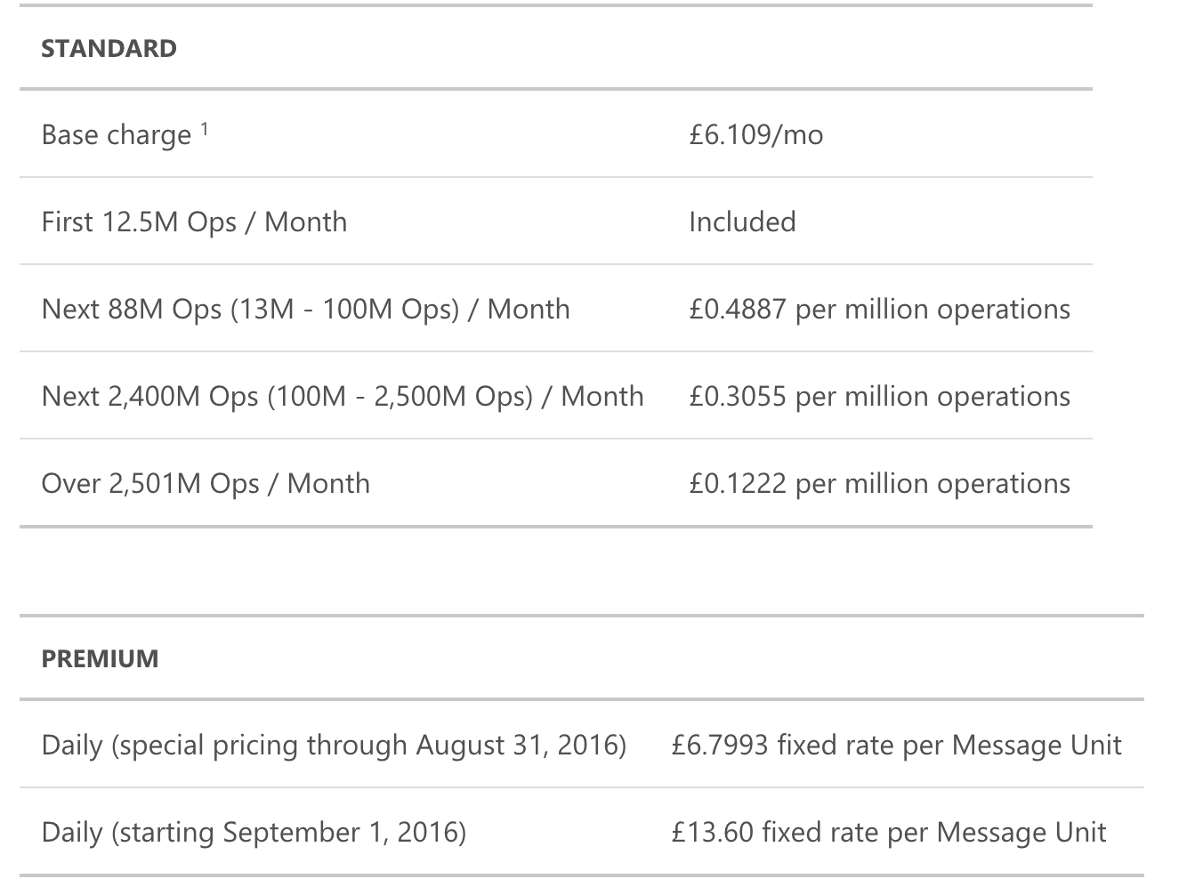
How much is going to cost me?

Slide 14
How much is going to cost me?
Example:
1 MU (4k messages throughput, 1k brokered connections) => 13.60 x 31days = 421.6£ monthly.
Playing safe (For example: Applying DR Strategy):
2 MU (8k messages throughput, 2k brokered connections) =>
13.60 x 2 x 31 days = 843.2£ monthly
(Discounts may be discussed with you Account Manager)

Slide 15
Technical Limitations
Service Bus enables up to 1000 concurrent connections to a messaging entity (or 5000 using AMQP).
10k topics / queues per namespace.
Message size – Each message is limited to a total size of 256KB, including message headers. (Premium goes to 1MB)
Message header size – Each message header is limited to 64KB.
4k messages per MU.
Max Topic Size is 80GB.

Slide 16
Best Practices
Protocols
Service Bus enables clients to send and receive messages via two protocols: the Service Bus client protocol, and HTTP (REST). The Service Bus client protocol is more efficient, because it maintains the connection to the Service Bus service as long as the messaging factory exists. It also implements batching and prefetching. The Service Bus client protocol is available for .NET applications using the .NET APIs.

Slide 17
Best Practices
Reusing factories and clients
Service Bus client objects, such as QueueClient or MessageSender, are created through a MessagingFactory object, which also provides internal management of connections. You should not close messaging factories or queue, topic, and subscription clients after you send a message, and then re-create them when you send the next message. Closing a messaging factory deletes the connection to the Service Bus service, and a new connection is established when recreating the factory. Establishing a connection is an expensive operation that you can avoid by re-using the same factory and client objects for multiple operations. You can safely use the QueueClient object for sending messages from concurrent asynchronous operations and multiple threads.

Slide 18
Best Practices
Batching client
Client-side batching enables a queue or topic client to delay the sending of a message for a certain period of time. If the client sends additional messages during this time period, it transmits the messages in a single batch. Client-side batching also causes a queue/subscription client to batch multiple Complete requests into a single request. Batching is only available for asynchronous Send and Complete operations. Synchronous operations are immediately sent to the Service Bus service. Batching does not occur for peek or receive operations, nor does batching occur across clients.

Slide 19
Best Practices
Async Operations.
Multiple factories: all clients (senders in addition to receivers) that are created by the same factory share one TCP connection. The maximum message throughput is limited by the number of operations that can go through this TCP connection. The throughput that can be obtained with a single factory varies greatly with TCP round-trip times and message size. To obtain higher throughput rates, you should use multiple messaging factories.

Slide 20
Best Practices
Receive mode
When creating a queue or subscription client, you can specify a receive mode: Peek-lock or Receive and Delete. The default receive mode is PeekLock. When operating in this mode, the client sends a request to receive a message from Service Bus. After the client has received the message, it sends a request to complete the message.
When setting the receive mode to ReceiveAndDelete, both steps are combined in a single request. This reduces the overall number of operations, and can improve the overall message throughput. This performance gain comes at the risk of losing messages.
Service Bus does not support transactions for receive-and-delete operations. In addition, peek-lock semantics are required for any scenarios in which the client wants to defer or dead-letter a message.

Slide 21
Best Practices
Prefetch
Prefetching enables the queue or subscription client to load additional messages from the service when it performs a receive operation. The client stores these messages in a local cache. The size of the cache is determined by the QueueClient.PrefetchCount orSubscriptionClient.PrefetchCount properties. Each client that enables prefetching maintains its own cache. A cache is not shared across clients. If the client initiates a receive operation and its cache is empty, the service transmits a batch of messages. The size of the batch equals the size of the cache or 256KB, whichever is smaller. If the client initiates a receive operation and the cache contains a message, the message is taken from the cache.

Slide 22
Best Practices
Recap
Goal: Maximize the throughput of a single topic. The number of senders and receivers is small.
Use a partitioned topic for improved performance and availability.
To increase the overall send rate into the topic, use multiple message factories to create senders. For each sender, use asynchronous operations or multiple threads.
To increase the overall receive rate from the topic, use multiple message factories to create receivers.
Use asynchronous operations to take advantage of client-side batching.
Set the batching interval to 50ms to reduce the number of Service Bus client protocol transmissions. If multiple senders are used, increase the batching interval to 100ms.
Leave batched store access enabled. This increases the overall rate at which messages can be written into the queue.
Set the prefetch count to 20 times the maximum processing rates of all receivers of a factory. This reduces the number of Service Bus client protocol transmissions.

Slide 23
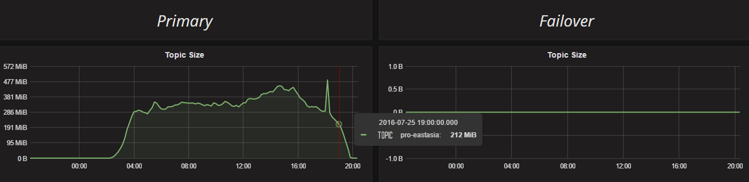
Get better insights with metrics
Source: https://github.com/andyroyle

Slide 24
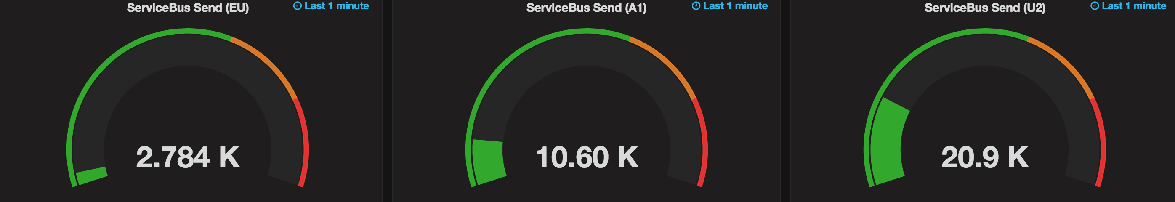
Get better insights with metrics

Slide 25
Security
Shared Access Signature (SAS) authentication enables applications to authenticate to Service Bus using an access key configured on the namespace, or on the messaging entity (queue or topic) with which specific rights are associated. You can then use this key to generate a SAS token that clients can in turn use to authenticate to Service Bus.

Slide 26
Performance & Scalability
Namespaces.
Messaging Units.

Slide 27
Advanced Usages
SQL Filters. (Properties, Session).
Delete on Idle.
Batched messages (max size)
Serialization of your messages in your client

Slide 28
Advanced Usages
Dead Letter
Transactional
Scheduled Messages

Slide 29
Patterns
Point to Point Channel
Requires that only one receiver gets the message.
Service Bus Queue and controlling what services are listening.

Slide 30
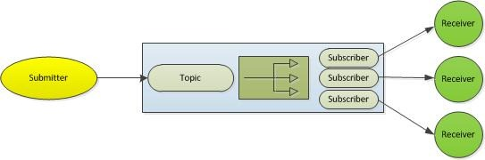
Patterns
Publisher Subscriber
Requires that the message or event sent to the channel will be delivered to each and every receiver. Once the receiver obtains a copy of the message it is removed from the channel. This can be implemented through the use of Service Topics.

Slide 31
Patterns
Channel Adapter
Requires that there is an interface so that any application can connect and be integrated with other applications. The Service Bus Queues and Topics both provide a full API that can be utilized by a number of different technologies.

Slide 32
Patterns
Messaging Bridge
Provides a connection between different messaging systems. Essentially to transmit message that was intended for another messaging system. This can be done through either the Service Bus Queues or Topics with the receiver getting the message and forwarding it to endpoints provided by the other messaging system. In addition, the receiver can get the message and forward it on to on-premise messaging systems through WCF.
Source: https://blogs.msdn.microsoft.com/skaufman/2012/04/16/integration-patterns-utilizing-the-windows-azure-service-bus/

Slide 33
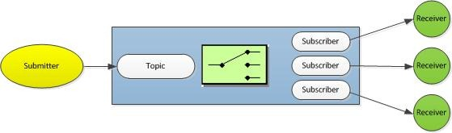
Patterns
Content Based Router
This pattern requires the the router system inspect each message and direct that message to different channels based on data elements contained in the message. The routing should be configurable to route based on different fields, the existence or non-existence of a specific value and the routing rules should be easily maintained as there are typically frequent changes
Subscription setup, and message properties.

Slide 34
Patterns
Message Filter
This pattern requires that any message that doesn’t match the criteria of a subscription will be discarded. This pattern is used to eliminate any messages that aren’t routed to a subscriber such as those setup using the Content Based Router pattern. If the message doesn’t fall into a filter used by the subscriber then the message should be routed to a filter channel.
When using an Azure Service Bus Topic you can utilize the RuleDescription object along with the FilterAction and FilterExpression objects to setup the subscriber filters. You can explicitly utilize the MatchNoneFilterExpression object to subscribe to messages that haven’t been routed to any other subscriber. Once routed to this subscriber you can either log that the message wasn’t picked up and you can either process it or discard the message

Slide 35
Patterns
Splitter
This pattern provides the ability to break apart a composite message into its separate message parts and process the related message parts separately. This pattern is useful in scenarios where you might have an order that has many order items and each of the order items need to be sent to different receivers or sent to different inventory systems.
This pattern can be implemented in Azure using the Service Bus Topic or Queue by utilizing the sessions feature. To setup a queue or topic for sessions we need to set the RequiresSession property in the QueueDescription or SubscriptionDescription. Then each message needs a SessionId in order to relate the individual messages. The receiver will read a message and accept the session. Once the session is accepted, the session is locked and other receivers won’t be able accept it. This ensures that there are no competing receivers. One thing to note about sessions and Azure is that session ordering is guaranteed even if the receiver crashes. Another thing to think about is this pattern comes in handy when you need to provide support for sending messages larger than the allowed message size. To send larger message, you can chunk the message into smaller sizes and use the session id in order to receive all the messages in the same session and then reassemble them.

Slide 36
Patterns
Aggregator
This pattern is related to the splitter pattern. Whereas the splitter processes separate messages, the aggregator is used to bring all the separate messages back together.
This pattern can be implemented in Azure using the Service Bus Topic and correlation. When setting up the subscription you can use the CorrelationFilterExpression just as we did with the FilterExpressions in the code samples shown above in previous patterns. So the submitter would set the CorrelationId property of the BrokeredMessage object to an identifier. Then this same identifier would be used in the CorrelationFilter object that was configured when creating the subscription. Also, you will want to know when the processing is finished for this correlation set. You could easily create a custom property on the BrokeredMessage that lists the total number of messages that are in the set or you may just decide to create a flag that states that this is the last message in the set. Once the total count has been received or the message containing the flag is received then you can perform whatever task is required to aggregate all the messages together.
You might ask, why use Correlation over Session. The CorrelationId property provides an exact match, the CorrelationId is saved in a hash table and the CorrelationId processing is better optimized for matching performance than the SQL expression filters.
Source: https://blogs.msdn.microsoft.com/skaufman/2012/04/16/integration-patterns-utilizing-the-windows-azure-service-buspart-ii/

Slide 37
Patterns
Paired Namespaces for Disaster Recovery
Things that will happen automatically:
Creation of backlog queues.
Creation of a MessageSender object that talks to queues or topics.
When a messaging entity becomes unavailable, sends ping messages to the entity in an attempt to detect when that entity becomes available again.
Optionally creates of a set of “message pumps” that move messages from the backlog queues to the primary queues.
Coordinates closing/faulting of the primary and secondary MessagingFactory instances.

Slide 38
Patterns
Paired Namespaces for Disaster Recovery
As the namespace owner, you are responsible for cleaning up any unused/unwanted backlog queues. The reason for this decision is that Service Bus cannot know what purposes exist for all the queues in your namespace. Furthermore, if a queue exists with the given name but does NOT meet the assumed QueueDescription, then your reasons are your own for changing the default behavior. No guarantees are made for modifications to the backlog queues by your code.

Slide 39
Patterns
Paired Namespaces for Disaster Reco
The following properties are cleared and added under a new alias, allowing Service Bus and the SDK to process messages uniformly:
Old Property Name | New Property Name
SessionId | x-ms-sessionid
TimeToLive | x-ms-timetolive
ScheduledEnqueueTimeUtc | x-ms-path

Slide 40
Patterns
Auto Forward
The auto-forwarding feature enables you to chain a queue or subscription to another queue or topic that is part of the same namespace. When auto-forwarding is enabled, Service Bus automatically removes messages that are placed in the first queue or subscription (source) and puts them in the second queue or topic (destination)

Slide 41
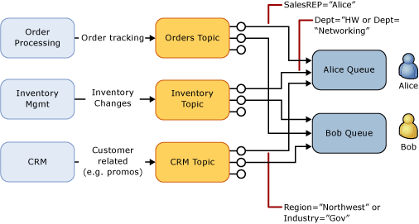
Patterns
Auto Forward

Slide 42
Patterns
Transactions
In a transfer operation, a sender (or transaction processor, P) first sends a message to a "transfer queue" (T) and the transfer queue immediately proceeds to move the message to the intended destination queue (Q) using the same robust transfer implementation that the auto-forward capability relies on. The message is never committed to the transfer queue's log in a way that it becomes visible for the transfer queue's consumers.
Source: https://github.com/Azure-Samples/azure-servicebus-messaging-samples/tree/master/AtomicTransactions

Slide 43
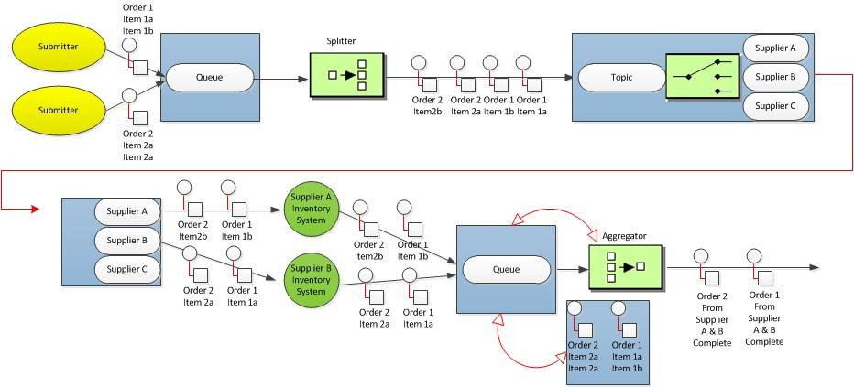
Patterns (things may get nasty)
Composed Message Processor

Slide 44
My favorite Pattern
Make it work and deliver business value.
This patterns is related to the amount of money that a business needs in order to run smoothly, while staying closer to profit and success. To apply this properly, find the Queue technology that you can easily scale and deploy automaticity, test it hard, make it work, monitor it, ideally set some alerts on top of it, and focus on the next things to come.
It should be working while you are sleeping, if it isn’t then you can reconsider changing it, if it fit your business needs, leave it.

Slide 45
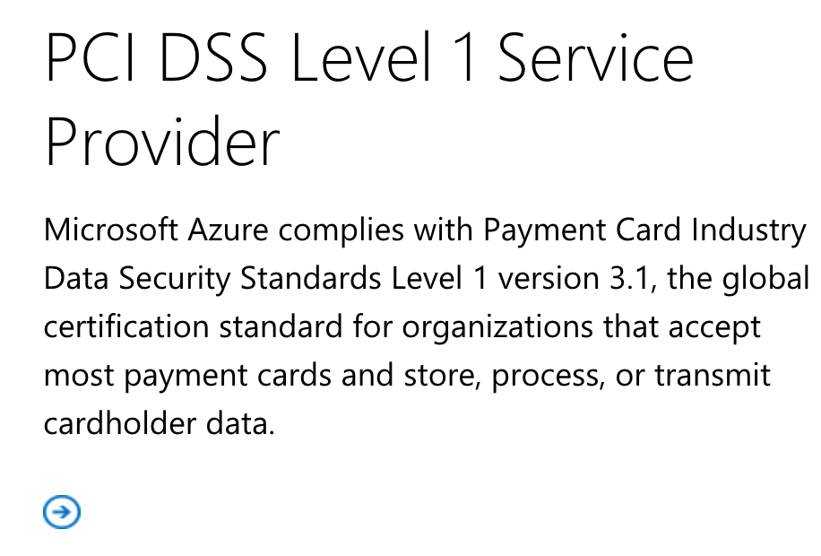
PCI Compliance
The Payment Card Industry Data Security Standard (PCI DSS) is a set of security standards designed to ensure that ALL companies that accept, process, store or transmit credit card information maintain a secure environment.
Source : https://www.microsoft.com/en-us/trustcenter/Compliance

Slide 46
Further readings
@DanRosanova, Intro to Service Bus: Service Bus 101
Service Bus 102
Service Bus 103
Service Bus 104
Message at Scale with Azure Service Bus Queues and Topics
Azure Queues vs Service Bus Queues
Performance

Slide 47
Code
Azure Service Bus Template for Disaster Recovery
https://github.com/pliyosenpai/azure-servicebus
Ve.Messaging
https://github.com/ve-interactive/Ve.Messaging
Azure Service Bus Monitoring with Python (ready to use with puppet)
https://github.com/andyroyle

Slide 48
QA
Yes, we have had pizza.

Slide 49
We are hiring

Slide 50
THANKS!

