Slide 1
LLHD
A Multi-level Intermediate Representation for Hardware Description Languages
Fabian Schuiki Andreas Kurth Tobias Grosser Luca Benini
CS595E February 3, 2020

Slide 2
The Problem
We use HDLs to describe hardware, with the goal of eventually getting something to run on silicon
However, there’s a deep design toolchain along the way
Simulation
Formal verification
Linting
Logic synthesis
Logical equivalence checking
Technology mapping
Placement and routing

Slide 3
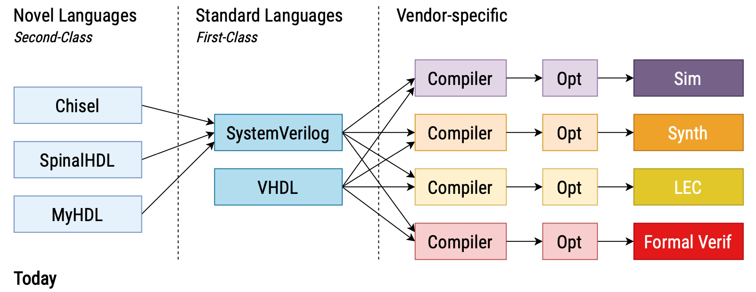
Design Flow Redundancy
SystemVerilog and VHDL are the de-facto standard inputs to these vendor-specific design flows
Designers use a safe subset to get consistent results across disparate tools which are interpreting the languages’ semantics (hopefully) the best they can

Slide 4
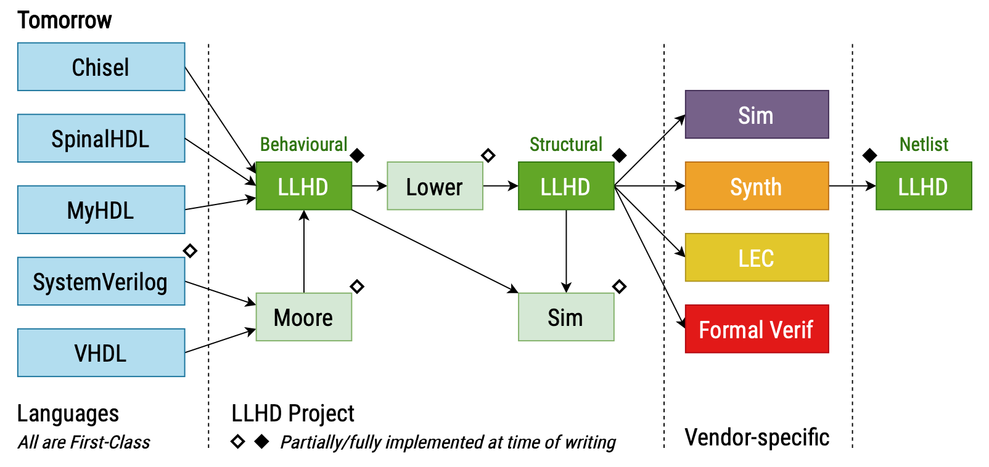
The Solution: LLHD
An multi-level static single assignment (SSA) intermediate representation (IR) for representing digital circuits throughout the entire design flow
Hierarchical, concurrent, time-dependent
Netlist ⊂ Synthesis ⊂ Simulation
The Moore compiler frontend for transforming HDLs into LLHD
Both a reference and optimized simulator
Goal: capture designs described in HDLs, even non-synthesizable constructs like simulation and verification

Slide 5
3 Levels of LLHD

Slide 6
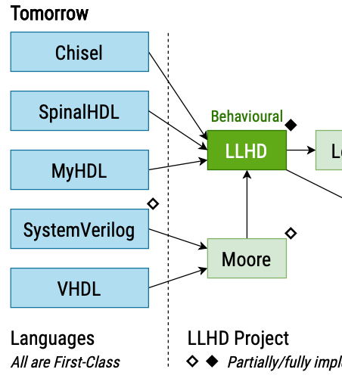
Behavioral LLHD
Capture higher-level HDL circuit descriptions easily
Simulation
Testbenches
Formal verification
Example: Behavioral Verilog
Describe input/output behavior; circuit as an algorithm
If-then-else
Case
Loops
Functions
Tasks
Time delays
Procedural assignment
Initial blocks

Slide 7
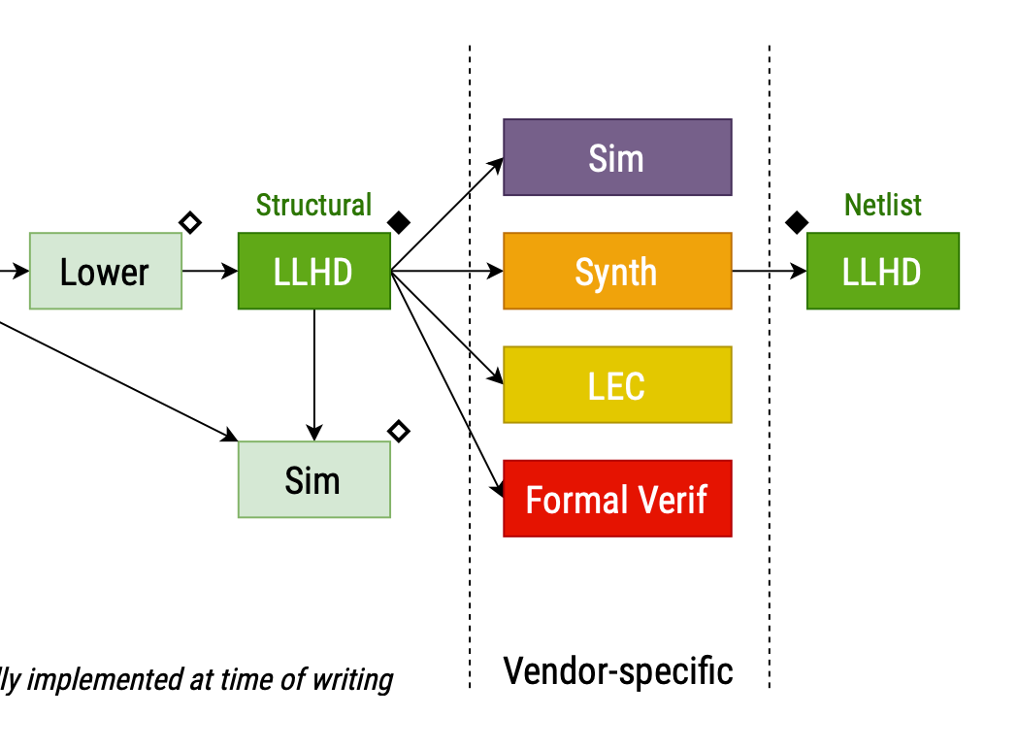
Structural and Netlist LLHD
Structural
Limit description to input/output relations
Easy for use by synthesizers/tools
Example: Structural Verilog
Netlist
Description is limited to entity instantiation and basic logical operations over signals

Slide 8
Execution and Timing Models
Execution Models
Control flow
Units consist of basic blocks, which have one terminator instruction (br, ret, halt, wait)
Data flow
Units contain only instructions forming a data flow graph
Timing Models
Immediate
Units execute in zero time (i.e. in between physical time steps)
Timed
Units persist throughout entire execution
Model reactions to signal changes
Can schedule state change and probe signals

Slide 9
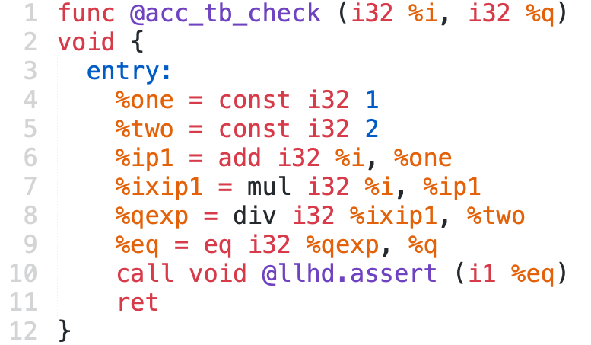
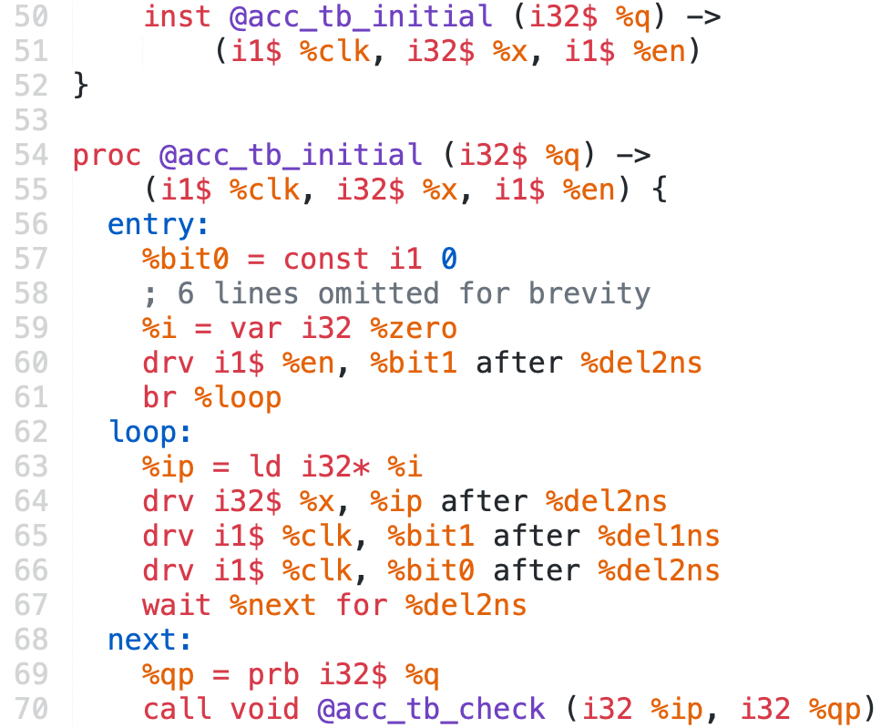
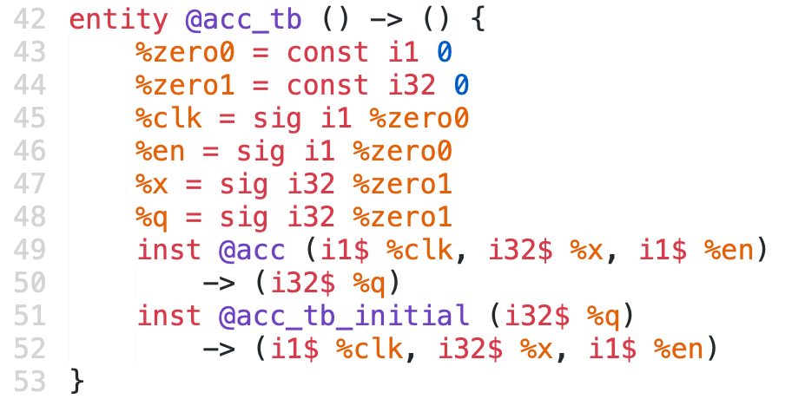
Hierarchy and Timing Model
Function (func, call)
Map inputs to outputs
May not interact with signals nor suspend execution
Timing: immediate
Execution: control flow
Process (prb, wait, halt,T$)
Map time-varying input signals output signals
Can probe and drive signals; never return
Timing: timed
Execution: control flow
Behavioral circuit description
Entity (reg, sig, del, con, inst)
Implicit execution schedule based on dataflow dependency
Build structure and design hierarchy, instantiate other entities and processes
Timing: timed
Execution: data flow
Structural circuit description
Notes:
Modules are composed of 1+ units: function, process, entity
Basic block: control-flow ends in br, ret, halt, wait

Slide 10
Some More Important Points
Entities are the only units that can
Instantiate processes or other entities
Create, delay, and connect signals
Create storage elements (registers)
Arithmetic operations (add, mul, eq, etc.) are preserved in Structural LLHD for optimization by commercial synthesizers
Stack and heap memory provided in order to represent all simulation and verification code in current HDLs
Lowering to structural LLHD requires all memory instructions to be promoted to values and phi (reconvergence) nodes
Notes:
What is reconvergence?

Slide 11
Strong Type System
Type | Description | Example
void | void type | func @foo (i32 %i, i32 %q) void
time | describe delays, elapsed time | %0 = const time 1ns 2d 3e
iN | (un)signed integer of N bits | %1 = const i28 9001
nN | enumeration representing one of N values | %2 = const n4 3
lN | nine-valued logic | %3 = const l8 “01XZHWLU”
T* | pointer to a memory location holding values of type T | st i8* %ptr, %1
T$ | time-varying signal carrying value of type T | %4 = prb i8$ %wire
[N x T] | collection of N values of type T | %4 = [3 x i16 %0]
{T0, T1, …} | struct of field types T0, T1, … | %6 = {i1 %0, i8 %1, time %2}

Slide 12
Mapping HDLs to Behavioral and Structural LLHD

Slide 13
Mapping HDLs to Behavioral LLHD
SystemVerilog | Behavioral LLHD
Modules | Entities
always_comb | Pure dataflow via entities
always_ff | Processes (behavioral) or structurally via reg
Parameters | Unsupported (parameterize before feeding to Moore)
Generate statements | Unsupported (unroll before feeding to Moore)
assert, assume, require | Llhd.assert intrinsic

Slide 14
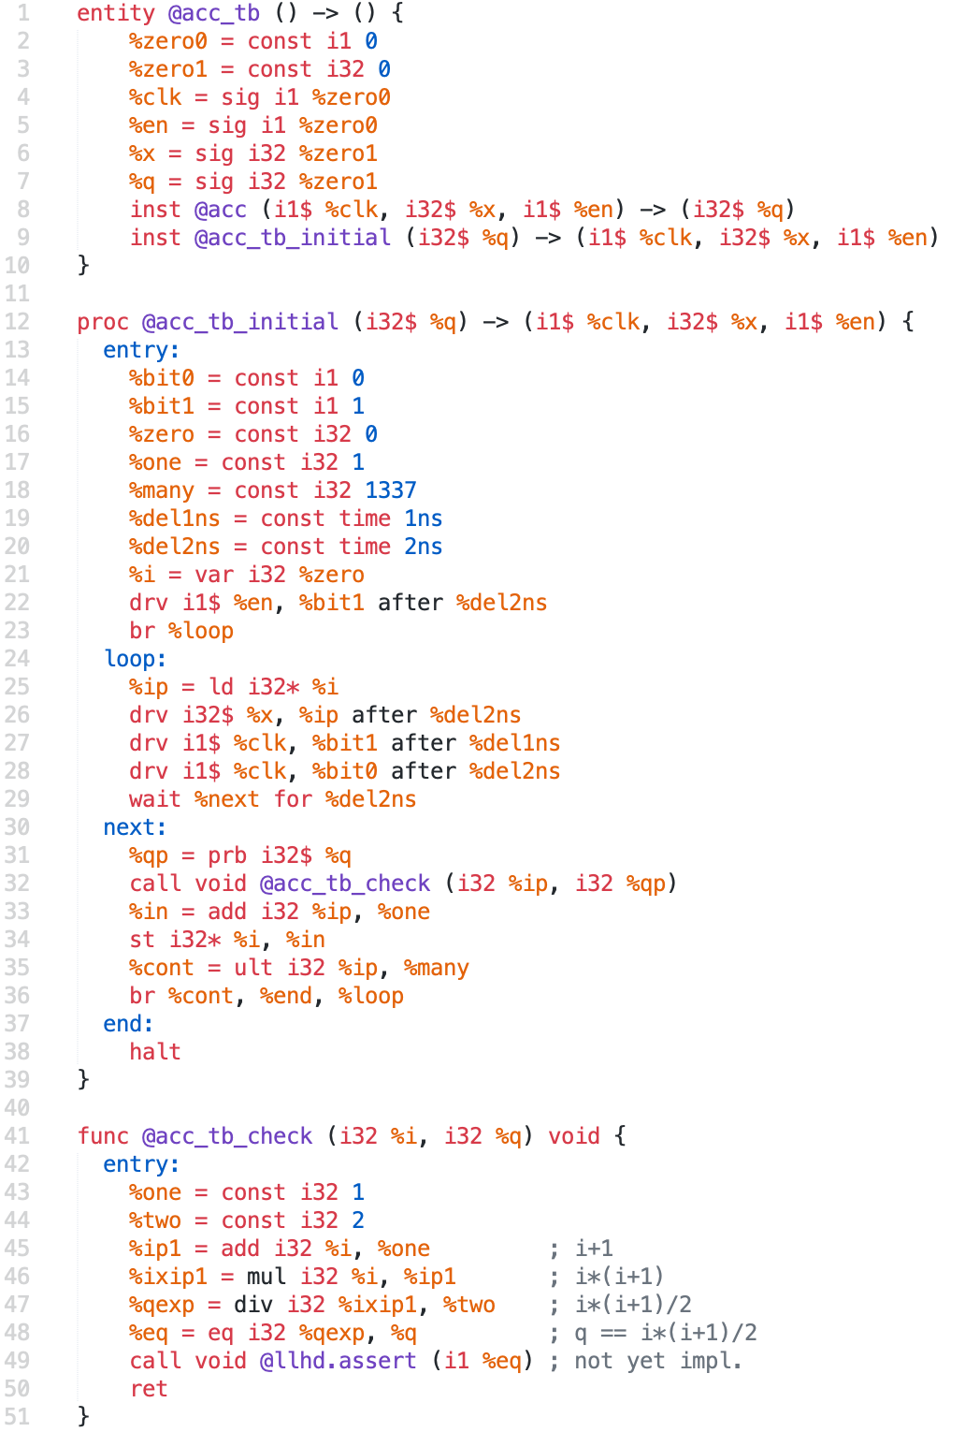
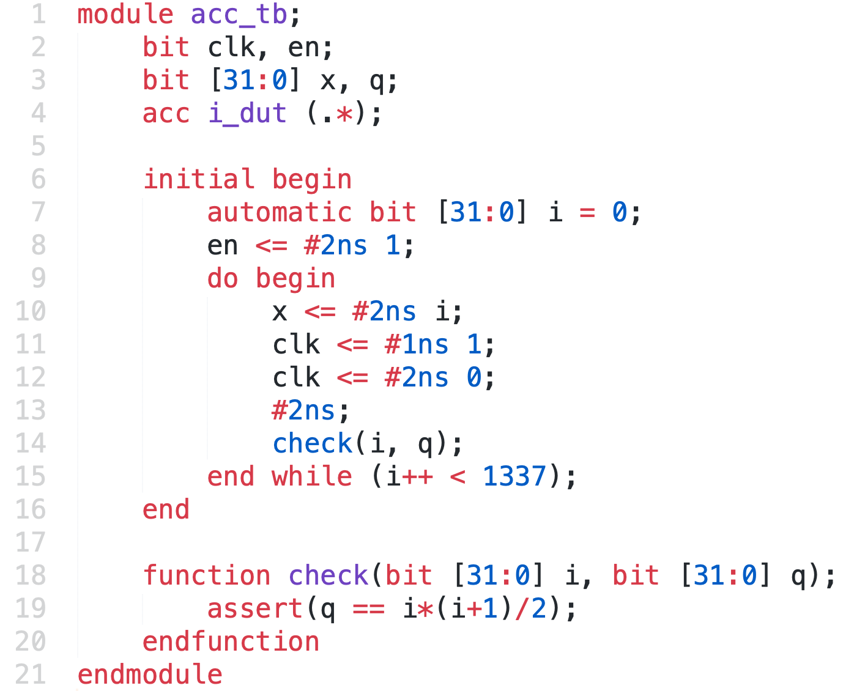
The Testbench
Constants used internally
Notes:
Go through each, define what wait does, call, add, inst, etc.

Slide 15
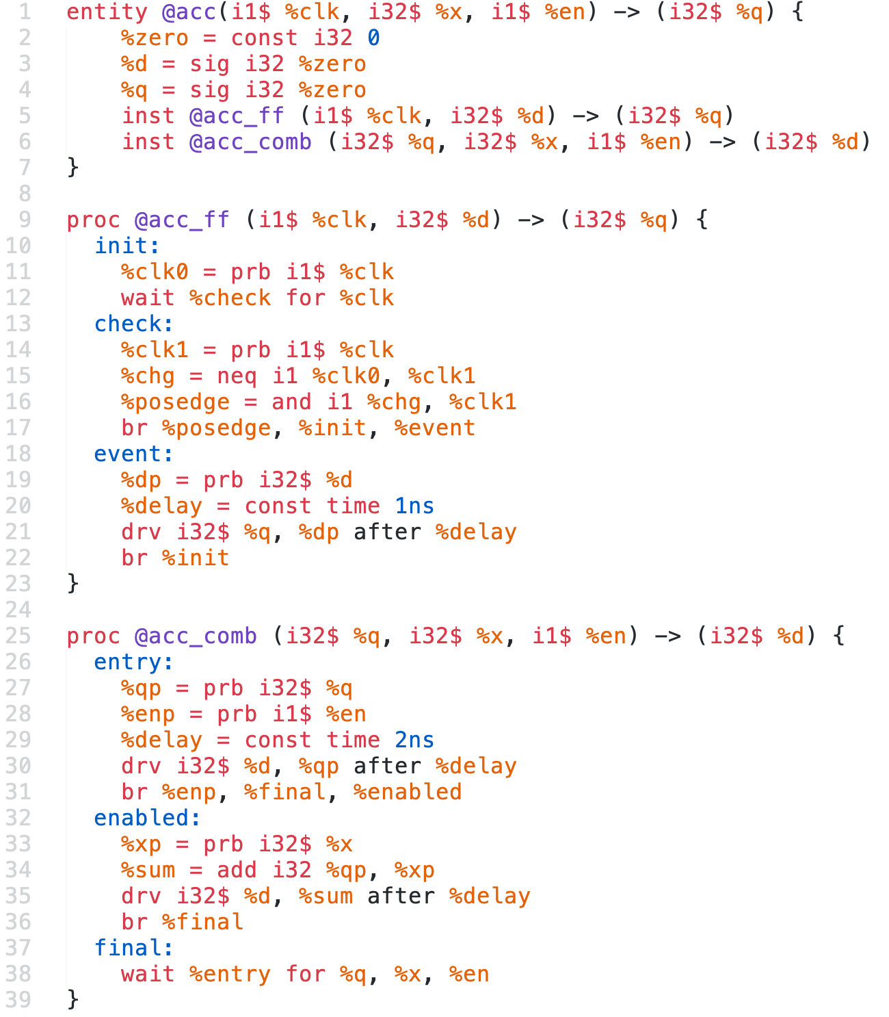
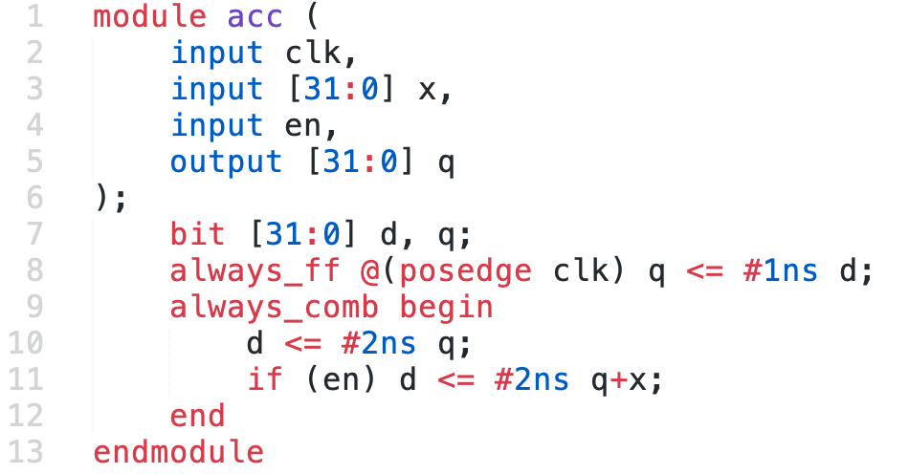
A SystemVerilog Accumulator
Basic block

Slide 16
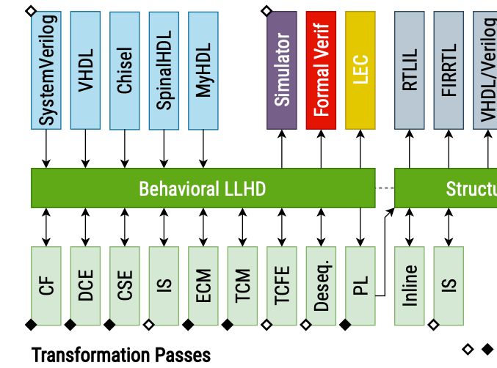
Lowering to Structural LLHD (AKA Initialisms Galore)
Goal: replace branches with branch-free code
Basic transformations (CF, DCE, CSE)
Instruction simplification (IS)
E.g. and %a, %a -> %a
Early code motion (ECM)
Move instructions up the CFG
Constants into entry block
Arith. inst. to earliest point operands available
Temporal code motion (TCM)
Move drv instructions into single exiting block for their respective temporal region (TR)
TRs are separated by wait instructions
Total Control Flow Elimination (TCFE)
Replace branches with muxes
Reduce to one basic block per TR
Desequentialization
Identify processes that describe flip flops/latches
Process with two BB/TRs, one term. in wait and the other br
Process Lowering (PL)
Lower trivial processes to entities
Process with one BB with terminator waiting on all signals
Inlining
Notes:
Constant folding (CF): evaluating constant expressions that you can at compile-time
Dead code elimination (DCE)
Common subexpression elimination (CSE)

Slide 17
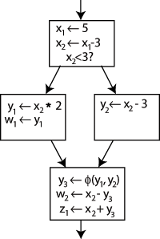
The phi instruction
%result = phi T [%v1, %bb1], ..., [%vN, %bbN]
Implements a Φ node in the SSA graph, producing one of its arguments %v1 to %vN depending from which basic block control flow originated when entering phi’s basic block
%vi to %vN must be of type T
Must provide a value for every predecessor of its containing basic block

Slide 18
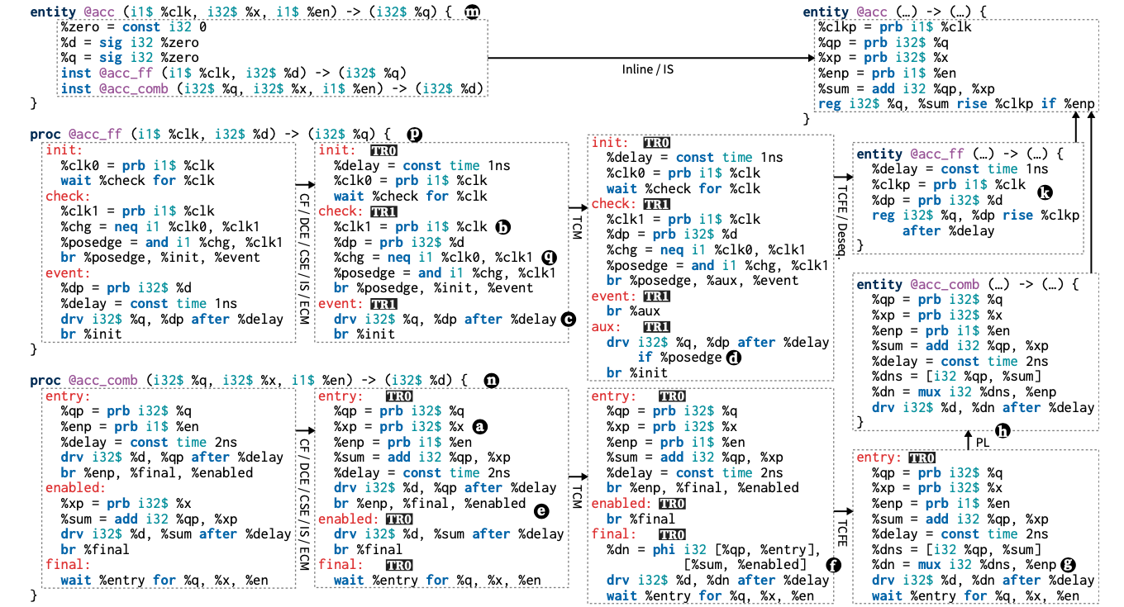
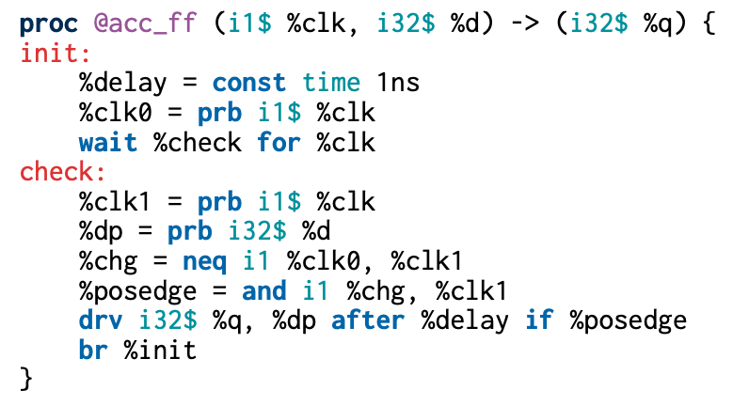
Goal: replace branches with branch-free code
Notes:
Mention the temporal region
Need to explain the problem in acc_ff 2nd stage that causes the TCM to kick in
Constant folding (CF): evaluating constant expressions that you can at compile-time
Dead code elimination (DCE)
Common subexpression elimination (CSE)
EGoal: replace branches with branch-free code
Instruction simplification (IS)
E.g. and %a, %a -> %a
Early code motion (ECM)
Move instructions up the CFG
Constants into entry block
Arith. inst. to earliest point operands available
Temporal code motion (TCM)
Move drv instructions into single exiting block for their respective temporal region (TR)
TRs are separated by wait instructions
Total Control Flow Elimination (TCFE)
Replace branches with muxes
Reduce to one basic block per TR
Desequentialization
Identify processes that describe flip flops/latches
Process with two BB/TRs, one term. in wait and the other br
Process Lowering (PL)
Lower trivial processes to entities
Process with one BB with terminator waiting on all signals
Inlining

Slide 19
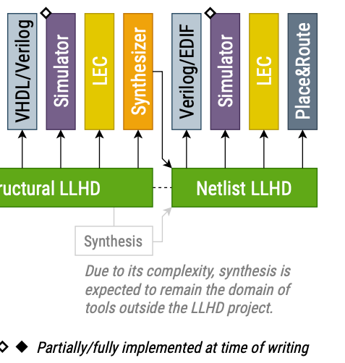
Lowering Structural LLHD to Netlist LLHD
The process of mapping the list of gates and wires to the physical resources and space constraints on the target technology
The domain of hardware synthesizers

Slide 20
Results

Slide 21
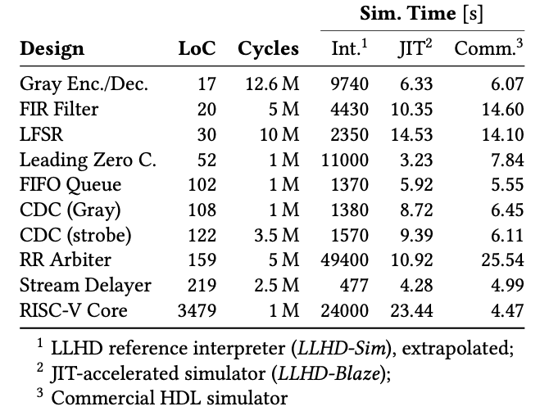
Evaluation
Implemented Moore compiler
Compiled and simulated several SystemVerilog designs
LLHD-Sim time is slower than commercial*
LLHD-Sim trace is equal to commercial
LLHD-Blaze JIT simulator is up to 2.4x faster than commercial
For example, in my own testing of the FIR filter, LLHD-Blaze was 400x faster; in 30 seconds
LLHD-Blaze simulated 10,000 us (45,000,004 steps)
LLHD-Sim simulated 25 us (151,487 steps)
443x
* doesn’t say which commercial simulator in paper nor in submitted artifact

Slide 22
Conclusions
First IR capable of capturing a design from simulation to verification to synthesized netlist
LLHD lowers hurdle for innovation in digital design
New HDLs can just be lowered to LLHD
HLS compilers can generate LLHD
Simulators and synthesizers only need to parse LLHD

Slide 23
The End
Let’s try out the tools!
Also be sure to check out:
http://llhd.io https://dl.acm.org/do/10.1145/3395654

