Slide 1

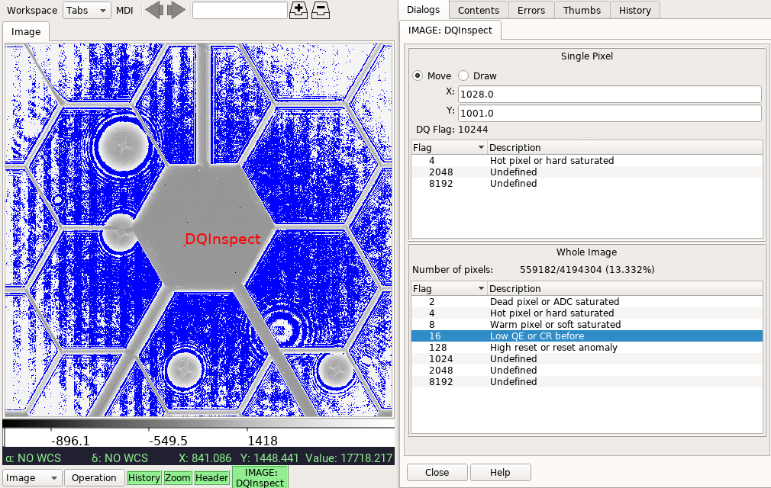
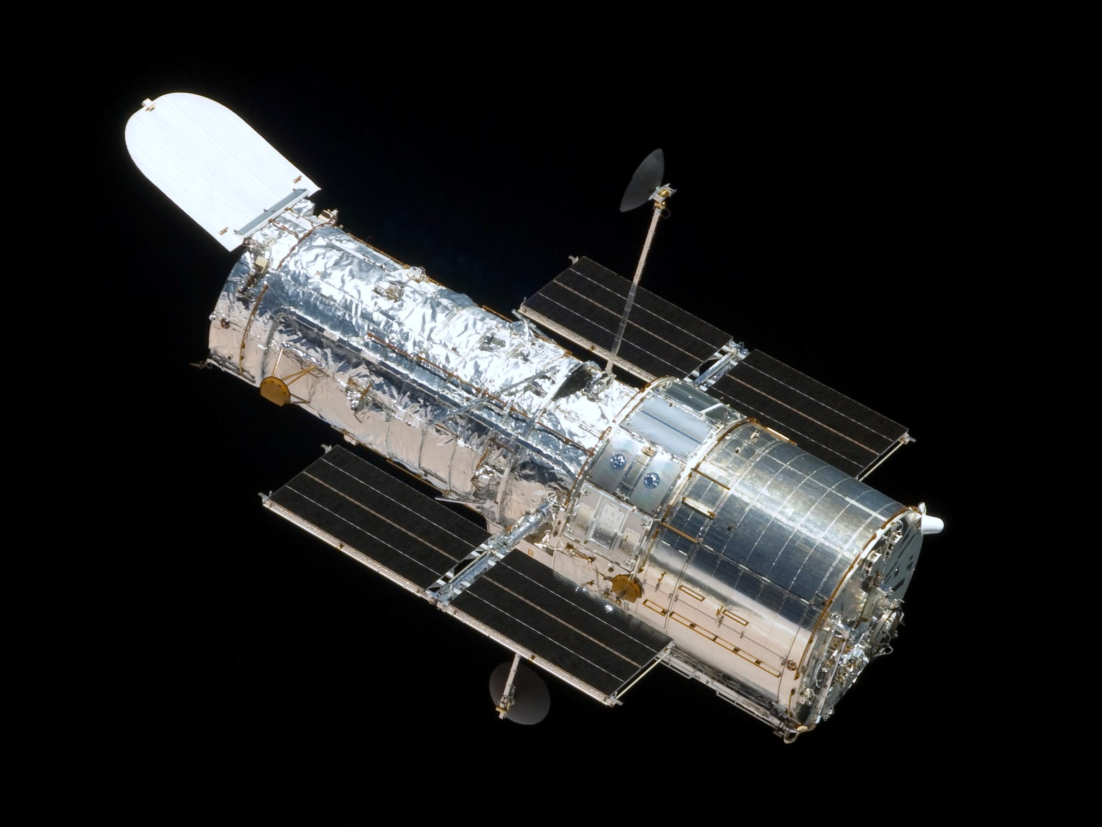
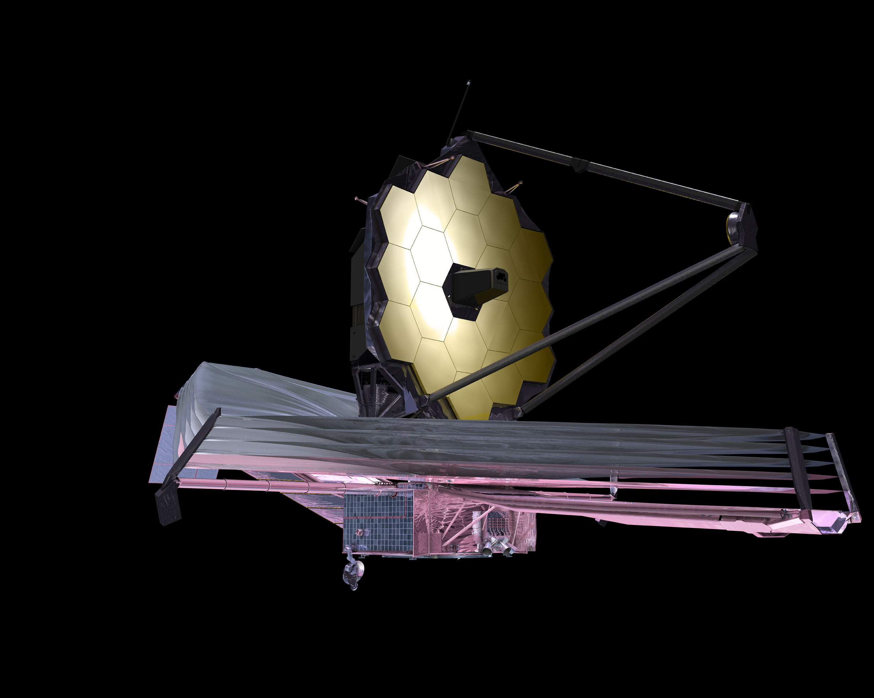
P11.3
P. L. Lim (STScI) & E. R. Jeschke (NAOJ)
stginga: Ginga Plugins for Data Analysis and Quality Assurance of HST and JWST Science Data

