Slide 1

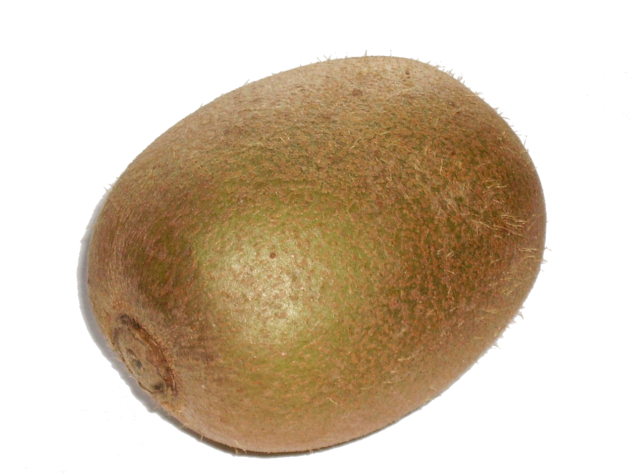
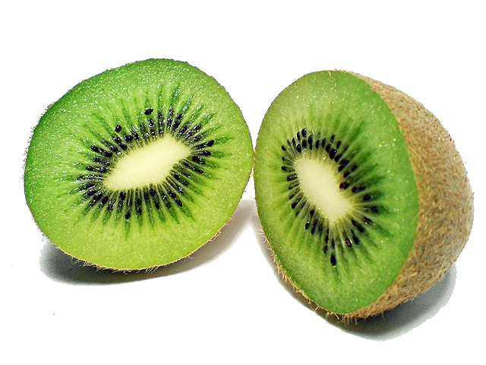
Let's convert a kiwi!
Title: Kiwi
Goal: Interconvert Kiwi and other markup formats
Task: Extend Pandoc to support Kiwi
MediaWiki
Html
Let's ''convert''
a '''kiwi'''!
<p>
Let's <em>convert</em>
a <strong>kiwi</strong>!
</p>
Markdown
LaTeX
Let's *convert*
a **kiwi**!
Let's \emph{convert}
a \textbf{kiwi}!
Pandoc
FoPra Proposal for Summer Semester 2013
Supervised by Yi Dai in Prof. Klaus Ostermann's Group

Slide 2

Kiwi improves wiki intuitively!
Title: Kiwi
Goal: Interconvert Kiwi and other markup formats
Task: Write a reader and/or a writer for Kiwi in Haskell
MediaWiki
Html
Let's ''convert''
a '''kiwi'''!
Pandoc
Abstract
Document
Tree
<p>
Let's <em>convert</em>
a <strong>kiwi</strong>!
</p>
reader
writer
writer
reader
Para
Markdown
LaTeX
Let's *convert*
a **kiwi**!
reader
Str
Str
Str
Space
Emph
Space
Str
Space
Strong
Str
writer
Let's \emph{convert}
a \textbf{kiwi}!
writer
“Let”
“'”
“s”
Str
“a”
Str
“!”
reader
“convert”
“kiwi”
reader
Kiwi
writer
Kiwi
Let's /convert/
a |kiwi|!
Let's /convert/
a |kiwi|!
https://github.com/plmday/Kiwi
FoPra Proposal for Summer Semester 2013
Supervised by Yi Dai in Prof. Klaus Ostermann's Group

