Slide 1
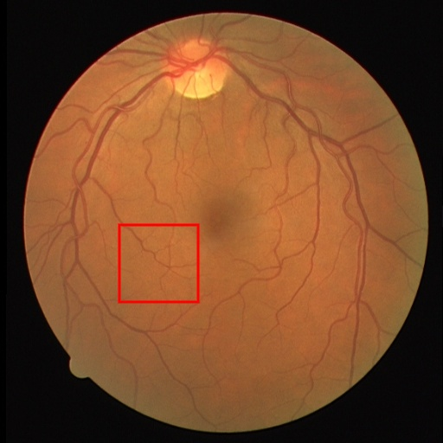
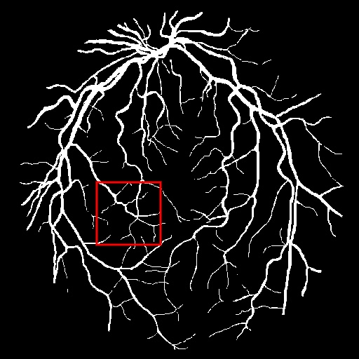
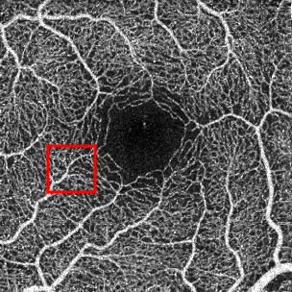
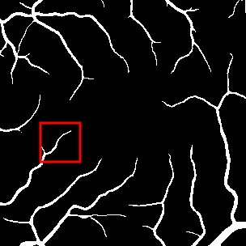
Overall Architecture: KAN-TransUNet
A
KAN-TransUnet
(Training Phase)
Conv
Block
Conv
Block
Downsample
Upsample
Conv
Block
Skip Connections
Conv
Block
TENT
(Test Phase)
Conv
Block
Conv
Block
Original Image
Segmentation Result
Transformer
Layer
Norm
Layer
KAN
Layer
Zoom-in: Single Transformer Layer
B
KAN Layer
C
TENT : Test-Time Adaptation Process
Pre-trained Model
Prediction
Conv Layers
(Frozen) 🔒
z
⋮
⋮
⋮
⋮
KAN(z)
Entropy
Loss
Norm Layers
(Trainable) 🔄
Unlabeled Image
Robust Mask
Gradient Update
Learnable Spline Functions φ(x) on Edges
Update
Norm Params

