Slide 1
Month 3 of newbie learns C++, choose my adventure!
Daniel Morgan @plodtv

Slide 2
Who Is Dan Morgan
DEFINITELY STILL AN IMPOSTER!!!

Slide 3

Principal DevOps Engineer

Slide 4

THIS IS SUPPOSED TO BE

Slide 5
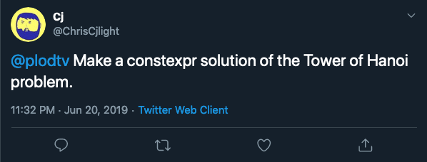

Slide 6
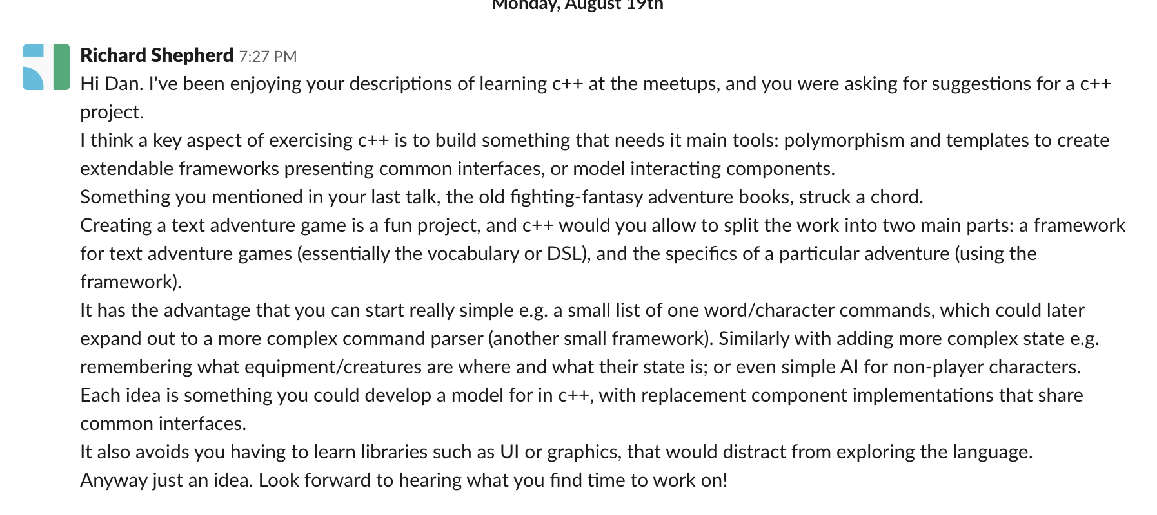

Slide 7


Slide 8
