Slide 1
Month 2 of n00b learns C++ choose my adventure!
Dan Morgan

Slide 2
Who Is Dan Morgan
STILL AN IMPOSTER!!!

Slide 3
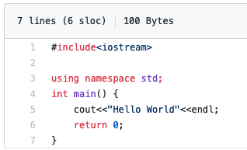
Hello World
#rust-and-cpp-cardiff

Slide 4
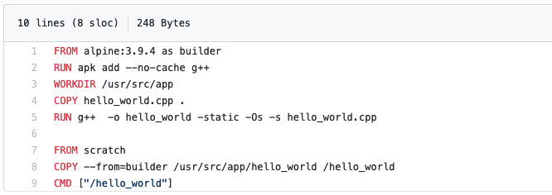

Slide 5
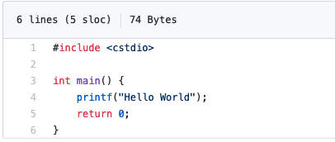
Hello World
#rust-and-cpp-cardiff

Slide 6

I ASKED WHERE NOW?!

Slide 7
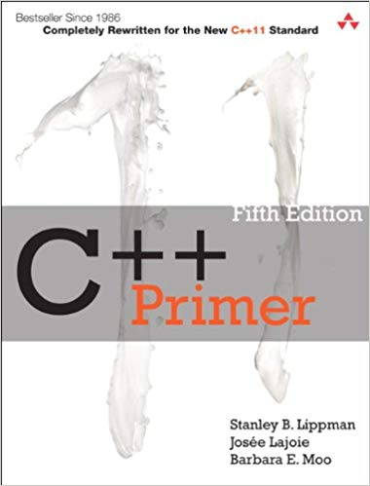
I DECIDED

Slide 8

BUT THIS IS SUPPOSED TO BE

Slide 9
What toy simple project should I do for next month?
TWEET ME!!
@plodtv
#rust-and-cpp-cardiff

Slide 10
Which unit test framework?
TWEET ME!!
@plodtv
# rust-and-cpp-cardiff

Slide 11
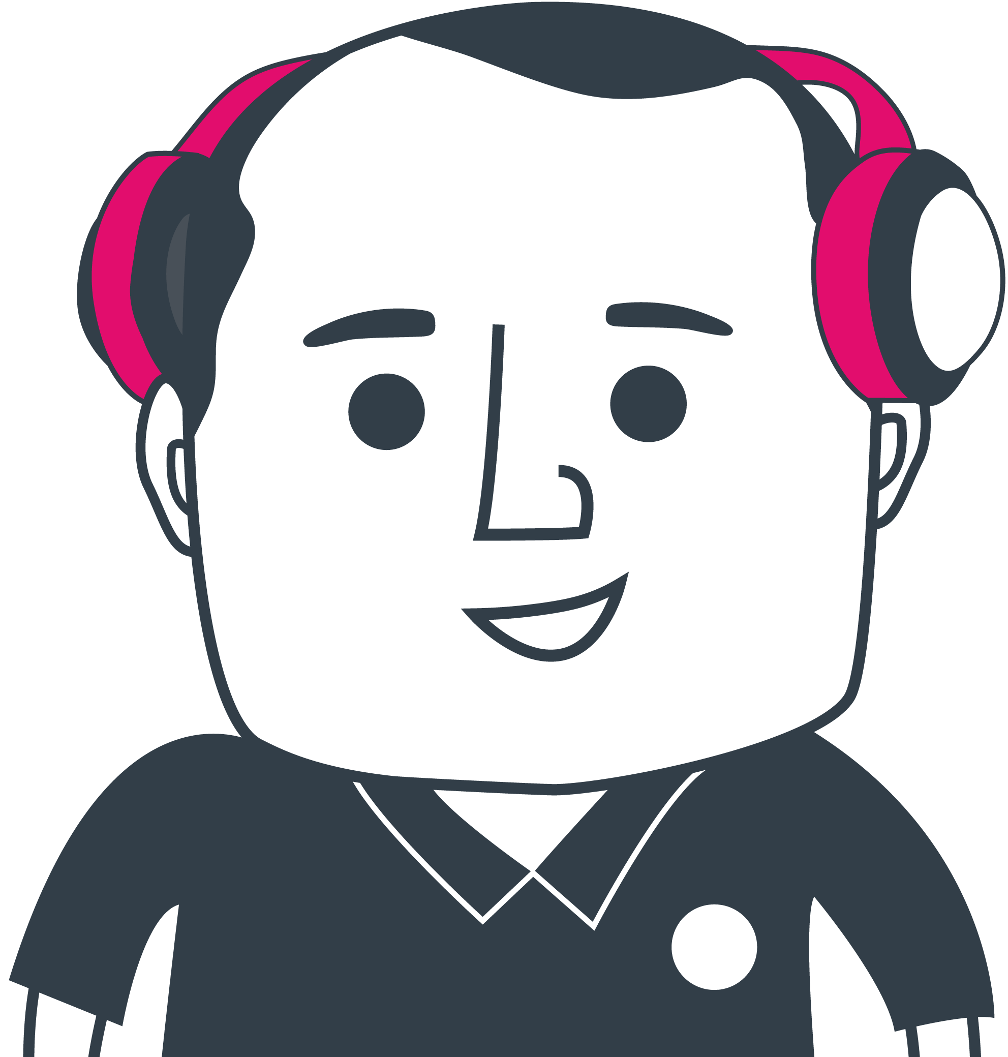
Daniel Morgan
Twitter: @plodtv | Linkedin: https://www.linkedin.com/in/plodtv/
Email: daniel@plod.tv
#rust-and-cpp-cardiff

