Slide 1
ENTERPRISE TRACK A
Udyam Digital
Find, buy and activate the right business bundle in one sitting: on a phone, in the owner's language
GenAI advisor
Instant quote
Smart KYC
Live tracker
Notes:
Udyam Digital turns a 17-day, paper-heavy field sale into a single sitting on a phone: a GenAI advisor in the owner's language, one transparent monthly price, KYC in minutes, and a tracker instead of follow-up calls. Business case for NorthStar's SMB arm.

Slide 2




Only 7% of SMB leads activate, and each big drop is fixable
THE PROBLEM
17.6 days
₹15,053
77%
lead to activation
to acquire one SMB
prefer a non-English language
3,026 lost before needs: unreachable, no time for a visit
→ Owner starts a 24×7 chat in 10 languages
1,113 lost after needs: price too high, quote too complex
→ Instant quote, one monthly price
273 lost at quote: missing documents, long paperwork
→ Smart KYC with registry prefill
220 lost after KYC: install delays and cancellations
→ Feasibility upfront, live tracker
Source: smb_leads.csv, 5,000 leads, Apr–Jun 2026 (synthetic). % = conversion from the previous stage.
Notes:
4,632 of 5,000 leads drop. 3,026 are lost before a need is even assessed and another 1,113 after the needs visit. Activated customers wait 17.6 days and chase status 3 times. At ₹15k acquisition cost per activation against a ₹6,900 median bundle, the field-led model is too expensive for small businesses. The biggest losses are not about product; each is a step we replace with software.

Slide 3




Lead with professional offices; win micro retail with a ₹2.2k digital starter
TARGET CUSTOMER AND PRICING
Dukaan Starter
Clinic & Office Pro
Kirana, salon, pharmacy
Clinic, CA firm · 8 staff
₹2,196 /mo
₹4,592 /mo
Fibre 100 · 2 SIMs · cloud POS
Fibre 300 · email · backup · security
Self-serve
Self-serve
Segment | Leads | Acq. cost | Payback | Churn 6 mo
Micro retail | 54% | ₹20,007 | 8.0 mo | 23%
Professional | 25% | ₹10,695 | 1.6 mo | 14%
Multi-site | 15% | ₹15,614 | 0.5 mo | 11%
Manufacturers | 6% | ₹15,324 | 0.8 mo | 8%
Multi-site One
Factory Connect
Restaurants, 3 outlets
Small unit · 30 workers
₹28,045 /mo
₹22,617 /mo
SD-WAN · failover · POS · CCTV
Leased line · IoT sensors · firewall
Digital + survey
Assisted
Acq. cost = sales and partner spend in segment ÷ activations; payback = acq. cost ÷ avg monthly bundle. Bundle prices: catalogue list prices excl. 18% GST.
Notes:
Professional offices convert at 11% and pay back acquisition in 1.6 months: the best fit for a self-serve journey. Micro retail is half the leads but loses money today (₹20k to acquire, ₹2.5k a month, 23% churn) and only works if acquisition cost drops below about ₹3k, which only a digital journey can do. Multi-site and manufacturers go to assisted sales. Prices are never invented by the AI: a deterministic rules engine applies city tier, staff, sites, GSTIN eligibility and dependencies; the AI explains the result.

Slide 4
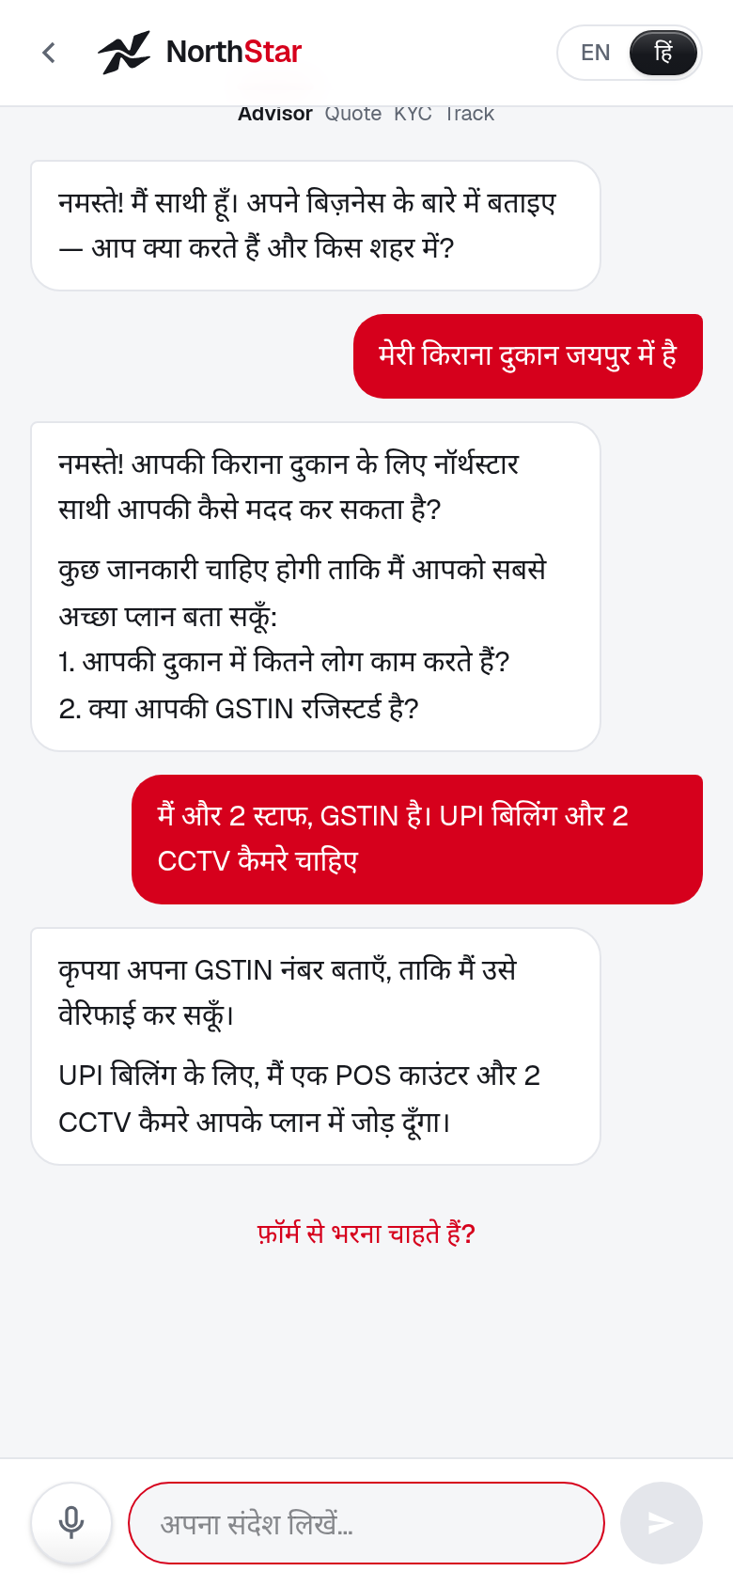
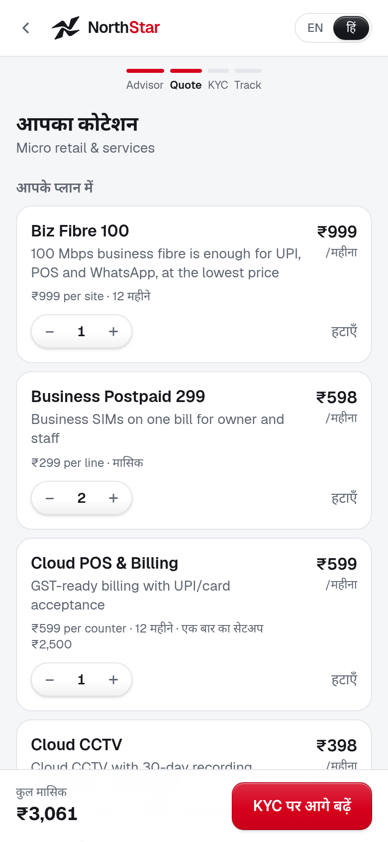
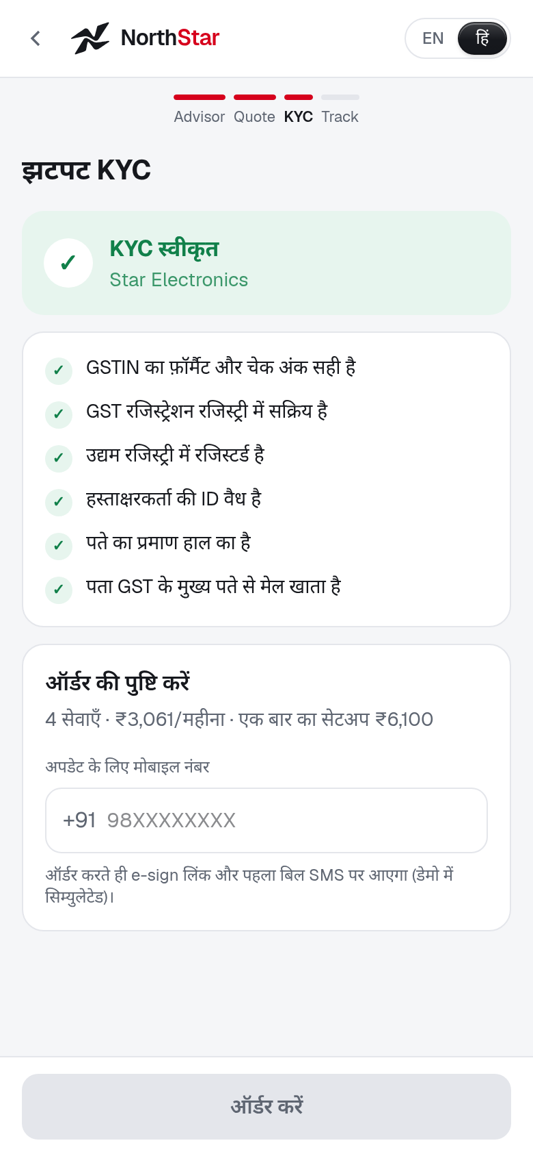
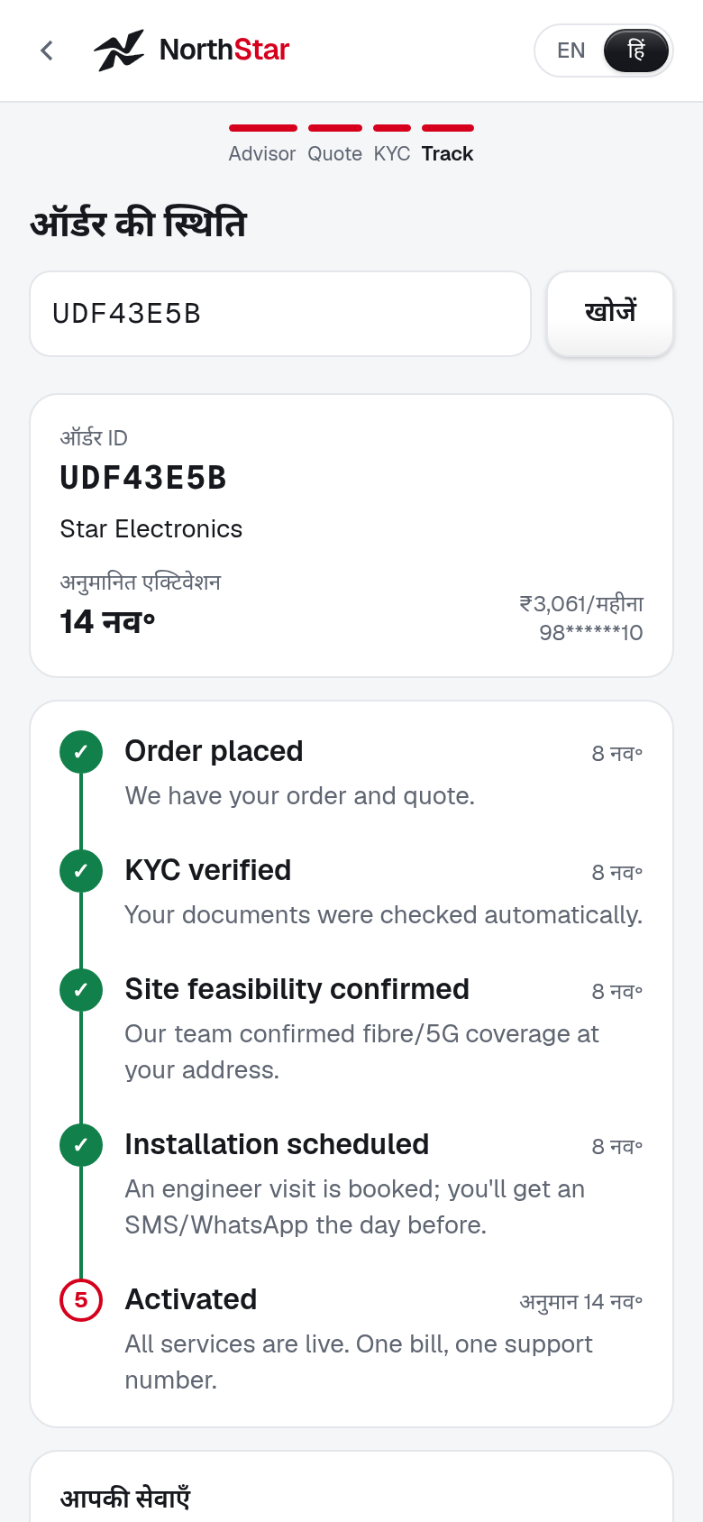
From chat to activation on a phone: no visit, no paperwork
THE SOLUTION
Smart KYC: 12 applicants, instant verdicts
5 approved
1 re-upload (blurred)
6 rejected
Caught: cancelled GSTIN, tampered check digit, edited legal name, 257-day-old bill, missing Udyam
22
customers activated last quarter had a cancelled or suspended GSTIN. A live registry check blocks this at sign-up.
1 Advisor
2 Quote
3 Smart KYC
4 Tracker
Chat in Hindi or English
One price, live add-ons
Consent, lookup, doc AI
Live ETA, WhatsApp alerts
Screens from the working prototype (Next.js + FastAPI + Gemini), shown in Hindi. KYC results from the 12 specimen applicants K01–K12.
Notes:
Demo flow: a Lucknow kirana owner types in Hindi. The advisor recommends fibre, 2 SIMs, POS and 2 cameras and explains why WhatsApp API needs a GSTIN. The owner tweaks the quote, gives purpose-wise consent (DPDP Act), uploads 4 documents and gets an instant verdict from 15+ checks: check digit, registry status, cross-document name and address match, bill age, ID expiry. OCR slips are repaired only when the GSTIN check digit then passes, so a tampered digit is still rejected. Images are deleted after verification.

Slide 5



Digital runs the routine sale; people win the complex accounts
GO-TO-MARKET
Self-serve digital
Micro retail and professional offices · ~80% of leads
Advisor, quote, KYC and tracker end to end. A person joins only when the owner asks.
Local channel partners
Credited, not bypassed
Partner desk shows the live callback queue and win-back list; commission on QR sign-ups.
Field sales
Multi-site, manufacturers, leased lines
Call list ranked by a propensity score: AUC 0.71, 1.9× lift in the top decile.
Acquisition cost per activation by lead source = spend on leads from that source ÷ activations (smb_leads.csv). Propensity: logistic regression, holdout.
Notes:
Field sales and partners cost 4–6 times more per activation than digital and referral channels. Instead of competing with them, the journey hands them better work: partners are credited for digital sign-ups in their area and get leads that need a human through the partner desk (callback queue, win-back list); field sales focus on multi-site and manufacturing accounts, worked in propensity order.

Slide 6





Five metrics define success; hitting them doubles activations
VALUE AND SUCCESS METRICS
TODAY
TARGET
+382
Lead → activation
7.4%
→
15%
Self-serve advisor, instant quote
activations per quarter
17.6
→
368 → 750
Days to activate
5
KYC in minutes, feasibility upfront
−₹10 lakh
Acquisition cost
₹15,053
→
₹6,000
acquisition spend per quarter
Digital and partner-referral mix
₹55.4L → ₹45L
6-month churn (micro)
23%
→
12%
Right-sized bundle, one bill
+₹26 lakh
Status-chase calls
3.0
→
new monthly revenue each quarter
0.5
Live tracker, WhatsApp alerts
382 × ₹6,900 median bundle
Targets are 12-month. Value per quarter assumes the same 5,000 leads; added revenue valued at the ₹6,900 median bundle (conservative vs ₹12,351 average).
Notes:
Targets are set from the data: 15% is what professional offices and manufacturers already reach; 5 days is the typical fibre install time in the catalogue; ₹6,000 sits between today's digital channels (₹4–6k) and partner-assisted deals. 750 activations at ₹6,000 costs ₹45 lakh, ₹10 lakh less than today, while 382 extra activations add about ₹26 lakh of monthly recurring revenue each quarter.

Slide 7




Pilot in four cities in 90 days, then scale language by language
ROLLOUT AND RISKS
0–3 MONTHS
Pilot
›
3–6 MONTHS
Expand
›
6–12 MONTHS
Scale
Mumbai, Pune, Nagpur, Lucknow
All tier 1 cities
Tier 1 and 2 nationwide
Hindi, Marathi, English · partner QR codes · weekly funnel review
+6 languages · WhatsApp front end · partner desk at scale
DigiLocker + e-sign · pricing tests · propensity-led field sales
KEY RISKS AND HOW THE DESIGN CONTAINS THEM
AI suggests a wrong product
Fake or misread documents
Rules engine picks products and prices; AI only explains
Registry cross-check, check digit, name match, human review
Partners feel bypassed
Privacy and DPDP Act
Credited for digital sign-ups; complex leads routed to them
Consent per purpose, images deleted, IDs masked, audit log
The ask Approve a 90-day, four-city pilot with partners, tracked weekly on the five metrics. The prototype already runs the full journey.
Pilot cities: highest-volume tier 1 and tier 2 cities for Hindi and Marathi speakers in smb_leads.csv.
Notes:
The pilot needs production integrations for GSTN/Udyam APIs, DigiLocker, e-sign and payment. Everything else (advisor, rules engine, KYC checks, tracker, partner desk) is in the working prototype.

