Slide 1
Udyam Digital
Find, buy and activate the right business bundle in one sitting: on a phone, in the owner's language
Enterprise Track A · Business case for Accel Business
Notes:
Udyam Digital turns a 17-day, paper-heavy field sale into a single sitting on a phone: a GenAI advisor in the owner's language, one transparent monthly price, KYC in minutes, and a tracker instead of follow-up calls.

Slide 2
Only 7% of SMB leads activate, and most are lost long before KYC
17.6 days
from lead to activation, with 3 status-chase calls per customer
₹15,053
acquisition cost per activated SMB, vs a ₹6,900 median monthly bundle
77%
of owners prefer a language other than English; today's journey is English-first
Source: smb_leads.csv, 5,000 leads, Apr–Jun 2026 (synthetic). % = conversion from previous stage.
Notes:
4,632 of 5,000 leads drop. 3,026 are lost before a need is even assessed and another 1,113 after the needs visit. Activated customers wait 17.6 days and chase status 3 times. At ₹15k acquisition cost per activation against a ₹6,900 median bundle, the field-led model is too expensive for small businesses.

Slide 3
Every major drop reason maps to a step we can automate
Lost at stage
Top reasons owners gave
What Udyam Digital does
Lead
Unreachable after 3 attempts (805) · Not interested on first call (470) · Wrong number (319)
Owner starts the chat (QR, WhatsApp, web), so the number is verified and intent is real
1,594 lost
Contacted
No time for a visit (531) · Locked in with provider (325) · Visit not scheduled (296)
24×7 self-serve advisor in 10 languages: no visit needed
1,432 lost
Needs assessed
Price too high (414) · Cheaper competitor (207) · Quote too complex (206) · Too slow (179)
Instant quote, one monthly price, add-ons the owner can switch on and off
1,113 lost
Quote accepted
Missing GST/Udyam doc (94) · Paperwork too long (79) · Details didn't match (47)
Smart KYC: registry prefill, document AI, clear fix-it messages
273 lost
KYC complete
Install delayed >21 days (98) · Cancelled before install (53) · Site not feasible (41)
Feasibility checked before payment; live tracker with an ETA
220 lost
Source: smb_leads.csv drop_reason by last stage reached (top reasons shown).
Notes:
The biggest losses are not about product: owners can't be reached, have no time for a visit, find the quote too slow or complex, or drown in paperwork. Each of these is a step we replace with software.

Slide 4
Lead with professional offices; win micro retail with a digital starter
Segment | Share of leads | Acq. cost / activation | Avg bundle / mo | Payback | 6-mo churn
Micro retail | 54% | ₹20,007 | ₹2,505 | 8.0 mo | 23%
Professional offices | 25% | ₹10,695 | ₹6,796 | 1.6 mo | 14%
Multi-site | 15% | ₹15,614 | ₹31,233 | 0.5 mo | 11%
Manufacturers | 6% | ₹15,324 | ₹19,980 | 0.8 mo | 8%
Priority: 1) Professional offices, fully digital. 2) Micro retail with a ₹2.2k starter, digital only: acquisition cost must fall below ₹3k. 3) Multi-site and manufacturers through assisted sales: highest value per account.
Micro retail is half the leads but loses money today: ₹20k to acquire, ₹2.5k a month, 23% gone in 6 months.
Acquisition cost = all sales and partner spend in the segment ÷ activations. Payback = acquisition cost ÷ average monthly bundle.
Notes:
Professional offices convert at 11% and pay back acquisition in 1.6 months: the best fit for a self-serve journey. Micro retail is the volume prize but only works if acquisition cost drops below about ₹3k, which only a digital journey can do. Multi-site and manufacturers have the highest value and need a site survey, so they go to assisted sales with better leads.

Slide 5
Four bundles, each with one monthly price set by the rules engine
Dukaan Starter
Clinic & Office Pro
Multi-site One
Factory Connect
Kirana, salon, pharmacy · 3 staff
Clinic, CA firm · 8 staff
Restaurant/retail · 3 outlets
Small unit · 30 workers
₹2,196 /mo
₹4,592 /mo
₹28,045 /mo
₹22,617 /mo
Biz Fibre 100
2 business SIMs
Cloud POS & billing
Add CCTV: ₹199 per camera
Biz Fibre 300
2 priority SIMs
Email on own domain × 8
Cloud backup 1 TB
Endpoint security × 4
Fibre 300 + 4G/5G failover per site
Managed SD-WAN
POS × 3, CCTV × 6
Managed firewall
Leased line 20 Mbps, 99.5% SLA
Machine IoT sensors × 6
10 SIMs, email × 30
Managed firewall
12 months · setup ₹2,500
12 months · no setup fee
24 months · setup ₹49,800
24 months · setup ₹32,000
Self-serve digital
Self-serve digital
Digital + partner survey
Assisted (feasibility)
Prices from product_catalogue.csv list prices, excluding 18% GST. Bundles generated by the prototype's rules engine for a typical profile.
Notes:
The advisor never invents a price: a deterministic rules engine applies city tier, staff, site and GSTIN eligibility plus product dependencies, then the AI explains the result. The starter bundle matches what micro customers actually bought (fibre + SIMs + POS), at ₹2,196 a month. We propose spreading setup fees over the first 12 bills for micro customers.

Slide 6
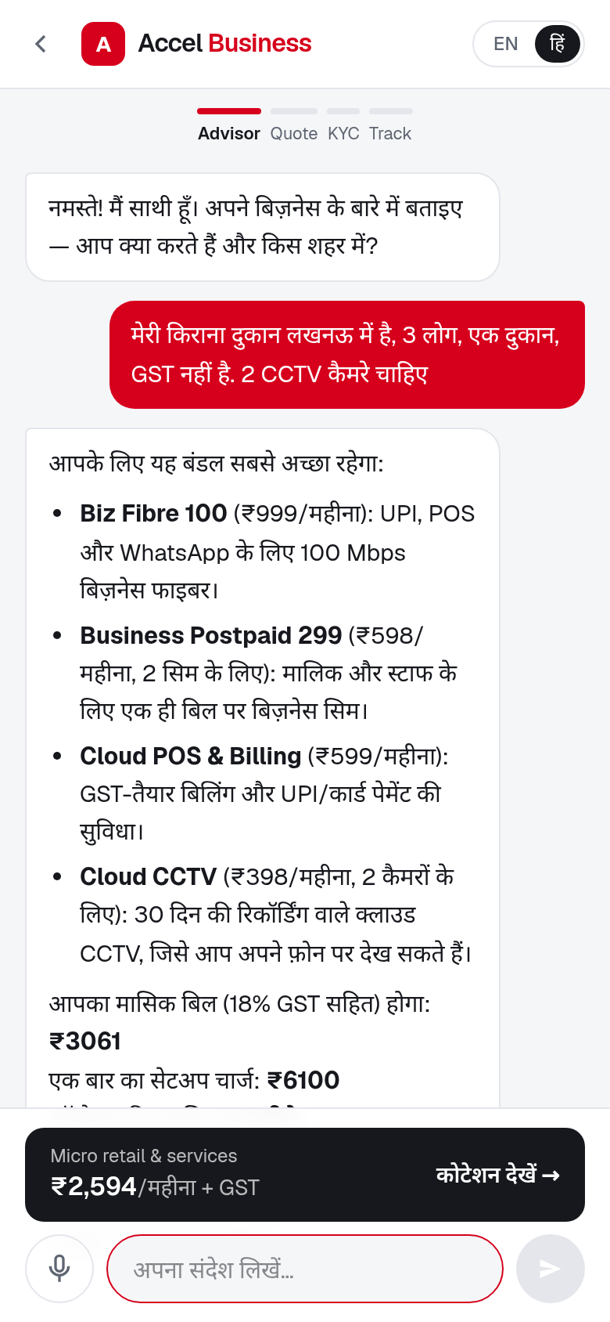
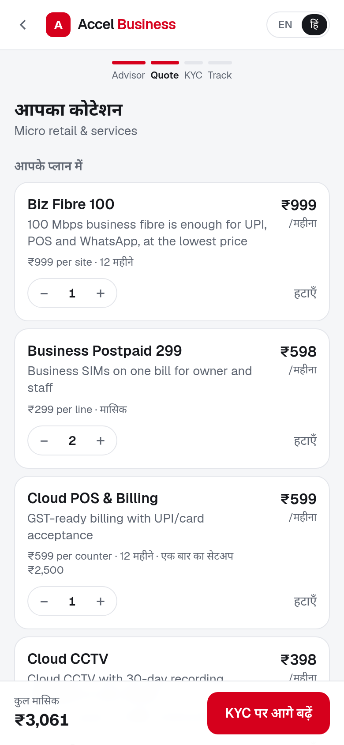
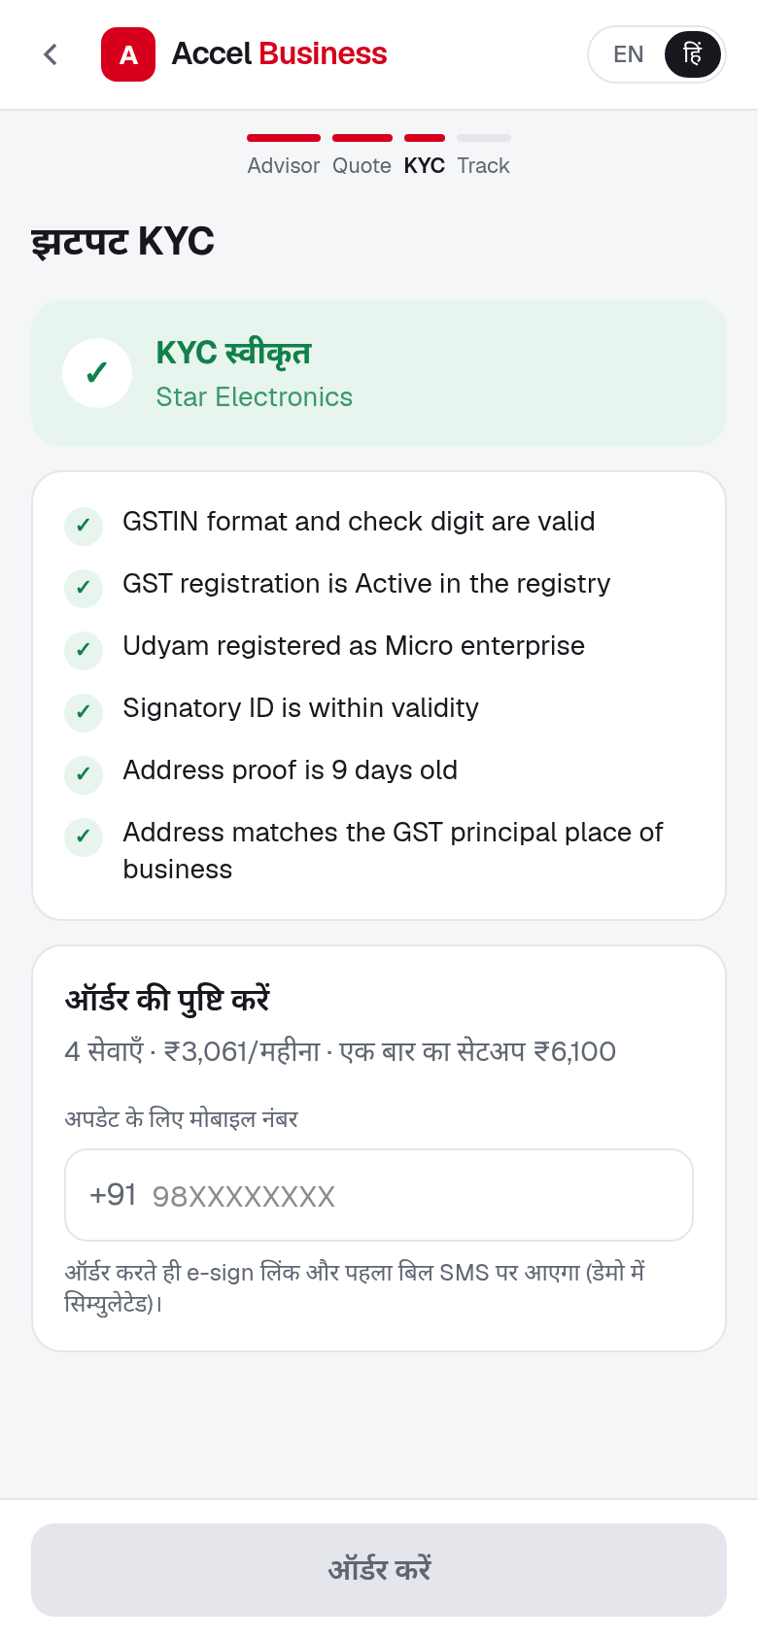
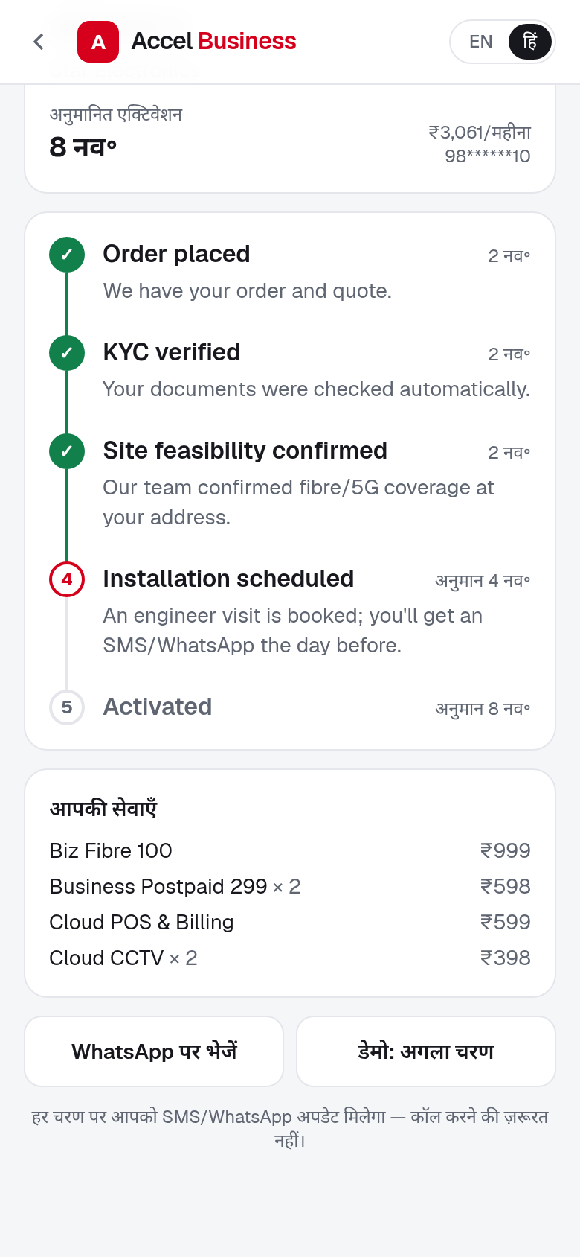
From chat to activation on a phone: no visit, no paperwork
1 Advisor
2 Quote
3 Smart KYC
4 Tracker
Chat or speak in Hindi or English; GenAI explains the bundle
One monthly price; switch add-ons on and off, total updates live
Consent, GSTIN/Udyam lookup, document AI, 15+ checks
Live timeline and ETA; WhatsApp updates instead of calls
Screens from the working prototype (Next.js + FastAPI + Gemini), shown in Hindi.
Notes:
Demo flow: a Lucknow kirana owner types in Hindi. The advisor recommends fibre, 2 SIMs, POS and 2 cameras for ₹2,594 a month and explains why WhatsApp API needs a GSTIN. The owner tweaks the quote, consents, uploads 4 documents, gets an instant verdict and places the order. The tracker replaces the 3 status-chase calls.

Slide 7





Smart KYC verifies a business in minutes and closes a compliance leak
Consent first (DPDP Act)
12 applicants: 5 approved · 1 re-upload · 6 rejected
Purpose-wise consent, what we collect and never collect, retention, withdraw anytime
Cancelled GSTIN + blank Udyam number (K01)
Udyam certificate missing (K05)
One GSTIN digit changed: check digit fails (K06)
Edited legal name on GST certificate (K07)
Address proof 257 days old (K11)
Blurred certificate: ask to re-upload (K04)
Registry lookup
GSTIN and Udyam checked live: status, legal name, address
Document AI
Gemini vision reads 4 documents; fixes OCR slips only if the check digit agrees
15+ automatic checks
22
customers activated last quarter had a cancelled or suspended GSTIN. A live registry check blocks this at sign-up.
Check digit, active status, names and addresses across documents, 90-day bill, ID expiry
Instant verdict
Approve, re-upload or reject, with a reason the owner understands
Results from running the prototype on the 12 specimen applicants (K01–K12) and on mock_gstin_registry.csv.
Notes:
In the specimen set, OCR misread several GSTINs (O vs 0, S vs 5). We repair those only when the GSTIN check digit then passes, so a genuinely tampered digit (K06) is still rejected. Document images are discarded after verification; only extracted fields and the verdict are kept.

Slide 8



Digital runs the routine sale; people win the complex accounts
Self-serve digital
Micro retail and professional offices (~80% of leads)
Advisor, quote, KYC and tracker end to end. A person joins only if the owner asks.
Local channel partners
Same leads, earned not lost
Get every lead the advisor can't close, with context; earn commission on QR-code sign-ups; do installs.
Field sales
Multi-site, manufacturers, leased lines
Work a call list ranked by a propensity score; use the same app on a tablet for the quote and KYC.
Acquisition cost per activation by lead source = total spend on leads from that source ÷ activations (smb_leads.csv).
Notes:
Field sales and partners cost 4–6 times more per activation than digital and referral channels. Instead of competing with them, the journey hands them better work: partners are credited for digital sign-ups in their area and get the leads that need a human; field sales focus on multi-site and manufacturing accounts where a site survey is needed and the bundle is worth ₹20–30k a month.

Slide 9
Five metrics define success; hitting them doubles activations
Metric | Today | 12-mo target | Main lever
Lead → activation | 7.4% | 15% | Self-serve advisor, instant quote
Days lead → activation | 17.6 | 5 | KYC in minutes, feasibility upfront
Acquisition cost / activation | ₹15,053 | ₹6,000 | Digital and partner-referral mix
6-month churn (micro) | 23% | 12% | Right-sized bundle, one bill
Status-chase calls / customer | 3.0 | 0.5 | Live tracker, WhatsApp alerts
+382
activations per quarter (368 → 750)
−₹10 lakh
acquisition spend per quarter (₹55.4L → ₹45L)
+₹26 lakh
monthly recurring revenue added each quarter
Value per quarter assumes the same 5,000 leads; added revenue valued at the ₹6,900 median bundle (conservative vs the ₹12,351 average).
Notes:
Targets are set from the data: 15% is what professional offices and manufacturers already reach; 5 days is the typical fibre install time in the catalogue; ₹6,000 sits between today's digital channels (₹4–6k) and partner-assisted deals. 750 activations at ₹6,000 costs ₹45 lakh, ₹10 lakh less than today, while 382 extra activations add about ₹26 lakh of monthly recurring revenue each quarter.

Slide 10
Pilot in four cities in 90 days, then scale language by language
0–3 months · Pilot
3–6 months · Expand
6–12 months · Scale
Mumbai, Pune, Nagpur, Lucknow
All tier 1 cities
Tier 1 and tier 2 nationwide
Hindi, Marathi, English · partner QR codes · weekly funnel review
+6 languages · WhatsApp front end · back-office lead console
DigiLocker + e-sign live · pricing tests · propensity-led field sales
Key risks and how the design contains them
AI suggests a wrong or ineligible product
Fake or misread documents
The rules engine picks products and prices; the AI only explains. Judge-style scenarios run as tests
Registry cross-check, GSTIN check digit, cross-document name match; human review when in doubt
Field force or partners feel bypassed
Privacy and DPDP compliance
Partners credited for digital sign-ups in their area; complex leads routed to them with context
Consent per purpose, images deleted after verification, IDs masked, audit log of consents
Pilot cities chosen from the highest-volume tier 1 and tier 2 cities for Hindi and Marathi speakers in smb_leads.csv.
Notes:
Ask: approve a 90-day pilot in four cities with partner participation, measured weekly on the five metrics. The prototype already runs the full journey; the pilot needs production integrations for GSTN/Udyam APIs, DigiLocker, e-sign and payment.

