Slide 1
Inventory Management System
Dakota, Parker, Matt, Kevin, Tyler

Slide 2
Purpose
Automate inventory ordering
Transfer inventory when cost effective
Support multiple store locations
Receive data reactively

Slide 3

Technologies
Trello
Git
Spring
AOP
WebFlux
Reactor
AWS
Keyspaces
EC2
IAM Users
Sonar-Cloud
Swagger UI
Junit
Mockito
This Photo by Unknown Author is licensed under CC BY-SA

Slide 4
Key Features
User Roles
Secure Login
JWT
Bcrypt
Data Availability (CassandraDB)
Reactive
? Custom cost algorithm
Inventory tracking

Slide 5
API
SwaggerUI

Slide 6
Demo

Slide 7
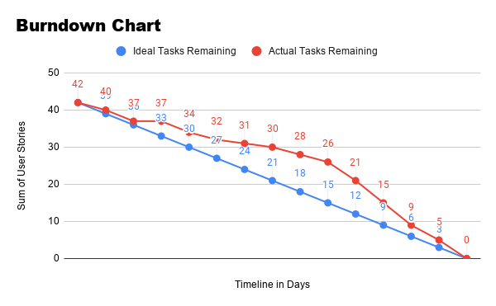
Burn Down

Slide 8
Challenges
Algorithm
Non-Standardized Dev Environments
Reactive Development
Planning
High-throughput Testing Client

Slide 9
Dev-Ops
Gitlab
Sonar-Cloud

Slide 10
Future Plans
Docker
Kubernetes
Micro-Service
Weighted algorithm

