Slide 1
If you havent done this already,
Go to your bootcamp code folder:
cd sydneyTestersBootcamp/
cd 03_ContinuousIntegration/
Go to CI_Server folder and start VM:
cd CI_Server/
vagrant up
Test if it is up:
vagrant ssh
java –version
Repeat for the CI_Agent folder
Create account at Heroku.com and activate it
Notes:
We’ll have this slide up while people are coming in.

Slide 2



Continuous Integration
Hans Dushanthakumar
hans@thoughtworks.com
Alejandro Sanchez
sisalex@hotmail.com
Leo Salazar
lsalazar@thoughtworks.com
Notes:
Introduce the speakers

Slide 3


Agenda
Continuous Integration Intro
Installing Jenkins server
Configuring Jenkins
Deployment using Jenkins
Notes:
More focus on hands-on than theory.
Any questions, please stick your hands up.
Need any help in hands-on, stick your hand up.
The app that we’ll use today. Running tests with Rake.

Slide 4








Development process
Feature 1
Merge
Integration Test
Feature 2, Part 1
Feature 2, Part 2
Notes:
Problems with not having CI. Need for CI.

Slide 5




Development process with CI
Listen for changes
Build
Run Tests
Make results visible
push
Notes:
Integrate all the time.
Monitor code repo for changes, Run per-configured commands (eg “Rake”), Show results

Slide 6

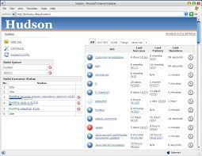
Jenkins
Notes:
About Jenkins.
CI Server
Opensource, Free
Written in Java
Easy to install, configure, upgrade (plugins)
Great dev & user communities

Slide 7
Overview
Install Jenkins on a VM (Centos Linux)
Install plug ins
Configuration of the Server
Create a Job to watch a Git Repository and Start the test on change
Notes:
Overview of what we are about to do? In case people are confused by all the vagrant stuff:
Will start up a Virtualbox VM (Centos Linux)
Will use Vagrant (as learnt in previous session) to manage then VM, install dependencies (Java, ruby, bundler, phantomjs etc)
Why we are running a VM to do this (so everyone has a similar environment)
Configure CI Server to “watch” a git repository
Configure CI Server to start tests if any changes in the repository

Slide 8
Start your VMs
Go to your bootcamp code folder:
cd sydneyTestersBootcamp/
cd 03_ContinuousIntegration/
Go to CI_Server folder and start VM:
cd CI_Server/
vagrant up
Test if it is up:
vagrant ssh
java –version
Repeat for the CI_Agent folder

Slide 9
Installation
Installation:
sudo yum install jenkins
Installation from local installer:
sudo rpm –i /Installers/jenkins….rpm
Start/Stop Jenkins service:
sudo service jenkins start
Access jenkins server from host machine:
http://localhost:9080
Notes:
Overview of what we are about to do? In case people are confused by all the vagrant stuff:
Will start up a Virtualbox VM (Centos Linux)
Will use Vagrant (as learnt in previous session) to manage then VM, install dependencies (Java, ruby, bundler, phantomjs etc)
Why we are running a VM to do this (so everyone has a similar environment)
Configure CI Server to “watch” a git repository
Configure CI Server to start tests if any changes in the repository

Slide 10
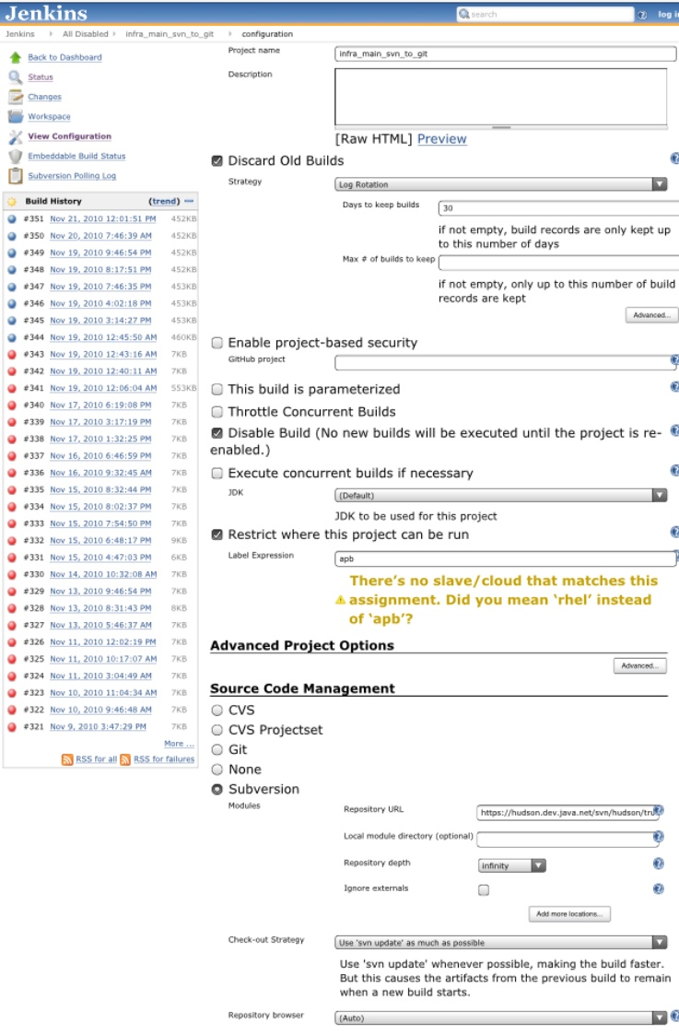

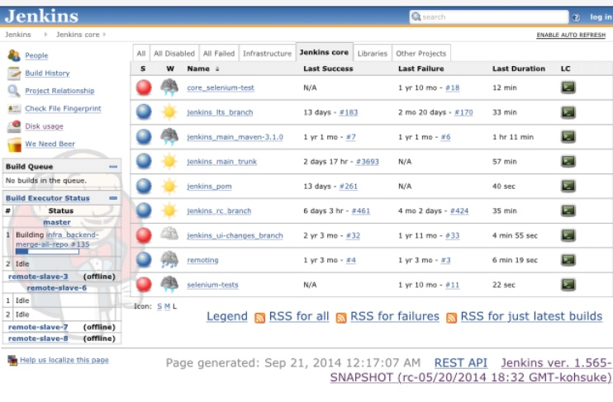
Configuring Jenkins Server: Jobs
Notes:
Git Repo:
https://github.com/SydneyTestersBootcamp/QuickQuoteCi.git
Poll SCM:
* * * * *
Build step:
export PATH=/usr/local/rvm/gems/ruby-2.1.2/bin:/usr/local/rvm/gems/ruby-2.1.2@global/bin:/usr/local/rvm/rubies/ruby-2.1.2/bin:/usr/local/bin:/bin:/usr/bin:/usr/local/sbin:/usr/sbin:/sbin:/usr/local/rvm/bin:/home/vagrant/bin;
bundle install --path ./;
bundle exec rake;

Slide 11
Things to configure
Code Repository to watch
https://github.com/SydneyTestersBootcamp/QuickQuoteCi.git
Trigger (ie when to build)
* * * * *
Build Steps (ie how to build)
bundle install –path ./
Bundle exec rake
Post Build Actions
Notes:
Git Repo:
https://github.com/SydneyTestersBootcamp/QuickQuoteCi.git
Trigger (Poll SCM):
* * * * *
Build step:
export PATH=/usr/local/rvm/gems/ruby-2.1.2/bin:/usr/local/rvm/gems/ruby-2.1.2@global/bin:/usr/local/rvm/rubies/ruby-2.1.2/bin:/usr/local/bin:/bin:/usr/bin:/usr/local/sbin:/usr/sbin:/sbin:/usr/local/rvm/bin:/home/vagrant/bin;
bundle install --path ./;
bundle exec rake;

Slide 12

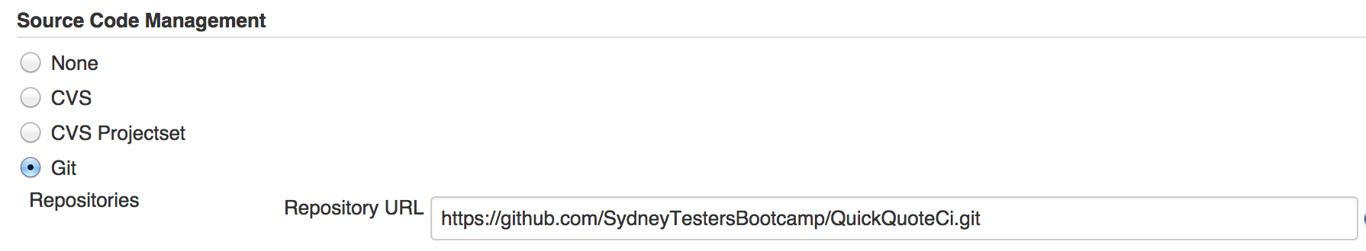
Jenkins Plugins
Git Plugin
https://github.com/SydneyTestersBootcamp/QuickQuoteCi.git
Notes:
Install Git Plugin, so that we can watch a git repo.

Slide 13
Things to configure
Code Repository to watch
https://github.com/SydneyTestersBootcamp/QuickQuoteCi.git
Trigger (ie when to build)
* * * * *
Build Steps (ie how to build)
bundle install –path ./
Bundle exec rake
Post Build Actions
Notes:
Git Repo:
https://github.com/SydneyTestersBootcamp/QuickQuoteCi.git
Trigger (Poll SCM):
* * * * *
Build step:
export PATH=/usr/local/rvm/gems/ruby-2.1.2/bin:/usr/local/rvm/gems/ruby-2.1.2@global/bin:/usr/local/rvm/rubies/ruby-2.1.2/bin:/usr/local/bin:/bin:/usr/bin:/usr/local/sbin:/usr/sbin:/sbin:/usr/local/rvm/bin:/home/vagrant/bin;
bundle install --path ./;
bundle exec rake;

Slide 14
Demo:
Make a change to the repo
Watch the tests run
Notes:
Demo how when I checkin to the codebase, a build automatically starts on everyone’s machines.

Slide 15
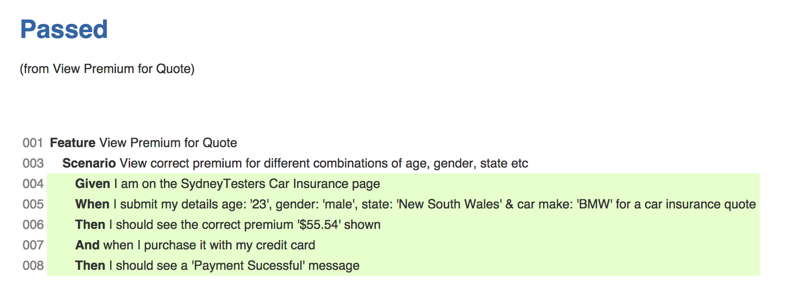

Jenkins Plugins: Cucumber
results/cucumber.json
Notes:
Cucumber report files: reports/cucumber.json

Slide 16
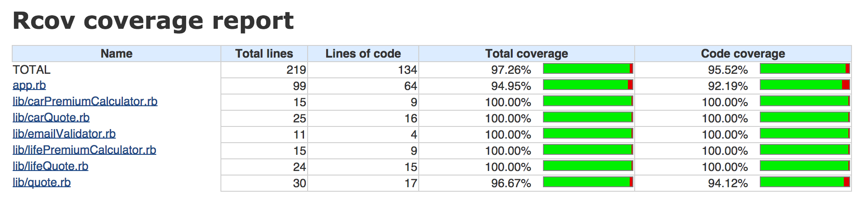

Jenkins Plugins: Code Coverage
coverage/rcov
Notes:
Rcov report directory: coverage/rcov

Slide 17
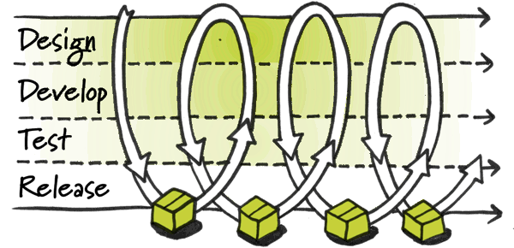
Deployment to Test Environment
Notes:
What is CD? Need for CD. Slide from TWU?

Slide 18
Build/Deploy Pipelines
Build/Run Automated tests
Deploy to QA Env
Deploy to Staging Env
Deploy to Production
Notes:
Stages: Unit Test, Acceptance Test, Package, Deploy to Test Env, Deploy to Staging Env, Deploy to Prod.
Run in parallel, some stages dependent on others.

Slide 19
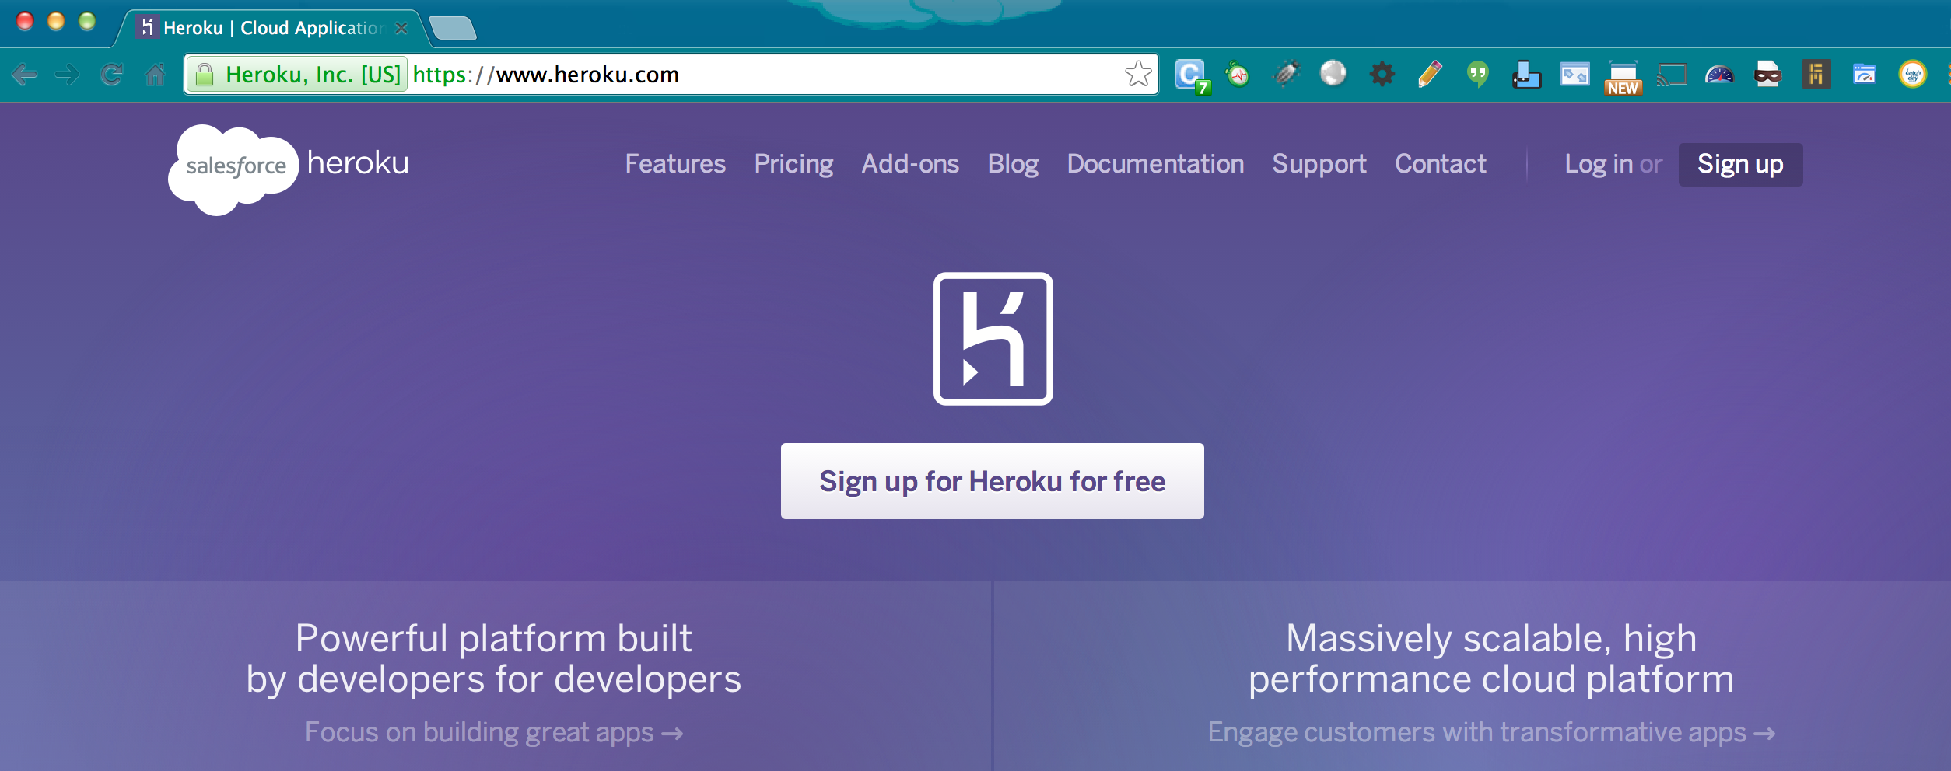
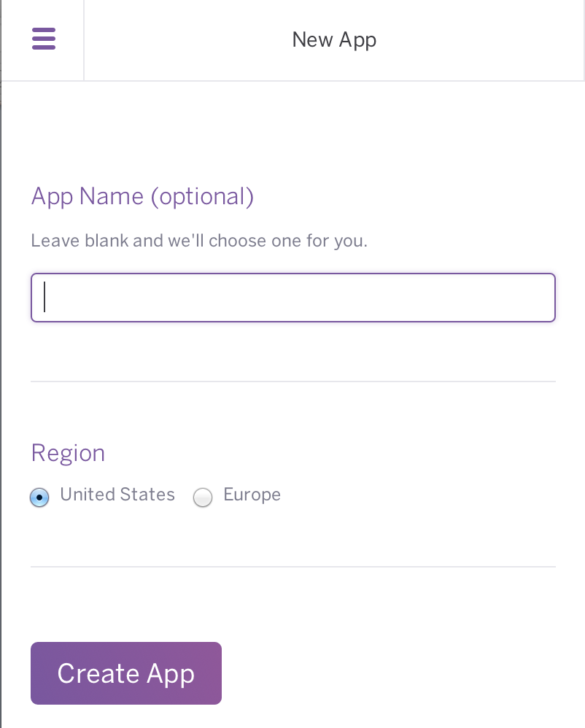
Deploy to Heroku
Notes:
About Heroku:
App hosting platform
Can host diff types of apps for free
Create App (placeholder). Talk about the URL of the app, visit it.
Find the Heroku API key.
Talk about how to deploy to Heroku (push to special git repo)
Build Step:
export PATH=/usr/local/rvm/gems/ruby-2.1.2/bin:/usr/local/rvm/gems/ruby-2.1.2@global/bin:/usr/local/rvm/rubies/ruby-2.1.2/bin:/usr/local/bin:/bin:/usr/bin:/usr/local/sbin:/usr/sbin:/sbin:/usr/local/rvm/bin:/home/vagrant/bin;
export APP_NAME=testhdushanci;
export HEROKU_API_KEY=03dcc037-28f5-4a24-8eed-c0dacf815fe4;
bundle install --path ./;
bundle exec rake deploy;

Slide 20
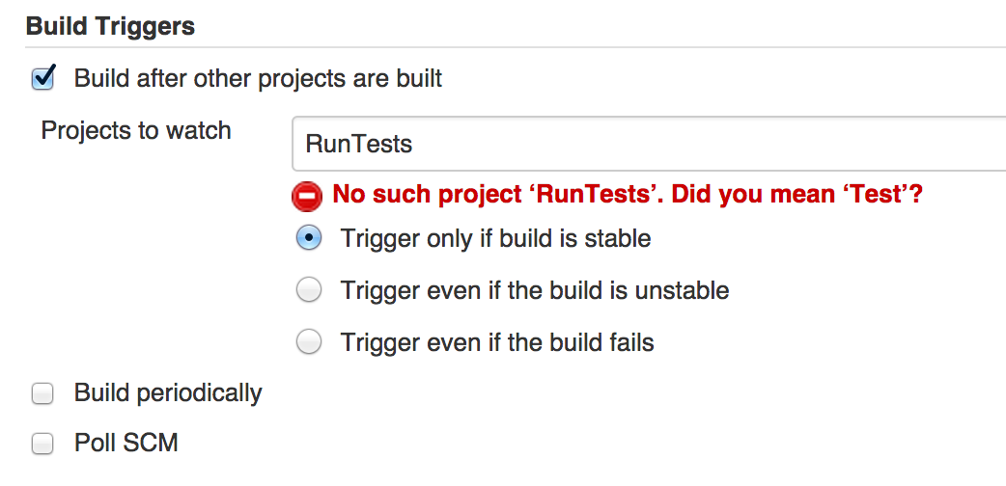
Continuous Delivery with Jenkins
Notes:
Build Step:
export PATH=/usr/local/rvm/gems/ruby-2.1.2/bin:/usr/local/rvm/gems/ruby-2.1.2@global/bin:/usr/local/rvm/rubies/ruby-2.1.2/bin:/usr/local/bin:/bin:/usr/bin:/usr/local/sbin:/usr/sbin:/sbin:/usr/local/rvm/bin:/home/vagrant/bin;
export APP_NAME=testhdushanci;
export HEROKU_API_KEY=03dcc037-28f5-4a24-8eed-c0dacf815fe4;
bundle install --path ./;
bundle exec rake deploy;

Slide 21
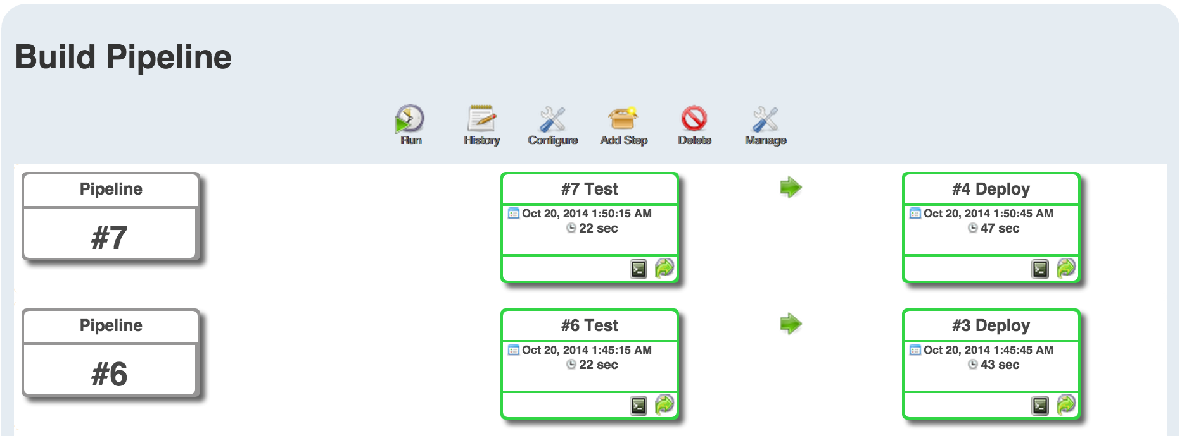

Jenkins Plugins: Pipelines
Notes:
Build Step:
export PATH=/usr/local/rvm/gems/ruby-2.1.2/bin:/usr/local/rvm/gems/ruby-2.1.2@global/bin:/usr/local/rvm/rubies/ruby-2.1.2/bin:/usr/local/bin:/bin:/usr/bin:/usr/local/sbin:/usr/sbin:/sbin:/usr/local/rvm/bin:/home/vagrant/bin;
export APP_NAME=testhdushanci;
export HEROKU_API_KEY=03dcc037-28f5-4a24-8eed-c0dacf815fe4;
bundle install --path ./;
bundle exec rake deploy;

Slide 22

Distributed CI
Slave
Build
Run Tests
Master
Make results visible
Listen for changes
push
Feedback
Notes:
Why is Distributed CI needed?

Slide 23
Distributed CI: Setup
Start up a slave machine
Configure slave node in Jenkins
Remote Path
/vagrant
Host
‘vagrant ssh’ into the CI Agent VM and run ‘ifconfig’ to find IP address of CI Agent
Username/password
username: vagrant, password: vagrant
Notes:
What is CD? Need for CD. Slide from TWU?

Slide 24





Other CI/CD Tools
Notes:
Other CI/CD tools.

Slide 25
Recap
Why CI
Installing/Configuring Jenkins server
Installed/configured plugins
Deployed to Heroku
Notes:
More focus on hands-on than theory.
Any questions, please stick your hands up.
Need any help in hands-on, stick your hand up.
The app that we’ll use today. Running tests with Rake.

Slide 26
Questions & Comments?

