Slide 1
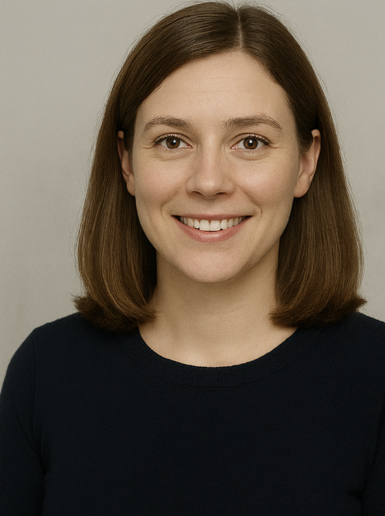





NAME
Anna Keller
DESCRIPTOR
Not a history expert, but enjoys light, human-centered stories about Switzerland’s past. Anna is emotionally engaged by strong storytelling and visuals that are easy to grasp. She likes content that connects to current events or social issues she cares about.
QUOTE
Capture the essence to one or two points that could come out of the persona’s own mouth - so to speak.
“I’m not a scientist, but I want to understand how pandemics shaped the past and what that can teach us today.”
"It’s wild how history repeats itself. If we saw it coming before, why weren’t we better prepared?"
EDUCATED GUESS
WHO IS IT ?
Sketch the personal profile, age, location, job title, what kind of person is it? Think about one or more personas from segmentation.
Anna Keller is a 34-year-old communications specialist living in Bern, Switzerland. She works full-time at a communications agency and shares her home with her partner and their dog. She holds a bachelor’s degree in communication and has an average level of digital literacy: she's comfortable with digital tools, websites, and interactive content but not deeply tech-savvy. Anna is a curious, socially aware individual who enjoys light, engaging stories about history, especially when they relate to current issues. She spends her free time walking in nature, browsing social media, and discovering surprising facts about Swiss history.
WHAT GOALS?
Wat is the supreme motivator? What are (latent) needs and desires?
WHAT ATTITUDE?
What is the point of view? What is the expectation, perception of the service, company or brand. What motivates the persona to go to the website, into the shop, or use the service.
ASPIRATIONAL
Anna’s main motivation is to understand how past pandemics affected society and what we can learn from them today. She's not looking for expert-level analysis but rather wants to grasp the broader historical and social impacts in a way that feels approachable. Her underlying desire is to feel more confident discussing these topics with others and to satisfy her curiosity about how her own region experienced historical public health events. She enjoys being able to share unexpected insights with friends or on social media, especially when they’re thought-provoking or locally relevant.
Anna approaches topics like pandemics with emotional curiosity. She doesn’t want to feel overwhelmed or excluded by overly technical or academic content. Instead, she values websites and resources that feel welcoming, human-centred, and clearly explain ideas without making her feel out of her depth. She expects visual content and storytelling to do the heavy lifting. When she visits a website or data visualization, she's hoping for a meaningful connection something that relates to her life today and sparks a deeper understanding of the past.
ASPIRATIONAL
WHICH BEHAVIOUR?
What does she do? Tell stories about her behaviour while using a service, product or site. Channel usage for various needs (internet, visiting comparable sites, mobile, social media). What works well, what are the frustrations, what is stopping her from choosing a function, service or product?
Anna engages most with content she can relate to or that offers a fresh perspective on current issues. She enjoys browsing Instagram and YouTube, especially for short videos, infographics, and emotional storytelling. She’s likely to click on interactive maps or scroll-based stories that feel intuitive and visually rich. However, she tends to skip dense academic texts or complex charts unless something emotionally hooks her first.
She trusts sources that feel down-to-earth and relevant to her life, and she’s often drawn in by local stories or surprising historical facts. When something is too technical, cold, or assumes expert knowledge, she loses interest quickly.
ACTUAL
ACTUAL
Which Trends, mindstyles or other indicators are applicable for this persona?
Anna reflects a post-COVID trend of wanting to understand public health and history better. She prefers quick, human-centred learning with emotional stories and local relevance. She values content that’s easy to grasp and believes everyone should be able to understand important topics not just experts
How important are functional, emotional, expressive benefits.
All three matter to Anna, but emotional and expressive benefits matter most. She wants to feel informed and confident, and she loves sharing content that makes her seem thoughtful and socially aware. Functionally, she also appreciates when complex topics are made simple.
Fast or slow decision maker? Why, how can you tell?
Decisions made on facts or emotion? Why, how can you tell?
Anna is slow to engage unless something grabs her emotionally. But once she's interested, she quickly explores, clicks, or shares. She needs a personal or emotional hook to get started.
Anna leads with emotion. Stories and visuals catch her attention first. She’ll pay attention to facts if they’re well explained, but she avoids content that feels dry or overly technical.
THE PERSONA CORE POSTER by CREATIVE COMPANION
This work is licensed under the Creative Commons Attribution-ShareAlike 3.0 Unported License. To view a copy of this license, visit http://creative- commons.org/licenses/by-sa/3.0/ or send a letter to Creative Commons, 444 Castro Street, Suite 900, Mountain View, California, 94041, USA.
WWW.CREATIVE-COMPANION.COM

Slide 2
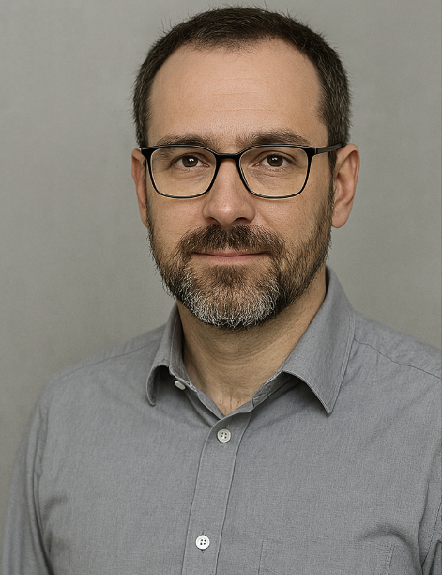
NAME
Dr. Markus Frei
DESCRIPTOR
Markus is deeply invested in understanding health systems through time. He values data-rich, transparent visualizations that highlight long-term patterns. He sees history as a tool for improving decision-making and public preparedness.
QUOTE
Capture the essence to one or two points that could come out of the persona’s own mouth - so to speak.
“I need clarity and depth. If the visuals are sound and the data reliable, this could become a valuable academic resource.”
"It’s not enough to say what happened — I want to know why and how it shaped policy."
EDUCATED GUESS
WHO IS IT ?
Sketch the personal profile, age, location, job title, what kind of person is it? Think about one or more personas from segmentation.
Dr. Markus Frei is a 47-year-old epidemiologist and associate professor based in Zurich, Switzerland. He holds a PhD in Public Health and leads a research group focused on health system resilience. He is a highly educated academic who uses advanced digital tools and platforms for research. Markus enjoys hiking, mentoring students, and reading in-depth historical analyses. He’s deeply analytical and values precision and depth in all academic materials he engages with.
WHAT GOALS?
Wat is the supreme motivator? What are (latent) needs and desires?
WHAT ATTITUDE?
What is the point of view? What is the expectation, perception of the service, company or brand. What motivates the persona to go to the website, into the shop, or use the service.
ASPIRATIONAL
Markus is driven by the goal of understanding long-term health trends and using historical data to inform modern research, teaching, and policy. He wants to draw meaningful comparisons across time and regions to uncover patterns in public health responses. His work is both academic and practical aimed at improving systems and resilience through evidence.
Markus has a critical, evidence-based mindset. He values depth, nuance, and methodological transparency. He approaches data with high expectations and little patience for oversimplification. He’s motivated to engage with tools and platforms that respect the complexity of public health history and offer serious analytical value.
ASPIRATIONAL
WHICH BEHAVIOUR?
What does she do? Tell stories about her behaviour while using a service, product or site. Channel usage for various needs (internet, visiting comparable sites, mobile, social media). What works well, what are the frustrations, what is stopping her from choosing a function, service or product?
Markus uses academic websites, research platforms, and data dashboards to download datasets, apply filters, and create region- or time-specific analyses. He often cross-references data, checks sources, and prefers content he can reuse in lectures or publications. He avoids visuals that lack detail or clarity and is frustrated by clickbait-like graphics with no real substance. He is active on Twitter and LinkedIn to follow peers and share findings, but his primary focus is academic utility.
ACTUAL
ACTUAL
Which Trends, mindstyles or other indicators are applicable for this persona?
Markus represents a trend among researchers who seeks insights, combining history, epidemiology, and sociology to inform public health strategies. He values open data, system thinking, and transparent communication. He’s aligned with the growing academic interest in using historical evidence to improve modern preparedness and policy-making.
How important are functional, emotional, expressive benefits.
For Markus, functional benefits are most important: he needs accurate data, advanced tools, and reproducible insights. Emotional benefits are secondary, but he appreciates when a dataset helps him feel more empowered in his work. Expressively, he uses quality visualizations to elevate discourse in academic and policy circles.
Fast or slow decision maker? Why, how can you tell?
Decisions made on facts or emotion? Why, how can you tell?
Markus engages with content fairly quickly if it seems useful, but he takes time to assess its reliability and depth before fully committing. He’ll revisit valuable tools or visuals, especially if they support his teaching or research. His pace reflects a thoughtful academic approach cautious but purposeful.
Facts come first for Markus. He’s data-driven and looks for clear methodology and solid evidence. While he respects emotional storytelling, it only resonates with him when it’s used responsibly to highlight deeper systemic issues like inequality or lack of preparedness. Emotion supports the message, but facts build the trust.
THE PERSONA CORE POSTER by CREATIVE COMPANION
This work is licensed under the Creative Commons Attribution-ShareAlike 3.0 Unported License. To view a copy of this license, visit http://creative- commons.org/licenses/by-sa/3.0/ or send a letter to Creative Commons, 444 Castro Street, Suite 900, Mountain View, California, 94041, USA.
WWW.CREATIVE-COMPANION.COM

