Slide 1

Haskell Architecture in Practice

Slide 2
OnPing
OnPing is our main product
Main Features:
  Communicate with PLCs
  Real-time Alarm System
  Data Analysis, Automated Reports
  Customizable Dashboard
Customers:
  Energy Producers
  Agricultural Industry
  Water Resource Management
References:
http://www.plowtech.net/
https://en.wikipedia.org/wiki/Programmable_logic_controller

Slide 3
OnPing Codebase History
Original codebase in PHP and C#
  C# has lots of libraries
  But ran into poor support from Microsoft
  Lots of issues with dynamic typing in PHP
Started transitioning to Haskell in December 2012
First Haskell hires in July 2013

Slide 4
Motivation for Using Haskell
Eliminates many kinds of bugs with types
More compiler error catching makes it easier to collaborate with a team
Good testing libraries (Hspec and Tasty)
Good community
Promotes research in Computer Science, Programming Languages, Type Theory, Math
  Applicative functors were discovered through Haskell¹
References:
¹McBride, Conor, and Ross Paterson. "Applicative programming with effects." Journal of functional programming 18.01 (2008): 1-13.

Slide 5
Challenges with Haskell
Lack of industrial protocol libraries
  We made our own
Pushing code to production
  Build systems are still a challenge
  Cabal, Stack, Shake
Thin talent pool
Steep beginners curve
  More resources available now

Slide 6
OnPing Architecture - Overview
Yesod and Persistent
MongoDB, MySQL, Postgres, SimpleStore, Arena
Docker
Angular 1 and GHCJS
Microservices - Servant
Private Hackage
References:
https://hackage.haskell.org/package/arena
https://github.com/plow-technologies/simple-store

Slide 7
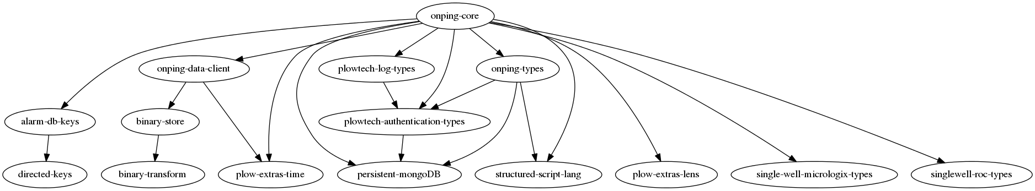
OnPing Architecture – Dependency Graph

Slide 8
OnPing Architecture - Microservices
Processes that communicate over a network
Small, lightweight protocols
Decrease coupling
Organize services around tasks
  Front-end, search engine, accounting, etc.
  We use it for databases and machine communication protocols
Testing and Deployment are more challenging
Network Latency, Message Formatting
  References:
    https://en.wikipedia.org/wiki/Microservices
    Newman, Sam. Building Microservices. 1st Ed. O'Reilly.

Slide 9
Three Useful Libraries
Servant
  Microservice architecture
Haxl and Persistent
  cached database queries
  centralize all queries
GHCJS
  type safe front end programming
  reuse Haskell code
Resources:
https://github.com/facebook/Haxl/tree/master/example/facebook
https://haskell-servant.readthedocs.io/en/stable/
http://www.yesodweb.com/book/persistent
https://github.com/ghcjs/ghcjs

Slide 10
Servant
Type-based API
  Request and Responses enforce types
  Help client and server match
Implement ToJSON and FromJSON for all types passed or received in Requests/Responses
Resources:
https://hackage.haskell.org/package/aeson-0.11.2.0/docs/Data-Aeson.html
https://github.com/haskell-servant/example-servant-minimal
https://github.com/haskell-servant/example-servant-persistent

Slide 11
Servant – Microservices
Three packages
  Servant API declaration, Request and Response types
  Servant Server (does not no about Servant Client)
  Servant Client (needs location of Servant Server, but no cabal dependency to it)
The Servant Client can have its own database(s)
We have one client that connects multiple servant databases
Resources:
https://github.com/plow-technologies/presentation-tutorials/tree/master/onping-architecture/servant-with-persistent

Slide 12
Haxl and Persistent
Persistent is a database modeling system in Haskell
  QuasiQuoters that produce database entity types
  Supports MongoDB, Sqlite, Mysql, Postgresql
share [mkPersist sqlSettings, mkMigrate "migrateAll"] [persistLowerCase|
User
name Text
age Int
UniqueName name
deriving Eq Read Show Generic
|]
{-
Types: User, Key User, UserId, UserName, UserAge,UniqueName, Entity UserId User
Functions: migrateAll, userName, userAge
-}

Slide 13
Haxl and Persistent
Haxl is a caching library
  Useful for complicated queries that retrieve data from multiple sources
  Fits microservice architecture
  It also works as a general data access wrapper (db, files, microservices, external APIs)
  Does not provide automatic cache invalidation (you can do this manually)
  Need to make Hashable instances of all data being stored
Resources:
https://github.com/facebook/Haxl/tree/master/example/facebook
https://github.com/plow-technologies/presentation-tutorials/tree/master/onping-architecture/haxl-example
https://hackage.haskell.org/package/hashable-1.2.4.0/docs/Data-Hashable.html

Slide 14
GHCJS
Haskell to JavaScript compiler
Supports Template Haskell, cabal, stack
  Careful with networking libraries, resulting code runs in a browser
  Able to use most general libraries
  We have a ghcjs-servant-client library
You can run google clojure compiler on the resulting code (still a bit large though)
Resources:
https://github.com/ghcjs/ghcjs
https://github.com/ghcjs/ghcjs-examples/
https://github.com/ghcjs/ghcjs/wiki/Deployment
https://github.com/plow-technologies/ghcjs-servant-client

Slide 15
GHCJS - LiveVDom
Combine JavaScript events and VDom algorithm
Use Valentine QuasiQuoters to write code more naturally
STM-Notify to handle changes (messaging system)
Use ghcjs-servant-client to get query the main server (can hide cross origin queries in the main routes)
Resources:
https://github.com/Matt-Esch/virtual-dom
https://github.com/ghcjs/ghcjs-vdom
https://github.com/plow-technologies/live-vdom
https://github.com/plow-technologies/valentine
https://github.com/plow-technologies/stm-notify

Slide 16
Thanks for your time!

