Slide 1




PORTFOLIO
Presented by: Chalantorn Satayachiti

Slide 2


OUTLINE
Mini Project
Internship Project

Slide 3



INTERNSHIP PROJECT

Slide 4
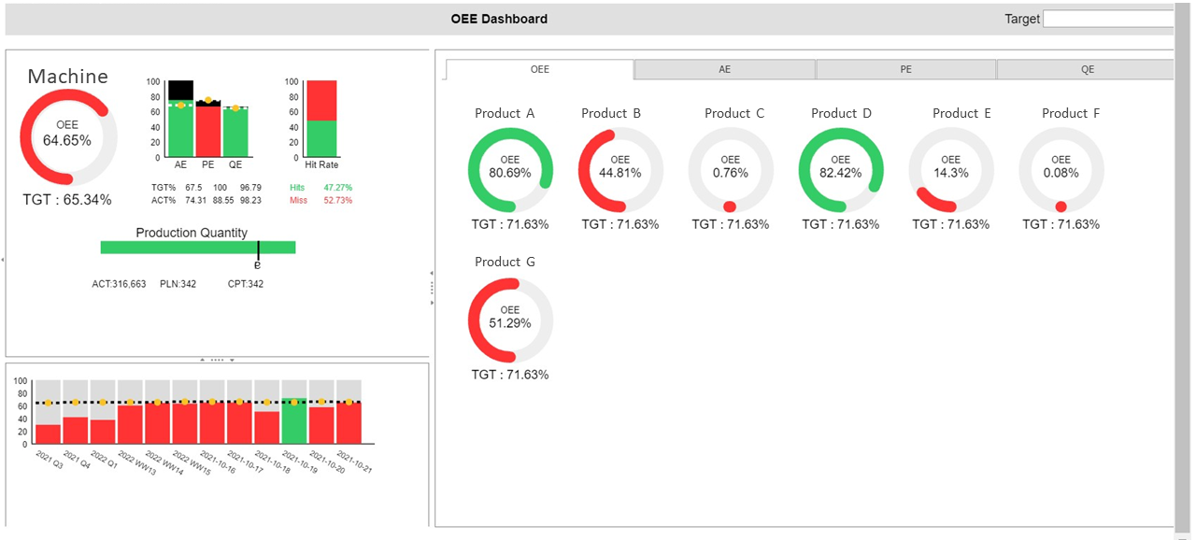
OLD SYSTEM

Slide 5
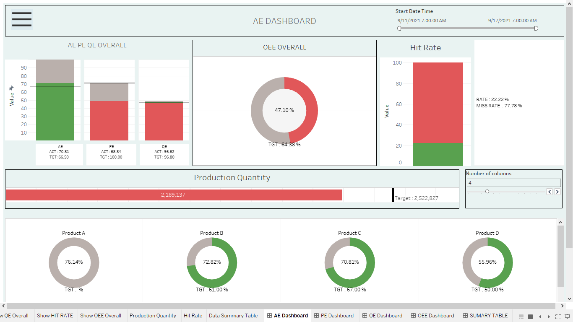
NEW SYSTEM

Slide 6
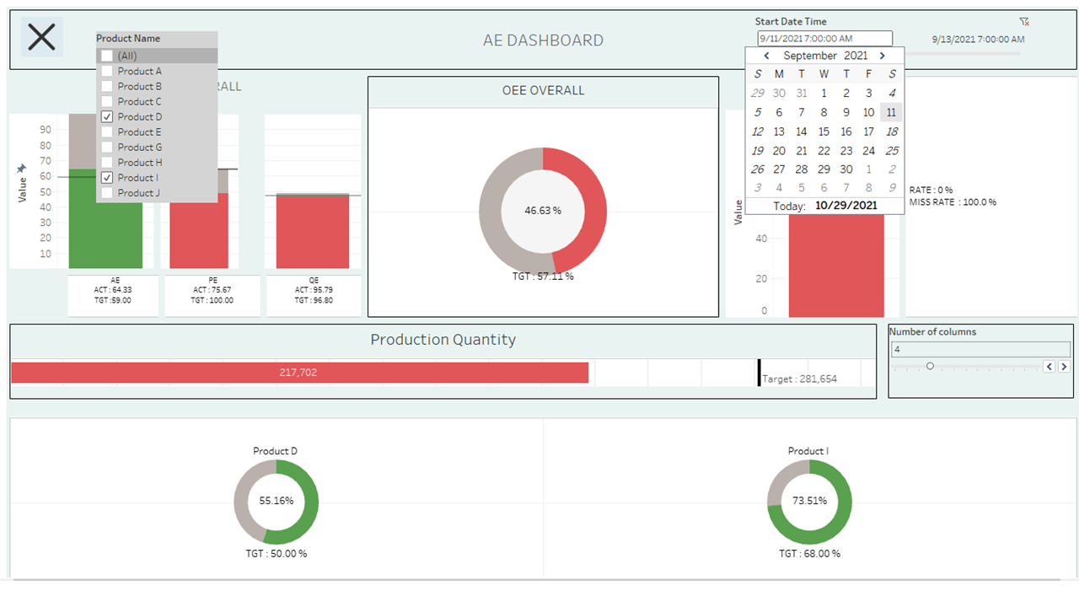
ADD FEARTURE

Slide 7
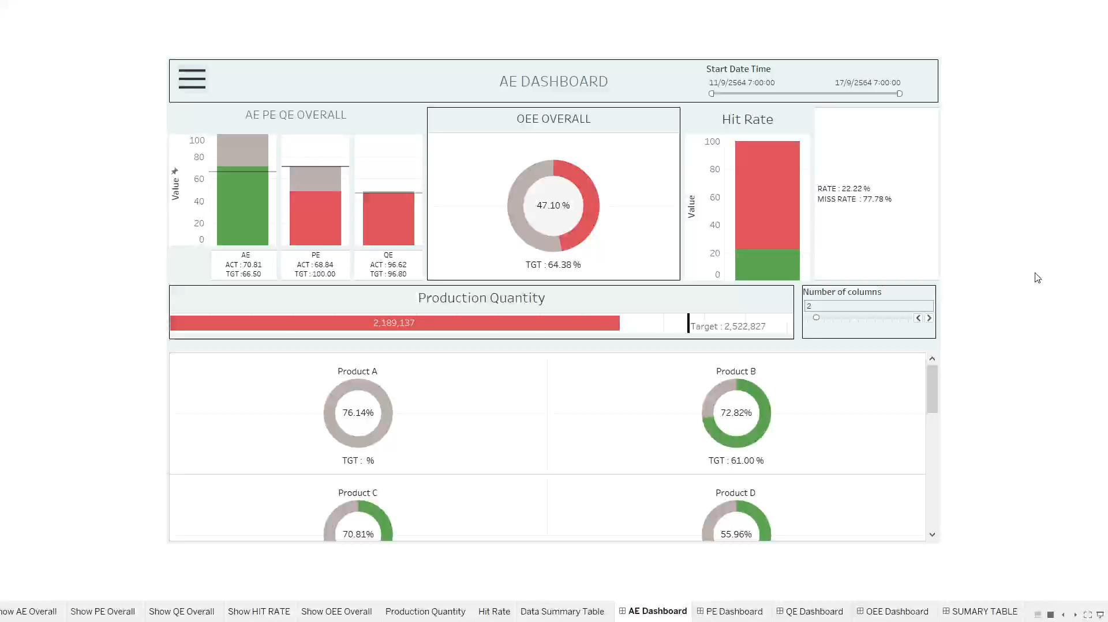
WORKING

Slide 8




THANK YOU FOR
ATTENTION

