Slide 1
SDD 2024 – 2025 Elective Course Class #1 - What is MLOps ?

Slide 2
Definition of MLOps

Slide 3

Definition of MLOps

Slide 4
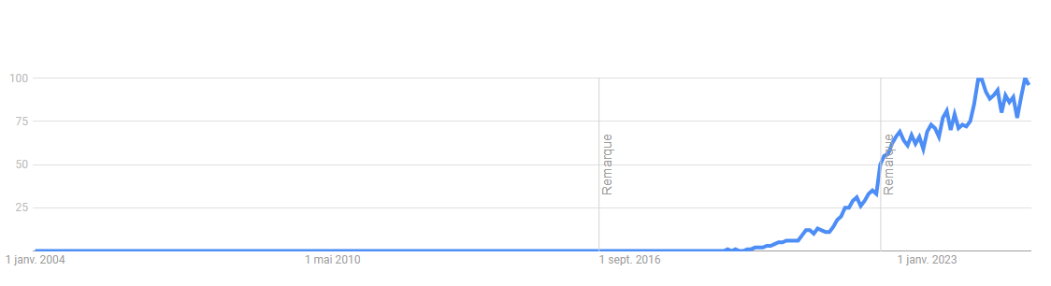
Why is MLOps getting more and more important ?
The benefits of AI and ML no longer need to be proven, especially with the boom of Generative AI. The launch of ChatGPT in November 2022 has made the public understand, perhaps for the first time, the potential of AI → Companies want to move AI solutions from the POC (Proof of Concept) stage to the production stage Below is the trend of searches for the "MLOps" keyword on Google

Slide 5
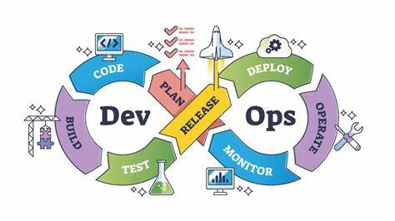
« MLOps is DevOps applied to ML »
MLOps stands for "Machine Learning Operations“ (2015)
MLOps empowers data scientists and app developers to help bring ML models to production. MLOps enables you to track / version / audit / certify / re-use every asset in your ML lifecycle and provides orchestration services to streamline managing this lifecycle
MLOps originates from DevOps (2007)
DevOps is a set of Best practices and technologies…
…to manage efficiently the lifecycle of the development of a Software
DevOps originates from Agile philosophy

Slide 6
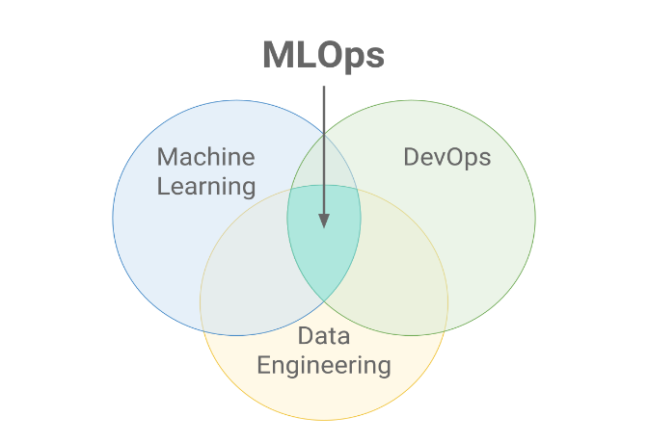
To put it straightforward
MLOps is a set of technologies and best practices that has 4 objectives:
1. Bring ML models to production, so the models can be used
2. Allow the maintenance of models in production
3. Monitor the lifecycle of a ML project
4. Automatize as many tasks as possible while achieving objectives #1 et #2

Slide 7
Implement MLOps

Slide 8

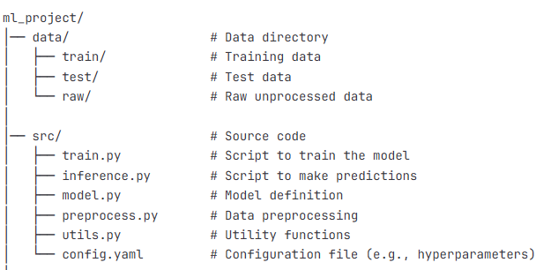
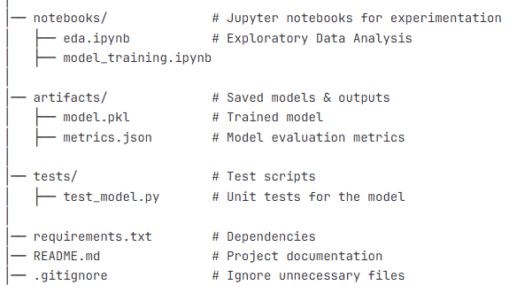
What does a typical ML project look like ?
The ML project is source code
Some questions:

Slide 9
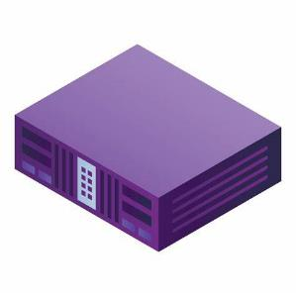
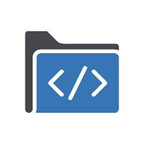

Some challenges to tackle when deploying
Deploy a ML model means serving the source code on a target server and running the code on it
Questions :
How to have the source code running on the target server with its having probable different specifications compared to my local computer (.e.g : not the same python version, not the same OS…) ?
Once deployed and running correctly how is it possible to keep improving the source code (.e.g. switch from a model to another ) ?

Slide 10
Some challenges to tackle when deploying
Deploy a ML model means serving the source code on a target server and running the code on it
Questions:
How to have the source code running on the target server with its having probable different specifications compared to my local computer (.e.g : not the same python version, not the same OS…) ?
→ Containerization (Docker)
Once deployed and running correctly how is it possible to keep improving the source code (.e.g. switch from a model to another ) ? → Continuous Integration / Continuous Deployment

Slide 11

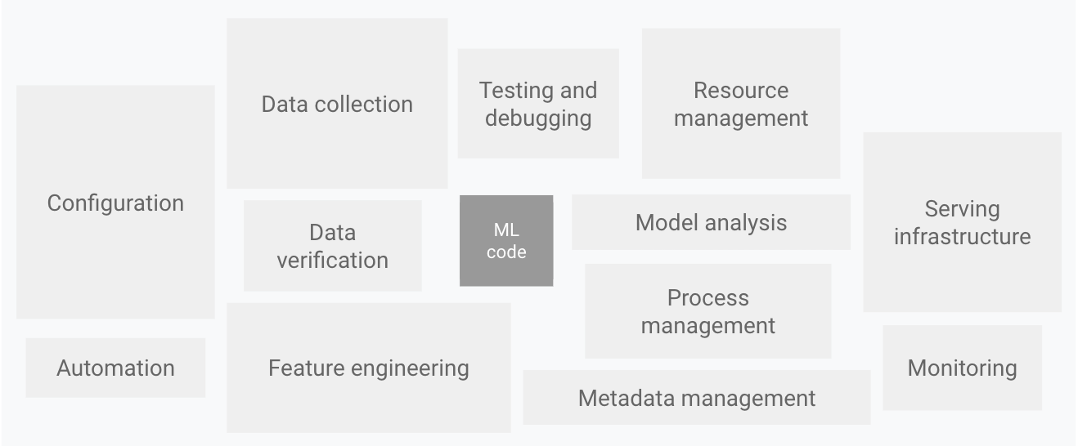
A ML project is a complex system not so easy to be deployed in production
2015

Slide 12
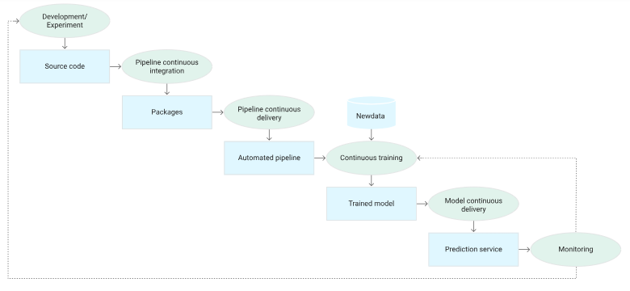
MLOps worfklow

Slide 13
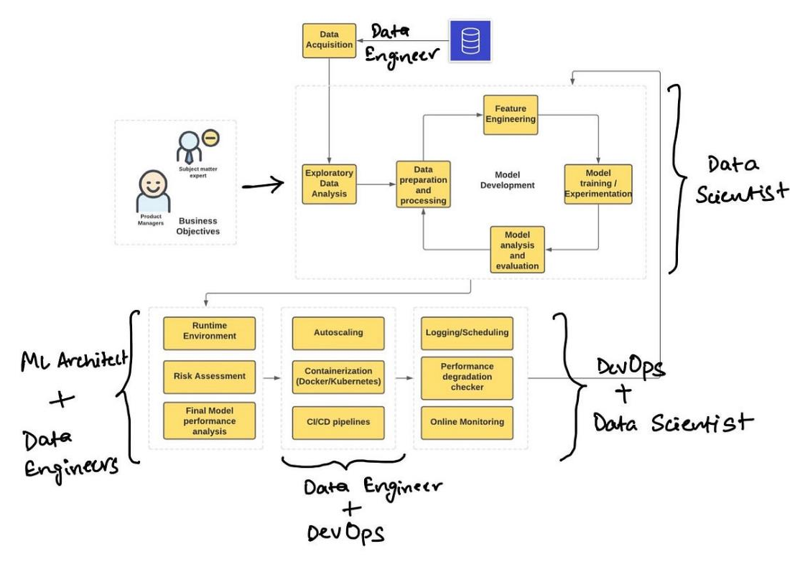
Deploying a ML project involves many data experts

Slide 14




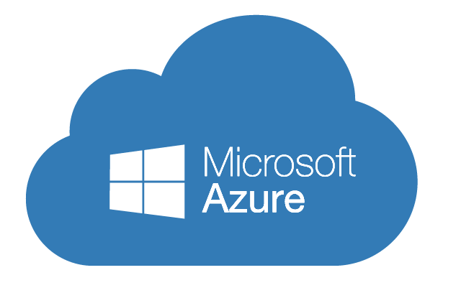
MLOps comes often associated with Cloud
Cloud refers to remote servers accessible through network
Public Cloud refers to servers accessible through internet
Cloud gathers useful services to run ML:
- Compute (GPU, RAM)
- Storage (e.g. for data)
- LLM foundational models (Llama, Gemini) since little time

Slide 15
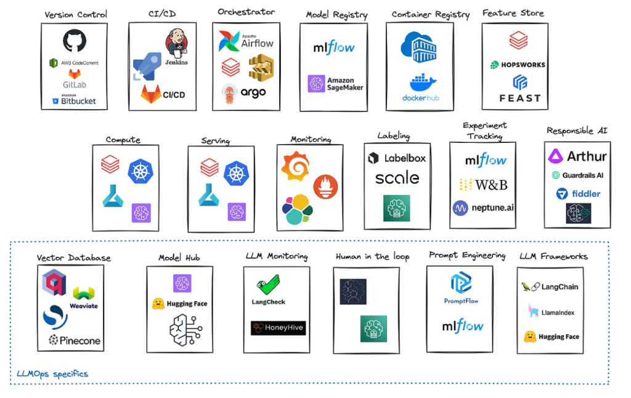
MLOps tools landscape

Slide 16
Some resources
Hidden technical debt in Machine Learning systems (2015)
Build and deploy generative AI and machine learning models in an enterprise by Google (2024)

