Slide 1
4- ML pipeline

Slide 2
Course objectives
Understand the definition and importance of ML pipelines
Introduction to Google's E2E ML platform: TFX
Explain the concepts of CI, CD, and CT
Explore useful technologies for ML pipelines

Slide 3
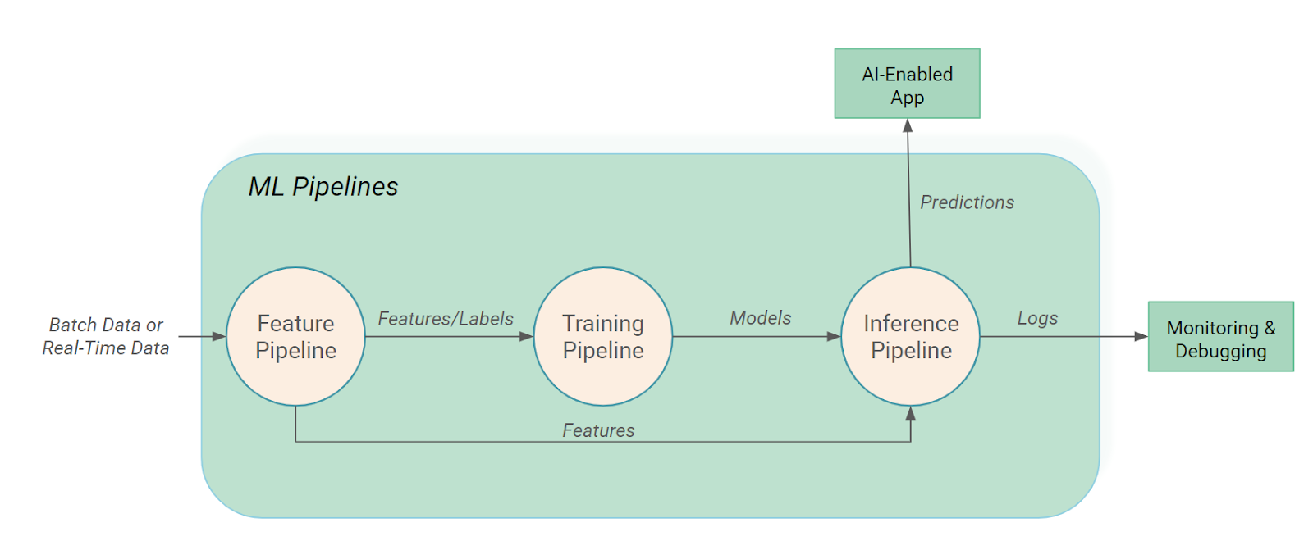
What is a ML pipeline ?

Slide 4
What is a ML pipeline ?
Definition: An ML pipeline is a series of steps designed to automate the process of developing and deploying machine learning models. It encompasses data acquisition, preprocessing, training, evaluation, and deployment.
Importance:
Automation of repetitive tasks.
Reduction of human errors.
Improvement of reproducibility and scalability.
Acceleration of the model development cycle.

Slide 5
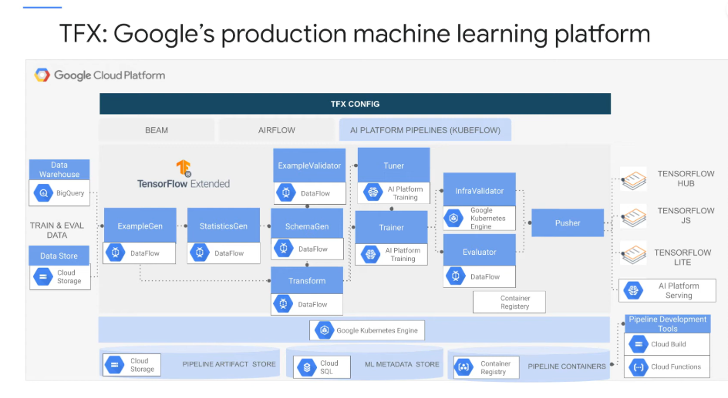

Slide 6
Components of an ML pipeline
Data Acquisition: Collection and storage of raw data.
Preprocessing: Cleaning, transforming, and scaling of data.
Training: Training the model on processed data.
Validation: Evaluating the model's performance.
Deployment: Putting the model into production.
Monitoring: Tracking the model's performance in production.

Slide 7
Introduction to TFX (TensorFlow Extended)
What is TFX?
An end-to-end (E2E) platform from Google for deploying machine learning workflows in production
Compatible infrastructures : For GCP and on-premise
Completely opensourced in 2019 : used at Alphabet of course but also Spotify, Twitter, Airbus
Components of TFX:
TensorFlow Data Validation (TFDV): Data analysis.
TensorFlow Transform (TFT): Data preprocessing.
TensorFlow Model Analysis (TFMA): Model evaluation.
TensorFlow Serving: Model deployment.
TensorFlow Metadata (TFMD): Metadata management.
Pipeline Orchestrator: (e.g., Apache Beam, Kubeflow).

Slide 8
CI, CD, CT in ML Pipelines
CI (Continuous Integration):
Continuous integration of code changes.
Automation of unit and integration tests.
CD (Continuous Deployment/Delivery):
Continuous deployment of models to production.
Automation of deployment steps.
CT (Continuous Training):
Continuous training of models with new data.
Automatic updating of models in production.

Slide 9
Useful Technologies
Orchestration:
Kubeflow, Airflow, Apache Beam.
Data Versioning:
DVC (Data Version Control), MLflow.
Model Management:
MLflow, TensorFlow Serving, TFX.
Monitoring and Logging:
Prometheus, Grafana, ELK Stack.
Environment Management:
Docker, Kubernetes.
Metadata Management:
TensorFlow Metadata, ML Metadata.

