Slide 1
Unsupervised Learning
3.4 Compressive Sensing
3.4.1 Overview
A common goal of the engineering field of signal processing is to reconstruct a signal from a series of sampling measurements. In general, this task is impossible because there is no way to reconstruct a signal during the times that the signal is not measured. Nevertheless, with prior knowledge or assumptions about the signal, it turns out to be possible to perfectly reconstruct a signal from a series of measurements. Over time, engineers have improved their understanding of which assumptions are practical and how they can be generalized.
An early breakthrough in signal processing was the Nyquist–Shannon sampling theorem. It states that if the signal's highest frequency is less than half of the sampling rate, then the signal can be reconstructed perfectly. The main idea is that with prior knowledge about constraints on the signal’s frequencies, fewer samples are needed to reconstruct the signal.
Around 2004, Emmanuel Candès, Terence Tao, and David Donoho proved that given knowledge about a signal’s sparsity, the signal may be reconstructed with even fewer samples than the sampling theorem requires. This idea is the basis of compressed sensing.
Source https://en.wikipedia.org/wiki/Compressed_sensing

Slide 2
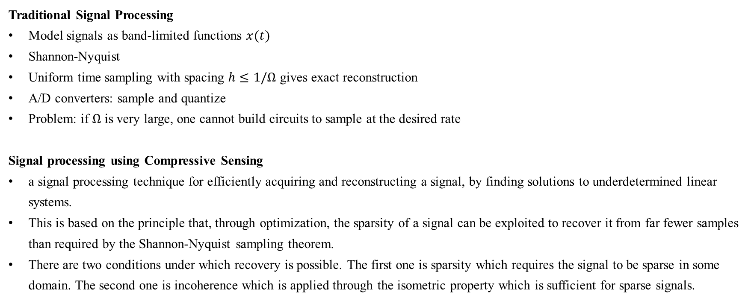
Unsupervised Learning
3.4 Compressive Sensing
3.4.1 Overview
Traditional Signal Processing
Model signals as band-limited functions $x(t)$
Shannon-Nyquist
Uniform time sampling with spacing $h≤1/Ω$ gives exact reconstruction
A/D converters: sample and quantize
Problem: if $Ω$ is very large, one cannot build circuits to sample at the desired rate
Signal processing using Compressive Sensing
a signal processing technique for efficiently acquiring and reconstructing a signal, by finding solutions to underdetermined linear systems.
This is based on the principle that, through optimization, the sparsity of a signal can be exploited to recover it from far fewer samples than required by the Shannon-Nyquist sampling theorem.
There are two conditions under which recovery is possible. The first one is sparsity which requires the signal to be sparse in some domain. The second one is incoherence which is applied through the isometric property which is sufficient for sparse signals.
Source1 http://people.eecs.berkeley.edu/~oholtz/Talks/CS.pdf
Source2 https://en.wikipedia.org/wiki/Compressed_sensing

Slide 3
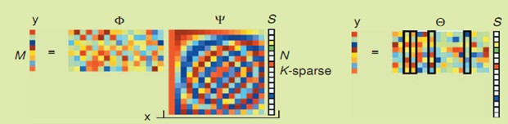
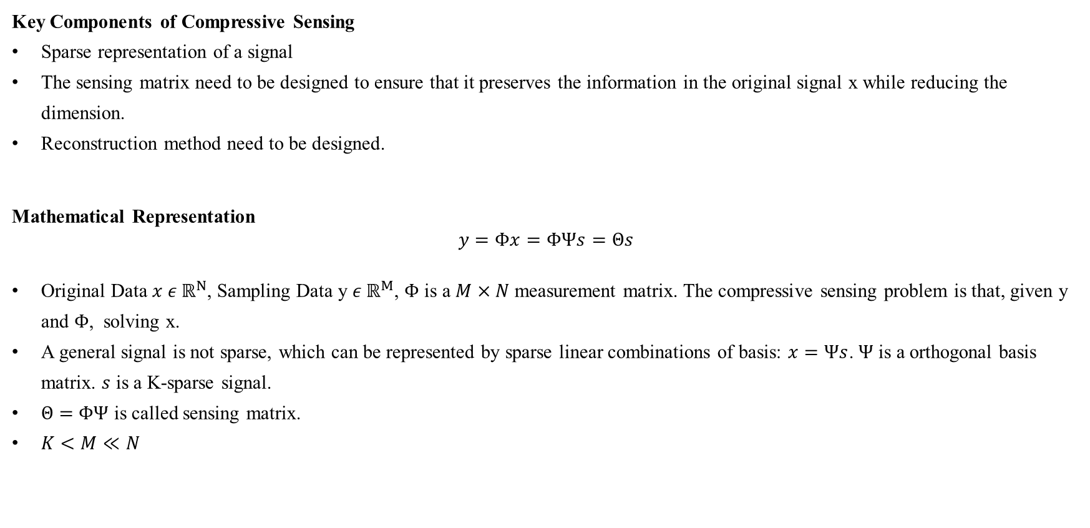
Unsupervised Learning
3.4 Compressive Sensing
3.4.2 Algorithm
Key Components of Compressive Sensing
Sparse representation of a signal
The sensing matrix need to be designed to ensure that it preserves the information in the original signal x while reducing the dimension.
Reconstruction method need to be designed.
Mathematical Representation
$$y=Φx=ΦΨs=Θs$$
Original Data $x ε ℝ^{N}$, Sampling Data y $ε ℝ^{M}$, $Φ$ is a $M×N$ measurement matrix. The compressive sensing problem is that, given y and $Φ$, solving x.
A general signal is not sparse, which can be represented by sparse linear combinations of basis: $x=Ψs$. $Ψ$ is a orthogonal basis matrix. $s$ is a K-sparse signal.
$Θ=$ $ΦΨ$ is called sensing matrix.
$K<M≪N$
Source http://blog.csdn.net/zouxy09/article/details/8118329

Slide 4
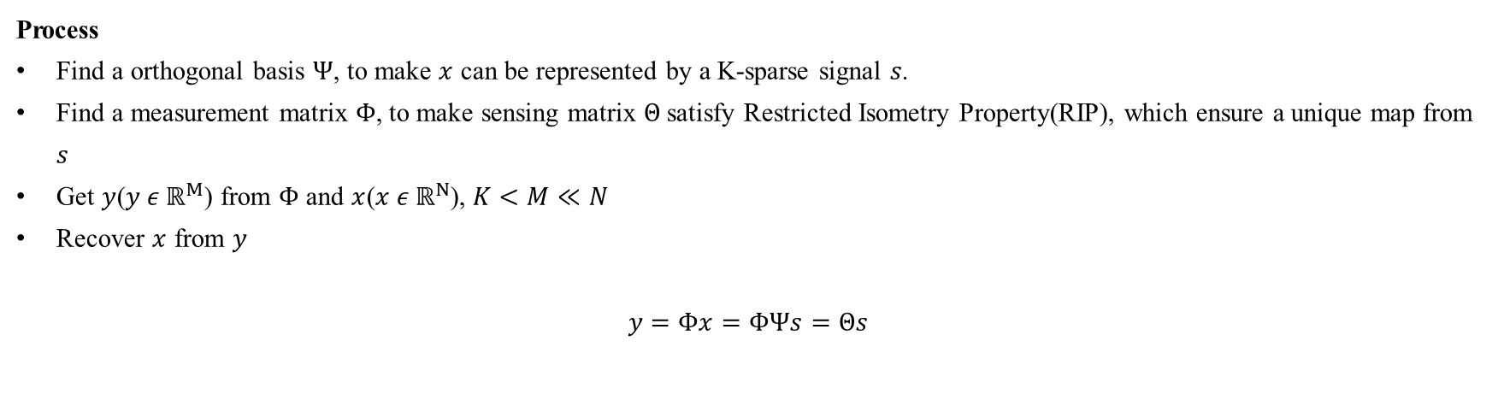
Unsupervised Learning
3.4 Compressive Sensing
3.4.2 Algorithm
Process
Find a orthogonal basis $Ψ$, to make $x$ can be represented by a K-sparse signal 𝑠.
Find a measurement matrix $Φ$, to make sensing matrix $Θ$satisfy Restricted Isometry Property(RIP), which ensure a unique map from $s$
Get $y$($y ε ℝ^{M}$) from $Φ$ and $x$($x ε ℝ^{N}$), $K<M≪N$
Recover $x$ from $y$
$$y=Φx=ΦΨs=Θs$$
Source1 http://blog.csdn.net/zouxy09/article/details/8118329
Source2 http://blog.csdn.net/jbb0523/article/details/44565647

Slide 5
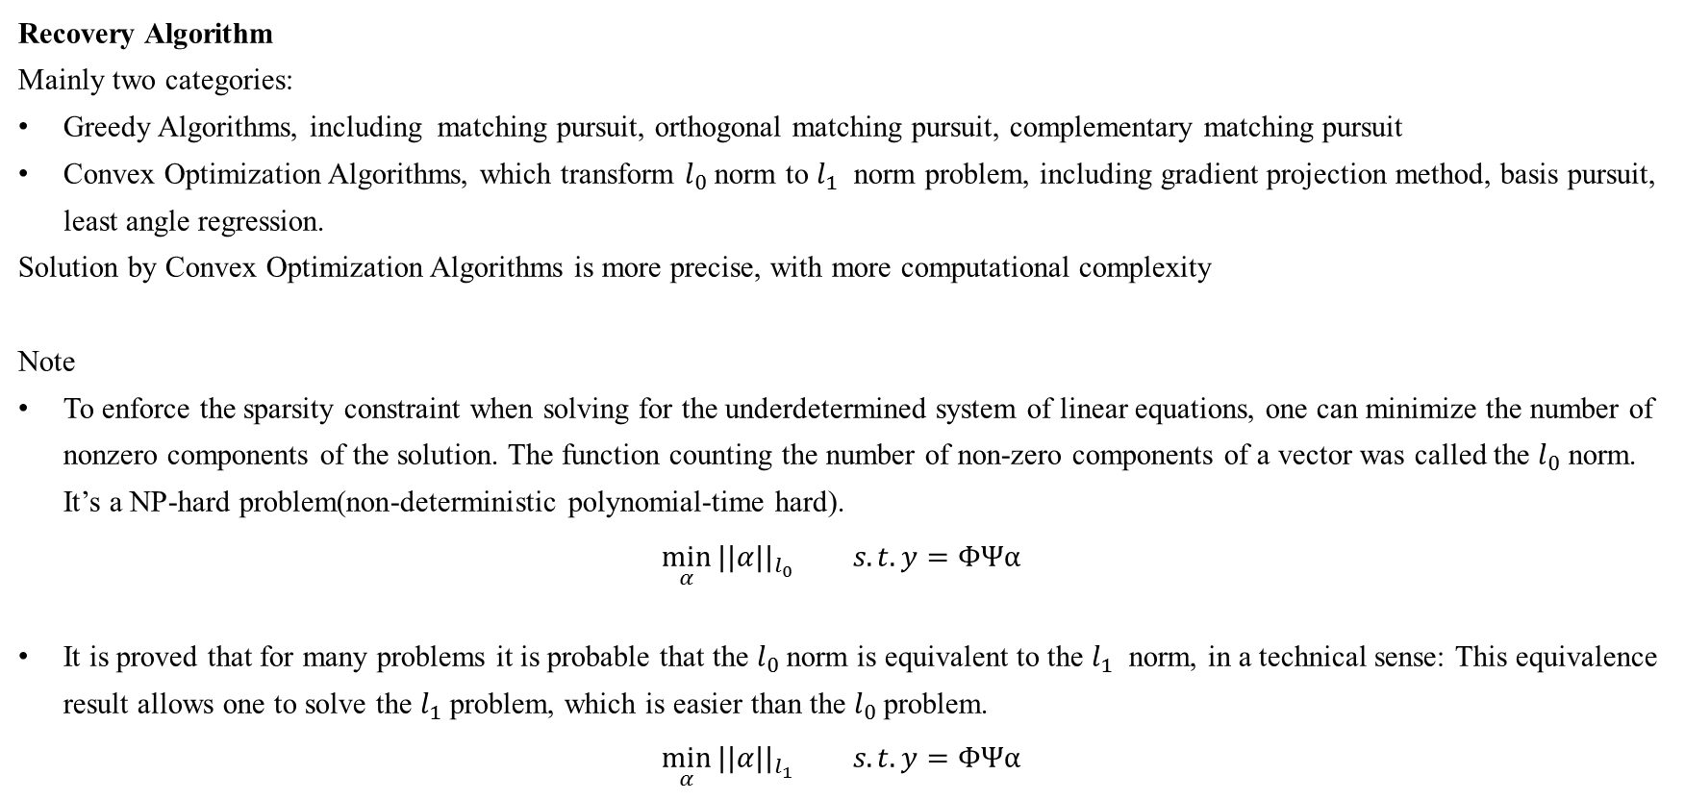
Unsupervised Learning
3.4 Compressive Sensing
3.4.2 Algorithm
Recovery Algorithm
Mainly two categories:
Greedy Algorithms, including matching pursuit, orthogonal matching pursuit, complementary matching pursuit
Convex Optimization Algorithms, which transform $l_{0}$norm to $l_{1}$ norm problem, including gradient projection method, basis pursuit, least angle regression.
Solution by Convex Optimization Algorithms is more precise, with more computational complexity
Note
To enforce the sparsity constraint when solving for the underdetermined system of linear equations, one can minimize the number of nonzero components of the solution. The function counting the number of non-zero components of a vector was called the $l_{0}$ norm. It’s a NP-hard problem(non-deterministic polynomial-time hard).
$$\min_{α}{{||α||}_{l_{0}}} s.t. y=ΦΨα$$
It is proved that for many problems it is probable that the $l_{0}$norm is equivalent to the $l_{1}$ norm, in a technical sense: This equivalence result allows one to solve the $l_{1}$problem, which is easier than the $l_{0}$problem.
$$\min_{α}{{||α||}_{l_{1}}} s.t. y=ΦΨα$$
Source1 http://blog.csdn.net/zouxy09/article/details/8118329
Source2 https://en.wikipedia.org/wiki/Compressed_sensing

