Slide 1
Unsupervised Learning
3.3 Auto-encoder
3.3.1 Feature Representation
input
prediction
input
prediction
Error
Error
?
target
How should we train the input-output mapping if we do not have target values?
Code has to retain information from the input
input
code

Slide 2
Unsupervised Learning
3.3 Auto-encoder
3.3.1 Feature Representation
Three of the most common ways of defining a simpler representation include
lower dimensional representations
sparse representations
independent representations
How to constrain the model to represent training samples?
Reconstruct the input from the code and make code compact (Auto-encoder with Bottleneck).
Reconstruct the input from the code and make code sparse (Sparse Auto-encoders)
Work in LeCun, Ng, Fergus, Lee, Yu’s labs
Input is partially corrupted(Denoising Auto-encoders)
Work in Y. Bengio, Lee's lab
Make sure that the model defines a distribution that normalizes to 1 (Restricted Boltzmann Machine).
Work in Y. Bengio, Hinton, Lee, Salakthudinov's lab

Slide 3
Unsupervised Learning
3.3 Auto-encoder
3.3.1 How to Use Feature Representation
Given unlabeled data, learn features
Use encoder to produce features and train another layer on the top
feed features to classifier and jointly train the whole system
input
prediction
label

Slide 4
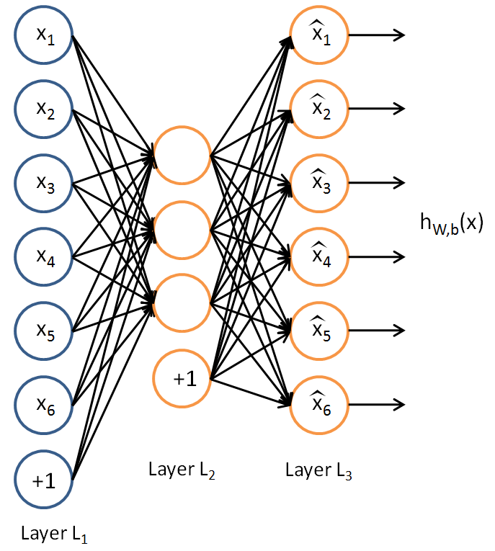
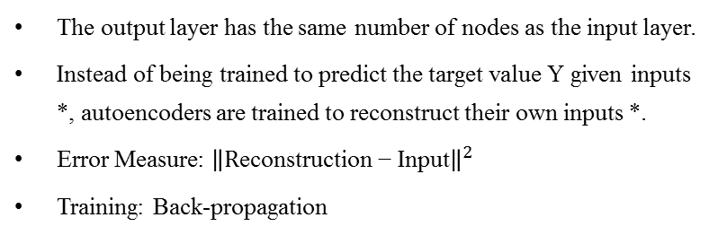
Unsupervised Learning
3.3 Auto-encoder
3.3.2 Basic Auto-encoder Introduction
The output layer has the same number of nodes as the input layer.
Instead of being trained to predict the target value Y given inputs *, autoencoders are trained to reconstruct their own inputs *.
Error Measure: ${\left\|\text{R}\text{econstruction}\text{ − }\text{I}\text{nput}\right\|}^{2}$
Training: Back-propagation
input
code
reconstruction
encoder
decoder
Error
Imposing constraints on the network, and discover interesting structure about the data
limit the number of hidden units: If the input were completely random, this compression task would be very difficult. If there is structure in the data, for example, if some of the input features are correlated, then this algorithm will be able to discover some of those correlations. (Auto-encoder with Bottleneck)
Impose a sparsity constraint on the hidden units: Sparse coding is a class of unsupervised methods for learning sets of over-complete bases to represent data efficiently. The aim of sparse coding is to find a set of basis vectors such that we can represent an input vector as a linear combination of these basis vectors. The advantage of having an over-complete basis is that our basis vectors are better able to capture structures and patterns inherent in the input data. (Sparse Auto-encoders)
Add noise to the input: Train the autoencoder to reconstruct the input from a corrupted version of it, to force the hidden layer to discover more robust features and prevent it from simply learning the identity. (Denoising Auto-encoders)

Slide 5
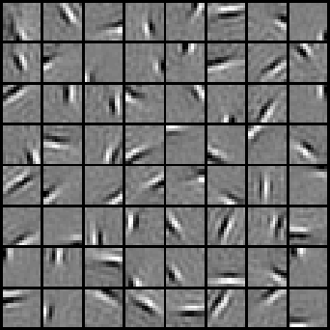



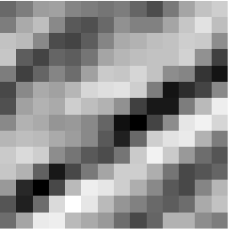
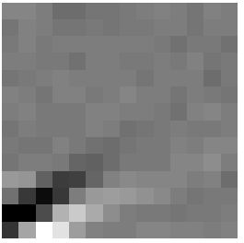
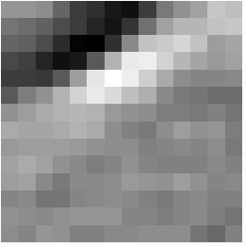
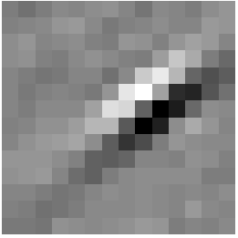
Unsupervised Learning
3.3 Auto-encoder
3.3.3 Sparse Coding
= 0.8 * + 0.3 * + 0.5 *
* » 0.8 * f₃₆ + 0.3 * f₄₂ + 0.5 * f₆₃
[a₁, …, a₆₄] = [0, 0, …, 0, 0.8, 0, …, 0, 0.3, 0, …, 0, 0.5, 0]
(feature representation)

Slide 6
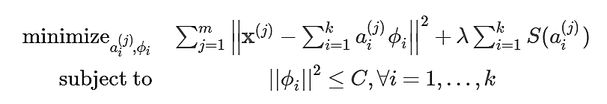
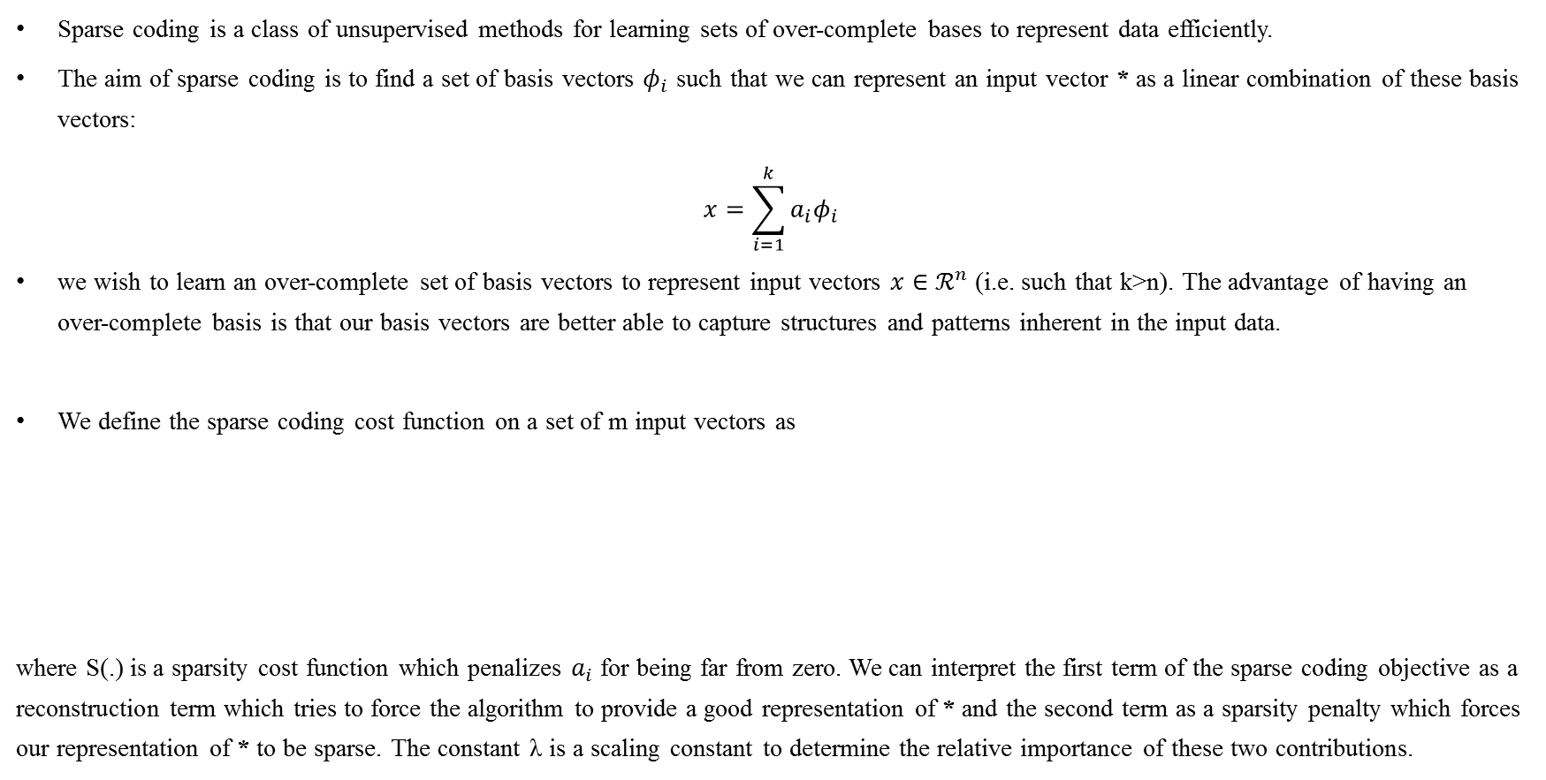
Unsupervised Learning
3.3 Auto-encoder
3.3.3 Sparse Coding
Sparse coding is a class of unsupervised methods for learning sets of over-complete bases to represent data efficiently.
The aim of sparse coding is to find a set of basis vectors $φ_{i}$ such that we can represent an input vector * as a linear combination of these basis vectors:
$$x=\sum_{i=1}^{k}{a_{i}φ_{i}}$$
we wish to learn an over-complete set of basis vectors to represent input vectors $x∈ℛ^{n}$ (i.e. such that k>n). The advantage of having an over-complete basis is that our basis vectors are better able to capture structures and patterns inherent in the input data.
We define the sparse coding cost function on a set of m input vectors as
where S(.) is a sparsity cost function which penalizes $a_{i}$ for being far from zero. We can interpret the first term of the sparse coding objective as a reconstruction term which tries to force the algorithm to provide a good representation of * and the second term as a sparsity penalty which forces our representation of * to be sparse. The constant λ is a scaling constant to determine the relative importance of these two contributions.

Slide 7
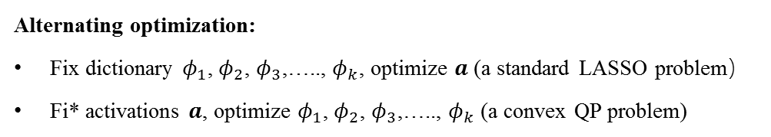
Unsupervised Learning
3.3 Auto-encoder
3.3.3 Sparse Coding
Alternating optimization:
Fix dictionary $φ_{1}$, $φ_{2}$, $φ_{3}$,….., $φ_{k}$, optimize $a$(a standard LASSO problem）
Fi* activations $a$, optimize $φ_{1}$, $φ_{2}$, $φ_{3}$,….., $φ_{k}$ (a convex QP problem)
Limitation
Even after a set of basis vectors have been learnt, in order to “encode” a new data example, optimization must be performed to obtain the required coefficients. This significant “runtime” cost means that sparse coding is computationally expensive to implement even at test time especially compared to typical feedforward architectures.

Slide 8
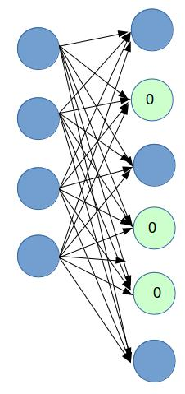
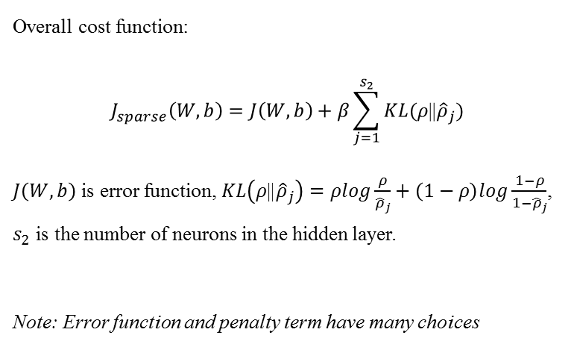
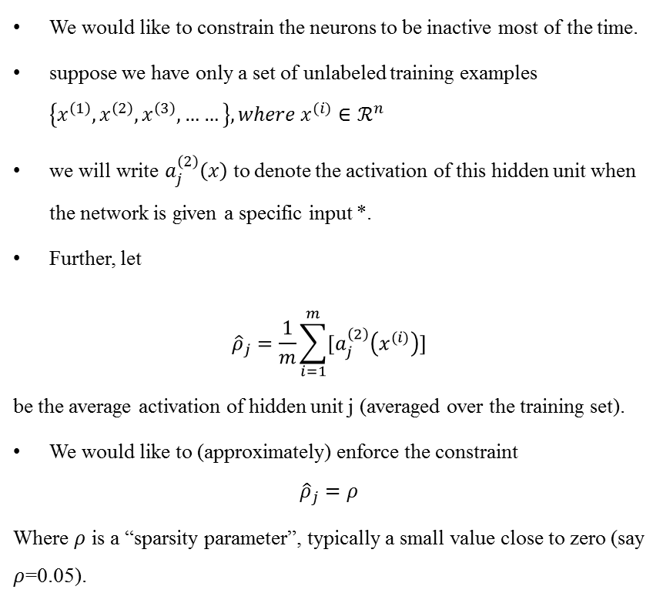
Unsupervised Learning
3.3 Auto-encoder
3.3.4 Sparse Auto-Encoder
We would like to constrain the neurons to be inactive most of the time.
suppose we have only a set of unlabeled training examples $\left\{x^{\left(1\right)}, x^{\left(2\right)}, x^{\left(3\right)}, ……\right\}, where x^{(i)}∈ℛ^{n}$
we will write $a_{j}^{\left(2\right)}\left(x\right)$ to denote the activation of this hidden unit when the network is given a specific input *.
Further, let
$${\hat{ρ}}_{j}=\frac{1}{m}\sum_{i=1}^{m}{[a_{j}^{\left(2\right)}\left(x^{(i)}\right)]}$$
be the average activation of hidden unit j (averaged over the training set).
We would like to (approximately) enforce the constraint
$${\hat{ρ}}_{j}=ρ$$
Where $ρ$ is a “sparsity parameter”, typically a small value close to zero (say $ρ$=0.05).
Overall cost function:
$$J_{sparse}\left(W,b\right)=J\left(W,b\right)+β\sum_{j=1}^{s_{2}}{KL(ρ\text{||}{\hat{ρ}}_{j})}$$
$J\left(W,b\right)$ is error function, $KL\left(ρ\text{||}{\hat{ρ}}_{j}\right)=ρlog\frac{ρ}{{\hat{ρ}}_{j}}+\left(1−ρ\right)log\frac{1−ρ}{1−{\hat{ρ}}_{j}}$, $s_{2}$ is the number of neurons in the hidden layer.
Note: Error function and penalty term have many choices
Sparsity Penalty
input
reconstruction
encoder
code
decoder
Error

Slide 9
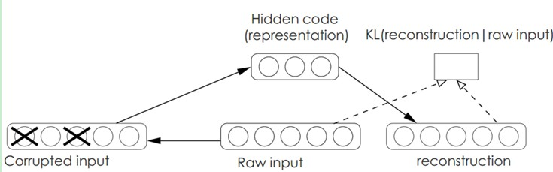
Unsupervised Learning
3.3 Auto-encoder
3.3.5 Denoising Auto-Encoder
Corrupt the input(e.g. set 25% of input to 0)
Reconstruct the uncorrupted input
Use uncorrupted encoding as input to next level
In order to force the hidden layer to discover more robust features and prevent it from simply learning the identity, we train the autoencoder to reconstruct the input from a corrupted version of it.
The denoising auto-encoder is a stochastic version of the auto-encoder. A denoising auto-encoder does two things: try to encode the input (preserve the information about the input), and try to undo the effect of a corruption process stochastically applied to the input of the auto-encoder. The latter can only be done by capturing the statistical dependencies between the inputs.

