Slide 1
Reinforcement Learning
4.1 Introduction
In reinforcement learning, the algorithm gets to choose an action in response to each data point. The learning algorithm also receives a reward signal a short time later, indicating how good the decision was. Based on this, the algorithm modifies its strategy in order to achieve the highest reward.
Reinforcement learning is common in robotics, where the set of sensor readings at one point in time is a data point, and the algorithm must choose the robot's next action. It is also a natural fit for Internet of Things applications.
In machine learning, the environment is typically formulated as a Markov decision process (MDP) as many reinforcement learning algorithms for this context utilize dynamic programming techniques. The main difference between the classical techniques and reinforcement learning algorithms is that the latter do not need knowledge about the MDP and they target large MDPs where exact methods become infeasible.
Reinforcement learning differs from standard supervised learning in that correct input/output pairs are never presented, nor sub-optimal actions explicitly corrected. Further, there is a focus on on-line performance, which involves finding a balance between exploration (of uncharted territory) and exploitation (of current knowledge).
Source1 https://azure.microsoft.com/en-us/documentation/articles/machine-learning-algorithm-choice/
Source2 https://en.wikipedia.org/wiki/Reinforcement_learning

Slide 2
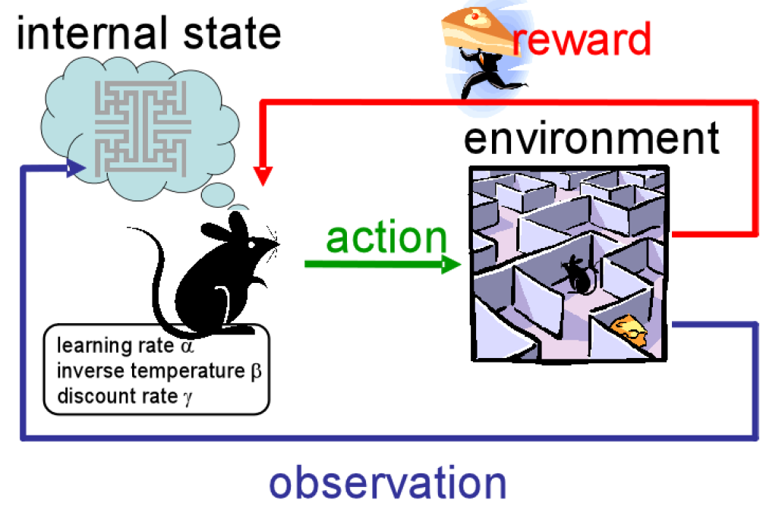
Reinforcement Learning
4.1 Introduction
Learning system in an unknown environment
Knowledge only through interacting with environment
Explores the environment and receives rewards
Find strategy/policy, which maximizes overall reward
Goal: Optimal behavior
Source Marc Deisenroth, Imperial College London, Tutorial on Reinforcement Learning, http://www.doc.ic.ac.uk/~mpd37/teaching/tutorials/2013-09-17-rl.pdf

Slide 3
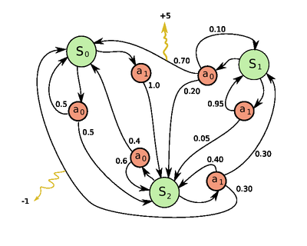
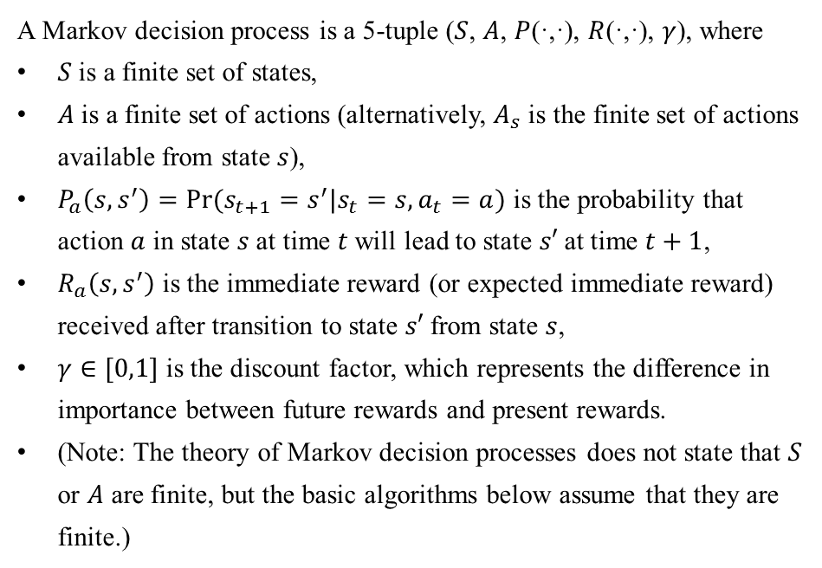
Reinforcement Learning
4.2 Markov Decision Process
4.2.1 Definition
A Markov decision process is a 5-tuple ($S$, $A$, $P$(·,·), $R$(·,·), $γ$), where
$S$is a finite set of states,
$A$is a finite set of actions (alternatively, $A_{s}$ is the finite set of actions available from state $s$),
$P_{a}\left(s,s^{′}\right)=Pr⁡(s_{t+1}=s^{′}|s_{t}=s,a_{t}=a)$ is the probability that action $a$ in state $s$ at time $t$ will lead to state $s′$at time $t+1$,
$R_{a}\left(s,s^{′}\right)$ is the immediate reward (or expected immediate reward) received after transition to state $s′$from state $s$,
$γ∈[0,1]$ is the discount factor, which represents the difference in importance between future rewards and present rewards.
(Note: The theory of Markov decision processes does not state that $S$ or $A$ are finite, but the basic algorithms below assume that they are finite.)
Example of a simple MDP with three states and two actions.
Source https://en.wikipedia.org/wiki/Markov_decision_process

Slide 4
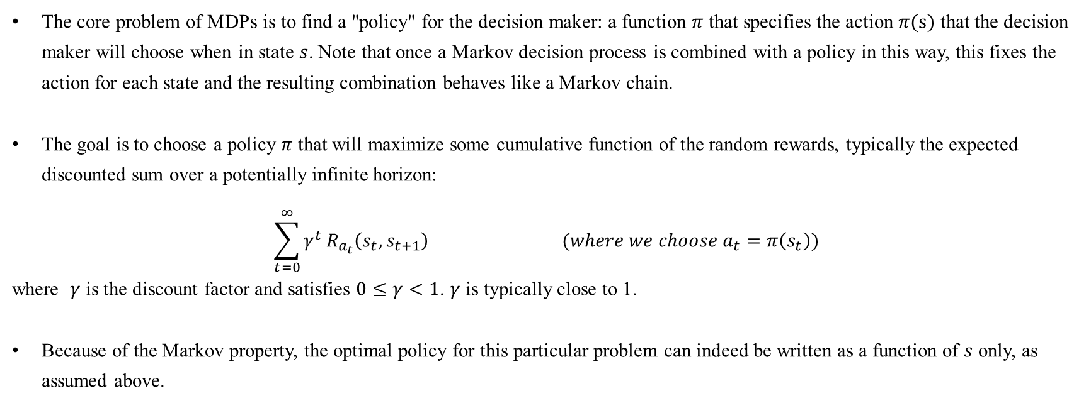
Reinforcement Learning
4.2 Markov Decision Process
4.2.2 Problem
The core problem of MDPs is to find a "policy" for the decision maker: a function $π$ that specifies the action $π(s)$ that the decision maker will choose when in state $s$. Note that once a Markov decision process is combined with a policy in this way, this fixes the action for each state and the resulting combination behaves like a Markov chain.
The goal is to choose a policy $π$ that will maximize some cumulative function of the random rewards, typically the expected discounted sum over a potentially infinite horizon:
$$\sum_{t=0}^{∞}{γ^{t}}R_{a_{t}}\left(s_{t},s_{t+1}\right) (where we choose a_{t}=π\left(s_{t}\right))$$
where $γ$ is the discount factor and satisfies $0≤γ<1$. $γ$ is typically close to 1.
Because of the Markov property, the optimal policy for this particular problem can indeed be written as a function of $s$ only, as assumed above.
Source https://en.wikipedia.org/wiki/Markov_decision_process

Slide 5
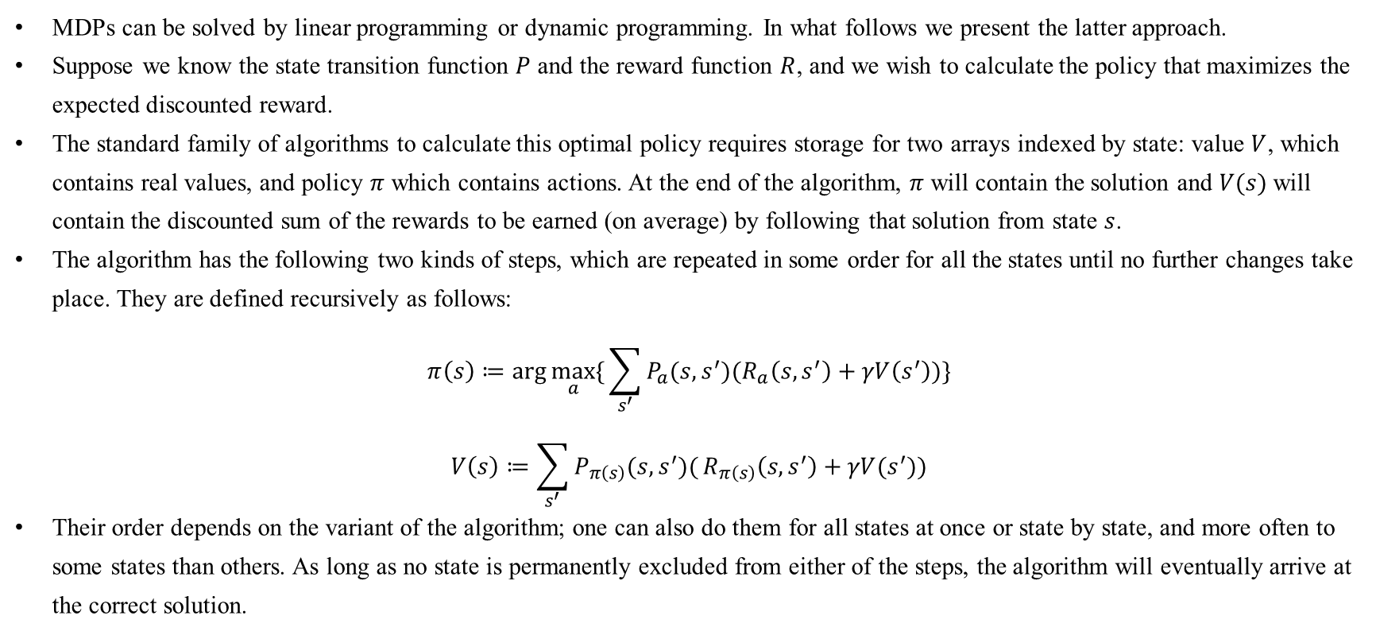
Reinforcement Learning
4.2 Markov Decision Process
4.2.3 Algorithms
MDPs can be solved by linear programming or dynamic programming. In what follows we present the latter approach.
Suppose we know the state transition function $P$ and the reward function $R$, and we wish to calculate the policy that maximizes the expected discounted reward.
The standard family of algorithms to calculate this optimal policy requires storage for two arrays indexed by state: value $V$, which contains real values, and policy $π$ which contains actions. At the end of the algorithm, $π$ will contain the solution and $V(s)$will contain the discounted sum of the rewards to be earned (on average) by following that solution from state $s$.
The algorithm has the following two kinds of steps, which are repeated in some order for all the states until no further changes take place. They are defined recursively as follows:
$$π\left(s\right)≔\arg{\max_{a}{\{}\sum_{s^{′}}{P_{a}(s,s^{′})(R_{a}\left(s,s^{′}\right)+γV\left(s^{′}\right))\}}}$$
$$V\left(s\right)≔\sum_{s^{′}}{P_{π\left(s\right)}(s,s^{′})(}R_{π\left(s\right)}\left(s,s^{′}\right)+γV(s^{′}))$$
Their order depends on the variant of the algorithm; one can also do them for all states at once or state by state, and more often to some states than others. As long as no state is permanently excluded from either of the steps, the algorithm will eventually arrive at the correct solution.
Source https://en.wikipedia.org/wiki/Markov_decision_process

Slide 6
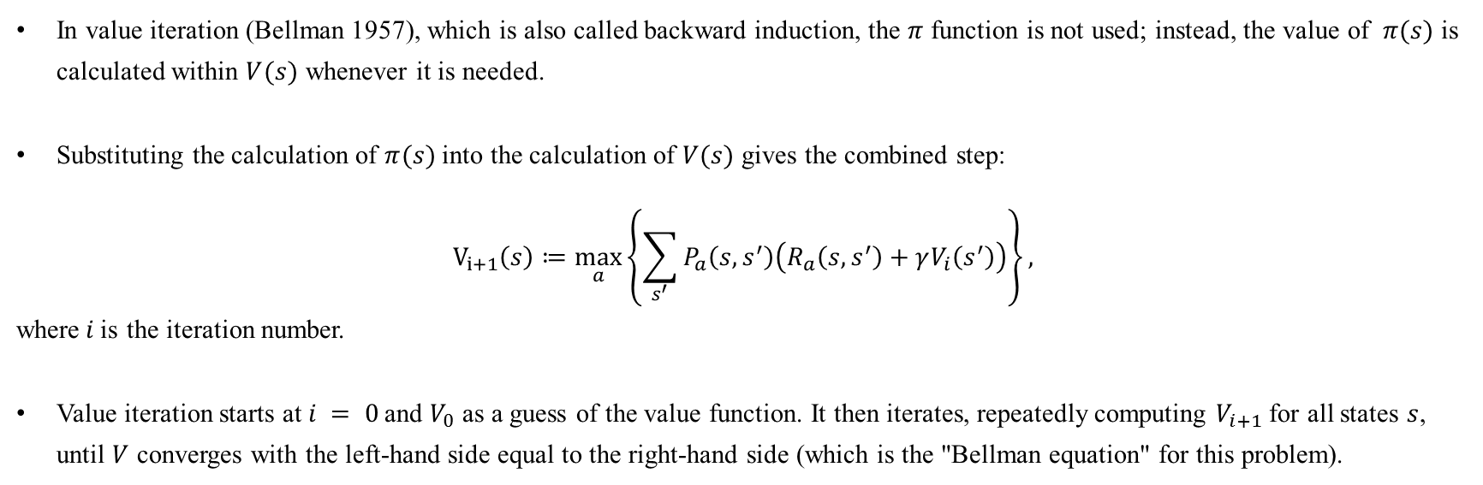
Reinforcement Learning
4.2 Markov Decision Process
4.2.3 Algorithms: Value iteration
In value iteration (Bellman 1957), which is also called backward induction, the $π$ function is not used; instead, the value of $π(s)$ is calculated within $V(s)$ whenever it is needed.
Substituting the calculation of $π(s)$ into the calculation of $V(s)$ gives the combined step:
$$V_{i+1}\left(s\right)≔\max_{a}\left\{\sum_{s^{′}}{P_{a}\left(s,s^{′}\right)\left(R_{a}\left(s,s^{′}\right)+γV_{i}\left(s^{′}\right)\right)}\right\},$$
where$i$is the iteration number.
Value iteration starts at $i = 0$and $V_{0}$ as a guess of the value function. It then iterates, repeatedly computing $V_{i+1}$ for all states $s$, until $V$ converges with the left-hand side equal to the right-hand side (which is the "Bellman equation" for this problem).
Source https://en.wikipedia.org/wiki/Markov_decision_process

Slide 7
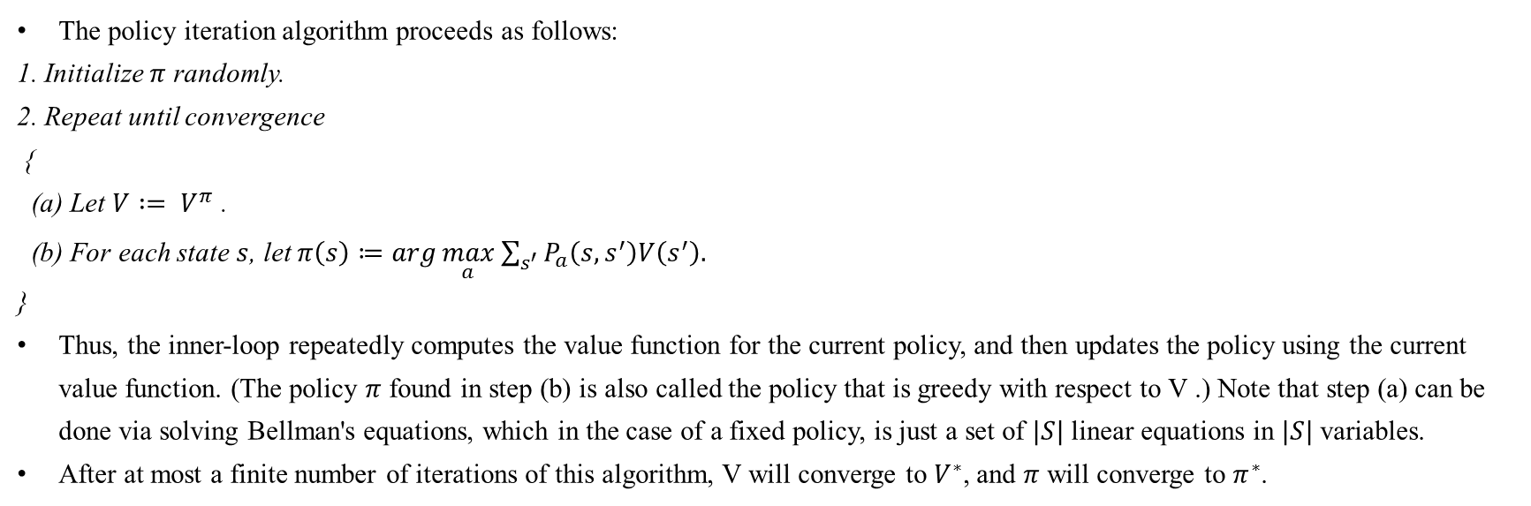
Reinforcement Learning
4.2 Markov Decision Process
4.2.3 Algorithms: Policy iteration
The policy iteration algorithm proceeds as follows:
1. Initialize $π$ randomly.
2. Repeat until convergence
{
(a) Let $V := V^{π}$ .
(b) For each state $s$, let $π\left(s\right)≔\arg{\max_{a}{\sum_{s^{′}}{P_{a}\left(s,s^{′}\right)V\left(s^{′}\right).}}}$
}
Thus, the inner-loop repeatedly computes the value function for the current policy, and then updates the policy using the current value function. (The policy $π$ found in step (b) is also called the policy that is greedy with respect to V .) Note that step (a) can be done via solving Bellman's equations, which in the case of a fixed policy, is just a set of $|S|$linear equations in $|S|$variables.
After at most a finite number of iterations of this algorithm, V will converge to $V^{∗}$, and $π$ will converge to $π^{∗}$.
Source Andrew Ng, Stanford CS229 Lecture notes, Reinforcement Learning and Control, https://see.stanford.edu/materials/aimlcs229/cs229-notes12.pdf

Slide 8
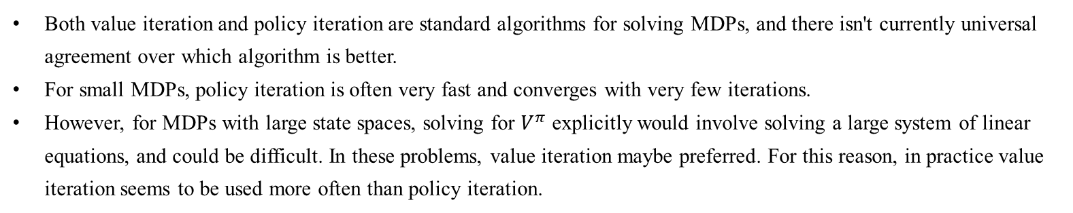
Reinforcement Learning
4.2 Markov Decision Process
4.2.3 Algorithms
Both value iteration and policy iteration are standard algorithms for solving MDPs, and there isn't currently universal agreement over which algorithm is better.
For small MDPs, policy iteration is often very fast and converges with very few iterations.
However, for MDPs with large state spaces, solving for $V^{π}$ explicitly would involve solving a large system of linear equations, and could be difficult. In these problems, value iteration maybe preferred. For this reason, in practice value iteration seems to be used more often than policy iteration.
Source https://en.wikipedia.org/wiki/Markov_decision_process

Slide 9
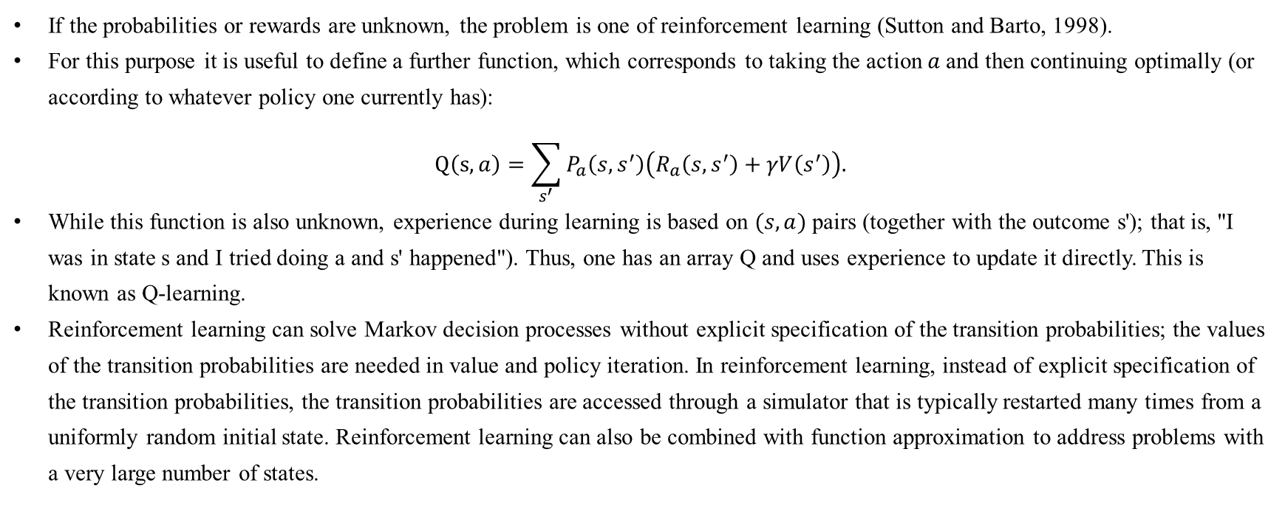
Reinforcement Learning
4.2 Markov Decision Process
4.2.4 Reinforcement learning
If the probabilities or rewards are unknown, the problem is one of reinforcement learning (Sutton and Barto, 1998).
For this purpose it is useful to define a further function, which corresponds to taking the action$a$and then continuing optimally (or according to whatever policy one currently has):
$$Q\left(s,a\right)=\sum_{s^{′}}{P_{a}\left(s,s^{′}\right)\left(R_{a}\left(s,s^{′}\right)+γV\left(s^{′}\right)\right).}$$
While this function is also unknown, experience during learning is based on $(s, a)$pairs (together with the outcome s'); that is, "I was in state s and I tried doing a and s' happened"). Thus, one has an array Q and uses experience to update it directly. This is known as Q‑learning.
Reinforcement learning can solve Markov decision processes without explicit specification of the transition probabilities; the values of the transition probabilities are needed in value and policy iteration. In reinforcement learning, instead of explicit specification of the transition probabilities, the transition probabilities are accessed through a simulator that is typically restarted many times from a uniformly random initial state. Reinforcement learning can also be combined with function approximation to address problems with a very large number of states.
Source https://en.wikipedia.org/wiki/Markov_decision_process

Slide 10
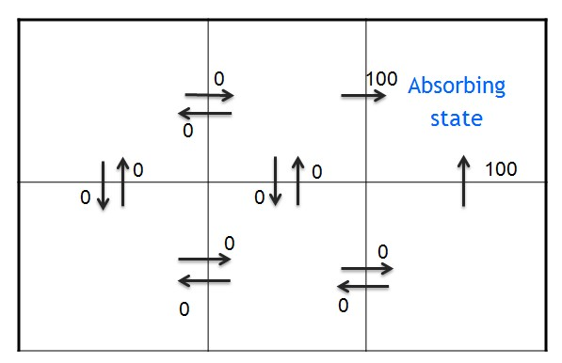
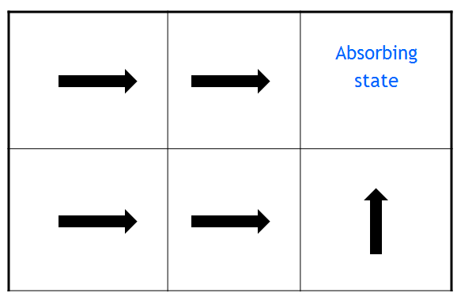
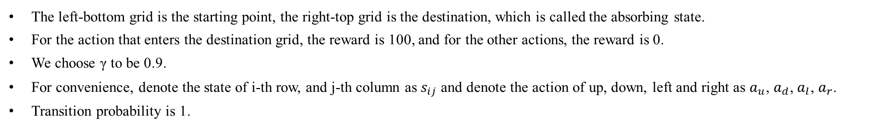
Reinforcement Learning
4.2 Markov Decision Process
4.2.5 Example
The left-bottom grid is the starting point, the right-top grid is the destination, which is called the absorbing state.
For the action that enters the destination grid, the reward is 100, and for the other actions, the reward is 0.
We choose γ to be 0.9.
For convenience, denote the state of i-th row, and j-th column as $s_{ij}$ and denote the action of up, down, left and right as $a_{u}$, $a_{d}$, $a_{l}$, $a_{r}$.
Transition probability is 1.
Reward
A fixed policy
Source http://www.cnblogs.com/jinxulin/p/3517377.html

Slide 11
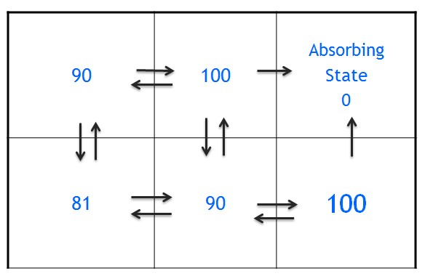
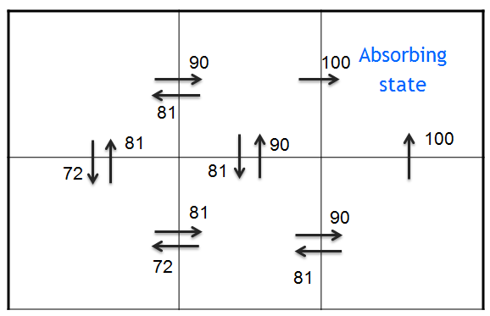
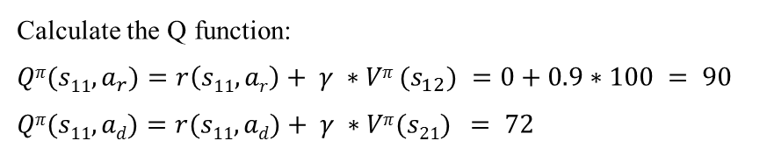
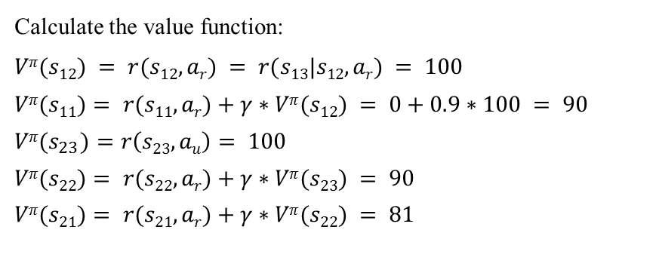
Reinforcement Learning
4.2 Markov Decision Process
4.2.5 Example
Calculate the value function:
$$Vπ(s12) = r(s12,ar) = r(s13|s12,ar) = 100$$
$$Vπ(s11)= r(s11,ar)+γ∗Vπ(s12) = 0+0.9∗100 = 90$$
$$Vπ(s_{23})=r\left(s23,au\right)= 100$$
$$Vπ(s22)= r(s22,ar)+γ∗Vπ(s23) = 90$$
$$Vπ(s21)= r(s21,ar)+γ∗Vπ(s22) = 81$$
Value function
Calculate the Q function:
$$Qπ(s11,a_{r})=r\left(s11,ar\right)+ γ ∗Vπ (s_{12}) =0+0.9∗100 = 90$$
$$Qπ(s11,ad)=r(s11,ad)+ γ ∗Vπ(s21) = 72$$
Q function
Source http://www.cnblogs.com/jinxulin/p/3517377.html

Slide 12
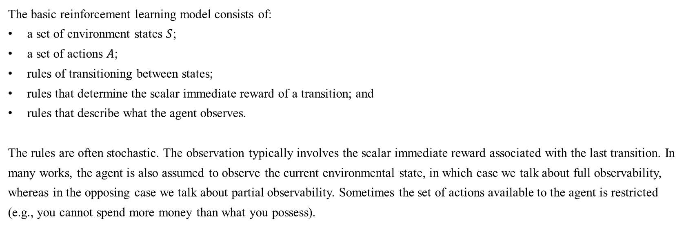
Reinforcement Learning
4.3 Reinforcement Learning
4.3.1 Introduction
The basic reinforcement learning model consists of:
a set of environment states $S$;
a set of actions $A$;
rules of transitioning between states;
rules that determine the scalar immediate reward of a transition; and
rules that describe what the agent observes.
The rules are often stochastic. The observation typically involves the scalar immediate reward associated with the last transition. In many works, the agent is also assumed to observe the current environmental state, in which case we talk about full observability, whereas in the opposing case we talk about partial observability. Sometimes the set of actions available to the agent is restricted (e.g., you cannot spend more money than what you possess).
Source https://en.wikipedia.org/wiki/Reinforcement_learning

Slide 13
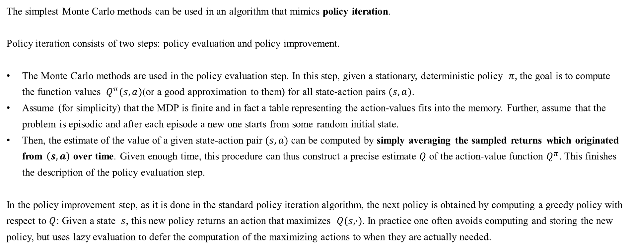
Reinforcement Learning
4.3 Reinforcement Learning
4.3.2 Algorithm: Monte Carlo methods
The simplest Monte Carlo methods can be used in an algorithm that mimics policy iteration.
Policy iteration consists of two steps: policy evaluation and policy improvement.
The Monte Carlo methods are used in the policy evaluation step. In this step, given a stationary, deterministic policy $π$, the goal is to compute the function values $Q^{π}(s,a)$(or a good approximation to them) for all state-action pairs $(s,a)$.
Assume (for simplicity) that the MDP is finite and in fact a table representing the action-values fits into the memory. Further, assume that the problem is episodic and after each episode a new one starts from some random initial state.
Then, the estimate of the value of a given state-action pair $(s,a)$ can be computed by simply averaging the sampled returns which originated from $\left(s,a\right)$ over time. Given enough time, this procedure can thus construct a precise estimate $Q$ of the action-value function $Q^{π}$. This finishes the description of the policy evaluation step.
In the policy improvement step, as it is done in the standard policy iteration algorithm, the next policy is obtained by computing a greedy policy with respect to $Q$: Given a state $s$, this new policy returns an action that maximizes $Q(s,∙)$. In practice one often avoids computing and storing the new policy, but uses lazy evaluation to defer the computation of the maximizing actions to when they are actually needed.
Source http://mnemstudio.org/path-finding-q-learning-tutorial.htm

Slide 14
Reinforcement Learning
4.3 Reinforcement Learning
4.3.2 Algorithm: Monte Carlo methods
A few problems with this procedure are as follows:
The procedure may waste too much time on evaluating a suboptimal policy;
It uses samples inefficiently in that a long trajectory is used to improve the estimate only of the single state-action pair that started the trajectory;
When the returns along the trajectories have high variance, convergence will be slow;
It works in episodic problems only;
It works in small, finite MDPs only.
Source http://mnemstudio.org/path-finding-q-learning-tutorial.htm

Slide 15
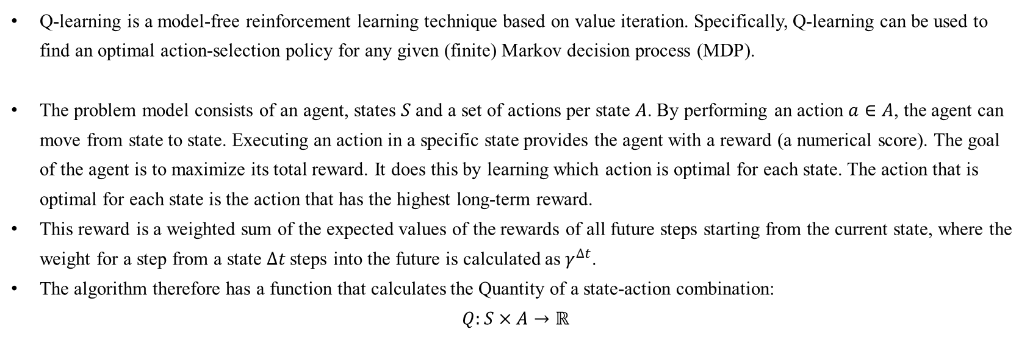
Reinforcement Learning
4.3 Reinforcement Learning
4.3.3 Algorithm: Q-learning
Q-learning is a model-free reinforcement learning technique based on value iteration. Specifically, Q-learning can be used to find an optimal action-selection policy for any given (finite) Markov decision process (MDP).
The problem model consists of an agent, states $S$ and a set of actions per state $A$. By performing an action $a∈A$, the agent can move from state to state. Executing an action in a specific state provides the agent with a reward (a numerical score). The goal of the agent is to maximize its total reward. It does this by learning which action is optimal for each state. The action that is optimal for each state is the action that has the highest long-term reward.
This reward is a weighted sum of the expected values of the rewards of all future steps starting from the current state, where the weight for a step from a state $∆t$ steps into the future is calculated as $γ^{∆t}$.
The algorithm therefore has a function that calculates the Quantity of a state-action combination:
$$Q:S×A→ℝ$$
Source https://en.wikipedia.org/wiki/Q-learning

Slide 16
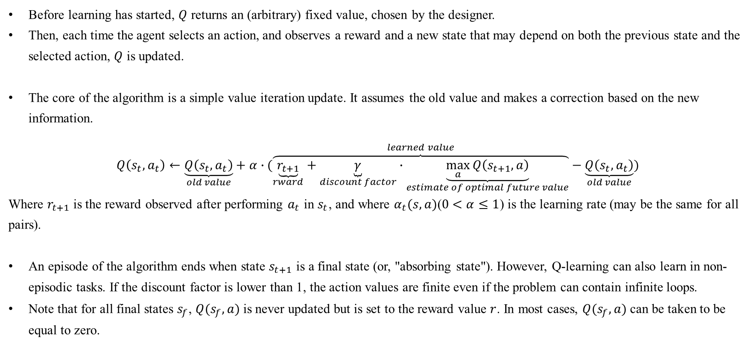
Reinforcement Learning
4.3 Reinforcement Learning
4.3.3 Algorithm: Q-learning
Before learning has started, $Q$ returns an (arbitrary) fixed value, chosen by the designer.
Then, each time the agent selects an action, and observes a reward and a new state that may depend on both the previous state and the selected action, $Q$ is updated.
The core of the algorithm is a simple value iteration update. It assumes the old value and makes a correction based on the new information.
$$Q\left(s_{t},a_{t}\right)←\underset{old value}{\underbrace{Q\left(s_{t},a_{t}\right)}}+α∙(\overset{learned value}{\overbrace{\underset{rward}{\underbrace{r_{t+1}}}+\underset{discount factor}{\underbrace{γ}}∙\underset{estimate of optimal future value}{\underbrace{\max_{a}{Q\left(s_{t+1},a\right)}}}}}−\underset{old value}{\underbrace{Q\left(s_{t},a_{t}\right)}})$$
Where $r_{t+1}$ is the reward observed after performing $a_{t}$ in $s_{t}$, and where $α_{t}(s,a)$($0<α≤1$) is the learning rate (may be the same for all pairs).
An episode of the algorithm ends when state $s_{t+1}$ is a final state (or, "absorbing state"). However, Q-learning can also learn in non-episodic tasks. If the discount factor is lower than 1, the action values are finite even if the problem can contain infinite loops.
Note that for all final states $s_{f}$, $Q(s_{f},a)$is never updated but is set to the reward value $r$. In most cases, $Q(s_{f},a)$can be taken to be equal to zero.
Source https://en.wikipedia.org/wiki/Q-learning

Slide 17
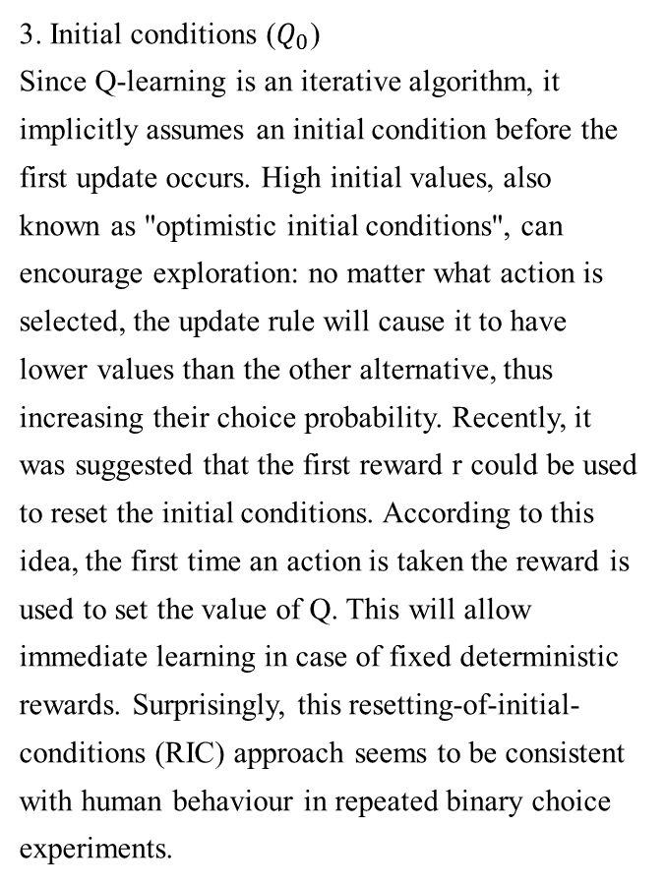
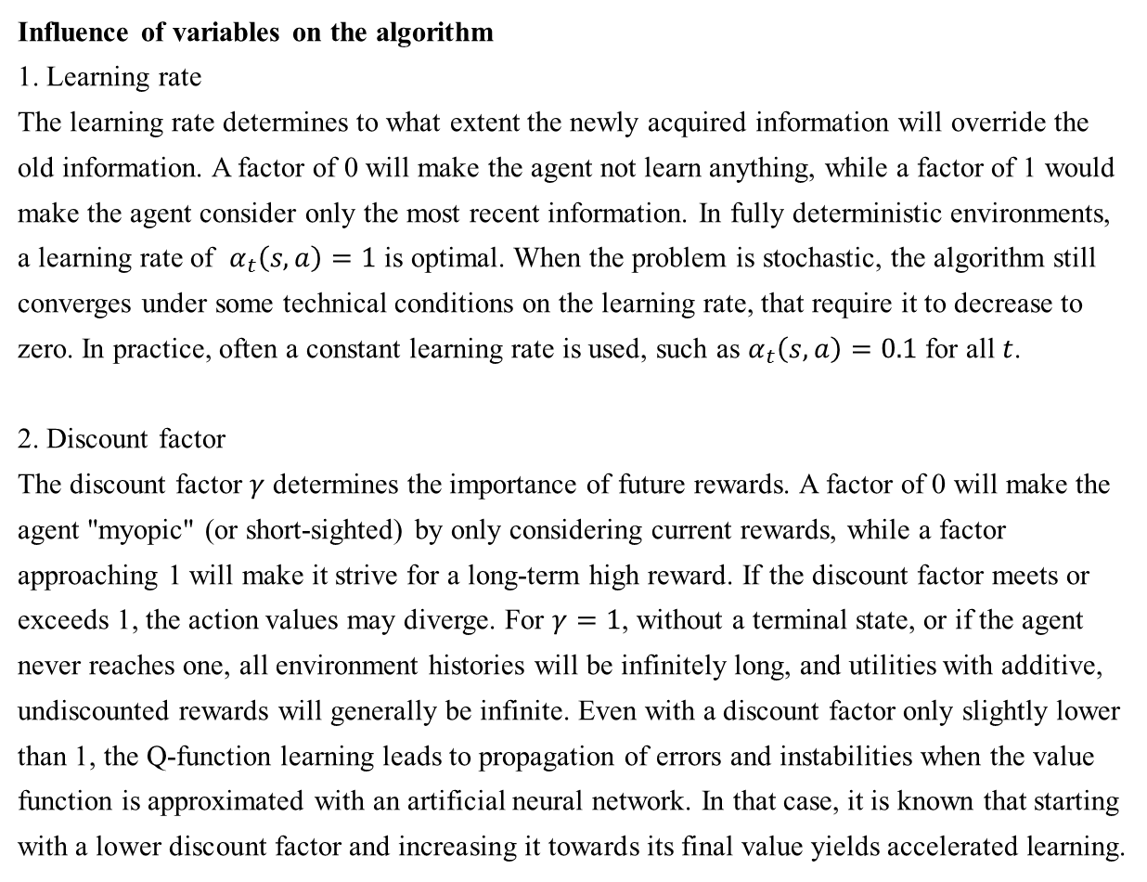
Reinforcement Learning
4.3 Reinforcement Learning
4.3.3 Algorithm: Q-learning
Influence of variables on the algorithm
1. Learning rate
The learning rate determines to what extent the newly acquired information will override the old information. A factor of 0 will make the agent not learn anything, while a factor of 1 would make the agent consider only the most recent information. In fully deterministic environments, a learning rate of $α_{t}\left(s,a\right)=1$ is optimal. When the problem is stochastic, the algorithm still converges under some technical conditions on the learning rate, that require it to decrease to zero. In practice, often a constant learning rate is used, such as $α_{t}\left(s,a\right)=0.1$ for all $t$.
2. Discount factor
The discount factor $γ$ determines the importance of future rewards. A factor of 0 will make the agent "myopic" (or short-sighted) by only considering current rewards, while a factor approaching 1 will make it strive for a long-term high reward. If the discount factor meets or exceeds 1, the action values may diverge. For $γ=1$, without a terminal state, or if the agent never reaches one, all environment histories will be infinitely long, and utilities with additive, undiscounted rewards will generally be infinite. Even with a discount factor only slightly lower than 1, the Q-function learning leads to propagation of errors and instabilities when the value function is approximated with an artificial neural network. In that case, it is known that starting with a lower discount factor and increasing it towards its final value yields accelerated learning.
3. Initial conditions ($Q_{0}$)
Since Q-learning is an iterative algorithm, it implicitly assumes an initial condition before the first update occurs. High initial values, also known as "optimistic initial conditions", can encourage exploration: no matter what action is selected, the update rule will cause it to have lower values than the other alternative, thus increasing their choice probability. Recently, it was suggested that the first reward r could be used to reset the initial conditions. According to this idea, the first time an action is taken the reward is used to set the value of Q. This will allow immediate learning in case of fixed deterministic rewards. Surprisingly, this resetting-of-initial-conditions (RIC) approach seems to be consistent with human behaviour in repeated binary choice experiments.
Source https://en.wikipedia.org/wiki/Q-learningt

Slide 18
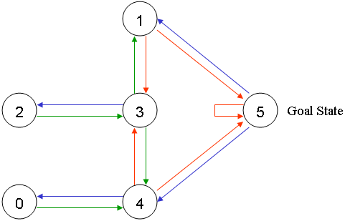
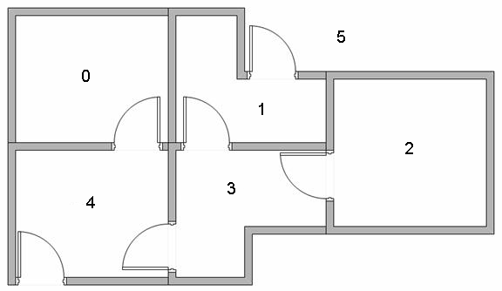
Reinforcement Learning
4.3 Reinforcement Learning
4.3.3 Algorithm: Q-learning: Example
Suppose we have 5 rooms in a building connected by doors as shown in the figure below.
We'll number each room 0 through 4.
The outside of the building can be thought of as one big room (5).
Notice that doors 1 and 4 lead into the building from room 5 (outside).
We can represent the rooms on a graph, each room as a node, and each door as a link.
Source http://mnemstudio.org/path-finding-q-learning-tutorial.htm

Slide 19
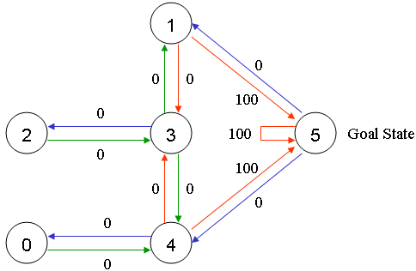
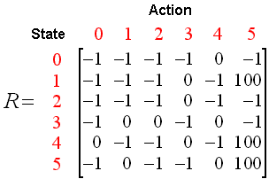
Reinforcement Learning
4.3 Reinforcement Learning
4.3.3 Algorithm: Q-learning: Example
For this example, we'd like to put an agent in any room, and from that room, go outside the building (this will be our target room). In other words, the goal room is number 5.
To set this room as a goal, we'll associate a reward value to each door (i.e. link between nodes). The doors that lead immediately to the goal have an instant reward of 100. Other doors not directly connected to the target room have zero reward.
Because doors are two-way ( 0 leads to 4, and 4 leads back to 0 ), two arrows are assigned to each room. Each arrow contains an instant reward value.
We can put the state diagram and the instant reward values into the following reward table, "matrix R".
Note: The -1's in the table represent null values (i.e.; where there isn't a link between nodes). For example, State 0 cannot go to State 1.
Source http://mnemstudio.org/path-finding-q-learning-tutorial.htm

Slide 20
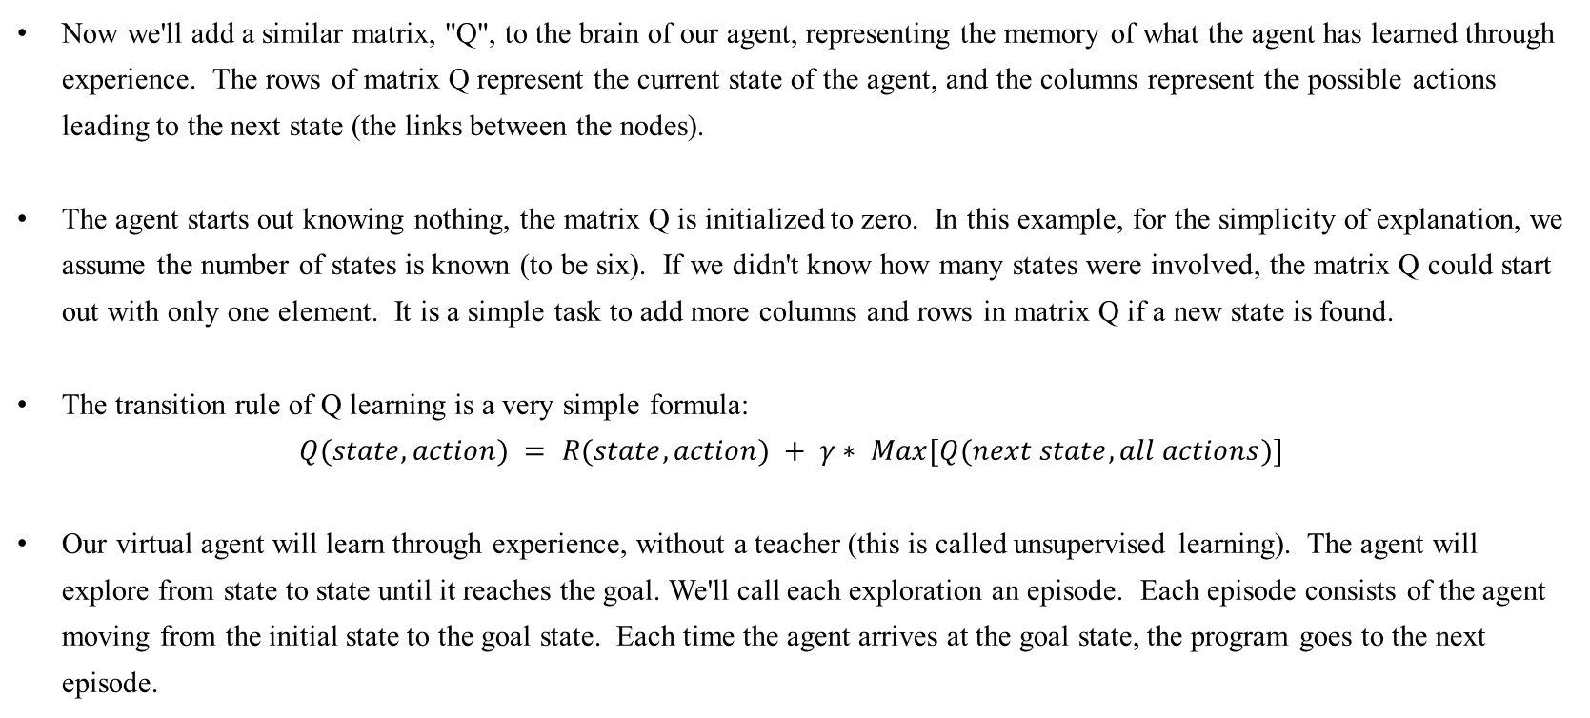
Reinforcement Learning
4.3 Reinforcement Learning
4.3.3 Algorithm: Q-learning: Example
Now we'll add a similar matrix, "Q", to the brain of our agent, representing the memory of what the agent has learned through experience. The rows of matrix Q represent the current state of the agent, and the columns represent the possible actions leading to the next state (the links between the nodes).
The agent starts out knowing nothing, the matrix Q is initialized to zero. In this example, for the simplicity of explanation, we assume the number of states is known (to be six). If we didn't know how many states were involved, the matrix Q could start out with only one element. It is a simple task to add more columns and rows in matrix Q if a new state is found.
The transition rule of Q learning is a very simple formula:
$$Q(state, action) = R(state, action) + γ∗ Max[Q(next state, all actions)]$$
Our virtual agent will learn through experience, without a teacher (this is called unsupervised learning). The agent will explore from state to state until it reaches the goal. We'll call each exploration an episode. Each episode consists of the agent moving from the initial state to the goal state. Each time the agent arrives at the goal state, the program goes to the next episode.
Source http://mnemstudio.org/path-finding-q-learning-tutorial.htm

Slide 21
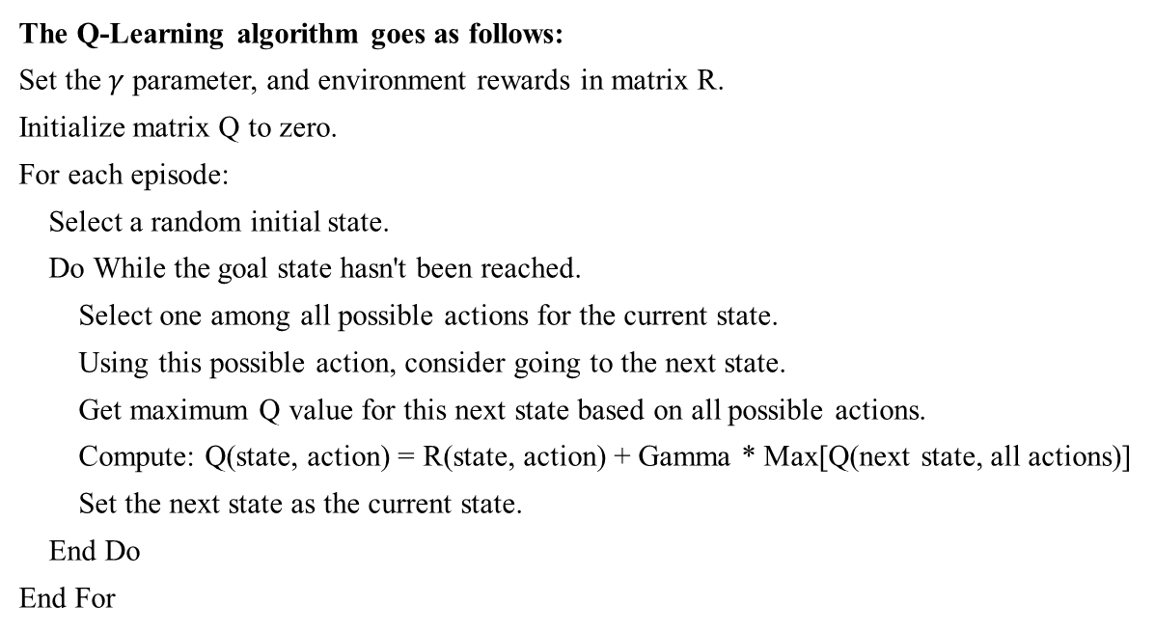
Reinforcement Learning
4.3 Reinforcement Learning
4.3.3 Algorithm: Q-learning: Example
The Q-Learning algorithm goes as follows:
Set the $γ$ parameter, and environment rewards in matrix R.
Initialize matrix Q to zero.
For each episode:
Select a random initial state.
Do While the goal state hasn't been reached.
Select one among all possible actions for the current state.
Using this possible action, consider going to the next state.
Get maximum Q value for this next state based on all possible actions.
Compute: Q(state, action) = R(state, action) + Gamma * Max[Q(next state, all actions)]
Set the next state as the current state.
End Do
End For
Source http://mnemstudio.org/path-finding-q-learning-tutorial.htm

Slide 22
Reinforcement Learning
4.3 Reinforcement Learning
4.3.3 Algorithm: Q-learning: Example
To use the matrix Q, the agent simply traces the sequence of states, from the initial state to goal state. The algorithm finds the actions with the highest reward values recorded in matrix Q for current state.
Algorithm to utilize the Q matrix:
Set current state = initial state.
From current state, find the action with the highest Q value.
Set current state = next state.
Repeat Steps 2 and 3 until current state = goal state.
The algorithm above will return the sequence of states from the initial state to the goal state.
Source http://mnemstudio.org/path-finding-q-learning-tutorial.htm

Slide 23
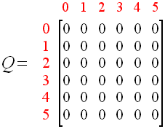
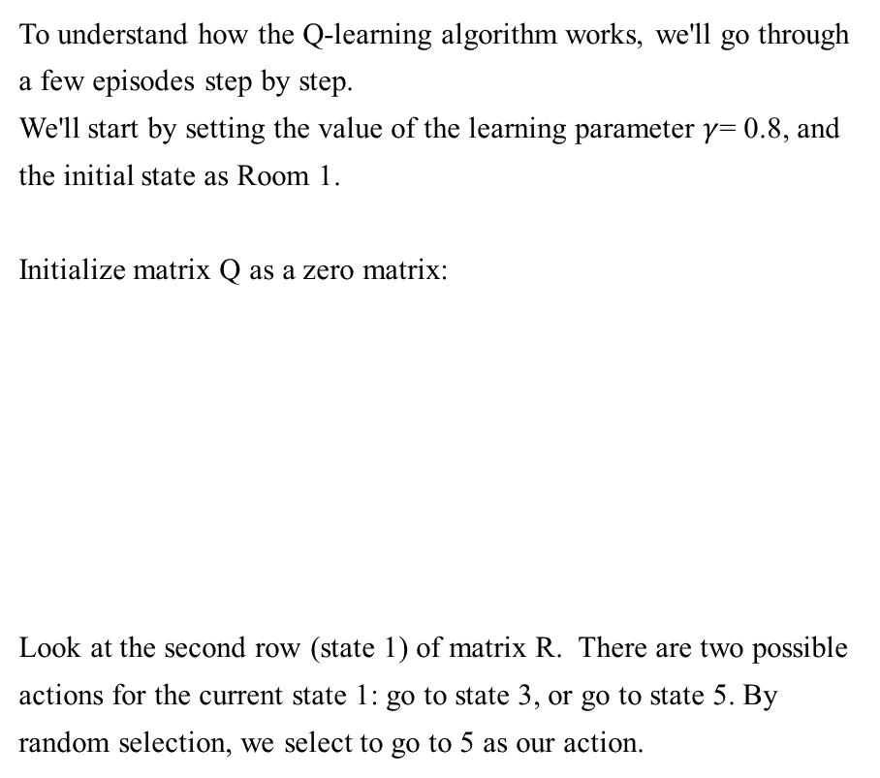
Reinforcement Learning
4.3 Reinforcement Learning
4.3.3 Algorithm: Q-learning: Example
To understand how the Q-learning algorithm works, we'll go through a few episodes step by step.
We'll start by setting the value of the learning parameter $γ$= 0.8, and the initial state as Room 1.
Initialize matrix Q as a zero matrix:
Look at the second row (state 1) of matrix R. There are two possible actions for the current state 1: go to state 3, or go to state 5. By random selection, we select to go to 5 as our action.
Source http://mnemstudio.org/path-finding-q-learning-tutorial.htm

Slide 24
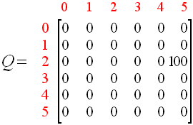
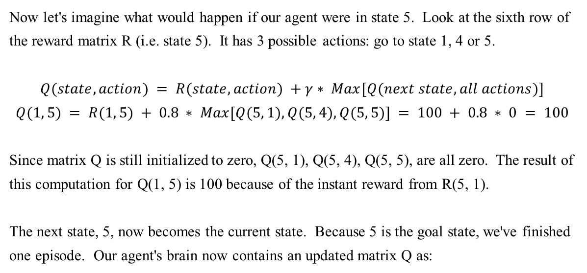
Reinforcement Learning
4.3 Reinforcement Learning
4.3.3 Algorithm: Q-learning: Example
Now let's imagine what would happen if our agent were in state 5. Look at the sixth row of the reward matrix R (i.e. state 5). It has 3 possible actions: go to state 1, 4 or 5.
$$Q(state, action) = R(state, action) +γ∗ Max[Q(next state, all actions)]$$
$$Q(1, 5) = R(1, 5) + 0.8 ∗ Max[Q(5, 1), Q(5, 4), Q(5, 5)] = 100 + 0.8 ∗ 0 = 100$$
Since matrix Q is still initialized to zero, Q(5, 1), Q(5, 4), Q(5, 5), are all zero. The result of this computation for Q(1, 5) is 100 because of the instant reward from R(5, 1).
The next state, 5, now becomes the current state. Because 5 is the goal state, we've finished one episode. Our agent's brain now contains an updated matrix Q as:
Source http://mnemstudio.org/path-finding-q-learning-tutorial.htm

Slide 25
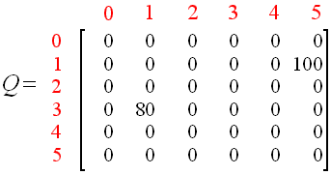
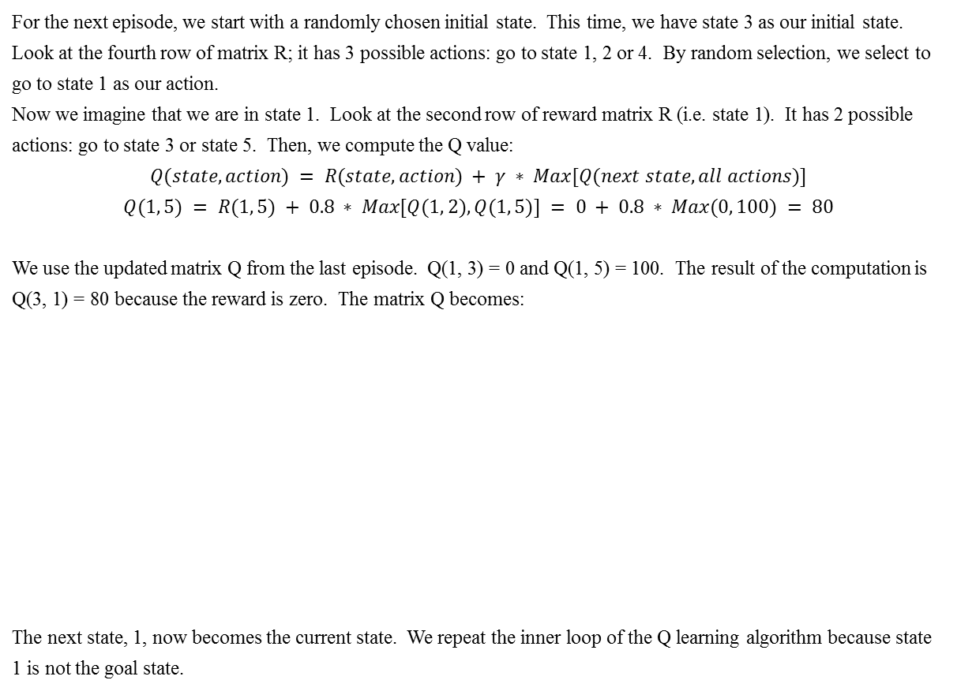
Reinforcement Learning
4.3 Reinforcement Learning
4.3.3 Algorithm: Q-learning: Example
For the next episode, we start with a randomly chosen initial state. This time, we have state 3 as our initial state.
Look at the fourth row of matrix R; it has 3 possible actions: go to state 1, 2 or 4. By random selection, we select to go to state 1 as our action.
Now we imagine that we are in state 1. Look at the second row of reward matrix R (i.e. state 1). It has 2 possible actions: go to state 3 or state 5. Then, we compute the Q value:
$$Q(state, action) = R(state, action) + γ ∗ Max[Q(next state, all actions)]$$
$$Q(1, 5) = R(1, 5) + 0.8 ∗ Max[Q(1, 2), Q(1, 5)] = 0 + 0.8 ∗ Max(0, 100) = 80$$
We use the updated matrix Q from the last episode. Q(1, 3) = 0 and Q(1, 5) = 100. The result of the computation is Q(3, 1) = 80 because the reward is zero. The matrix Q becomes:
The next state, 1, now becomes the current state. We repeat the inner loop of the Q learning algorithm because state 1 is not the goal state.
Source http://mnemstudio.org/path-finding-q-learning-tutorial.htm

Slide 26
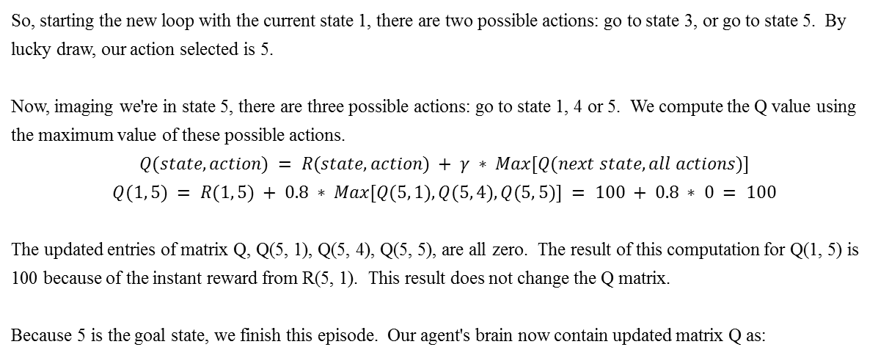
Reinforcement Learning
4.3 Reinforcement Learning
4.3.3 Algorithm: Q-learning: Example
So, starting the new loop with the current state 1, there are two possible actions: go to state 3, or go to state 5. By lucky draw, our action selected is 5.
Now, imaging we're in state 5, there are three possible actions: go to state 1, 4 or 5. We compute the Q value using the maximum value of these possible actions.
$$Q(state, action) = R(state, action) + γ ∗ Max[Q(next state, all actions)]$$
$$Q(1, 5) = R(1, 5) + 0.8 ∗ Max[Q(5, 1), Q(5, 4), Q(5, 5)] = 100 + 0.8 ∗ 0 = 100$$
The updated entries of matrix Q, Q(5, 1), Q(5, 4), Q(5, 5), are all zero. The result of this computation for Q(1, 5) is 100 because of the instant reward from R(5, 1). This result does not change the Q matrix.
Because 5 is the goal state, we finish this episode. Our agent's brain now contain updated matrix Q as:
Source http://mnemstudio.org/path-finding-q-learning-tutorial.htm

Slide 27
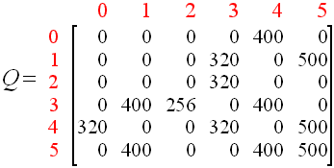
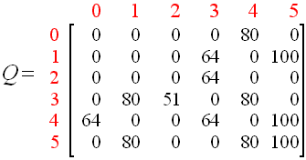
Reinforcement Learning
4.3 Reinforcement Learning
4.3.3 Algorithm: Q-learning: Example
If our agent learns more through further episodes, it will finally reach convergence values in matrix Q like:
This matrix Q, can then be normalized (i.e.; converted to percentage) by dividing all non-zero entries by the highest number (500 in this case):
Once the matrix Q gets close enough to a state of convergence, we know our agent has learned the most optimal paths to the goal state. Tracing the best sequences of states is as simple as following the links with the highest values at each state.
Source http://mnemstudio.org/path-finding-q-learning-tutorial.htm

Slide 28
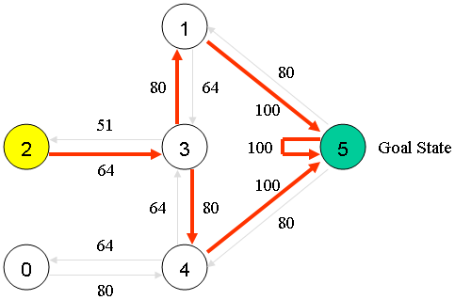
Reinforcement Learning
4.3 Reinforcement Learning
4.3.3 Algorithm: Q-learning: Example
For example, from initial State 2, the agent can use the matrix Q as a guide:
From State 2 the maximum Q values suggests the action to go to state 3.
From State 3 the maximum Q values suggest two alternatives: go to state 1 or 4. Suppose we arbitrarily choose to go to 1.
From State 1 the maximum Q values suggests the action to go to state 5.
Thus the sequence is 2 - 3 - 1 - 5.
Source http://mnemstudio.org/path-finding-q-learning-tutorial.htm

