Slide 1
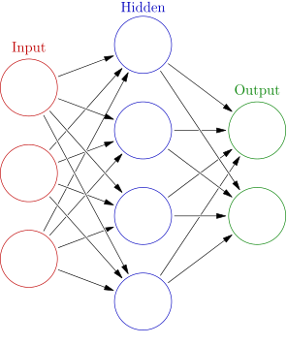
Supervised Learning
2.2 Neural Networks
2.2.1 Introduction
An artificial neutral network (ANN) is a system that is based on the biological neural network.
An ANN is comprised of a network of artificial neurons (also known as "nodes"). These nodes are connected to each other, and the strength of their connections to one another is assigned a value based on their strength: inhibition or excitation. If the value of the connection is high, then it indicates that there is a strong connection.
Within each node's design, a transfer function is built in.
There are three types of neurons in an ANN, input nodes, hidden nodes, and output nodes.
Source http://www.saedsayad.com/artificial_neural_network.htm

Slide 2
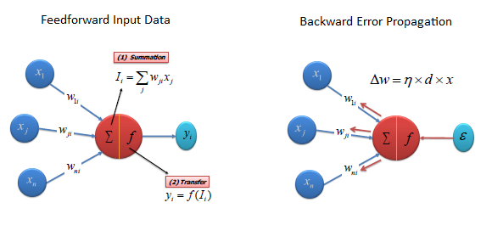
Supervised Learning
2.2 Neural Networks
2.2.1 Introduction
The input nodes take in information, in the form which can be numerically expressed. The information is presented as activation values, where each node is given a number.
This information is then passed throughout the network. Based on the connection strengths (weights), inhibition or excitation, and transfer functions, the activation value is passed from node to node. Each of the nodes sums the activation values it receives; it then modifies the value based on its transfer function.
The activation flows through the network, through hidden layers, until it reaches the output nodes. The output nodes then reflect the input in a meaningful way to the outside world.
The difference between predicted value and actual value (error) will be propagated backward by apportioning them to each node's weights according to the amount of this error the node is responsible for (e.g., gradient descent algorithm).
Source http://www.saedsayad.com/artificial_neural_network.htm

Slide 3
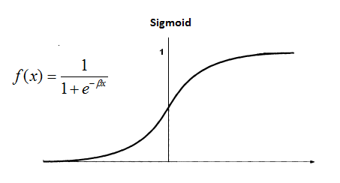
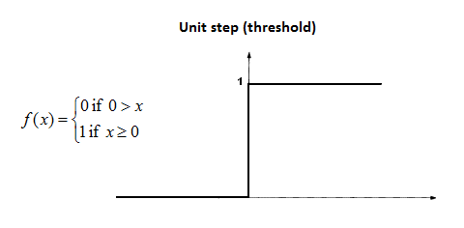
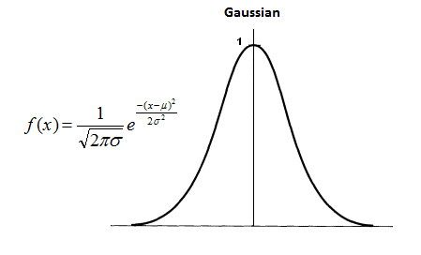
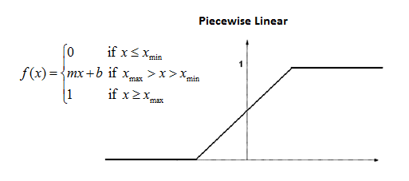
Supervised Learning
Sigmoid
The sigmoid function consists of 2 functions, logistic and tangential. The values of logistic function range from 0 and 1 and -1 to +1 for tangential function.
2.2 Neural Networks
2.2.2 Transfer Function
Unit step (threshold)
The output is set at one of two levels, depending on whether the total input is greater than or less than some threshold value.
Gaussian
Gaussian functions are bell-shaped curves that are continuous. The node output (high/low) is interpreted in terms of class membership (1/0), depending on how close the net input is to a chosen value of average.
Piecewise Linear
The output is proportional to the total weighted output.
Source http://www.saedsayad.com/artificial_neural_network.htm

Slide 4
Supervised Learning
2.2 Neural Networks
2.2.3 Algorithm
There are different types of neural networks, but they are generally classified into feed-forward and feed-back networks.
A feed-forward network
a non-recurrent network which contains inputs, outputs, and hidden layers; the signals can only travel in one direction.
Input data is passed onto a layer of processing elements where it performs calculations. Each processing element makes its computation based upon a weighted sum of its inputs. The new calculated values then become the new input values that feed the next layer. This process continues until it has gone through all the layers and determines the output.
A threshold transfer function is sometimes used to quantify the output of a neuron in the output layer.
Feed-forward networks include Perceptron (linear and non-linear) and Radial Basis Function networks.
Feed-forward networks are often used in data mining.
Common Examples are Perceptrons, Back Propagation Network, and Radial Basis Function Network.
A feed-back network
they can have signals traveling in both directions using loops.
All possible connections between neurons are allowed.
Since loops are present in this type of network, it becomes a non-linear dynamic system which changes continuously until it reaches a state of equilibrium.
Feed-back networks are often used in associative memories and optimization problems where the network looks for the best arrangement of interconnected factors.
Common Examples are Boltzmann machine and Hopfield network.
Source1 http://www.saedsayad.com/artificial_neural_network.htm
Source2 http://baike.baidu.com/view/1986922.htm

Slide 5
Supervised Learning
2.2 Neural Networks
2.2.4 Backpropagation Neural Networks
The backpropagation learning algorithm can be divided into two phases: propagation and weight update.
Phase 1: Propagation
(1) Forward propagation of a training pattern's input through the neural network in order to generate the propagation's output activations.
(2) Backward propagation of the propagation's output activations through the neural network using the training pattern target in order to generate the deltas (the difference between the targeted and actual output values) of all output and hidden neurons.
Phase 2: Weight update
(1) Multiply its output delta and input activation to get the gradient of the weight.
(2) Subtract a ratio (percentage) of the gradient from the weight.
Repeat phase 1 and 2 until the performance of the network is satisfactory.
This ratio (percentage) influences the speed and quality of learning; it is called the learning rate. The greater the ratio, the faster the neuron trains; the lower the ratio, the more accurate the training is. The sign of the gradient of a weight indicates where the error is increasing, this is why the weight must be updated in the opposite direction.
Source https://en.wikipedia.org/wiki/Backpropagation

Slide 6
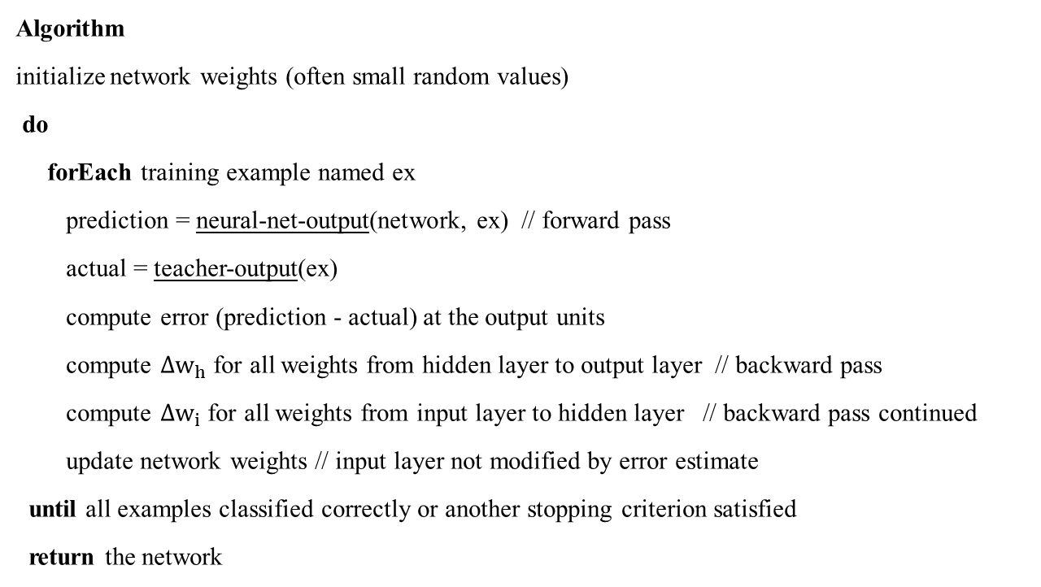
Supervised Learning
2.2 Neural Networks
2.2.4 Backpropagation Neural Networks
Algorithm
initialize network weights (often small random values)
do
forEach training example named ex
prediction = neural-net-output(network, ex) // forward pass
actual = teacher-output(ex)
compute error (prediction - actual) at the output units
compute $∆w_{h}$ for all weights from hidden layer to output layer // backward pass
compute $∆w_{i}$ for all weights from input layer to hidden layer // backward pass continued
update network weights // input layer not modified by error estimate
until all examples classified correctly or another stopping criterion satisfied
return the network
Source https://en.wikipedia.org/wiki/Backpropagation

Slide 7
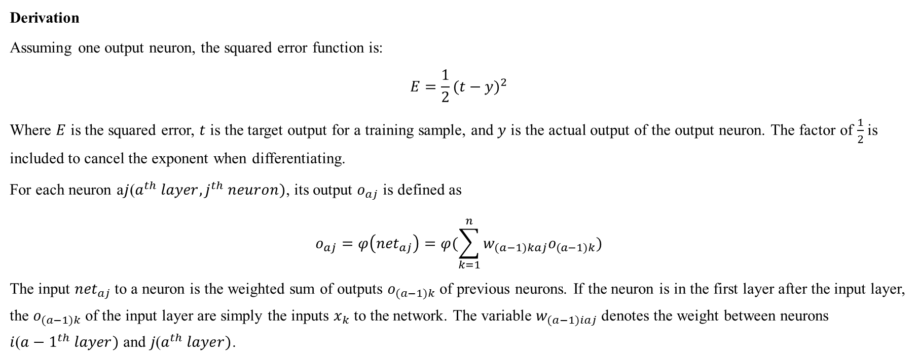
Supervised Learning
2.2 Neural Networks
2.2.4 Backpropagation Neural Networks
Derivation
Assuming one output neuron, the squared error function is:
$$E=\frac{1}{2}{(t−y)}^{2}$$
Where $E$ is the squared error, $t$ is the target output for a training sample, and $y$ is the actual output of the output neuron. The factor of $\frac{1}{2}$is included to cancel the exponent when differentiating.
For each neuron a$j$($a^{th} layer, j^{th} neuron)$, its output $o_{aj}$ is defined as
$$o_{aj}=φ\left({net}_{aj}\right)=φ(\sum_{k=1}^{n}{w_{(a−1)kaj}o_{(a−1)k}})$$
The input ${net}_{aj}$to a neuron is the weighted sum of outputs $o_{(a−1)k}$ of previous neurons. If the neuron is in the first layer after the input layer, the $o_{(a−1)k}$ of the input layer are simply the inputs $x_{k}$ to the network. The variable $w_{(a−1)iaj}$ denotes the weight between neurons $i$(${a−1}^{th} layer)$ and $j\text{(}a^{th} layer)$.
Source https://en.wikipedia.org/wiki/Backpropagation

Slide 8
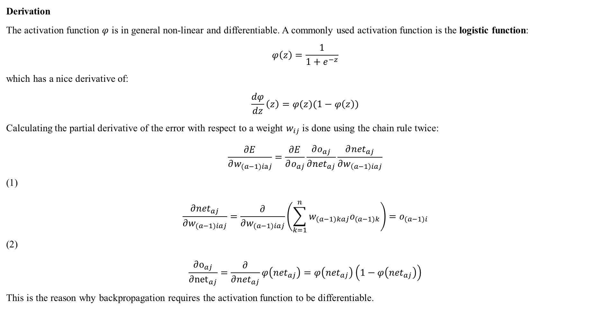
Supervised Learning
2.2 Neural Networks
2.2.4 Backpropagation Neural Networks
Derivation
The activation function $φ$ is in general non-linear and differentiable. A commonly used activation function is the logistic function:
$$φ\left(z\right)=\frac{1}{1+e^{−z}}$$
which has a nice derivative of:
$$\frac{dφ}{dz}\left(z\right)=φ(z)(1−φ\left(z\right))$$
Calculating the partial derivative of the error with respect to a weight $w_{ij}$ is done using the chain rule twice:
$$\frac{∂E}{∂w_{(a−1)iaj}}=\frac{∂E}{∂o_{aj}}\frac{∂o_{aj}}{∂{net}_{aj}}\frac{∂{net}_{aj}}{∂w_{\left(a−1\right)iaj}}$$
(1)
$$\frac{∂{net}_{aj}}{∂w_{(a−1)iaj}}=\frac{∂}{∂w_{(a−1)iaj}}\left(\sum_{k=1}^{n}{w_{(a−1)kaj}o_{(a−1)k}}\right)=o_{(a−1)i}$$
(2)
$$\frac{∂o_{aj}}{∂{net}_{aj}}=\frac{∂}{∂{net}_{aj}}φ\left({net}_{aj}\right)=φ\left({net}_{aj}\right)\left(1−φ\left({net}_{aj}\right)\right)$$
This is the reason why backpropagation requires the activation function to be differentiable.
Source https://en.wikipedia.org/wiki/Backpropagation

Slide 9

Supervised Learning
2.2 Neural Networks
2.2.4 Backpropagation Neural Networks
Derivation
(3) if the neuron $o_{aj}$ is in the output layer,
$$\frac{∂E}{∂o_{aj}}=\frac{∂E}{∂y}=\frac{∂}{∂y}\frac{1}{2}{(t−y)}^{2}=y−t$$
if $o_{aj}$ is in the inner layer of the network,
$$\frac{∂E}{∂o_{aj}}=\sum_{l∈L}{(\frac{∂E}{∂{net}_{(a+1)l}}\frac{∂{net}_{(a+1)l}}{∂o_{aj}}})=\sum_{l∈L}{(\frac{∂E}{∂o_{(a+1)l}}\frac{∂o_{l}}{∂{net}_{(a+1)l}}w_{aj(a+1)l}})$$
Overall,
$$\frac{∂E}{∂w_{(a−1)iaj}}=δ_{aj}o_{(a−1)i}$$
With
$$δ_{aj}=\frac{∂E}{∂o_{aj}}\frac{∂o_{aj}}{∂{net}_{aj}}=\left\{\begin{aligned}\left(o_{aj}−t_{aj}\right)o_{aj}\left(1−o_{aj}\right) if j is an output neuron \\ \left(\sum_{l∈L}{δ_{(a+1)l}}w_{aj(a+1)l}\right)o_{aj}\left(1−o_{aj}\right) if j is an inner neuron\end{aligned}\right.$$
Source https://en.wikipedia.org/wiki/Backpropagation

Slide 10
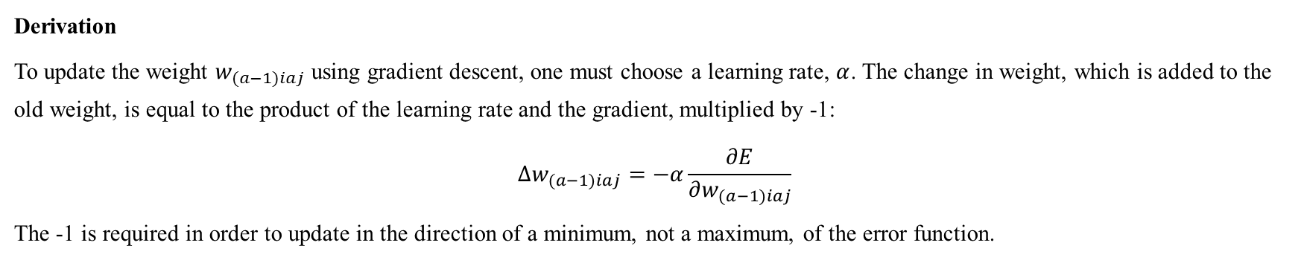
Supervised Learning
2.2 Neural Networks
2.2.4 Backpropagation Neural Networks
Derivation
To update the weight $w_{(a−1)iaj}$ using gradient descent, one must choose a learning rate, $α$. The change in weight, which is added to the old weight, is equal to the product of the learning rate and the gradient, multiplied by -1:
$$∆w_{(a−1)iaj}=−α\frac{∂E}{∂w_{(a−1)iaj}}$$
The -1 is required in order to update in the direction of a minimum, not a maximum, of the error function.
Limitation
Gradient descent with backpropagation is not guaranteed to find the global minimum of the error function, but only a local minimum
Source https://en.wikipedia.org/wiki/Backpropagation

Slide 11
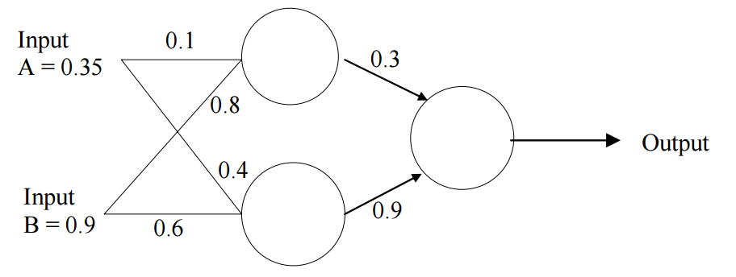
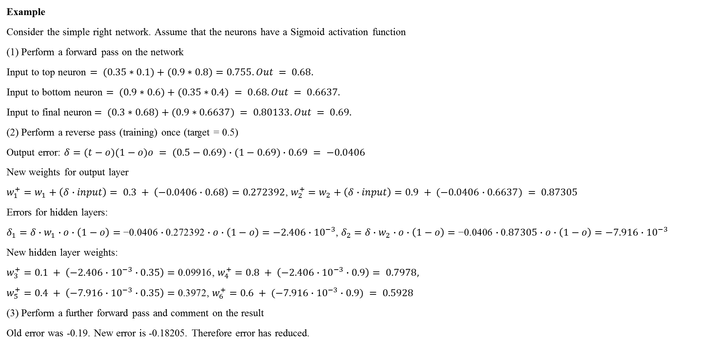
Supervised Learning
2.2 Neural Networks
2.2.4 Backpropagation Neural Networks
Example
Consider the simple right network. Assume that the neurons have a Sigmoid activation function
(1) Perform a forward pass on the network
Input to top neuron $= (0.35∗0.1)+(0.9∗0.8)=0.755. Out = 0.68.$
Input to bottom neuron $= (0.9∗0.6)+(0.35∗0.4) = 0.68. Out = 0.6637.$
Input to final neuron$= (0.3∗0.68)+(0.9∗0.6637) = 0.80133. Out = 0.69.$
(2) Perform a reverse pass (training) once (target = 0.5)
Output error: $δ=(t−o)(1−o)o = (0.5−0.69)∙(1−0.69)∙0.69 = −0.0406$
New weights for output layer
$w_{1}^{+}=w_{1}+\left(δ∙input\right)= 0.3 + \left(−0.0406∙0.68\right)=0.272392$, $w_{2}^{+}=w_{2}+\left(δ∙input\right)=0.9 + (−0.0406∙0.6637) = 0.87305$
Errors for hidden layers:
$δ_{1}=δ∙w_{1}∙o∙\left(1−o\right)=\text{−0.0406}∙\text{0.272392}∙o∙\left(1−o\right)=−2.406∙{10}^{−3}$, $δ_{2}=δ∙w_{2}∙o∙\left(1−o\right)=\text{−0.0406}∙\text{0.}87305∙o∙\left(1−o\right)=−7.916∙{10}^{−3}$
New hidden layer weights:
$w_{3}^{+}=0.1 + \left(−2.406∙{10}^{−3}∙0.35\right)=\text{0.09916}$, $w_{4}^{+}=0.8 + \left(−2.406∙{10}^{−3}∙0.9\right)= 0.7978,$
$w_{5}^{+}=0.4 + \left(−7.916∙{10}^{−3}∙0.35\right)=\text{0.}\text{3972}$, $w_{6}^{+}=0.6 + (−7.916∙{10}^{−3}∙0.9) = 0.5928$
(3) Perform a further forward pass and comment on the result
Old error was -0.19. New error is -0.18205. Therefore error has reduced.
Source https://www.fer.unizg.hr/_download/repository/BP_chapter3_-_bp.pdf

Slide 12
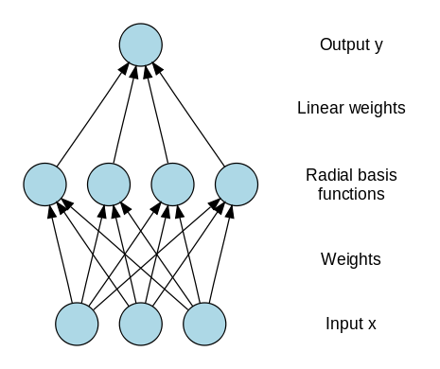
Supervised Learning
2.2 Neural Networks
2.2.5 Radial Basis Neural Networks
Introduction
A radial basis function network is an artificial neural network that uses radial basis functions as activation functions. The output of the network is a linear combination of radial basis functions of the inputs and neuron parameters.
Radial basis function (RBF) networks typically have three layers: an input layer, a hidden layer with a non-linear RBF activation function and a linear output layer.
Training
RBF networks are typically trained by a two-step algorithm. In the first step, the center vectors of the RBF functions in the hidden layer are chosen. This step can be performed in several ways; centers can be randomly sampled from some set of examples, or they can be determined using k-means clustering. Note that this step is unsupervised.
The second step simply fits a linear model with coefficients to the hidden layer's outputs with respect to some objective function.
Source https://en.wikipedia.org/wiki/Radial_basis_function_network

Slide 13
Supervised Learning
2.2 Neural Networks
2.2.6 Advantages and Limitations
Advantages
Can be applied to many problems, as long as there is some data.
Can be applied to problems, for which analytical methods do not yet exist
Can be used to model non-linear dependencies.
If there is a pattern, then neural networks should quickly work it out, even if the data is ‘noisy’.
Always gives some answer even when the input information is not complete.
Networks are easy to maintain.
Limitations
Like with any data-driven models, they cannot be used if there is no or very little data available.
There are many free parameters, such as the number of hidden nodes, the learning rate, minimal error, which may greatly influence the final result.
Not good for arithmetic and precise calculations.
Neural networks do not provide explanations. If there are many nodes, then there are too many weights that are difficult to interpret (unlike the slopes in linear models, which can be seen as correlations). In some tasks, explanations are crucial (e.g. air traffic control, medical diagnosis).
Source http://www.eis.mdx.ac.uk/staffpages/rvb/teaching/BIS3226/hand11.pdf

