Slide 1
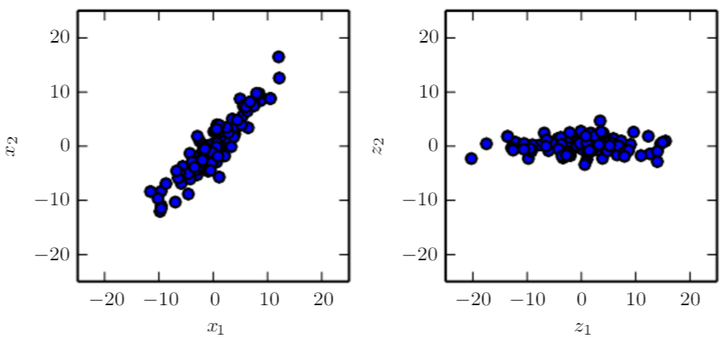
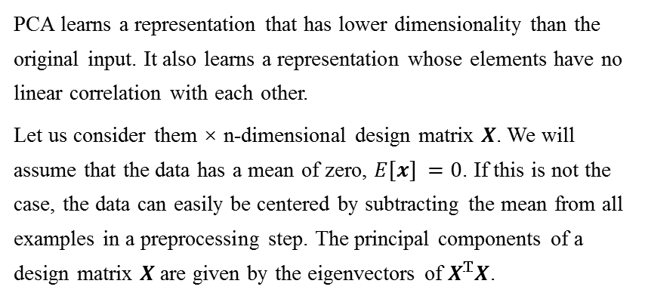
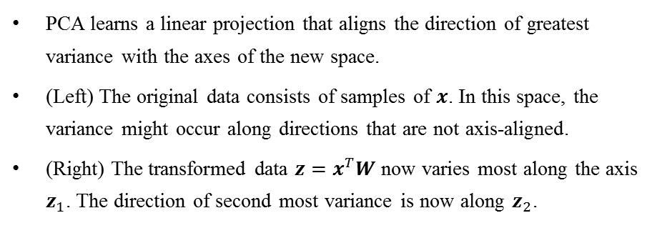
Unsupervised Learning
3.1 Principal Components Analysis
3.1.1 Introduction
PCA learns a representation that has lower dimensionality than the original input. It also learns a representation whose elements have no linear correlation with each other.
Let us consider them × n-dimensional design matrix $X$. We will assume that the data has a mean of zero, $E[x] =0$. If this is not the case, the data can easily be centered by subtracting the mean from all examples in a preprocessing step. The principal components of a design matrix $X$ are given by the eigenvectors of $X^{T}X$.
PCA learns a linear projection that aligns the direction of greatest variance with the axes of the new space.
(Left) The original data consists of samples of $x$. In this space, the variance might occur along directions that are not axis-aligned.
(Right) The transformed data $z=x^{T}W$ now varies most along the axis $z_{1}$. The direction of second most variance is now along $z_{2}$.

