Slide 1
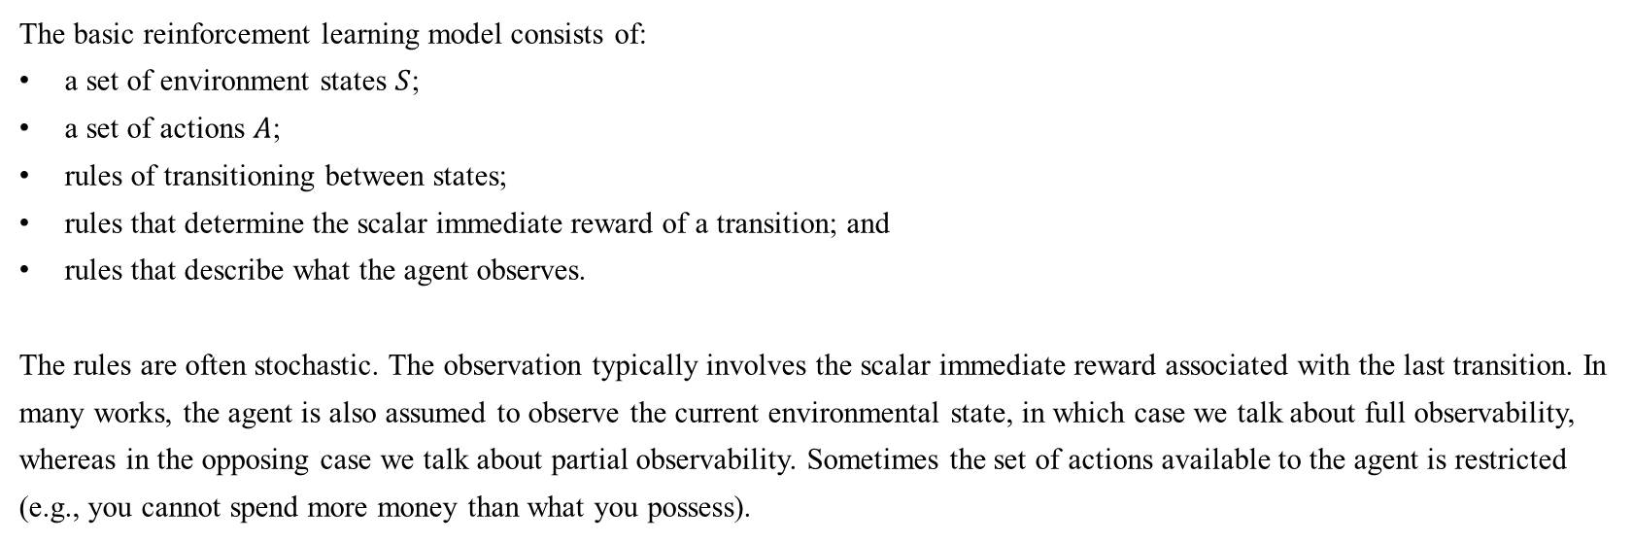
Reinforcement Learning
4.3 Reinforcement Learning
4.3.1 Introduction
The basic reinforcement learning model consists of:
a set of environment states $S$;
a set of actions $A$;
rules of transitioning between states;
rules that determine the scalar immediate reward of a transition; and
rules that describe what the agent observes.
The rules are often stochastic. The observation typically involves the scalar immediate reward associated with the last transition. In many works, the agent is also assumed to observe the current environmental state, in which case we talk about full observability, whereas in the opposing case we talk about partial observability. Sometimes the set of actions available to the agent is restricted (e.g., you cannot spend more money than what you possess).
Source https://en.wikipedia.org/wiki/Reinforcement_learning

Slide 2
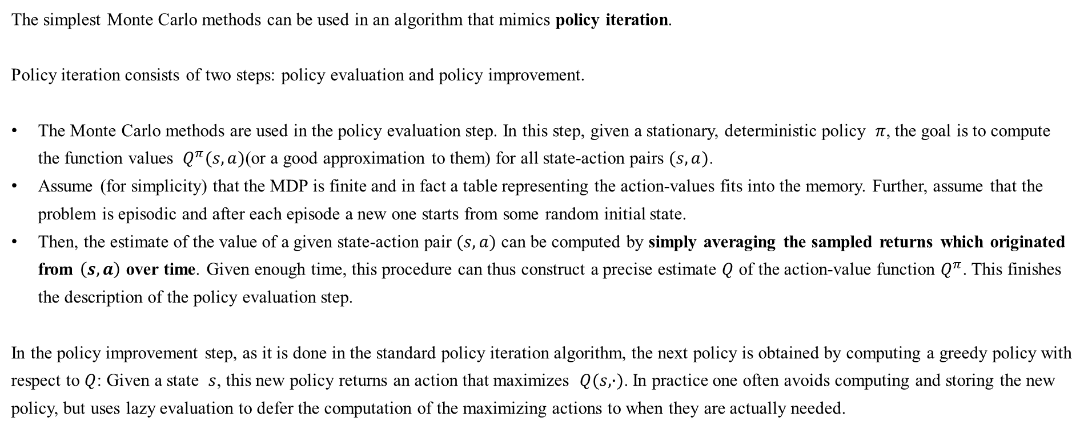
Reinforcement Learning
4.3 Reinforcement Learning
4.3.2 Algorithm: Monte Carlo methods
The simplest Monte Carlo methods can be used in an algorithm that mimics policy iteration.
Policy iteration consists of two steps: policy evaluation and policy improvement.
The Monte Carlo methods are used in the policy evaluation step. In this step, given a stationary, deterministic policy $π$, the goal is to compute the function values $Q^{π}(s,a)$(or a good approximation to them) for all state-action pairs $(s,a)$.
Assume (for simplicity) that the MDP is finite and in fact a table representing the action-values fits into the memory. Further, assume that the problem is episodic and after each episode a new one starts from some random initial state.
Then, the estimate of the value of a given state-action pair $(s,a)$ can be computed by simply averaging the sampled returns which originated from $\left(s,a\right)$ over time. Given enough time, this procedure can thus construct a precise estimate $Q$ of the action-value function $Q^{π}$. This finishes the description of the policy evaluation step.
In the policy improvement step, as it is done in the standard policy iteration algorithm, the next policy is obtained by computing a greedy policy with respect to $Q$: Given a state $s$, this new policy returns an action that maximizes $Q(s,∙)$. In practice one often avoids computing and storing the new policy, but uses lazy evaluation to defer the computation of the maximizing actions to when they are actually needed.
Source http://mnemstudio.org/path-finding-q-learning-tutorial.htm

Slide 3
Reinforcement Learning
4.3 Reinforcement Learning
4.3.2 Algorithm: Monte Carlo methods
A few problems with this procedure are as follows:
The procedure may waste too much time on evaluating a suboptimal policy;
It uses samples inefficiently in that a long trajectory is used to improve the estimate only of the single state-action pair that started the trajectory;
When the returns along the trajectories have high variance, convergence will be slow;
It works in episodic problems only;
It works in small, finite MDPs only.
Source http://mnemstudio.org/path-finding-q-learning-tutorial.htm

Slide 4
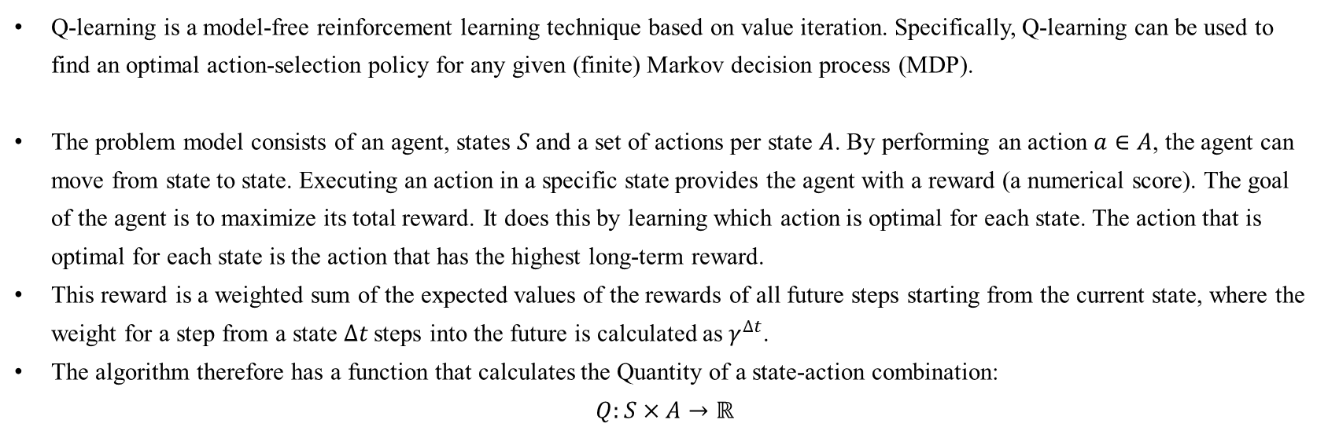
Reinforcement Learning
4.3 Reinforcement Learning
4.3.3 Algorithm: Q-learning
Q-learning is a model-free reinforcement learning technique based on value iteration. Specifically, Q-learning can be used to find an optimal action-selection policy for any given (finite) Markov decision process (MDP).
The problem model consists of an agent, states $S$ and a set of actions per state $A$. By performing an action $a∈A$, the agent can move from state to state. Executing an action in a specific state provides the agent with a reward (a numerical score). The goal of the agent is to maximize its total reward. It does this by learning which action is optimal for each state. The action that is optimal for each state is the action that has the highest long-term reward.
This reward is a weighted sum of the expected values of the rewards of all future steps starting from the current state, where the weight for a step from a state $∆t$ steps into the future is calculated as $γ^{∆t}$.
The algorithm therefore has a function that calculates the Quantity of a state-action combination:
$$Q:S×A→ℝ$$
Source https://en.wikipedia.org/wiki/Q-learning

Slide 5
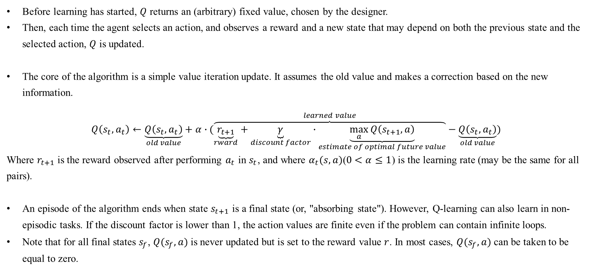
Reinforcement Learning
4.3 Reinforcement Learning
4.3.3 Algorithm: Q-learning
Before learning has started, $Q$ returns an (arbitrary) fixed value, chosen by the designer.
Then, each time the agent selects an action, and observes a reward and a new state that may depend on both the previous state and the selected action, $Q$ is updated.
The core of the algorithm is a simple value iteration update. It assumes the old value and makes a correction based on the new information.
$$Q\left(s_{t},a_{t}\right)←\underset{old value}{\underbrace{Q\left(s_{t},a_{t}\right)}}+α∙(\overset{learned value}{\overbrace{\underset{rward}{\underbrace{r_{t+1}}}+\underset{discount factor}{\underbrace{γ}}∙\underset{estimate of optimal future value}{\underbrace{\max_{a}{Q\left(s_{t+1},a\right)}}}}}−\underset{old value}{\underbrace{Q\left(s_{t},a_{t}\right)}})$$
Where $r_{t+1}$ is the reward observed after performing $a_{t}$ in $s_{t}$, and where $α_{t}(s,a)$($0<α≤1$) is the learning rate (may be the same for all pairs).
An episode of the algorithm ends when state $s_{t+1}$ is a final state (or, "absorbing state"). However, Q-learning can also learn in non-episodic tasks. If the discount factor is lower than 1, the action values are finite even if the problem can contain infinite loops.
Note that for all final states $s_{f}$, $Q(s_{f},a)$is never updated but is set to the reward value $r$. In most cases, $Q(s_{f},a)$can be taken to be equal to zero.
Source https://en.wikipedia.org/wiki/Q-learning

Slide 6
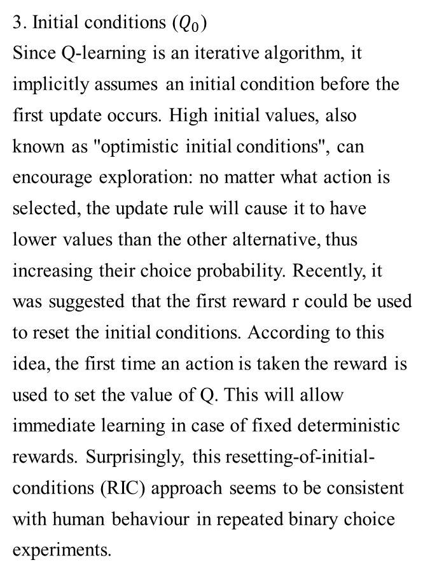
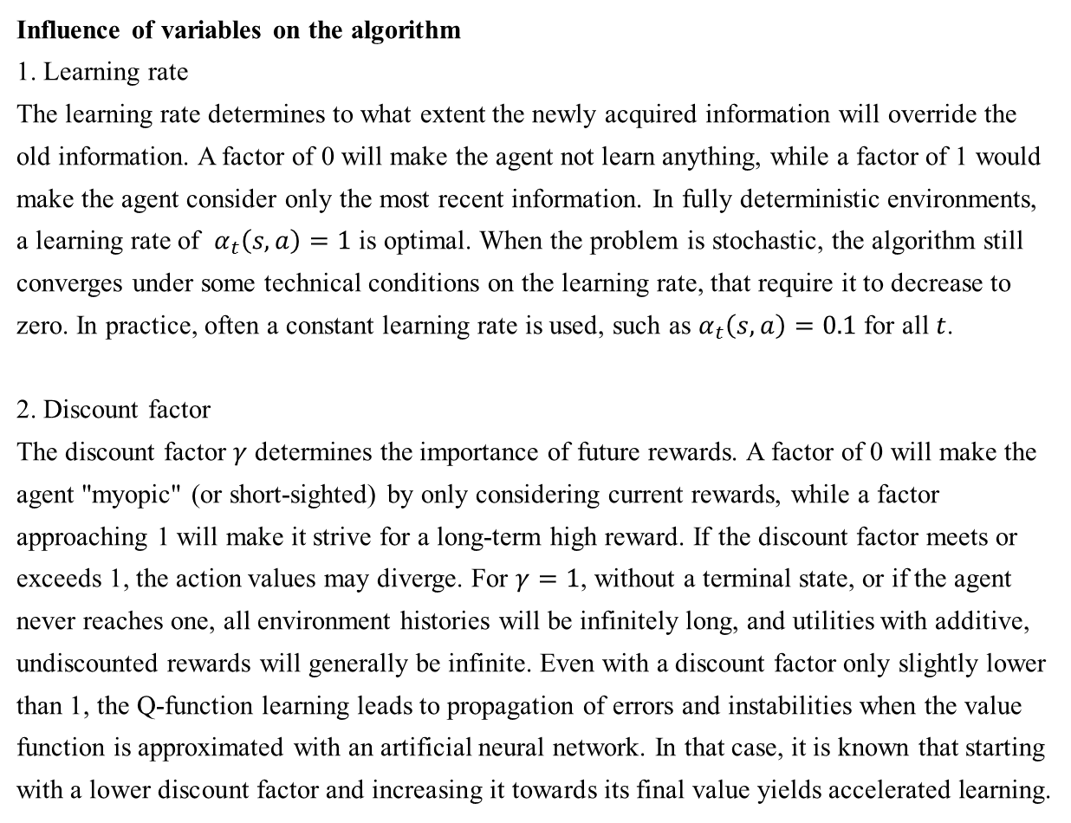
Reinforcement Learning
4.3 Reinforcement Learning
4.3.3 Algorithm: Q-learning
Influence of variables on the algorithm
1. Learning rate
The learning rate determines to what extent the newly acquired information will override the old information. A factor of 0 will make the agent not learn anything, while a factor of 1 would make the agent consider only the most recent information. In fully deterministic environments, a learning rate of $α_{t}\left(s,a\right)=1$ is optimal. When the problem is stochastic, the algorithm still converges under some technical conditions on the learning rate, that require it to decrease to zero. In practice, often a constant learning rate is used, such as $α_{t}\left(s,a\right)=0.1$ for all $t$.
2. Discount factor
The discount factor $γ$ determines the importance of future rewards. A factor of 0 will make the agent "myopic" (or short-sighted) by only considering current rewards, while a factor approaching 1 will make it strive for a long-term high reward. If the discount factor meets or exceeds 1, the action values may diverge. For $γ=1$, without a terminal state, or if the agent never reaches one, all environment histories will be infinitely long, and utilities with additive, undiscounted rewards will generally be infinite. Even with a discount factor only slightly lower than 1, the Q-function learning leads to propagation of errors and instabilities when the value function is approximated with an artificial neural network. In that case, it is known that starting with a lower discount factor and increasing it towards its final value yields accelerated learning.
3. Initial conditions ($Q_{0}$)
Since Q-learning is an iterative algorithm, it implicitly assumes an initial condition before the first update occurs. High initial values, also known as "optimistic initial conditions", can encourage exploration: no matter what action is selected, the update rule will cause it to have lower values than the other alternative, thus increasing their choice probability. Recently, it was suggested that the first reward r could be used to reset the initial conditions. According to this idea, the first time an action is taken the reward is used to set the value of Q. This will allow immediate learning in case of fixed deterministic rewards. Surprisingly, this resetting-of-initial-conditions (RIC) approach seems to be consistent with human behaviour in repeated binary choice experiments.
Source https://en.wikipedia.org/wiki/Q-learningt

Slide 7
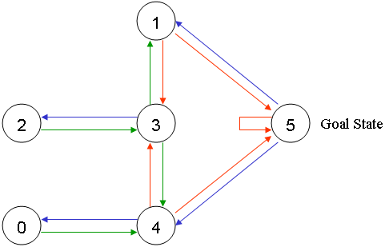
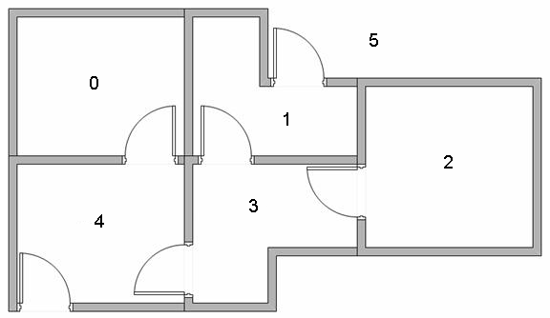
Reinforcement Learning
4.3 Reinforcement Learning
4.3.3 Algorithm: Q-learning: Example
Suppose we have 5 rooms in a building connected by doors as shown in the figure below.
We'll number each room 0 through 4.
The outside of the building can be thought of as one big room (5).
Notice that doors 1 and 4 lead into the building from room 5 (outside).
We can represent the rooms on a graph, each room as a node, and each door as a link.
Source http://mnemstudio.org/path-finding-q-learning-tutorial.htm

Slide 8
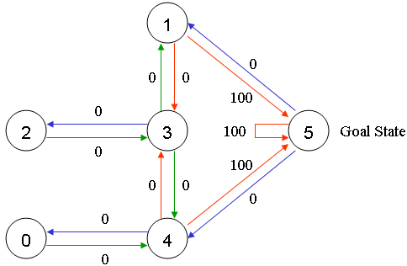
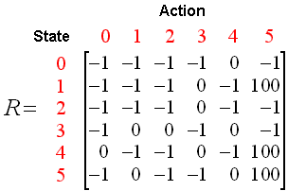
Reinforcement Learning
4.3 Reinforcement Learning
4.3.3 Algorithm: Q-learning: Example
For this example, we'd like to put an agent in any room, and from that room, go outside the building (this will be our target room). In other words, the goal room is number 5.
To set this room as a goal, we'll associate a reward value to each door (i.e. link between nodes). The doors that lead immediately to the goal have an instant reward of 100. Other doors not directly connected to the target room have zero reward.
Because doors are two-way ( 0 leads to 4, and 4 leads back to 0 ), two arrows are assigned to each room. Each arrow contains an instant reward value.
We can put the state diagram and the instant reward values into the following reward table, "matrix R".
Note: The -1's in the table represent null values (i.e.; where there isn't a link between nodes). For example, State 0 cannot go to State 1.
Source http://mnemstudio.org/path-finding-q-learning-tutorial.htm

Slide 9
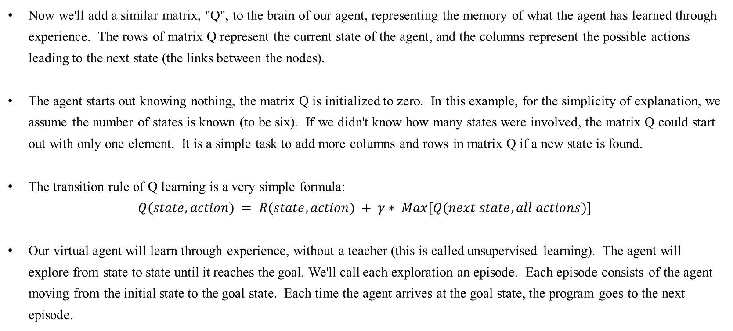
Reinforcement Learning
4.3 Reinforcement Learning
4.3.3 Algorithm: Q-learning: Example
Now we'll add a similar matrix, "Q", to the brain of our agent, representing the memory of what the agent has learned through experience. The rows of matrix Q represent the current state of the agent, and the columns represent the possible actions leading to the next state (the links between the nodes).
The agent starts out knowing nothing, the matrix Q is initialized to zero. In this example, for the simplicity of explanation, we assume the number of states is known (to be six). If we didn't know how many states were involved, the matrix Q could start out with only one element. It is a simple task to add more columns and rows in matrix Q if a new state is found.
The transition rule of Q learning is a very simple formula:
$$Q(state, action) = R(state, action) + γ∗ Max[Q(next state, all actions)]$$
Our virtual agent will learn through experience, without a teacher (this is called unsupervised learning). The agent will explore from state to state until it reaches the goal. We'll call each exploration an episode. Each episode consists of the agent moving from the initial state to the goal state. Each time the agent arrives at the goal state, the program goes to the next episode.
Source http://mnemstudio.org/path-finding-q-learning-tutorial.htm

Slide 10
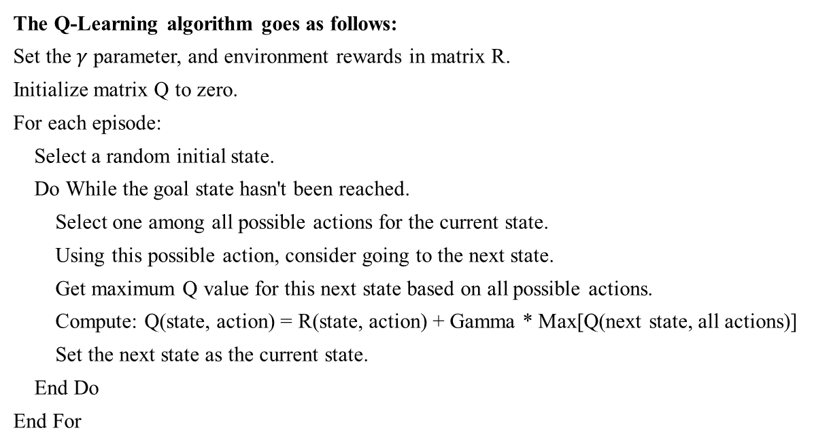
Reinforcement Learning
4.3 Reinforcement Learning
4.3.3 Algorithm: Q-learning: Example
The Q-Learning algorithm goes as follows:
Set the $γ$ parameter, and environment rewards in matrix R.
Initialize matrix Q to zero.
For each episode:
Select a random initial state.
Do While the goal state hasn't been reached.
Select one among all possible actions for the current state.
Using this possible action, consider going to the next state.
Get maximum Q value for this next state based on all possible actions.
Compute: Q(state, action) = R(state, action) + Gamma * Max[Q(next state, all actions)]
Set the next state as the current state.
End Do
End For
Source http://mnemstudio.org/path-finding-q-learning-tutorial.htm

Slide 11
Reinforcement Learning
4.3 Reinforcement Learning
4.3.3 Algorithm: Q-learning: Example
To use the matrix Q, the agent simply traces the sequence of states, from the initial state to goal state. The algorithm finds the actions with the highest reward values recorded in matrix Q for current state.
Algorithm to utilize the Q matrix:
Set current state = initial state.
From current state, find the action with the highest Q value.
Set current state = next state.
Repeat Steps 2 and 3 until current state = goal state.
The algorithm above will return the sequence of states from the initial state to the goal state.
Source http://mnemstudio.org/path-finding-q-learning-tutorial.htm

Slide 12
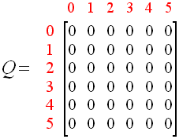
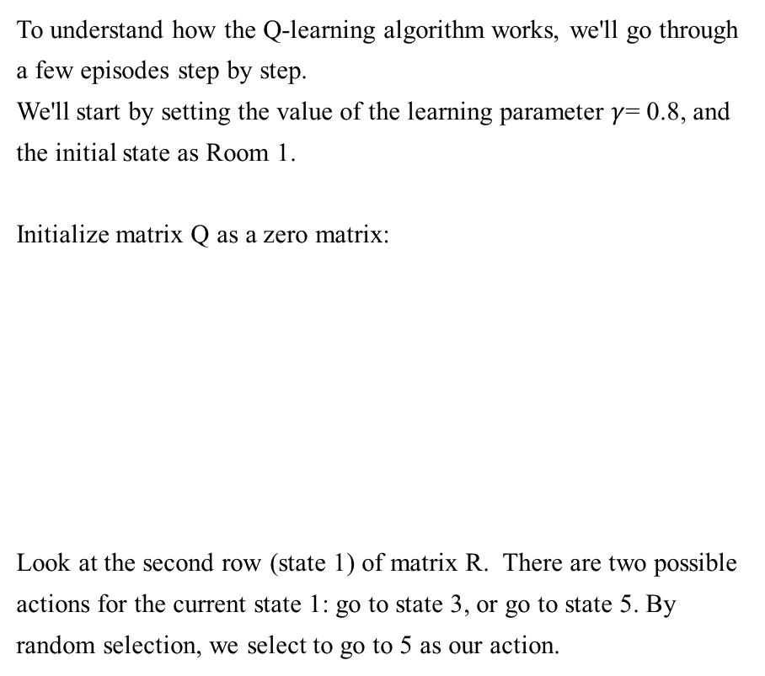
Reinforcement Learning
4.3 Reinforcement Learning
4.3.3 Algorithm: Q-learning: Example
To understand how the Q-learning algorithm works, we'll go through a few episodes step by step.
We'll start by setting the value of the learning parameter $γ$= 0.8, and the initial state as Room 1.
Initialize matrix Q as a zero matrix:
Look at the second row (state 1) of matrix R. There are two possible actions for the current state 1: go to state 3, or go to state 5. By random selection, we select to go to 5 as our action.
Source http://mnemstudio.org/path-finding-q-learning-tutorial.htm

Slide 13
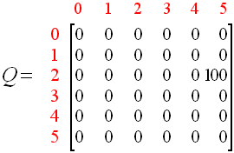
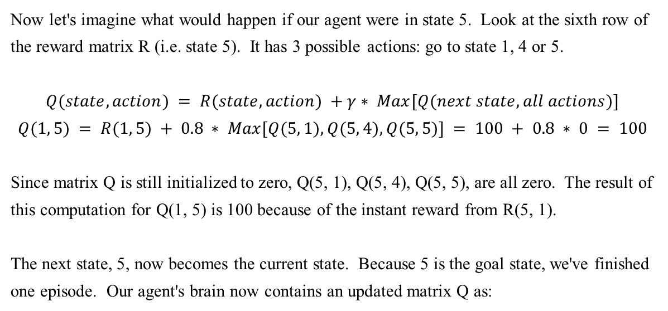
Reinforcement Learning
4.3 Reinforcement Learning
4.3.3 Algorithm: Q-learning: Example
Now let's imagine what would happen if our agent were in state 5. Look at the sixth row of the reward matrix R (i.e. state 5). It has 3 possible actions: go to state 1, 4 or 5.
$$Q(state, action) = R(state, action) +γ∗ Max[Q(next state, all actions)]$$
$$Q(1, 5) = R(1, 5) + 0.8 ∗ Max[Q(5, 1), Q(5, 4), Q(5, 5)] = 100 + 0.8 ∗ 0 = 100$$
Since matrix Q is still initialized to zero, Q(5, 1), Q(5, 4), Q(5, 5), are all zero. The result of this computation for Q(1, 5) is 100 because of the instant reward from R(5, 1).
The next state, 5, now becomes the current state. Because 5 is the goal state, we've finished one episode. Our agent's brain now contains an updated matrix Q as:
Source http://mnemstudio.org/path-finding-q-learning-tutorial.htm

Slide 14
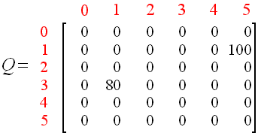
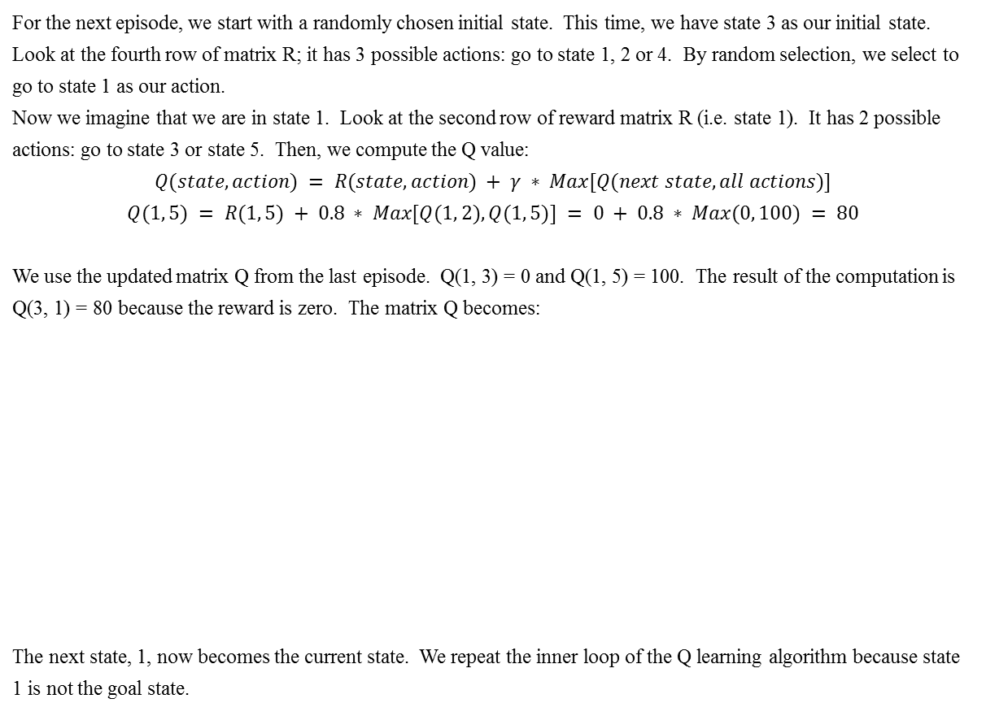
Reinforcement Learning
4.3 Reinforcement Learning
4.3.3 Algorithm: Q-learning: Example
For the next episode, we start with a randomly chosen initial state. This time, we have state 3 as our initial state.
Look at the fourth row of matrix R; it has 3 possible actions: go to state 1, 2 or 4. By random selection, we select to go to state 1 as our action.
Now we imagine that we are in state 1. Look at the second row of reward matrix R (i.e. state 1). It has 2 possible actions: go to state 3 or state 5. Then, we compute the Q value:
$$Q(state, action) = R(state, action) + γ ∗ Max[Q(next state, all actions)]$$
$$Q(1, 5) = R(1, 5) + 0.8 ∗ Max[Q(1, 2), Q(1, 5)] = 0 + 0.8 ∗ Max(0, 100) = 80$$
We use the updated matrix Q from the last episode. Q(1, 3) = 0 and Q(1, 5) = 100. The result of the computation is Q(3, 1) = 80 because the reward is zero. The matrix Q becomes:
The next state, 1, now becomes the current state. We repeat the inner loop of the Q learning algorithm because state 1 is not the goal state.
Source http://mnemstudio.org/path-finding-q-learning-tutorial.htm

Slide 15
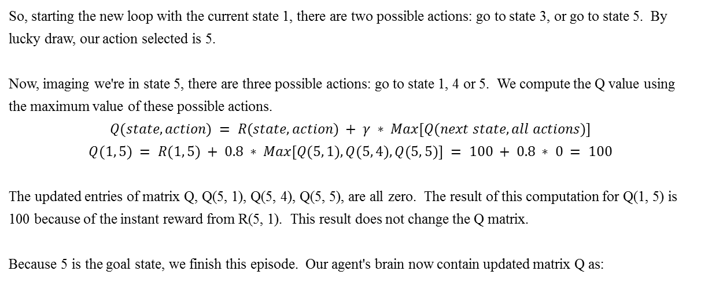
Reinforcement Learning
4.3 Reinforcement Learning
4.3.3 Algorithm: Q-learning: Example
So, starting the new loop with the current state 1, there are two possible actions: go to state 3, or go to state 5. By lucky draw, our action selected is 5.
Now, imaging we're in state 5, there are three possible actions: go to state 1, 4 or 5. We compute the Q value using the maximum value of these possible actions.
$$Q(state, action) = R(state, action) + γ ∗ Max[Q(next state, all actions)]$$
$$Q(1, 5) = R(1, 5) + 0.8 ∗ Max[Q(5, 1), Q(5, 4), Q(5, 5)] = 100 + 0.8 ∗ 0 = 100$$
The updated entries of matrix Q, Q(5, 1), Q(5, 4), Q(5, 5), are all zero. The result of this computation for Q(1, 5) is 100 because of the instant reward from R(5, 1). This result does not change the Q matrix.
Because 5 is the goal state, we finish this episode. Our agent's brain now contain updated matrix Q as:
Source http://mnemstudio.org/path-finding-q-learning-tutorial.htm

Slide 16
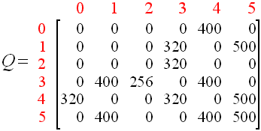
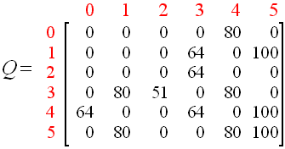
Reinforcement Learning
4.3 Reinforcement Learning
4.3.3 Algorithm: Q-learning: Example
If our agent learns more through further episodes, it will finally reach convergence values in matrix Q like:
This matrix Q, can then be normalized (i.e.; converted to percentage) by dividing all non-zero entries by the highest number (500 in this case):
Once the matrix Q gets close enough to a state of convergence, we know our agent has learned the most optimal paths to the goal state. Tracing the best sequences of states is as simple as following the links with the highest values at each state.
Source http://mnemstudio.org/path-finding-q-learning-tutorial.htm

Slide 17
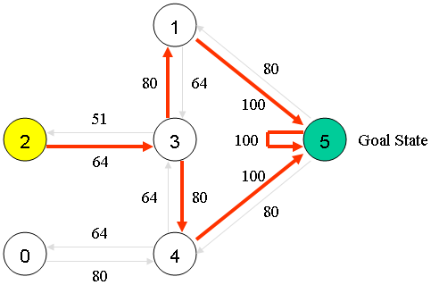
Reinforcement Learning
4.3 Reinforcement Learning
4.3.3 Algorithm: Q-learning: Example
For example, from initial State 2, the agent can use the matrix Q as a guide:
From State 2 the maximum Q values suggests the action to go to state 3.
From State 3 the maximum Q values suggest two alternatives: go to state 1 or 4. Suppose we arbitrarily choose to go to 1.
From State 1 the maximum Q values suggests the action to go to state 5.
Thus the sequence is 2 - 3 - 1 - 5.
Source http://mnemstudio.org/path-finding-q-learning-tutorial.htm

