Slide 1
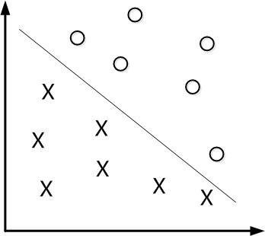
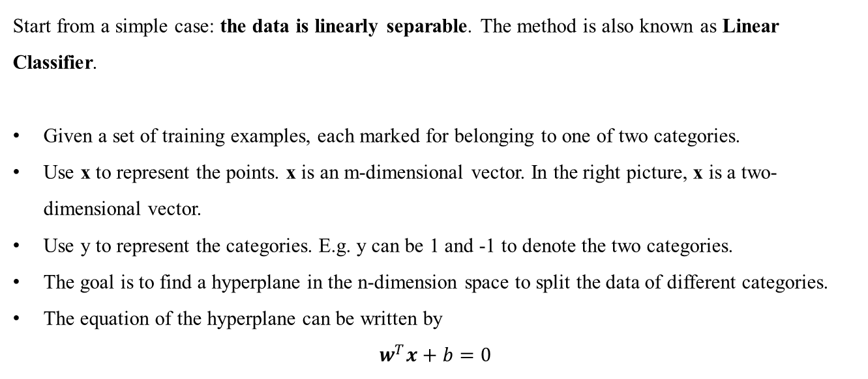
Supervised Learning
2.1 Support Vector Machine
2.1.1 Linear Classifier
Start from a simple case: the data is linearly separable. The method is also known as Linear Classifier.
Given a set of training examples, each marked for belonging to one of two categories.
Use x to represent the points. x is an m-dimensional vector. In the right picture, x is a two-dimensional vector.
Use y to represent the categories. E.g. y can be 1 and -1 to denote the two categories.
The goal is to find a hyperplane in the n-dimension space to split the data of different categories.
The equation of the hyperplane can be written by
$$w^{T}x+b=0$$
x₂
x₁
Source 支持向量机通俗导论, http://blog.csdn.net/v_july_v/article/details/7624837

Slide 2
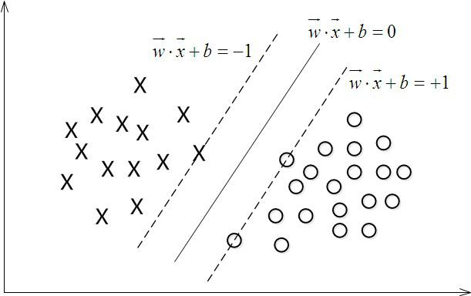
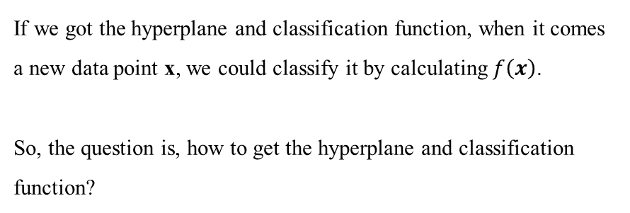
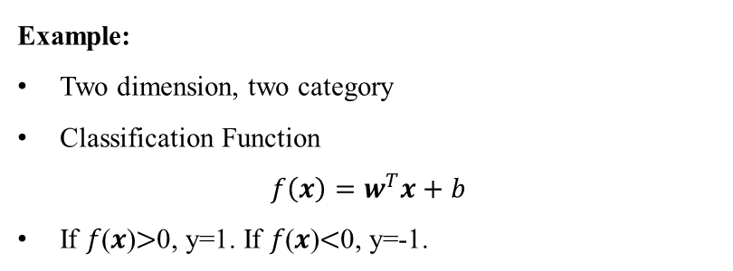
Supervised Learning
2.1 Support Vector Machine
2.1.1 Linear Classifier
Example:
Two dimension, two category
Classification Function
$${f\left(x\right)=w}^{T}x+b$$
If 𝑓(𝒙)$>$0, y=1. If 𝑓(𝒙)$<$0, y=-1.
x₂
If we got the hyperplane and classification function, when it comes a new data point x, we could classify it by calculating $f\left(x\right)$.
So, the question is, how to get the hyperplane and classification function?
x₁
Source 支持向量机通俗导论, http://blog.csdn.net/v_july_v/article/details/7624837

Slide 3
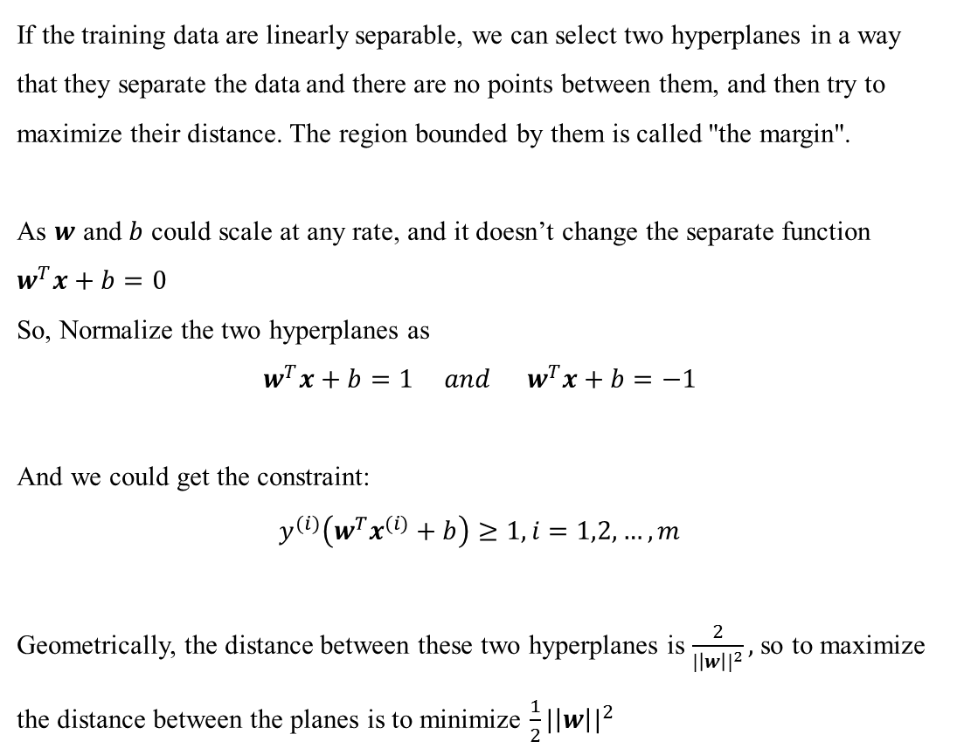
Supervised Learning
2.1 Support Vector Machine
2.1.1 Linear Classifier
If the training data are linearly separable, we can select two hyperplanes in a way that they separate the data and there are no points between them, and then try to maximize their distance. The region bounded by them is called "the margin".
As $w$ and $b$ could scale at any rate, and it doesn’t change the separate function $w^{T}x+b=0$
So, Normalize the two hyperplanes as
$$w^{T}x+b=1 and{ w}^{T}x+b=−1$$
And we could get the constraint:
$$y^{(i)}\left(w^{T}x^{(i)}+b\right)≥1, i=1,2,…,m$$
Geometrically, the distance between these two hyperplanes is $\frac{2}{{|\left|w\right||}^{2}},$so to maximize the distance between the planes is to minimize $\frac{1}{2}{|\left|w\right||}^{2}$
x₂
x₁
Source 支持向量机通俗导论, http://blog.csdn.net/v_july_v/article/details/7624837
Notes:
Huang Cheng asked why we need to consider two hyperplanes instead of the previous one.

Slide 4
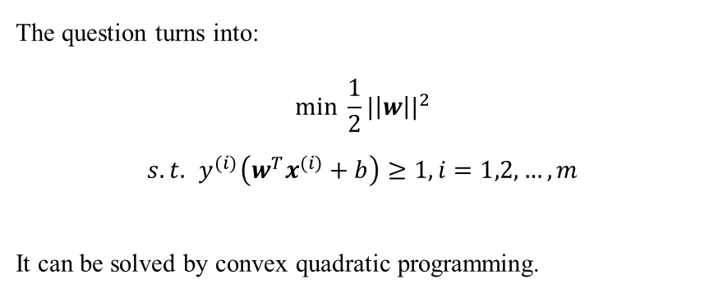
Supervised Learning
2.1 Support Vector Machine
2.1.1 Linear Classifier
x₁
The question turns into:
$$\min{\frac{1}{2}{|\left|w\right||}^{2}}$$
$$s.t.{ y}^{(i)}\left(w^{T}x^{(i)}+b\right)≥1, i=1,2,…,m$$
It can be solved by convex quadratic programming.
x₂
Source 支持向量机通俗导论, http://blog.csdn.net/v_july_v/article/details/7624837
Notes:
Xu Chao asked if what we could do if we got outliers.

Slide 5
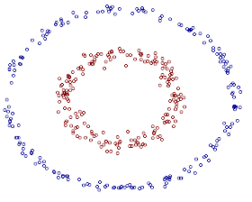

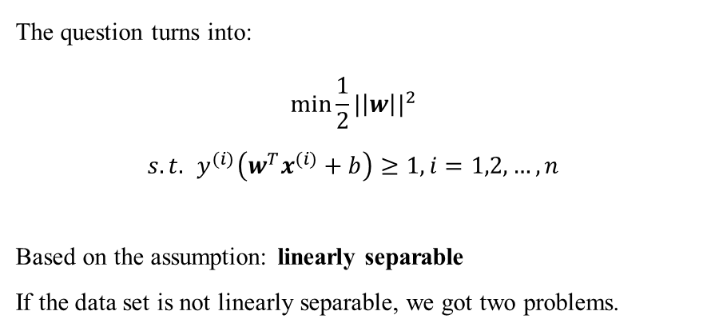
Supervised Learning
2.1 Support Vector Machine
2.1.1 Linear Classifier
The question turns into:
$$\min{\frac{1}{2}{|\left|w\right||}^{2}}$$
$$s.t.{ y}^{(i)}\left(w^{T}x^{(i)}+b\right)≥1, i=1,2,…,n$$
Based on the assumption: linearly separable
If the data set is not linearly separable, we got two problems.
x₂
x₁
Source 支持向量机通俗导论, http://blog.csdn.net/v_july_v/article/details/7624837

Slide 6
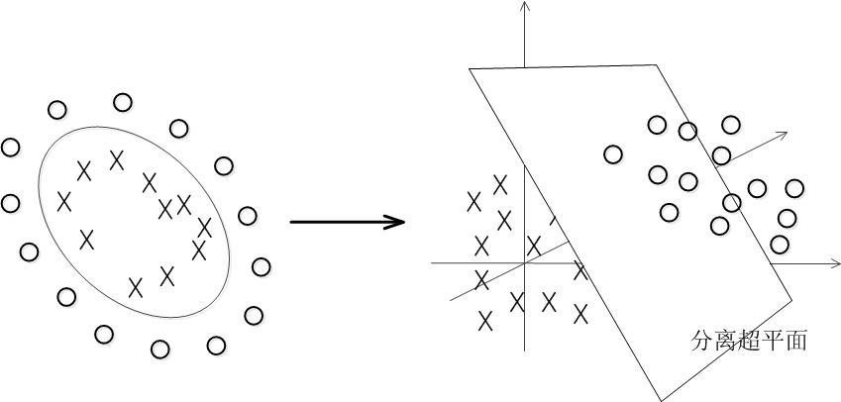
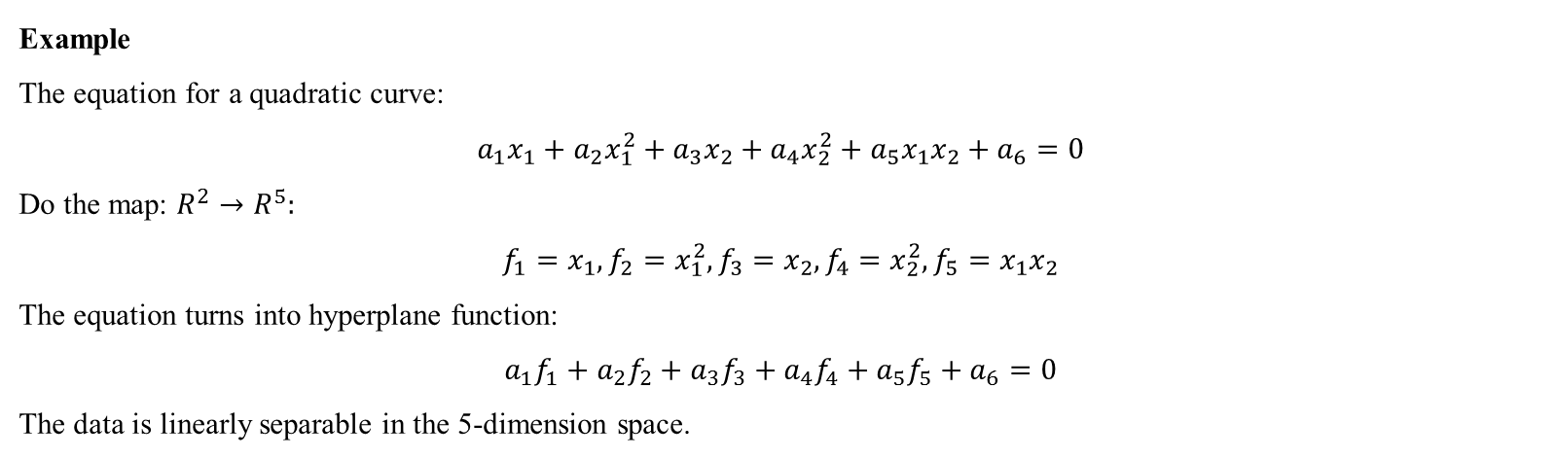
Supervised Learning
2.1 Support Vector Machine
2.1.2 Kernel
The basic idea is to map the data into the high-dimensional feature space.
The classifier is a hyperplane in the high-dimensional feature space, it may be nonlinear in the original input space.
Example
The equation for a quadratic curve:
$$a_{1}x_{1}+a_{2}x_{1}^{2}+a_{3}x_{2}+a_{4}x_{2}^{2}+a_{5}x_{1}x_{2}+a_{6}=0$$
Do the map: $R^{2}→R^{5}:$
$$f_{1}=x_{1},f_{2}=x_{1}^{2}, f_{3}=x_{2},f_{4}=x_{2}^{2},f_{5}=x_{1}x_{2}$$
The equation turns into hyperplane function:
$$a_{1}f_{1}+a_{2}f_{2}+a_{3}f_{3}+a_{4}f_{4}+a_{5}f_{5}+a_{6}=0$$
The data is linearly separable in the 5-dimension space.
Source 支持向量机通俗导论, http://blog.csdn.net/v_july_v/article/details/7624837

Slide 7
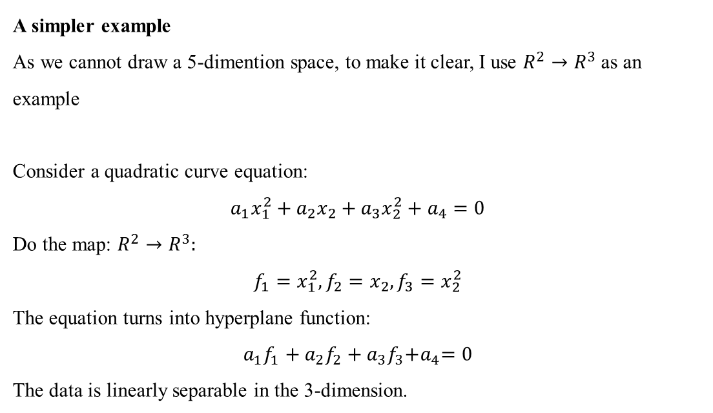
Supervised Learning
2.1 Support Vector Machine
2.1.2 Kernel
A simpler example
As we cannot draw a 5-dimention space, to make it clear, I use $R^{2}→R^{3}$ as an example
Consider a quadratic curve equation:
$$a_{1}x_{1}^{2}+a_{2}x_{2}+a_{3}x_{2}^{2}+a_{4}=0$$
Do the map: $R^{2}→R^{3}:$
$$f_{1}=x_{1}^{2}, f_{2}=x_{2},f_{3}=x_{2}^{2}$$
The equation turns into hyperplane function:
$$a_{1}f_{1}+a_{2}f_{2}+a_{3}f_{3}{+a}_{4}=0$$
The data is linearly separable in the 3-dimension.
Is there a different / better choice of the features${ f}_{1},f_{2},f_{3}$?
Source 支持向量机通俗导论, http://blog.csdn.net/v_july_v/article/details/7624837
Notes:
Okan wondered why the data is separable in the three-dimension.

Slide 8



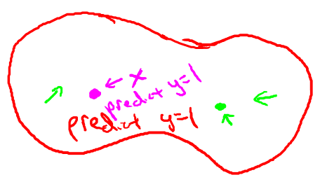
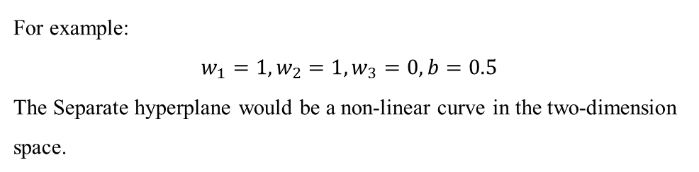
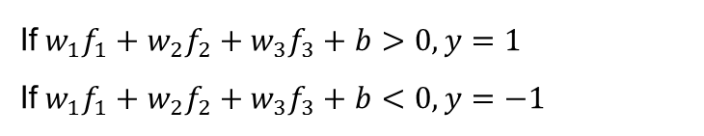
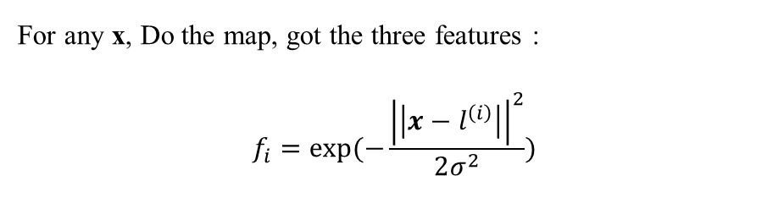
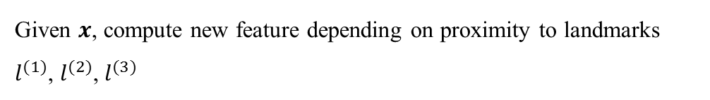
Supervised Learning
2.1 Support Vector Machine
2.1.2 Kernel
Given $x$, compute new feature depending on proximity to landmarks $l^{(1)}$, $l^{(2)}$, $l^{(3)}$
x₂
For any x, Do the map, got the three features :
$$f_{i}=exp(−\frac{{\left|\left|x−l^{\left(i\right)}\right|\right|}^{2}}{2σ^{2}})$$
x₁
If${w_{1}f}_{1}+{w_{2}f}_{2}+{w_{3}f}_{3}+b>0, y=1$
If${w_{1}f}_{1}+{w_{2}f}_{2}+{w_{3}f}_{3}+b<0, y=−1$
x₂
For example:
$$w_{1}=1,w_{2}=1,w_{3}=0, b=0.5$$
The Separate hyperplane would be a non-linear curve in the two-dimension space.
x₁
Source Machine Learning, Andrew Ng, https://class.coursera.org/ml-005/lecture

Slide 9

Supervised Learning
2.1 Support Vector Machine
2.1.2 Kernel
Given Training Data, ($x^{\left(1\right)}, y^{\left(1\right)}$), ($x^{\left(2\right)}, y^{\left(2\right)}$),…, ($x^{\left(m\right)}, y^{\left(m\right)}$)
For $x^{\left(i\right)}$, Calculate the m-dimensional$f^{\left(i\right)}$:
${f_{1}}^{\left(i\right)}=K(x^{\left(i\right)}$, $x^{(1)}),{f_{2}}^{\left(i\right)}=$ $K(x^{\left(i\right)}$, $x^{(2)})$,…,${f_{m}}^{\left(i\right)}=$ $K(x^{\left(i\right)}$, $x^{(m)})$
$y$=1, if $w^{T}f+b>0$
$y$=-1, if $w^{T}f+b<0$
The original question turns into:
$$\min{\frac{1}{2}{|\left|α\right||}^{2}}$$
$$s.t.{ y}^{(i)}\left(α^{T}f^{(i)}+b\right)≥1, i=1,2,…,m$$
Notes:
Zhai Bangzhao wondered how to do the mapping.

Slide 10
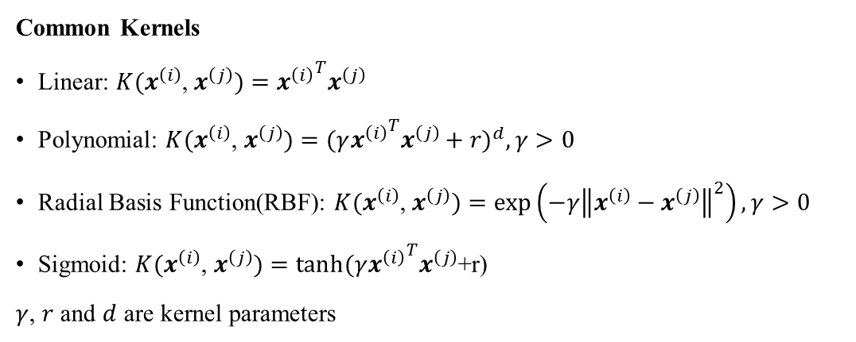
Supervised Learning
2.1 Support Vector Machine
2.1.2 Kernel
Common Kernels
Linear: $K(x^{\left(i\right)}$, $x^{\left(j\right)})={x^{\left(i\right)}}^{T}x^{\left(j\right)}$
Polynomial: $K(x^{\left(i\right)}$, $x^{\left(j\right)})={(γ{x^{\left(i\right)}}^{T}x^{\left(j\right)}+r)}^{d},γ>0$
Radial Basis Function(RBF): $K(x^{\left(i\right)}$, $x^{\left(j\right)})=exp\left(−γ{\left\|x^{\left(i\right)}−x^{\left(j\right)}\right\|}^{2}\right),γ>0$
Sigmoid: $K(x^{\left(i\right)}$, $x^{\left(j\right)})=tanh(γ{x^{\left(i\right)}}^{T}x^{\left(j\right)}$+r)
$γ$, $r$ and $d$ are kernel parameters
Source A Practical Guide to Support Vector Classification, http://www.csie.ntu.edu.tw/~cjlin/papers/guide/guide.pdf
Notes:
Huang Cheng asked how we could choose the suitable kernel function.

Slide 11
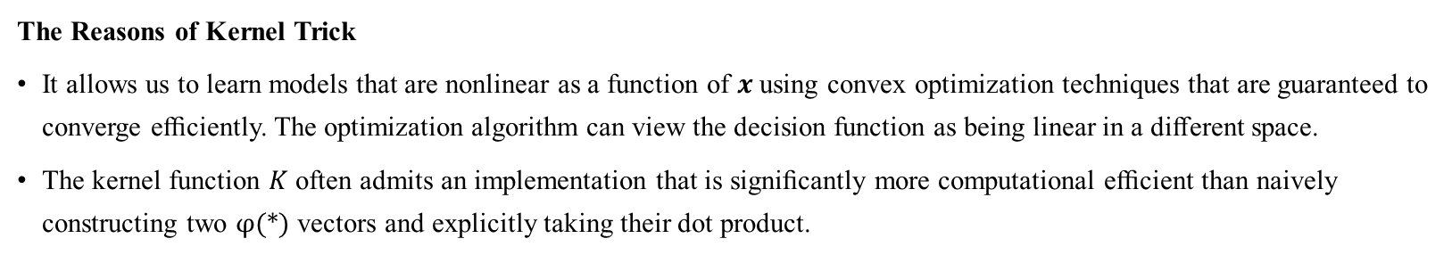
Supervised Learning
2.1 Support Vector Machine
2.1.2 Kernel
The Reasons of Kernel Trick
It allows us to learn models that are nonlinear as a function of $x$ using convex optimization techniques that are guaranteed to converge eﬃciently. The optimization algorithm can view the decision function as being linear in a diﬀerent space.
The kernel function $K$ often admits an implementation that is signiﬁcantly more computational eﬃcient than naively constructing two φ(*) vectors and explicitly taking their dot product.
Drawbacks to Kernel Machines
Kernel machines also suﬀer from a high computational cost of training when the dataset is large.
Kernel machines with generic kernels struggle to generalize well.
Source Deep Learning, Ian Goodfellow, Yoshua Bengio, and Aaron Courville, http://www.deeplearningbook.org, Book in preparation for MIT Press,2016
Notes:
Huang Cheng asked how we could choose the suitable kernel function.

Slide 12
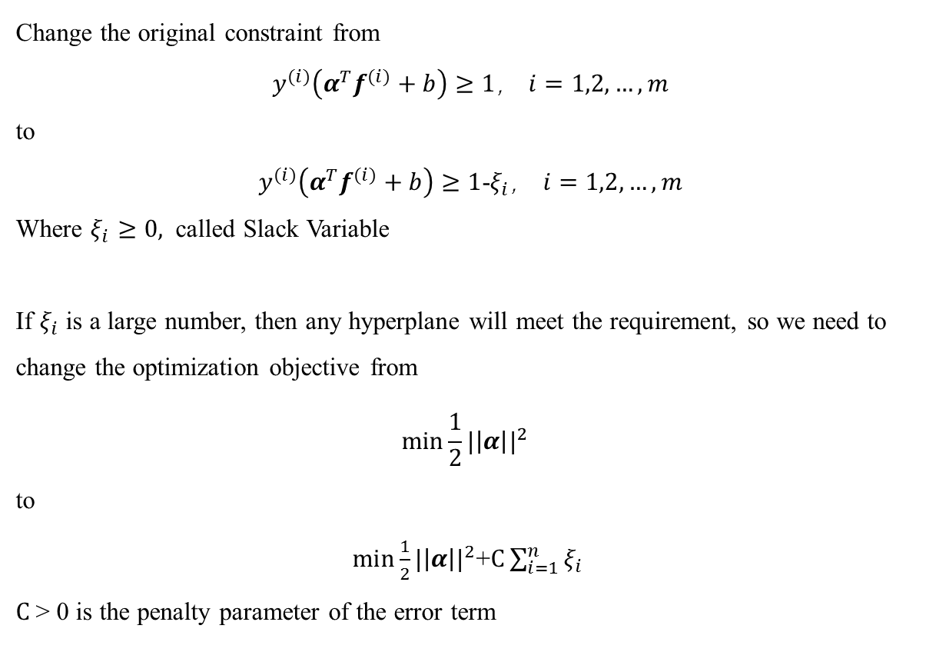
Supervised Learning
2.1 Support Vector Machine
2.1.3 Slack Variable
Change the original constraint from
${ y}^{(i)}\left(α^{T}f^{(i)}+b\right)≥1$， $i=1,2,…,m$
to
${ y}^{(i)}\left(α^{T}f^{(i)}+b\right)≥1$-$ξ_{i}$， $i=1,2,…,m$
Where $ξ_{i}≥0,$ called Slack Variable
If $ξ_{i}$ is a large number, then any hyperplane will meet the requirement, so we need to change the optimization objective from
$$\min{\frac{1}{2}{|\left|α\right||}^{2}}$$
to
$\min{\frac{1}{2}{|\left|α\right||}^{2}}$+$C\sum_{i=1}^{n}{ξ_{i}}$
$C$> 0 is the penalty parameter of the error term
x₂
x₁
Source 支持向量机通俗导论, http://blog.csdn.net/v_july_v/article/details/7624837

Slide 13
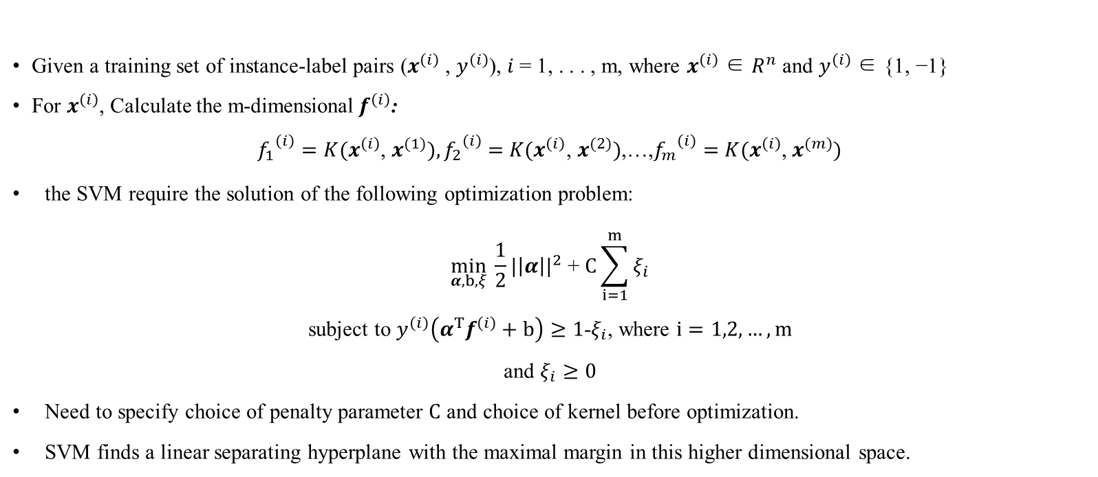
Supervised Learning
2.1 Support Vector Machine
2.1.4 Problem Statement
Given a training set of instance-label pairs ($x^{\left(i\right)}$ , $y^{\left(i\right)}$), $i$= 1, . . . , m, where $x^{\left(i\right)}$ ∈ $R^{n}$ and $y^{\left(i\right)}$ ∈ {1, −1}
For $x^{\left(i\right)}$, Calculate the m-dimensional$f^{\left(i\right)}$:
${f_{1}}^{\left(i\right)}=K(x^{\left(i\right)}$, $x^{(1)}),{f_{2}}^{\left(i\right)}=$ $K(x^{\left(i\right)}$, $x^{(2)})$,…,${f_{m}}^{\left(i\right)}=$ $K(x^{\left(i\right)}$, $x^{(m)})$
the SVM require the solution of the following optimization problem:
$$\min_{α, b, ξ}{\frac{1}{2}{|\left|α\right||}^{2} \text{+} C\sum_{i=1}^{m}{ξ_{i}}}$$
subject to $y^{\left(i\right)}\left(α^{T}f^{\left(i\right)}+b\right)≥1$-$ξ_{i}$, where $i=1,2,…,m$
and $ξ_{i}≥0$
Need to specify choice of penalty parameter $C$ and choice of kernel before optimization.
SVM finds a linear separating hyperplane with the maximal margin in this higher dimensional space.
Source A Practical Guide to Support Vector Classification, http://www.csie.ntu.edu.tw/~cjlin/papers/guide/guide.pdf
Notes:
Yu Mengxin questioned if we need to find the parameters before every training, it’s time-consuming.

Slide 14
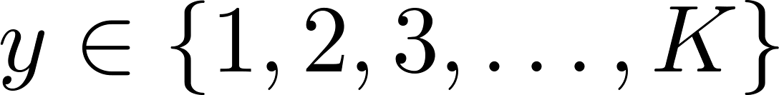
Supervised Learning
2.1 Support Vector Machine
2.1.5 Multiclass Classification
Use one-vs.-all method. (Train K SVMs, one to distinguish y= i from the rest, for i = 1,2,..K)
Source Machine Learning, Andrew Ng, https://class.coursera.org/ml-005/lecture

Slide 15
Supervised Learning
2.1 Support Vector Machine
2.1.6 Advantages and Disadvantages
Compare SVM with NN
Similarity
SVM + sigmoid kernel ~ two-layer feedforward NN
SVM + Gaussian kernel ~ RBF network
For most problems, SVM and NN have similar performance
Advantages
Based on sound mathematics theory Based on sound mathematics theory
Learning result is more robust
Over-fitting is not common
Not trapped in local minima (because of QP)
Fewer parameters to consider (kernel, error cost C)
Works well with fewer training samples (number of support vectors do not matter much)
Disadvantages
Problem need to be formulated as 2-class classification
Learning takes long time (QP optimization)
Source https://goo.gl/UBi0O8

Slide 16
Supervised Learning
2.1 Support Vector Machine
2.1.6 Advantages and Disadvantages
Advantages
prediction accuracy is generally high
robust works when training examples contain errors robust, works when training examples contain errors
fast evaluation of the learned target function
Criticism
long training time
difficult to understand the learned function(weights)
not easy to incorporate domain
Source https://goo.gl/UBi0O8

