Slide 1
Deep Learning
5.1 Convolutional Neural Networks
5.1.1 Overview
Convolutional networks (LeCun, 1989), also known as convolutional neural networks or CNNs, are a specialized kind of neural network for processing data that has a known, grid-like topology.
Deep neural networks exploit the property that many natural signals are compositional hierarchies, in which higher-level features are obtained by composing lower-level ones. In images, local combinations of edges form motifs, motifs assemble into parts, and parts form objects. Similar hierarchies exist in speech and text from sounds to phones, phonemes, syllables, words and sentences.
Convolutional networks have been tremendously successful in practical applications.

Slide 2
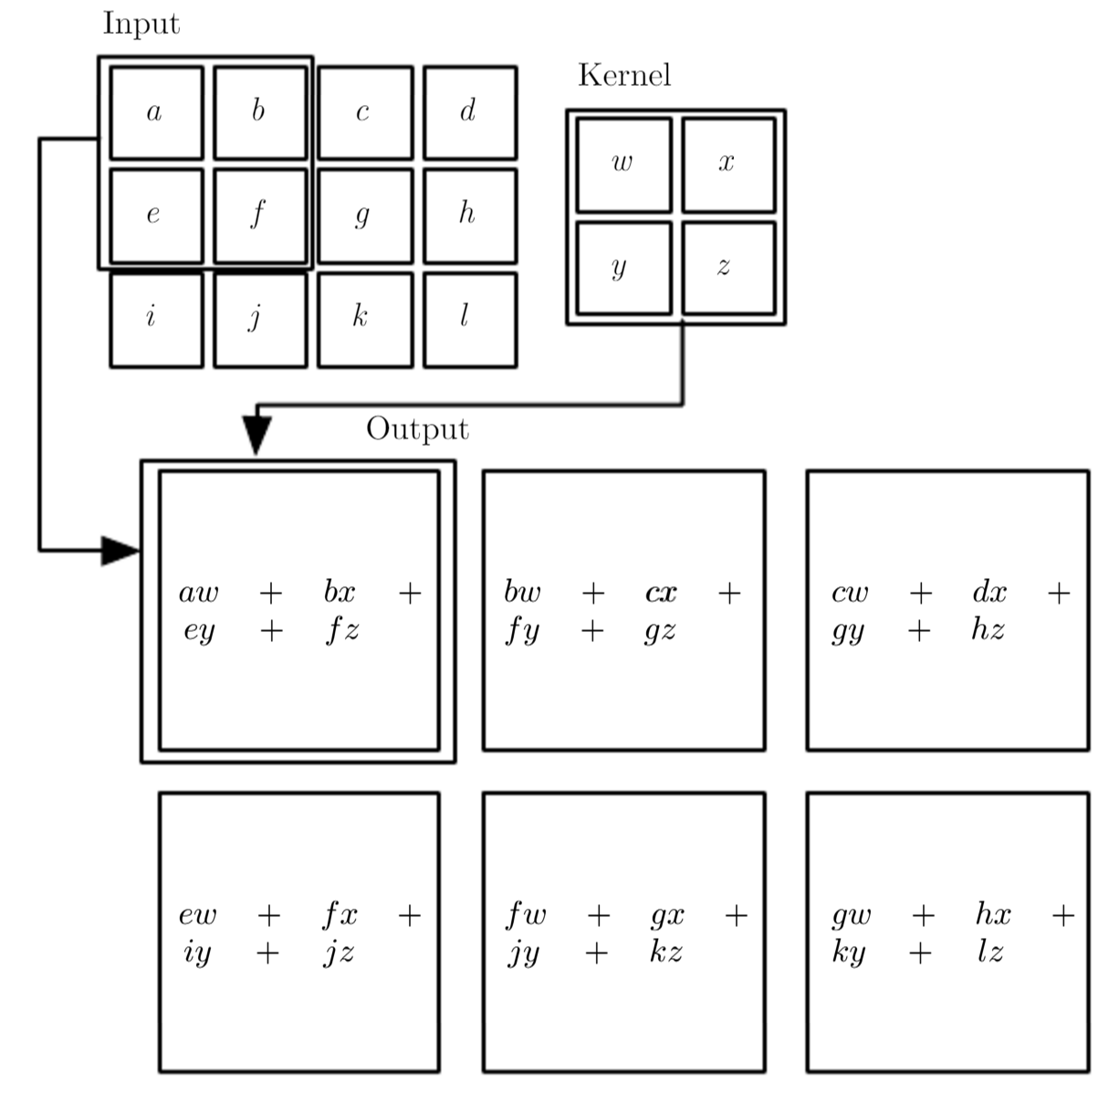
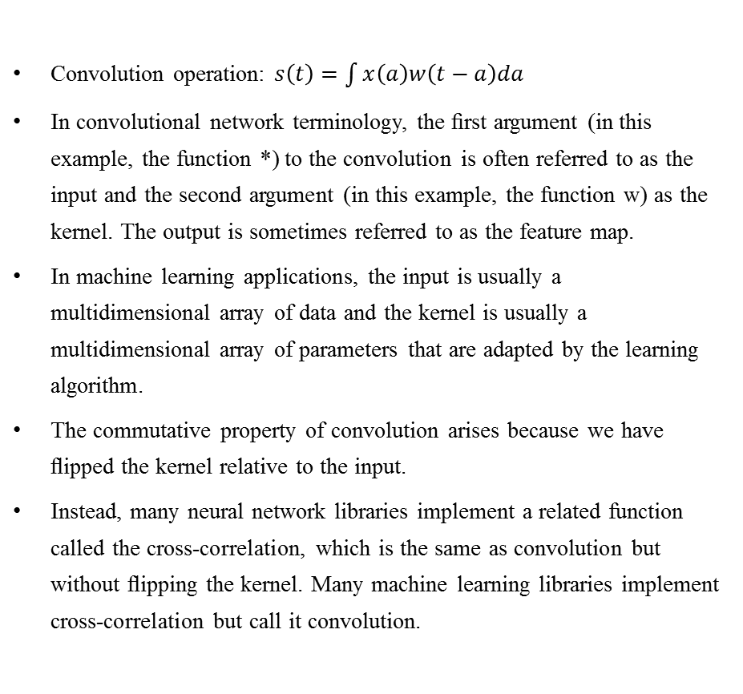
Deep Learning
5.1 Convolutional Neural Networks
5.1.2 What is Convolution
Convolution operation: $s\left(t\right)=\int{x\left(a\right)w\left(t−a\right)da}$
In convolutional network terminology, the ﬁrst argument (in this example, the function *) to the convolution is often referred to as the input and the second argument (in this example, the function w) as the kernel. The output is sometimes referred to as the feature map.
In machine learning applications, the input is usually a multidimensional array of data and the kernel is usually a multidimensional array of parameters that are adapted by the learning algorithm.
The commutative property of convolution arises because we have ﬂipped the kernel relative to the input.
Instead, many neural network libraries implement a related function called the cross-correlation, which is the same as convolution but without ﬂipping the kernel. Many machine learning libraries implement cross-correlation but call it convolution.
An example of 2-D convolution without kernel-ﬂipping.

Slide 3
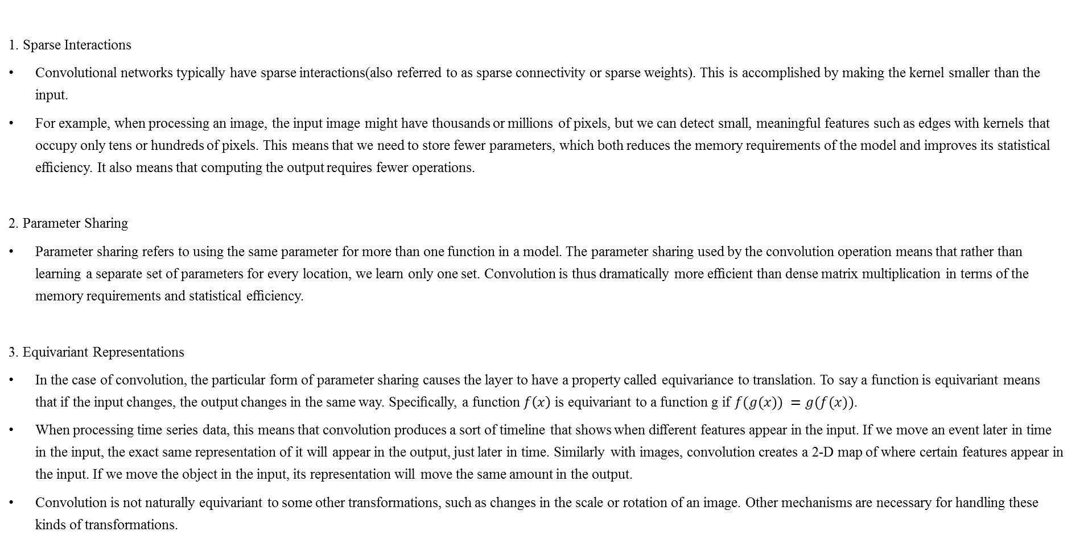
Deep Learning
5.1 Convolutional Neural Networks
5.1.3 Motivation of Convolution
1. Sparse Interactions
Convolutional networks typically have sparse interactions(also referred to as sparse connectivity or sparse weights). This is accomplished by making the kernel smaller than the input.
For example, when processing an image, the input image might have thousands or millions of pixels, but we can detect small, meaningful features such as edges with kernels that occupy only tens or hundreds of pixels. This means that we need to store fewer parameters, which both reduces the memory requirements of the model and improves its statistical eﬃciency. It also means that computing the output requires fewer operations.
2. Parameter Sharing
Parameter sharing refers to using the same parameter for more than one function in a model. The parameter sharing used by the convolution operation means that rather than learning a separate set of parameters for every location, we learn only one set. Convolution is thus dramatically more eﬃcient than dense matrix multiplication in terms of the memory requirements and statistical eﬃciency.
3. Equivariant Representations
In the case of convolution, the particular form of parameter sharing causes the layer to have a property called equivariance to translation. To say a function is equivariant means that if the input changes, the output changes in the same way. Speciﬁcally, a function $f\left(x\right)$ is equivariant to a function g if $f(g(x)) =g(f(x))$.
When processing time series data, this means that convolution produces a sort of timeline that shows when diﬀerent features appear in the input. If we move an event later in time in the input, the exact same representation of it will appear in the output, just later in time. Similarly with images, convolution creates a 2-D map of where certain features appear in the input. If we move the object in the input, its representation will move the same amount in the output.
Convolution is not naturally equivariant to some other transformations, such as changes in the scale or rotation of an image. Other mechanisms are necessary for handling these kinds of transformations.

Slide 4
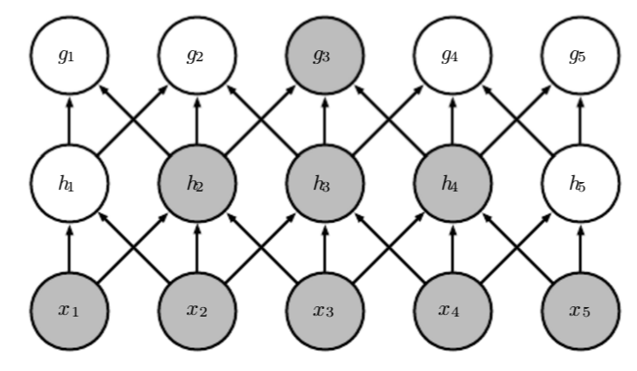
Deep Learning
5.1 Convolutional Neural Networks
5.1.3 Motivation of Convolution
Explanation of Sparse Interactions
The receptive ﬁeld of the units in the deeper layers of a convolutional network is larger than the receptive ﬁeld of the units in the shallow layers. This eﬀect increases if the network includes architectural features like strided convolution or pooling. This means that even though direct connections in a convolutional net are very sparse, units in the deeper layers can be indirectly connected to all or most of the input image.

Slide 5
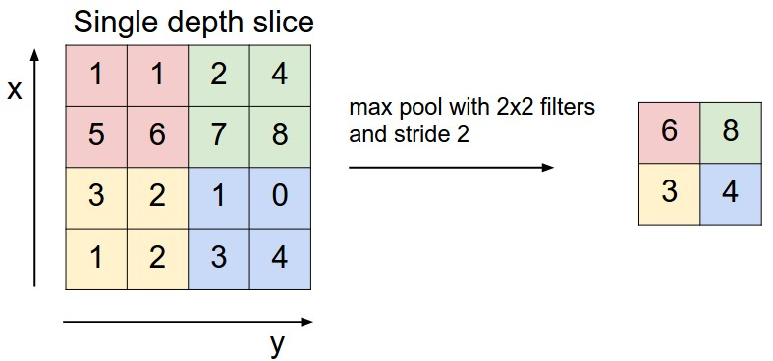
Deep Learning
5.1 Convolutional Neural Networks
5.1.4 Pooling
Features:
In all cases, pooling helps to make the representation become approximately invariant to small translations of the input. Invariance to local translation can be a very useful property if we care more about whether some feature is present than exactly where it is.
Because pooling summarizes the responses over a whole neighborhood, it is possible to use fewer pooling units than detector units, by reporting summary statistics for pooling regions. This improves the computational eﬃciency of the network.
For many tasks, pooling is essential for handling inputs of varying size.
Usage:
Some theoretical work gives guidance as to which kinds of pooling one should use in various situations (Boureau et al., 2010). It is also possible to dynamically pool features together, for example, by running a clustering algorithm on the locations of interesting features (Boureau et al., 2011). This approach yields a diﬀerent set of pooling regions for each image. Another approach is to learn a single pooling structure that is then applied to all images (Jia et al., 2012).
Pooling can complicate some kinds of neural network architectures that use top-down information, such as Boltzmann machines and auto encoders.

Slide 6
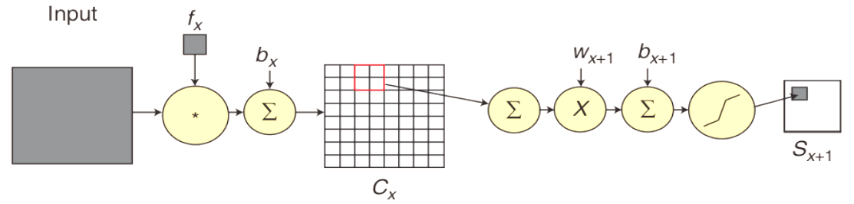
Deep Learning
5.1 Convolutional Neural Networks
5.1.5 The Convolution Process and Subsampling Process
The CNNs is comprised of a sequence of convolution process and subsampling process. The convolution process convolves an input with a trainable filter $f_{x}$ and adds a trainable bias $b_{x}$ to produce the convolution layer $C_{x}$, and the subsampling process sums a neighborhood, weights by scalar $w_{x+1}$, adds the trainable bias $b_{x+1}$, and passes through a sigmoid function to produce a smaller feature map $S_{x+1}$.

Slide 7
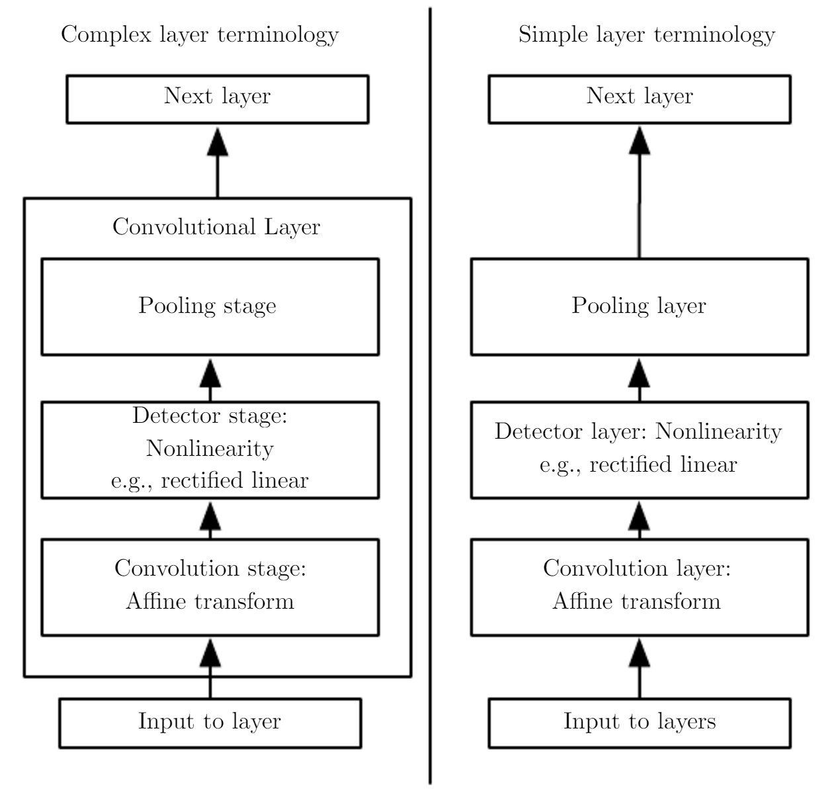
Deep Learning
5.1 Convolutional Neural Networks
5.5.6 Architectures of convolutional networks
The components of a typical convolutional neural network layer. There are two commonly used sets of terminology for describing these layers.
(Left) In this terminology, the convolutional net is viewed as a small number of relatively complex layers, with each layer having many “stages.” In this terminology, there is a one-to-one mapping between kernel tensors and network layers. In this book we generally use this terminology.
(Right)In this terminology, the convolutional net is viewed as a larger number of simple layers; every step of processing is regarded as a layer in its own right. This means that not every “layer” has parameters.

Slide 8
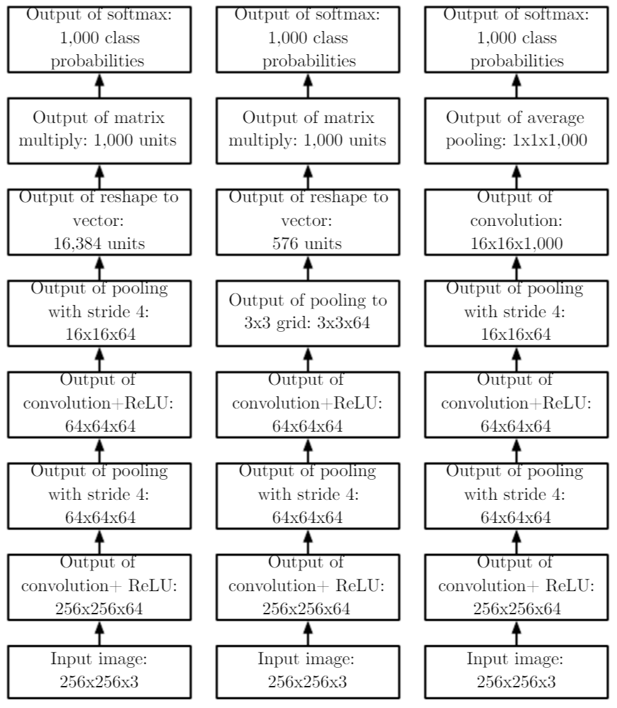
Deep Learning
5.1 Convolutional Neural Networks
5.5.6 Architectures of convolutional networks
The speciﬁc strides and depths used in this ﬁgure are not advisable for real use; they are designed to be very shallow in order to ﬁt onto the page. Real convolutional networks also often involve signiﬁcant amounts of branching, unlike the chain structures used here for simplicity.
(Left) A convolutional network that processes a ﬁxed image size. After alternating between convolution and pooling for a few layers, the tensor for the convolutional feature map is reshaped to ﬂatten out the spatial dimensions. The rest of the network is an ordinary feedforward network classiﬁer.
(Center) A convolutional network that processes a variable-sized image, but still maintains a fully connected section. This network uses a pooling operation with variably-sized pools but a ﬁxed number of pools, in order to provide a ﬁxed-size vector of 576 units to the fully connected portion of the network.
(Right) A convolutional network that does not have any fully connected weight layer. Instead, the last convolutional layer outputs one feature map per class. The model presumably learns a map of how likely each class is to occur at each spatial location. Averaging a feature map down to a single value provides the argument to the softmax classiﬁer at the top.

Slide 9
Deep Learning
5.1 Convolutional Neural Networks
5.1.7 Variants of the Basic Convolution Function
1. Convolution with a stride
We may want to skip over some positions of the kernel in order to reduce the computational cost (at the expense of not extracting our features as ﬁnely). We can think of this as down sampling the output of the full convolution function. It is also possible to deﬁne a separate stride for each direction of motion.
2. Zero padding
One essential feature of any convolutional network implementation is the ability to implicitly zero-pad the input in order to make it wider.
3. Locally connected layers, tiled convolution
Locally connected layers are useful when we know that each feature should be a function of a small part of space, but there is no reason to think that the same feature should occur across all of space.
Tiled convolution (Gregor and LeCun, 2010a; Le et al., 2010) oﬀers a compromise between a convolutional layer and a locally connected layer. Rather than learning a separate set of weights at every spatial location, we learn a set of kernels that we rotate through as we move through space.

Slide 10
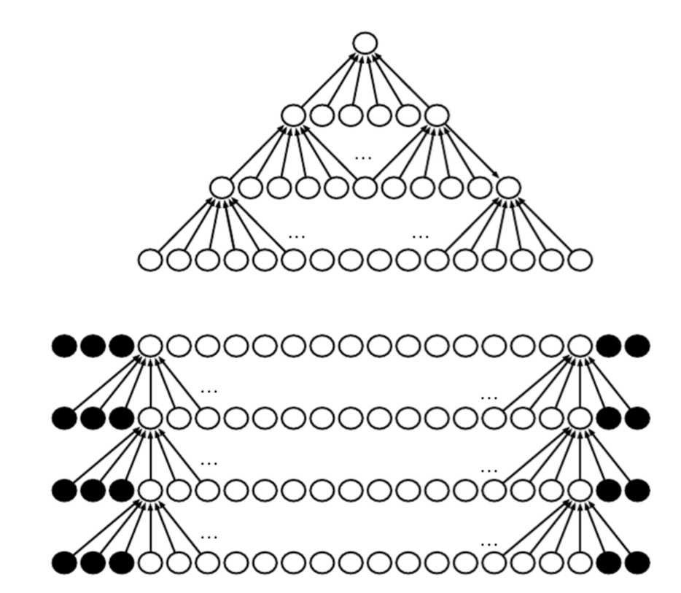
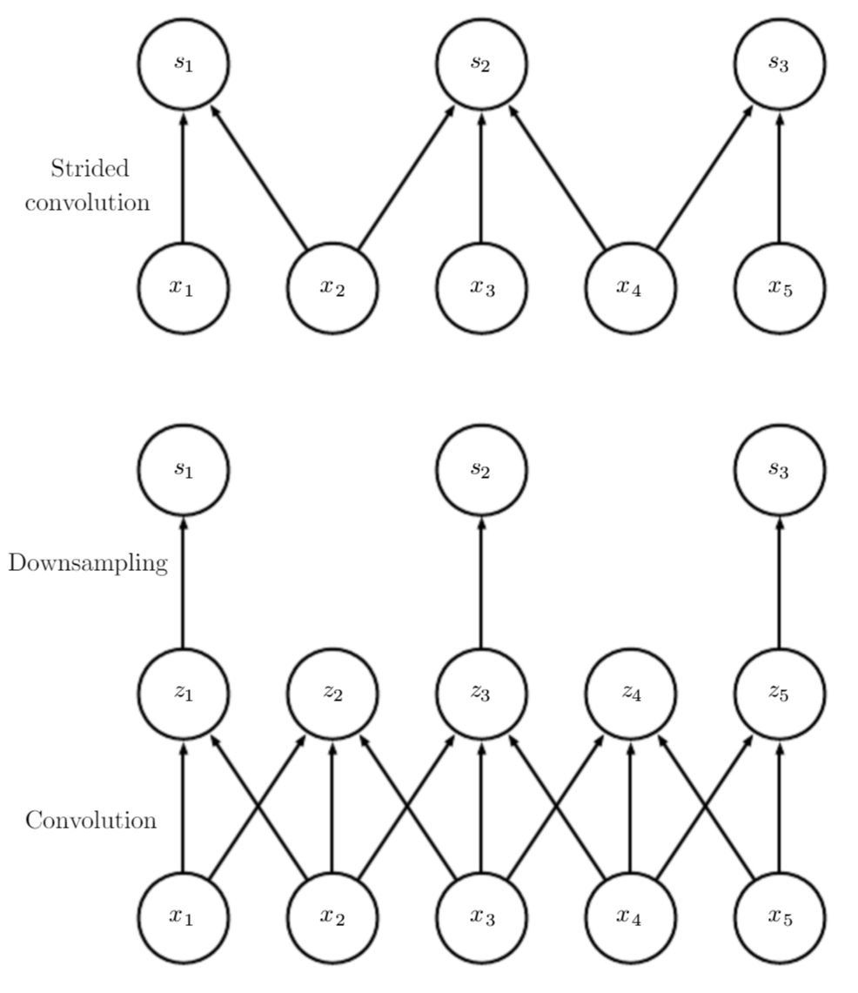
Deep Learning
5.1 Convolutional Neural Networks
5.1.7 Variants of the Basic Convolution Function
The eﬀect of zero padding on network size
Consider a convolutional network with a kernel of width six at every layer. In this example, we do not use any pooling, soonly the convolution operation itself shrinks the network size.
(Top) In this convolutional network, we do not use any implicit zero padding. This causes the representation to shrink by ﬁve pixels at each layer.
(Bottom) By adding ﬁve implicit zeroes to each layer, we prevent the representation from shrinking with depth. This allows us to make an arbitrarily deep convolutional network.
Convolution with a stride
(Top)Convolution with a stride length of two implemented in a single operation.
(Bottom)Convolution with a stride greater than one pixel is mathematically equivalent to convolution with unit stride followed by downsampling.
Obviously, the two-step approach involving downsampling is computationally wasteful, because it computes many values that are then discarded.

Slide 11
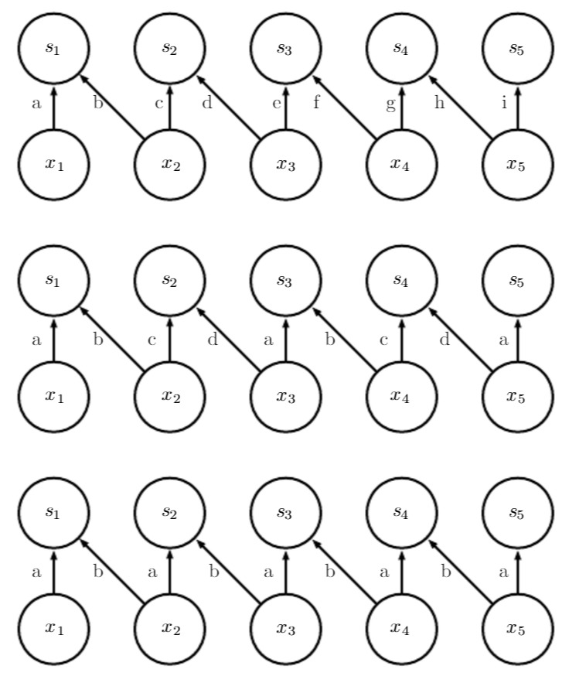
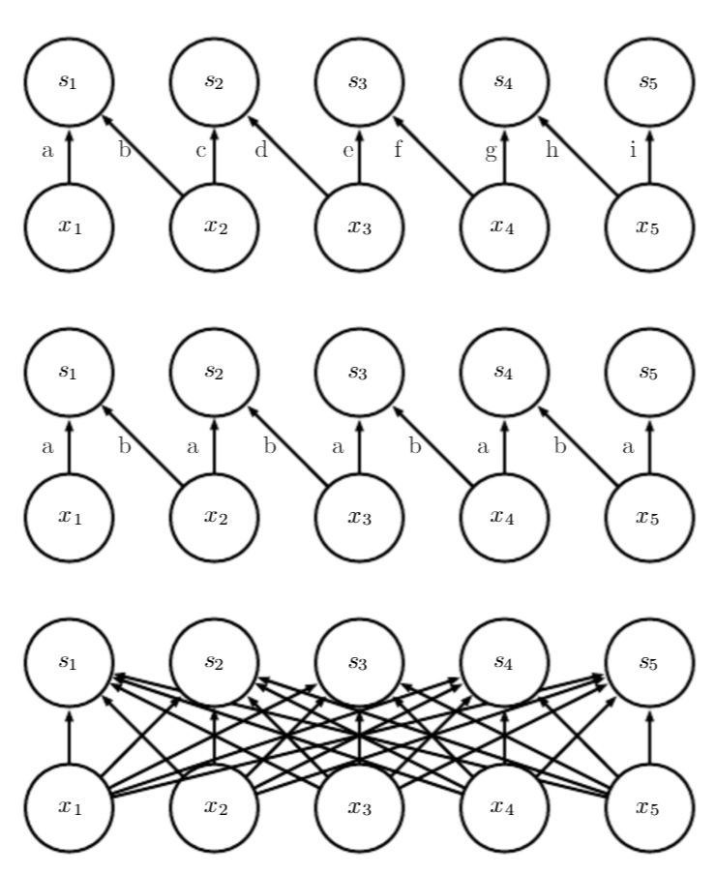
Deep Learning
5.1 Convolutional Neural Networks
5.1.7 Variants of the Basic Convolution Function
A comparison of locally connected layers, tiled convolution, and standard convolution
All three have the same sets of connections between units, when the same size of kernel is used. This diagram illustrates the use of a kernel that is two pixels wide. The diﬀerences between the methods lies in how they share parameters.
(Top) A locally connected layer has no sharing at all.
(Center) Tiled convolution has a set of t diﬀerent kernels. Here we illustrate the case of t= 2.
(Bottom) Traditional convolution is equivalent to tiled convolution with t= 1. There is only one kernel and it is applied everywhere.
Comparison of local connections, convolution, and full connections
(Top) A locally connected layer with a patch size of two pixels. Each edge is labeled with a unique letter to show that each edge is associated with its own weight parameter.
(Center) A convolutional layer with a kernel width of two pixels. This model has exactly the same connectivity as the locally connected layer. The locally connected layer has no parameter sharing.
(Bottom) A fully connected layer does not have the restricted connectivity of the locally connected layer.

Slide 12
Deep Learning
5.1 Convolutional Neural Networks
5.1.8 Data Types
The data used with a convolutional network usually consists of several channels, each channel being the observation of a diﬀerent quantity at some point in space or time.
For an example of convolutional networks applied to video, see Chen et al.(2010).
 | Single Channel | Multi-Channel
1-D | Audio waveform: The axis we convolve over corresponds to time. We discretize time and measure the amplitude of the waveform once per time step. | Skeleton animation data: Animations of 3-D computer-rendered characters are generated by altering the pose of a “skeleton” overtime. At each point in time, the pose of the character is described by a speciﬁcation of the angles of each of the joints in the character’s skeleton. Each channel in the data we feed to the convolutional model represents the angle about one axis of one joint.
2-D | Audio data that has been preprocessed with a Fourier transform: We can transform the audio wave-form into a 2D tensor with different rows corresponding to different frequencies and diﬀerent columns corresponding to diﬀerent points in time. Using convolution in the time makes the model equivariant to shifts in time. Using convolution across the frequency axis makes the model equivariant to frequency, so that the same melody played in a different octave produces the same representation but at a diﬀerent height in the network’s output. | Color image data: One channel contains the red pixels, one the green pixels, and one the blue pixels. The convolution kernel moves over both the horizontal and vertical axes of the image, conferring translation equivariance in both directions.
3-D | Volumetric data: A common source of this kind of data is medical imaging technology, such as CT scans. | Color video data: One axis corresponds to time, one to the height of the video frame, and one to the width of the video frame.
Examples of diﬀerent formats of data that can be used with convolutional networks.

Slide 13
Deep Learning
5.1 Convolutional Neural Networks
5.1.8 Data Types
Processing variable sized inputs
One advantage to convolutional networks is that they can also process inputs with varying spatial extents. These kinds of input simply cannot be represented by traditional, matrix multiplication-based neural networks.
For example, consider a collection of images, where each image has a diﬀerent width and height. It is unclear how to model such inputs with a weight matrix of ﬁxed size. Convolution is straightforward to apply; the kernel is simply applied a diﬀerent number of times depending on the size of the input, and the output of the convolution operation scales accordingly. In some cases, the network must produce some ﬁxed-size output. In this case we must make some additional design steps, like inserting a pooling layer whose pooling regions scale in size proportional to the size of the input, in order to maintain a ﬁxed number of pooled outputs.
Note that the use of convolution for processing variable sized inputs only makes sense for inputs that have variable size because they contain varying amounts of observation of the same kind of thing—diﬀerent lengths of recordings overtime, diﬀerent widths of observations over space, etc. Convolution does not make sense if the input has variable size because it can optionally include diﬀerent kinds of observations. For example, if we are processing college applications, and our features consist of both grades and standardized test scores, but not every applicant took the standardized test, then it does not make sense to convolve the same weights over both the features corresponding to the grades and the features corresponding to the test scores.

Slide 14
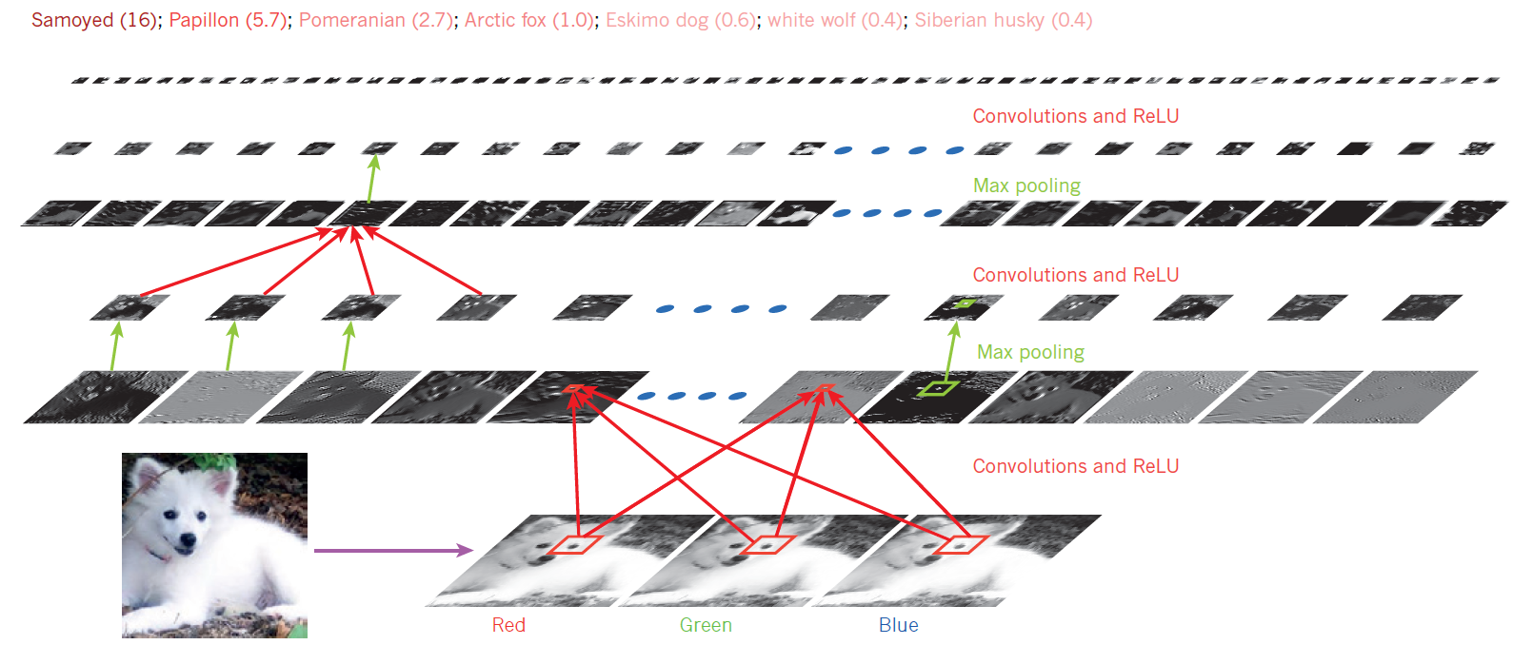
Deep Learning
5.1 Convolutional Neural Networks
5.1.9 Example
The outputs of each layer (horizontally) of a typical convolutional network architecture applied to the image of a Samoyed dog (bottom left; and RGB (red, green, blue) inputs, bottom right). Each rectangular image is a feature map corresponding to the output for one of the learned features, detected at each of the image positions. Information flows bottom up, with lower-level features acting as oriented edge detectors, and a score is computed for each image class in output. ReLU, rectified linear unit.

