Slide 1
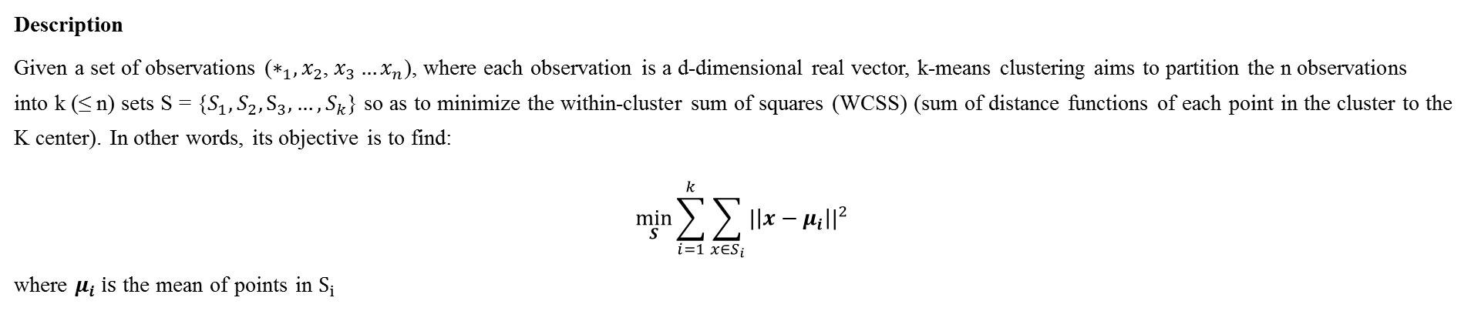
Unsupervised Learning
3.2 k-means Clustering
3.2.1 Introduction
Description
Given a set of observations ($∗_{1}, x_{2}$, $x_{3}…x_{n}$), where each observation is a d-dimensional real vector, k-means clustering aims to partition the n observations into k (≤ n) sets S = {$S_{1}, S_{2}, S_{3},…,S_{k}$} so as to minimize the within-cluster sum of squares (WCSS) (sum of distance functions of each point in the cluster to the K center). In other words, its objective is to find:
$$\min_{S}{\sum_{i=1}^{k}{\sum_{x∈S_{i}}{{|\left|x−μ_{i}\right||}^{2}}}}$$
where $μ_{i} is$ the mean of points in $S_{i}$
Initialization methods
Commonly used initialization methods are Forgy and Random Partition.
The Forgy method randomly chooses k observations from the data set and uses these as the initial means.
The Random Partition method first randomly assigns a cluster to each observation and then proceeds to the update step, thus computing the initial mean to be the centroid of the cluster's randomly assigned points.
The Forgy method tends to spread the initial means out, while Random Partition places all of them close to the center of the data set.
The Random Partition method is generally preferable for algorithms such as the k-harmonic means and fuzzy k-means. For expectation maximization and standard k-means algorithms, the Forgy method of initialization is preferable.

Slide 2
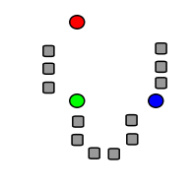
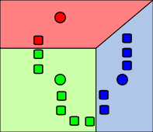
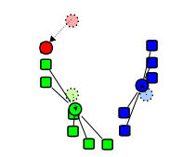
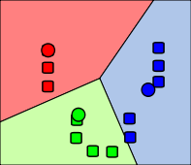
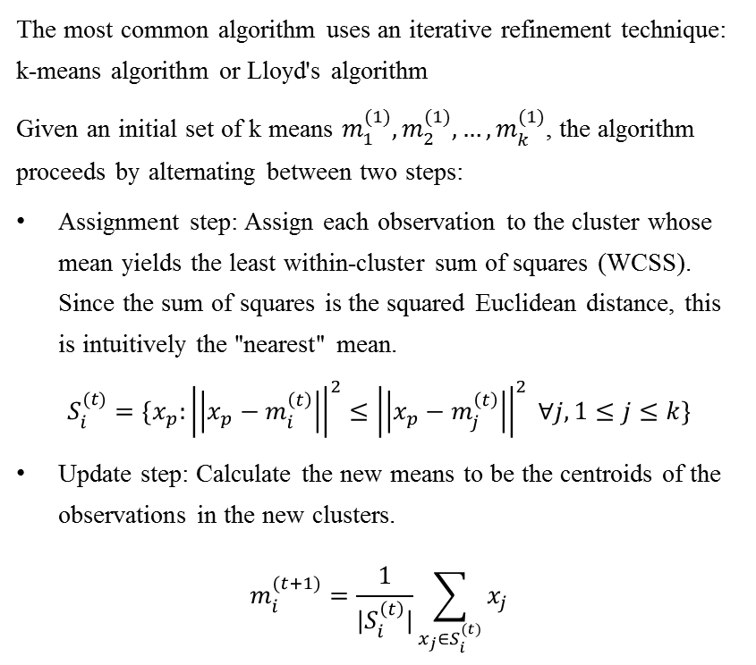
Unsupervised Learning
3.2 k-means Clustering
3.2.2 Standard algorithm
The most common algorithm uses an iterative refinement technique: k-means algorithm or Lloyd's algorithm
Given an initial set of k means $m_{1}^{(1)}, m_{2}^{(1)},…,m_{k}^{(1)}$, the algorithm proceeds by alternating between two steps:
Assignment step: Assign each observation to the cluster whose mean yields the least within-cluster sum of squares (WCSS). Since the sum of squares is the squared Euclidean distance, this is intuitively the "nearest" mean.
$$S_{i}^{(t)}=\{x_{p}:{\left|\left|x_{p}−m_{i}^{\left(t\right)}\right|\right|}^{2}≤{\left|\left|x_{p}−m_{j}^{\left(t\right)}\right|\right|}^{2} ∀j, 1≤j≤k\}$$
Update step: Calculate the new means to be the centroids of the observations in the new clusters.
$$m_{i}^{(t+1)}=\frac{1}{|S_{i}^{\left(t\right)}|}\sum_{x_{j}∈S_{i}^{(t)}}{x_{j}}$$
1. k initial "means" (in this case k=3) are randomly generated within the data domain (shown in color).
2. k clusters are created by associating every observation with the nearest mean.
3. The centroid of each of the k clusters becomes the new mean.
4. Steps 2 and 3 are repeated until convergence has been reached.

Slide 3
Unsupervised Learning
3.2 k-means Clustering
3.2.3 Limitation
The number of clusters k is an input parameter: an inappropriate choice of k may yield poor results. That is why, when performing k-means, it is important to run diagnostic checks for determining the number of clusters in the data set.
Convergence to a local minimum may produce counterintuitive (“wrong”) results.

