Slide 1
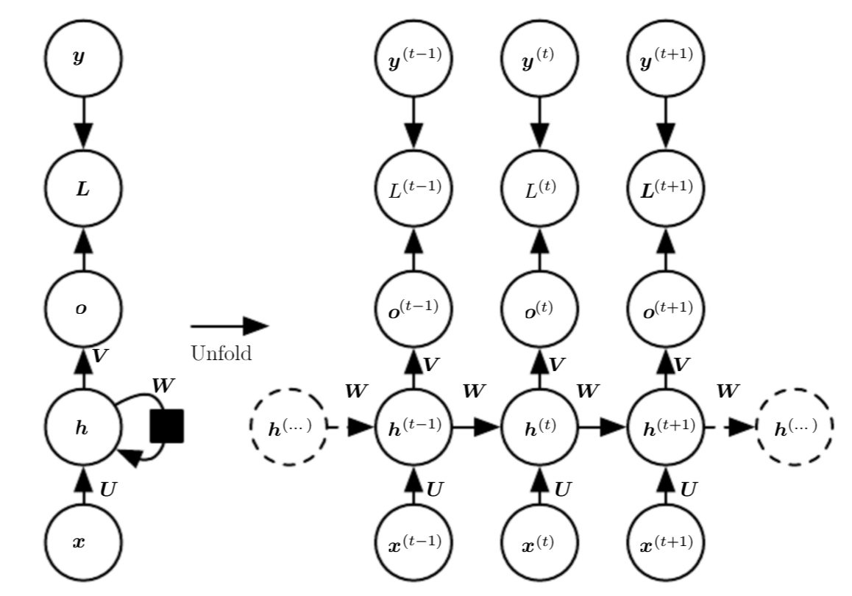
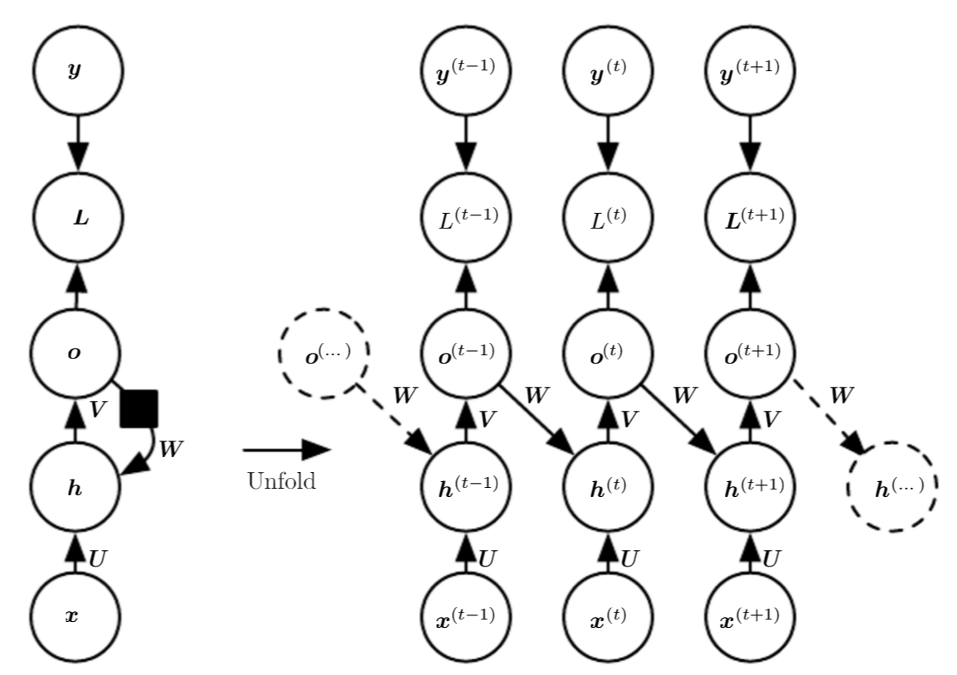
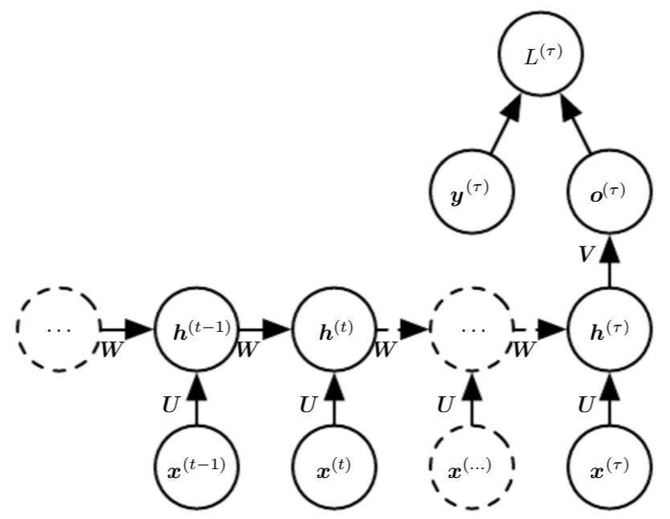
Deep Learning
5.2 Recurrent and Recursive Nets
5.2.1 Overview
Recurrent neural networks or RNNs (Rumelhart et al., 1986a) are a family of neural networks for processing sequential data. Most recurrent networks can also process sequences of variable length.
a recurrent neural network shares the same weights across several time steps.
Some examples of important design patterns for recurrent neural networks include the following:
Recurrent networks that produce an output at each time step and have recurrent connections between hidden units, illustrated in left figure.
Recurrent networks that produce an output at each time step and have recurrent connections only from the output at one time step to the hidden units at the next time step, illustrated in medium figure.
Recurrent networks with recurrent connections between hidden units, that read an entire sequence and then produce a single output, illustrated in right figure.

Slide 2
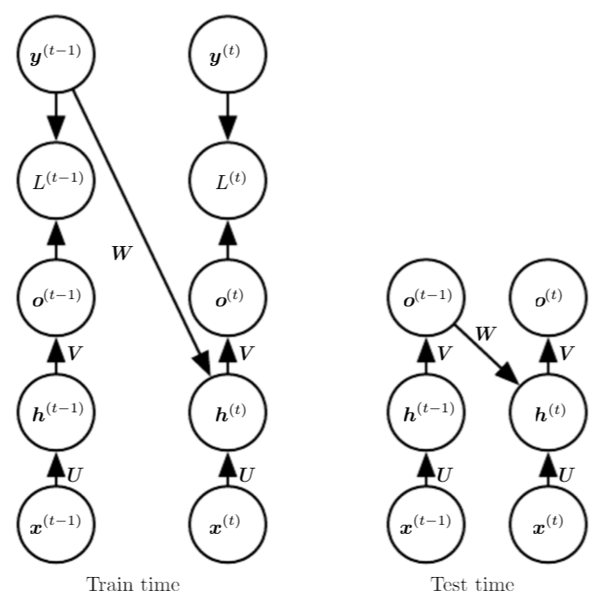
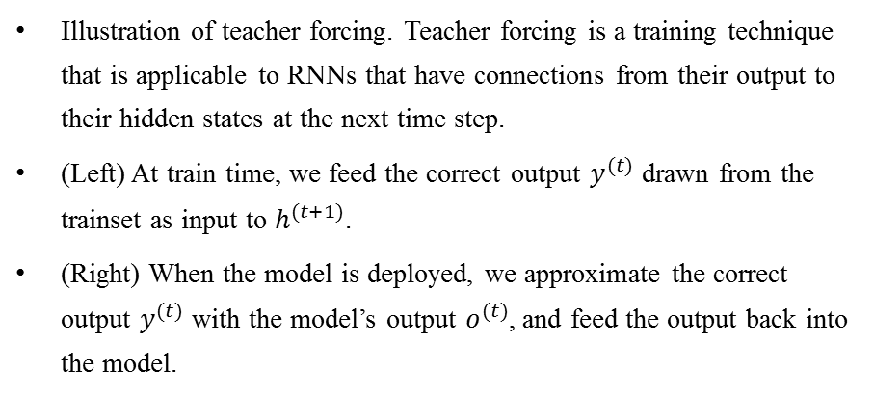
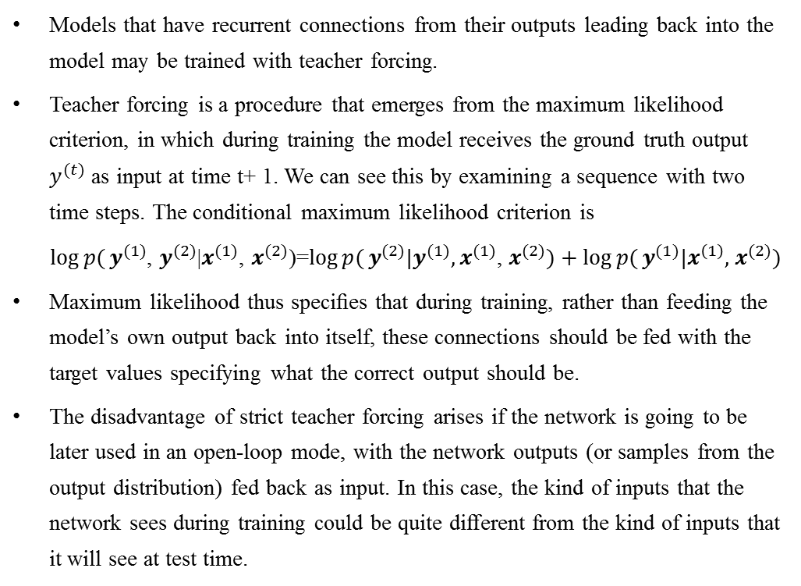
Deep Learning
5.2 Recurrent and Recursive Nets
5.2.2 Teacher Forcing and Networks with Output Recurrence
Models that have recurrent connections from their outputs leading back into the model may be trained with teacher forcing.
Teacher forcing is a procedure that emerges from the maximum likelihood criterion, in which during training the model receives the ground truth output $y^{(t)}$ as input at time t+ 1. We can see this by examining a sequence with two time steps. The conditional maximum likelihood criterion is
$\log{p(}y^{(1)}$, $y^{(2)}$|$x^{(1)}$, $x^{(2)}$)=$\log{p(}y^{(2)}|y^{(1)}{,x}^{(1)}$, $x^{(2)})+\log{p(}y^{(1)}|x^{\left(1\right)},$ $x^{(2)})$
Maximum likelihood thus speciﬁes that during training, rather than feeding the model’s own output back into itself, these connections should be fed with the target values specifying what the correct output should be.
The disadvantage of strict teacher forcing arises if the network is going to be later used in an open-loop mode, with the network outputs (or samples from the output distribution) fed back as input. In this case, the kind of inputs that the network sees during training could be quite diﬀerent from the kind of inputs that it will see at test time.
Illustration of teacher forcing. Teacher forcing is a training technique that is applicable to RNNs that have connections from their output to their hidden states at the next time step.
(Left) At train time, we feed the correct output $y^{(t)}$ drawn from the trainset as input to $h^{(t+1)}$.
(Right) When the model is deployed, we approximate the correct output $y^{(t)}$ with the model’s output $o^{(t)}$, and feed the output back into the model.

Slide 3
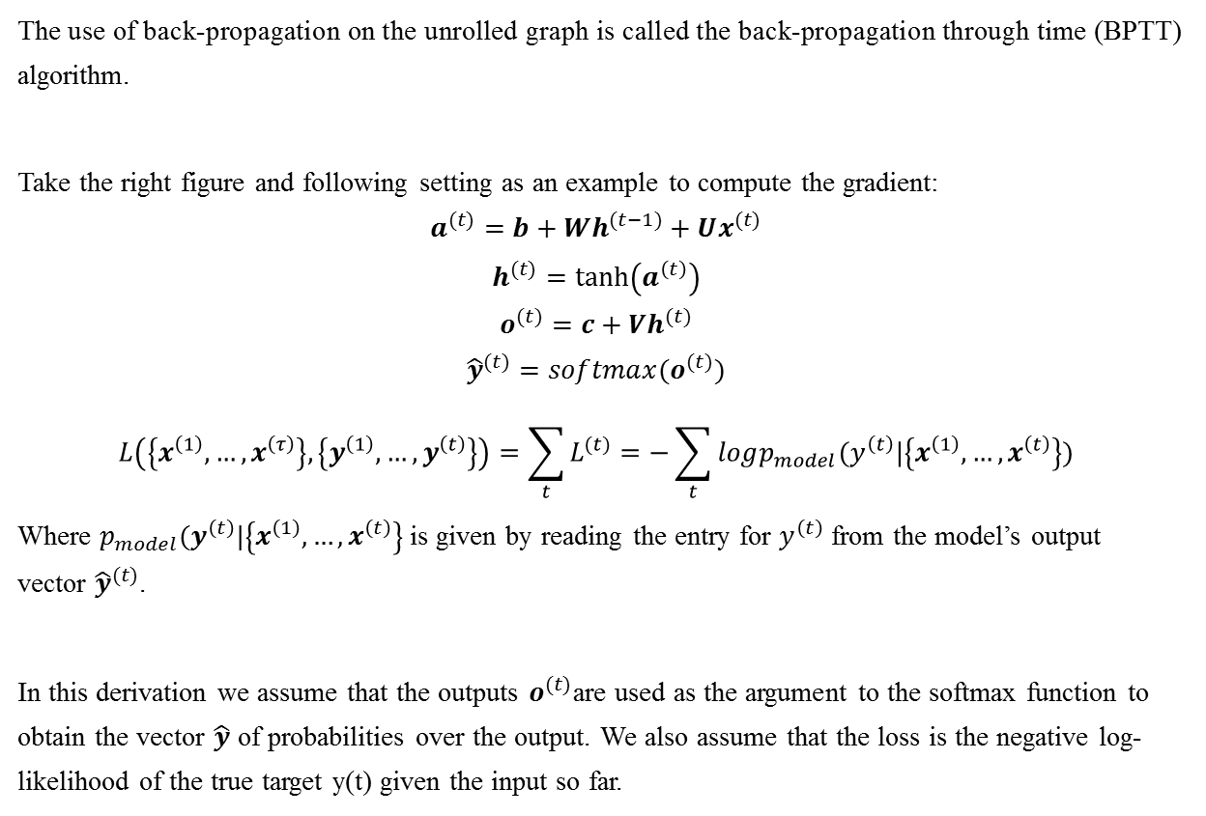
Deep Learning
5.2 Recurrent and Recursive Nets
5.2.3 Computing the Gradient in a Recurrent Neural Network
The use of back-propagation on the unrolled graph is called the back-propagation through time (BPTT) algorithm.
Take the right figure and following setting as an example to compute the gradient:
$$a^{(t)}=b+Wh^{(t−1)}+Ux^{(t)}$$
$$h^{(t)}=\tanh\left(a^{\left(t\right)}\right)$$
$$o^{(t)}=c+Vh^{(t)}$$
$${\hat{y}}^{(t)}=softmax(o^{(t)})$$
$$L\left(\left\{x^{\left(1\right)},…,x^{\left(τ\right)}\right\}, \left\{y^{\left(1\right)},…,y^{\left(t\right)}\right\}\right)=\sum_{t}{L^{(t)}}=−\sum_{t}{logp_{model}(y^{\left(t\right)}|\left\{x^{\left(1\right)},…,x^{\left(t\right)}\right\})}$$
Where $p_{model}(y^{\left(t\right)}|\left\{x^{\left(1\right)},…,x^{\left(t\right)}\right\}$ is given by reading the entry for $y^{\left(t\right)}$ from the model’s output vector ${\hat{y}}^{(t)}$.
In this derivation we assume that the outputs $o^{(t)}$are used as the argument to the softmax function to obtain the vector $\hat{y}$ of probabilities over the output. We also assume that the loss is the negative log-likelihood of the true target y(t) given the input so far.

Slide 4
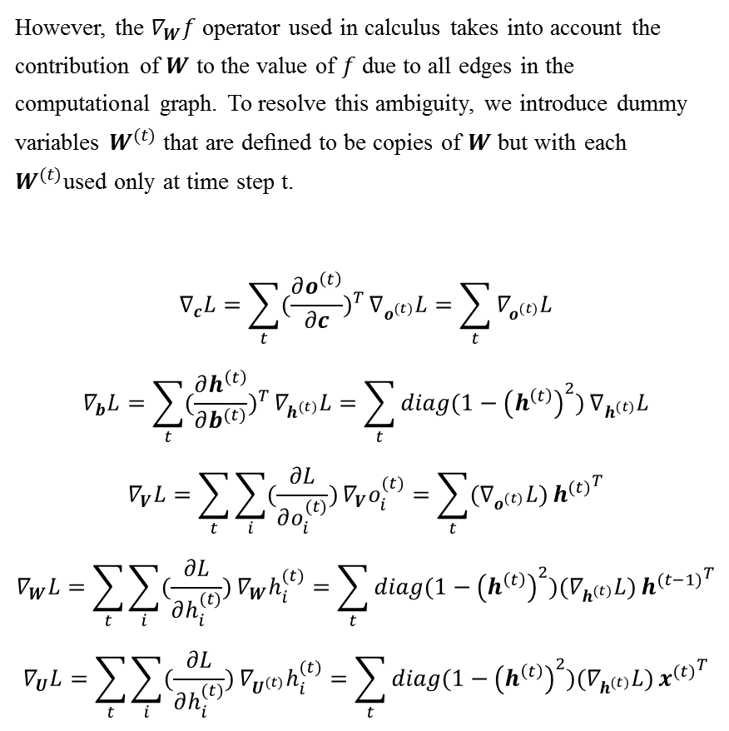
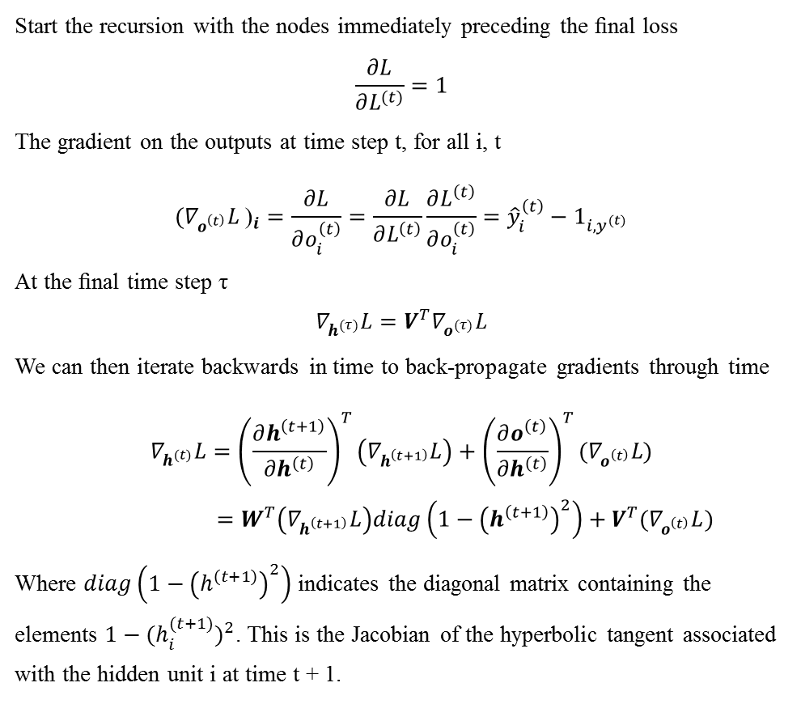
Deep Learning
5.2 Recurrent and Recursive Nets
5.2.3 Computing the Gradient in a Recurrent Neural Network
Start the recursion with the nodes immediately preceding the ﬁnal loss
$$\frac{∂L}{∂L^{(t)}}=1$$
The gradient on the outputs at time step t, for all i, t
$$({∇_{o^{\left(t\right)}}L \text{)}}_{i}=\frac{∂L}{∂o_{i}^{\left(t\right)}}=\frac{∂L}{∂L^{\left(t\right)}}\frac{∂L^{\left(t\right)}}{∂o_{i}^{\left(t\right)}}={\hat{y}}_{i}^{\left(t\right)}−1_{i,y^{(t)}}$$
At the ﬁnal time step τ
$$∇_{h^{(τ)}}L=V^{T}∇_{o^{(τ)}}L$$
We can then iterate backwards in time to back-propagate gradients through time
$$∇_{h^{(t)}}L={\left(\frac{∂h^{\left(t+1\right)}}{∂h^{\left(t\right)}}\right)}^{T}\left(∇_{h^{\left(t+1\right)}}L\right)+{\left(\frac{∂o^{\left(t\right)}}{∂h^{\left(t\right)}}\right)}^{T}(∇_{o^{\left(t\right)}}L\text{)}$$
$$=W^{T}\left(∇_{h^{\left(t+1\right)}}L\right)diag\left(1−{\left(h^{\left(t+1\right)}\right)}^{2}\right)+V^{T}(∇_{o^{\left(t\right)}}L)$$
Where $diag\left(1−{\left(h^{\left(t+1\right)}\right)}^{2}\right)$ indicates the diagonal matrix containing the elements $1−{(h_{i}^{(t+1)})}^{2}$. This is the Jacobian of the hyperbolic tangent associated with the hidden unit i at time t + 1.
However, the $∇_{W}f$ operator used in calculus takes into account the contribution of $W$ to the value of $f$ due to all edges in the computational graph. To resolve this ambiguity, we introduce dummy variables $W^{(t)}$ that are deﬁned to be copies of $W$ but with each $W^{(t)}$used only at time step t.
$$∇_{c}L=\sum_{t}{{(\frac{∂o^{\left(t\right)}}{∂c})}^{T}}∇_{o^{(t)}}L=\sum_{t}{∇_{o^{(t)}}L}$$
$$∇_{b}L=\sum_{t}{{(\frac{∂h^{\left(t\right)}}{∂b^{(t)}})}^{T}}∇_{h^{(t)}}L=\sum_{t}{diag(1−{\left(h^{\left(t\right)}\right)}^{2})}∇_{h^{(t)}}L$$
$$∇_{V}L=\sum_{t}{\sum_{i}{(\frac{∂L}{∂o_{i}^{(t)}})}}∇_{V}o_{i}^{(t)}=\sum_{t}{(∇_{o^{(t)}}L)}{h^{(t)}}^{T}$$
$$∇_{W}L=\sum_{t}{\sum_{i}{(\frac{∂L}{∂h_{i}^{(t)}})}}∇_{W}h_{i}^{(t)}=\sum_{t}{diag(1−{\left(h^{\left(t\right)}\right)}^{2})(∇_{h^{(t)}}L)}{h^{(t−1)}}^{T}$$
$$∇_{U}L=\sum_{t}{\sum_{i}{(\frac{∂L}{∂h_{i}^{(t)}})}}∇_{U^{(t)}}h_{i}^{(t)}=\sum_{t}{diag(1−{\left(h^{\left(t\right)}\right)}^{2})(∇_{h^{(t)}}L)}{x^{(t)}}^{T}$$

Slide 5
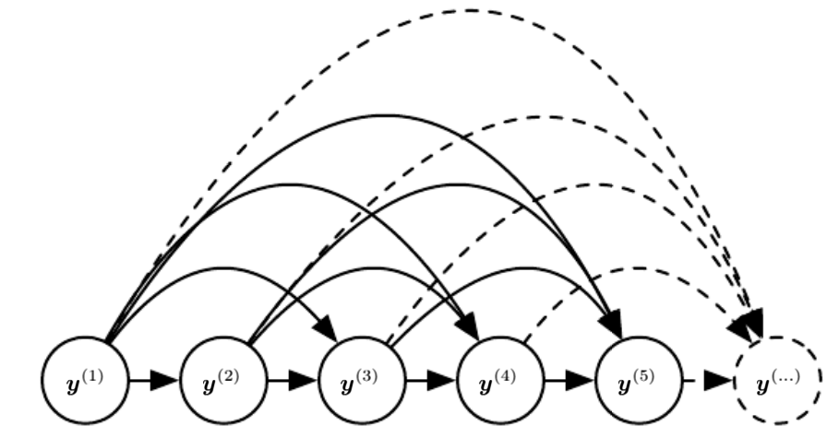
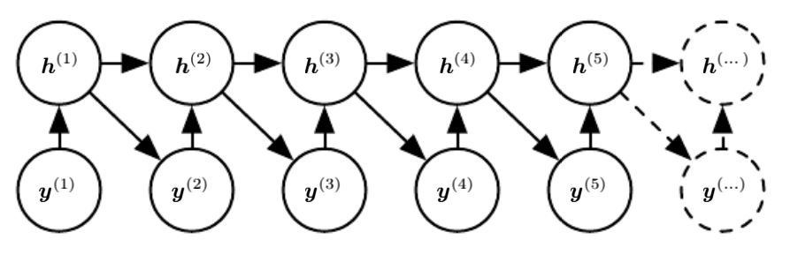
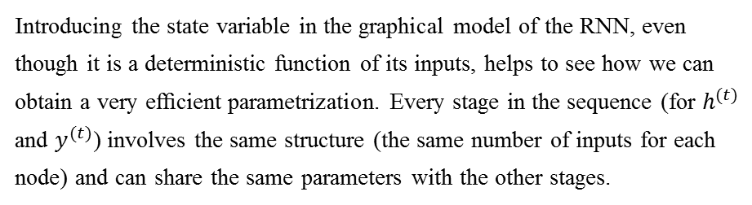
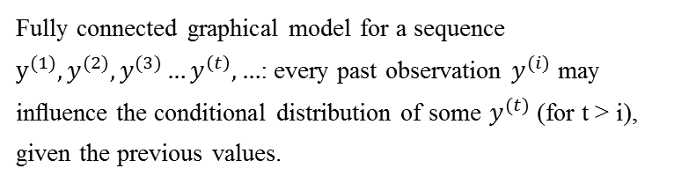
Deep Learning
5.2 Recurrent and Recursive Nets
5.2.4 Recurrent Networks as Directed Graphical Models
Introducing the state variable in the graphical model of the RNN, even though it is a deterministic function of its inputs, helps to see how we can obtain a very eﬃcient parametrization. Every stage in the sequence (for $h^{(t)}$ and $y^{(t)}$) involves the same structure (the same number of inputs for each node) and can share the same parameters with the other stages.
Fully connected graphical model for a sequence $y^{(1)}, y^{(2)}, y^{(3)}…y^{\left(t\right)},…$: every past observation $y^{(i)}$ may inﬂuence the conditional distribution of some $y^{(t)}$ (for t > i), given the previous values.

Slide 6
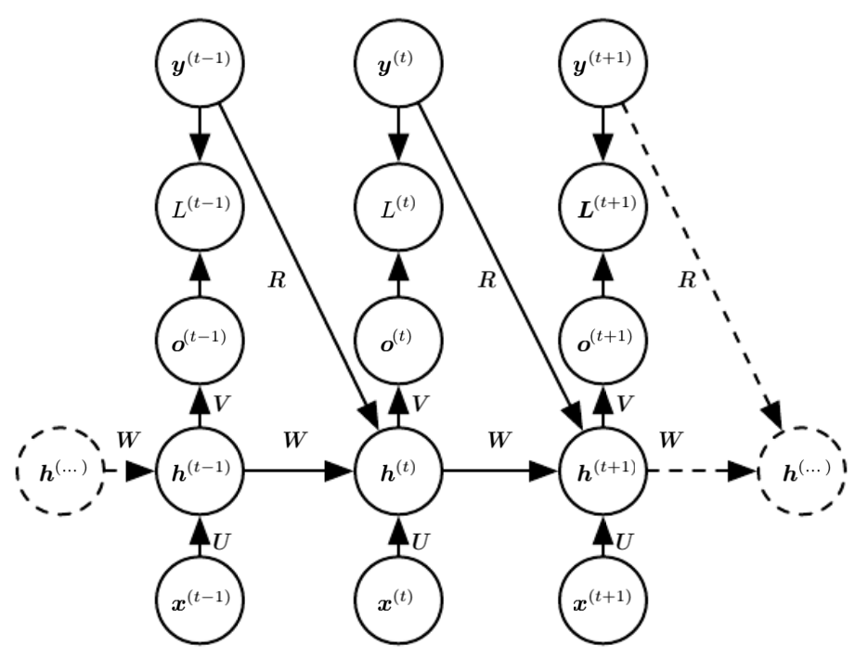
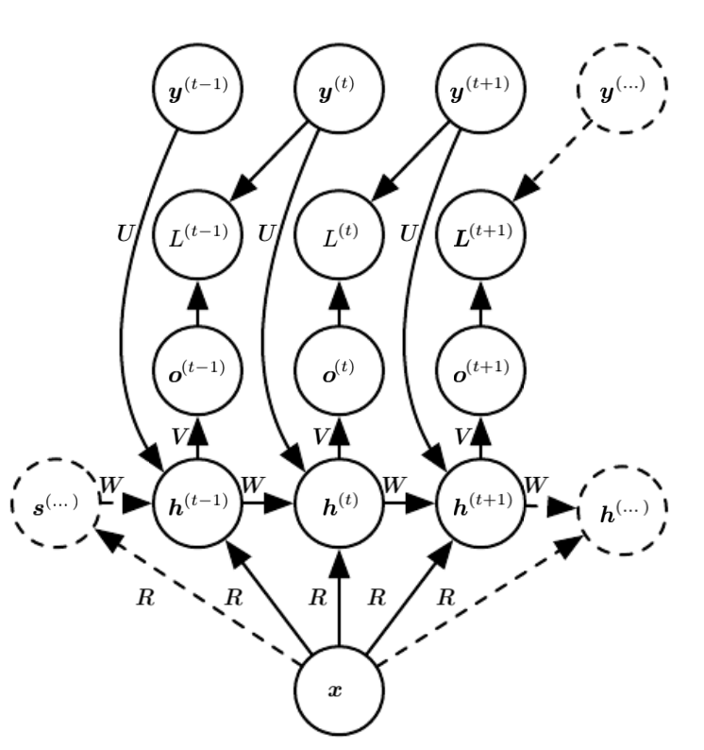
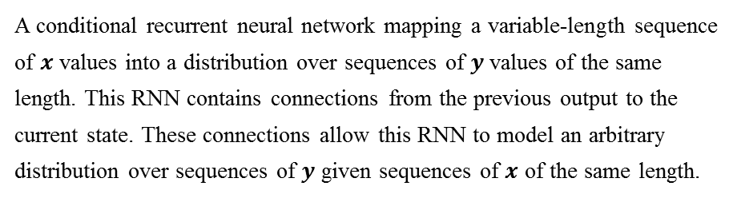
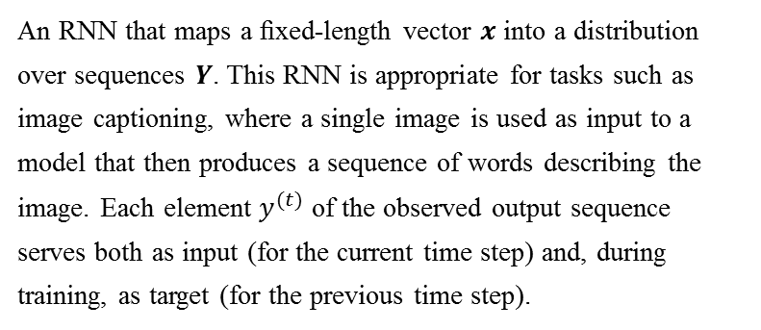
Deep Learning
5.2 Recurrent and Recursive Nets
5.2.5 Modeling Sequences Conditioned on Context with RNNs
An RNN that maps a ﬁxed-length vector $x$ into a distribution over sequences $Y$. This RNN is appropriate for tasks such as image captioning, where a single image is used as input to a model that then produces a sequence of words describing the image. Each element $y^{(t)}$ of the observed output sequence serves both as input (for the current time step) and, during training, as target (for the previous time step).
A conditional recurrent neural network mapping a variable-length sequence of $x$ values into a distribution over sequences of $y$values of the same length. This RNN contains connections from the previous output to the current state. These connections allow this RNN to model an arbitrary distribution over sequences of $y$ given sequences of $x$ of the same length.

Slide 7
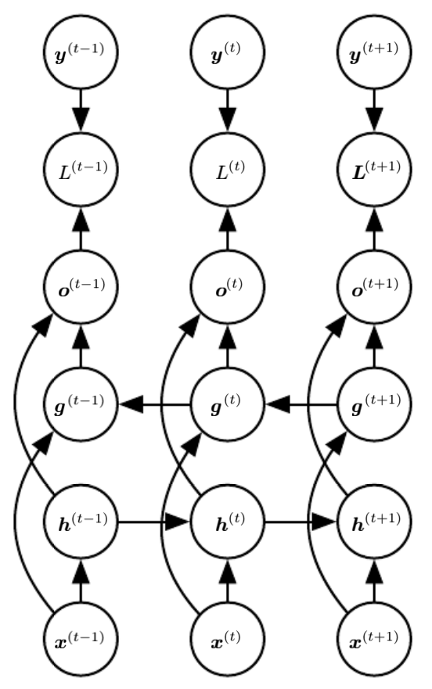
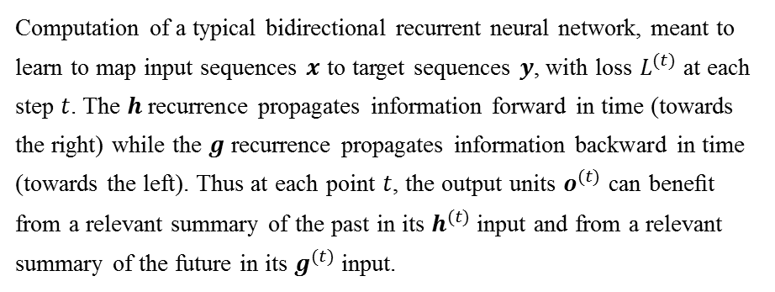
Deep Learning
5.2 Recurrent and Recursive Nets
5.2.6 Bidirectional RNNs
In many applications we want to output a prediction of y(t) which may depend on the whole input sequence. For example, in speech recognition, the correct interpretation of the current sound as a phoneme may depend on the next few phonemes because of co-articulation and potentially may even depend on the next few words because of the linguistic dependencies between nearby words: if there are two interpretations of the current word that are both acoustically plausible, we may have to look far into the future (and the past) to disambiguate them. This is also true of handwriting recognition and many other sequence-to-sequence learning tasks, described in the next section.
Computation of a typical bidirectional recurrent neural network, meant to learn to map input sequences $x$ to target sequences $y$, with loss $L^{(t)}$ at each step $t$. The $h$ recurrence propagates information forward in time (towards the right) while the $g$ recurrence propagates information backward in time (towards the left). Thus at each point $t$, the output units $o^{(t)}$ can beneﬁt from a relevant summary of the past in its $h^{(t)}$ input and from a relevant summary of the future in its $g^{(t)}$ input.

