Slide 1
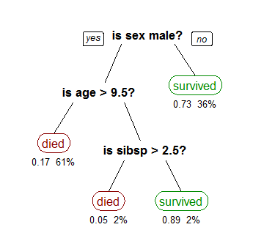
Supervised Learning
2.3 Decision Tree
2.3.1 Introduction
Decision tree builds classification or regression models in the form of a tree structure. It breaks down a dataset into smaller and smaller subsets while at the same time an associated decision tree is incrementally developed. The final result is a tree with decision nodes and leaf nodes.
Decision tree learning is the construction of a decision tree from class-labeled training tuples. A decision tree is a flow-chart-like structure, where each internal (non-leaf) node denotes a test on an attribute, each branch represents the outcome of a test, and each leaf (or terminal) node holds a class label. The topmost node in a tree is the root node.
A tree showing survival of passengers on the Titanic ("sibsp" is the number of spouses or siblings aboard). The figures under the leaves show the probability of survival and the percentage of observations in the leaf.
There are many specific decision-tree algorithms. Notable ones include:
ID3 (Iterative Dichotomiser 3)
C4.5 (successor of ID3)
CART (Classification And Regression Tree)
CHAID (CHi-squared Automatic Interaction Detector). Performs multi-level splits when computing classification trees.
MARS: extends decision trees to handle numerical data better.
Conditional Inference Trees. Statistics-based approach that uses non-parametric tests as splitting criteria, corrected for multiple testing to avoid overfitting. This approach results in unbiased predictor selection and does not require pruning.
Source1 Wikipedia, https://en.wikipedia.org/wiki/Decision_tree_learning
Source2 http://www.saedsayad.com/decision_tree.htm

Slide 2
Supervised Learning
2.3 Decision Tree
2.3.2 ID3 Algorithm: Classification
The core algorithm for building decision trees called ID3 by J. R. Quinlan which employs a top-down, greedy search through the space of possible branches with no backtracking. ID3 uses Entropy and Information Gain to construct a decision tree.
ID3 Algorithm Procedure for Classification
Step 1: Calculate entropy of the target.
Step 2: The dataset is then split on the different attributes. The entropy for each branch is calculated. Then it is added proportionally, to get total entropy for the split. The resulting entropy is subtracted from the entropy before the split. The result is the Information Gain, or decrease in entropy.
Step 3: Choose attribute with the largest information gain as the decision node.
Step 4a: A branch with entropy of 0 is a leaf node.
Step 4b: A branch with entropy more than 0 needs further splitting.
Step 5: The ID3 algorithm is run recursively on the non-leaf branches, until all data is classified.
Source http://www.saedsayad.com/decision_tree.htm

Slide 3
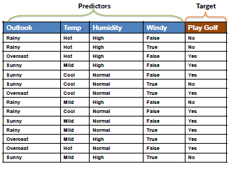
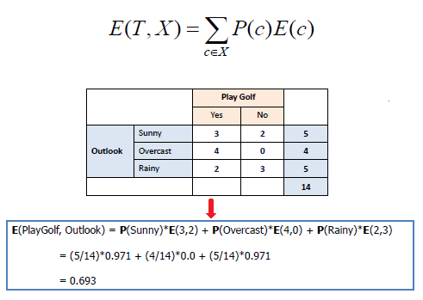
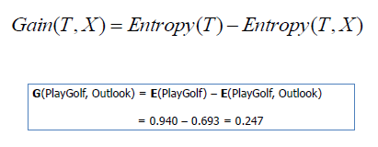
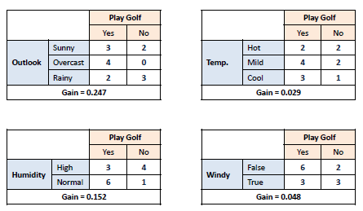
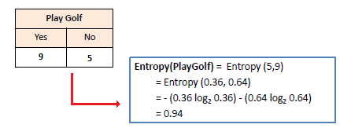
Supervised Learning
2.3 Decision Tree
2.3.2 ID3 Algorithm: Classification
Step 2: The dataset is then split on the different attributes. The entropy for each branch is calculated. Then it is added proportionally, to get total entropy for the split. The resulting entropy is subtracted from the entropy before the split. The result is the Information Gain, or decrease in entropy.
Step 0: Example Data
Step 1: Calculate entropy of the target.
Source http://www.saedsayad.com/decision_tree.htm

Slide 4
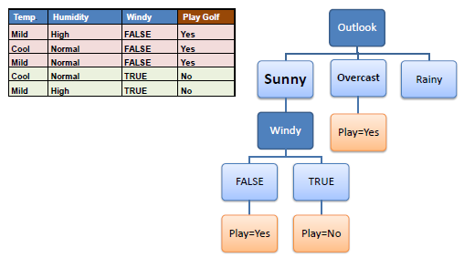
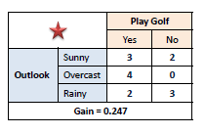
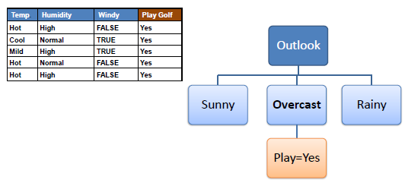
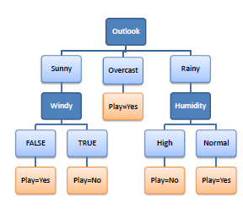
Supervised Learning
Step 4b: A branch with entropy more than 0 needs further splitting.
2.3 Decision Tree
2.3.2 ID3 Algorithm: Classification
Step 3: Choose attribute with the largest information gain as the decision node.
Step 4a: A branch with entropy of 0 is a leaf node.
Step 5: The ID3 algorithm is run recursively on the non-leaf branches, until all data is classified.
Source http://www.saedsayad.com/decision_tree.htm

Slide 5
Supervised Learning
2.3 Decision Tree
2.3.3 ID3 Algorithm: Regression
The ID3 algorithm can be used to construct a decision tree for regression by replacing Information Gain with Standard Deviation Reduction.
ID3 Algorithm Procedure for Regression
Step 1: The standard deviation of the target is calculated.
Step 2: The dataset is then split on the different attributes. The standard deviation for each branch is calculated. The resulting standard deviation is subtracted from the standard deviation before the split. The result is the standard deviation reduction.
Step 3: The attribute with the largest standard deviation reduction is chosen for the decision node.
Step 4a: Dataset is divided based on the values of the selected attribute.
Step 4b: A branch set with standard deviation more than 0 needs further splitting. In practice, we need some termination criteria. For example, when standard deviation for the branch becomes smaller than a certain fraction (e.g., 5%) of standard deviation for the full dataset OR when too few instances remain in the branch (e.g., 3).
Step 5: The process is run recursively on the non-leaf branches, until all data is processed. When the number of instances is more than one at a leaf node we calculate the average as the final value for the target.
Source http://www.saedsayad.com/decision_tree.htm

Slide 6
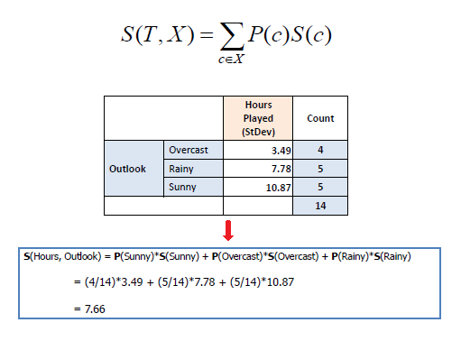
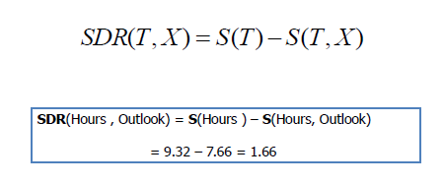
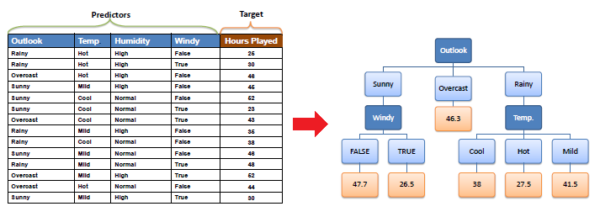
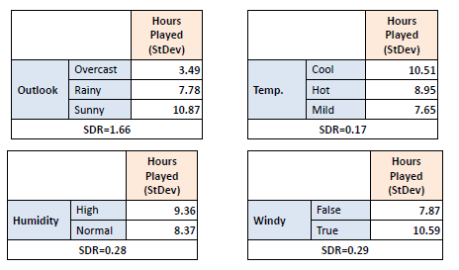
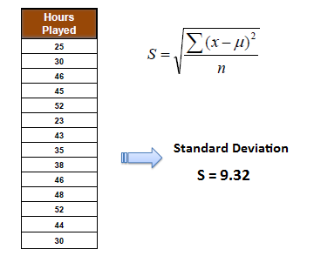
Supervised Learning
Step 2: The dataset is then split on the different attributes.
2.3 Decision Tree
2.3.3 ID3 Algorithm: Regression
Step 0: Example Data
Step 1: The standard deviation of the target is calculated.
Source http://www.saedsayad.com/decision_tree.htm

Slide 7
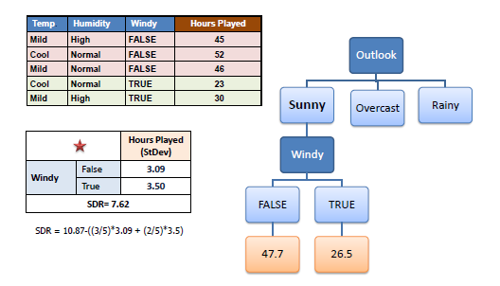
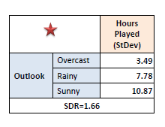
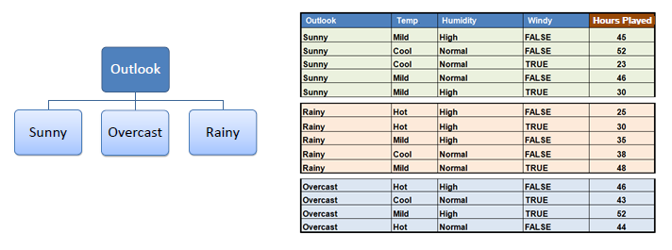
Supervised Learning
Step 4b: A branch set with standard deviation more than 0 needs further splitting.
2.3 Decision Tree
2.3.3 ID3 Algorithm: Regression
Step 3: The attribute with the largest standard deviation reduction is chosen for the decision node.
Step 4a: Dataset is divided based on the values of the selected attribute.
Step 5: The process is run recursively on the non-leaf branches, until all data is processed.
Source http://www.saedsayad.com/decision_tree.htm

Slide 8
Supervised Learning
2.3 Decision Tree
2.3.4 Avoid Overfitting
Overfitting is a significant practical difficulty for decision tree models and many other predictive models. There are several approaches to avoiding overfitting in building decision trees.
Pre-pruning that stop growing the tree earlier, before it perfectly classifies the training set.
Post-pruning that allows the tree to perfectly classify the training set, and then post prune the tree.
Practically, the second approach of post-pruning overfit trees is more successful because it is not easy to precisely estimate when to stop growing the tree.
The important step of tree pruning is to define a criterion be used to determine the correct final tree size using one of the following methods:
Use a distinct dataset from the training set (called validation set), to evaluate the effect of post-pruning nodes from the tree.
Build the tree by using the training set, then apply a statistical test to estimate whether pruning or expanding a particular node is likely to produce an improvement beyond the training set.
Error estimation
Significance testing (e.g., Chi-square test)
Minimum Description Length principle : Use an explicit measure of the complexity for encoding the training set and the decision tree, stopping growth of the tree when this encoding size (size(tree) + size(misclassifications(tree)) is minimized.
Source http://www.saedsayad.com/decision_tree_overfitting.htm

Slide 9
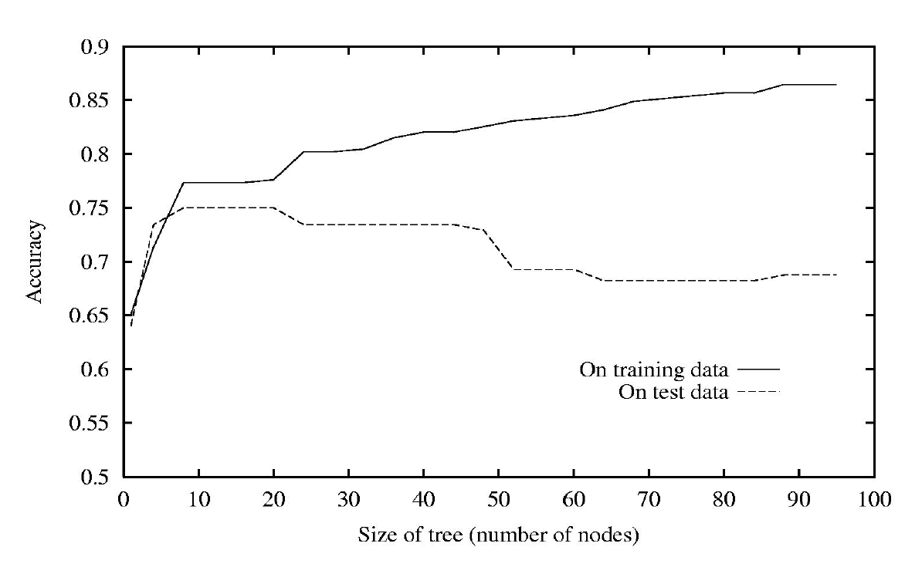
Supervised Learning
2.3 Decision Tree
2.3.4 Avoid Overfitting
Source David Sontag, Slides, Decision Trees, http://cs.nyu.edu/~dsontag/courses/ml12/slides/lecture11.pdf

Slide 10
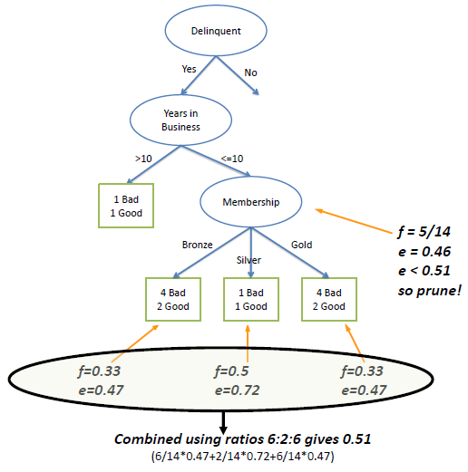
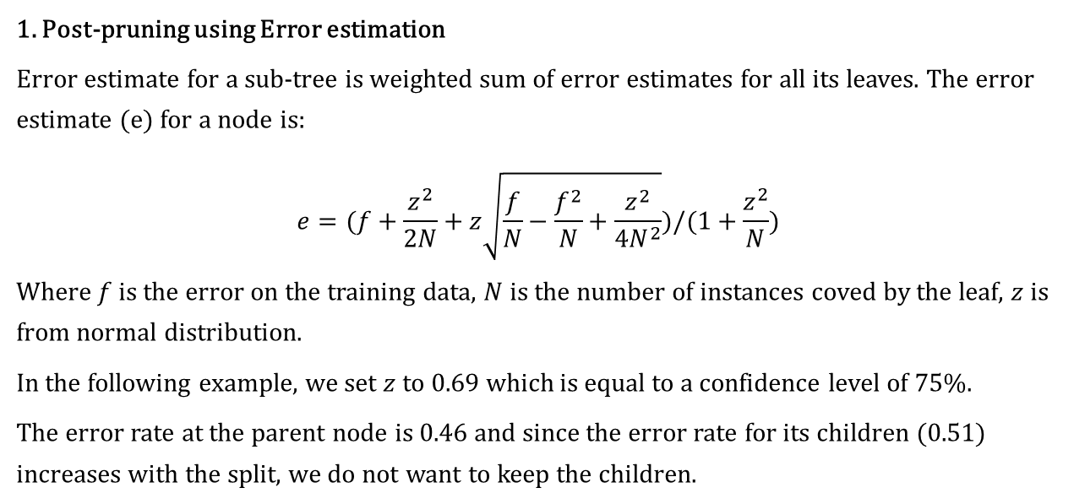
Supervised Learning
2.3 Decision Tree
2.3.4 Avoid Overfitting
1. Post-pruning using Error estimation
Error estimate for a sub-tree is weighted sum of error estimates for all its leaves. The error estimate (e) for a node is:
$$e=(f+\frac{z^{2}}{2N}+z\sqrt{\frac{f}{N}−\frac{f^{2}}{N}+\frac{z^{2}}{4N^{2}}})/(1+\frac{z^{2}}{N})$$
Where $f$ is the error on the training data, $N$ is the number of instances coved by the leaf, $z$ is from normal distribution.
In the following example, we set $z$ to 0.69 which is equal to a confidence level of 75%.
The error rate at the parent node is 0.46 and since the error rate for its children (0.51) increases with the split, we do not want to keep the children.
2. Post-pruning using Chi² test
In Chi² test we construct the corresponding frequency table and calculate the Chi² value and its probability.
If we require that the probability has to be less than a limit (e.g., 0.05), therefore we decide not to split the node.
 | Bronze | Silver | Gold
Bad | 4 | 1 | 4
Good | 2 | 1 | 2
Chi² = 0.21 Probability = 0.90
Degree of freedom=2
Source http://www.saedsayad.com/decision_tree_overfitting.htm

Slide 11
Supervised Learning
2.3 Decision Tree
2.3.5 Advantages
Advantages
Simple to understand and interpret. People are able to understand decision tree models after a brief explanation.
Requires little data preparation. Other techniques often require data normalization, dummy variables need to be created and blank values to be removed.
Able to handle both numerical and categorical data. Other techniques are usually specialized in analyzing datasets that have only one type of variable. (For example, relation rules can be used only with nominal variables while neural networks can be used only with numerical variables.)
Uses a white box model. If a given situation is observable in a model the explanation for the condition is easily explained by boolean logic. By contrast, in a black box model, the explanation for the results is typically difficult to understand, for example with an artificial neural network.
Possible to validate a model using statistical tests. That makes it possible to account for the reliability of the model.
Robust. Performs well even if its assumptions are somewhat violated by the true model from which the data were generated.
Performs well with large datasets. Large amounts of data can be analyzed using standard computing resources in reasonable time.
Source Wikipedia, https://en.wikipedia.org/wiki/Decision_tree_learning

Slide 12
Supervised Learning
2.3 Decision Tree
2.3.6 Limitations
Limitations
The problem of learning an optimal decision tree is known to be NP-complete under several aspects of optimality and even for simple concepts. Consequently, practical decision-tree learning algorithms are based on heuristics such as the greedy algorithm where locally-optimal decisions are made at each node. Such algorithms cannot guarantee to return the globally-optimal decision tree. To reduce the greedy effect of local-optimality some methods such as the dual information distance (DID) tree were proposed.
Decision-tree learners can create over-complex trees that do not generalize well from the training data. (This is known as overfitting.) Mechanisms such as pruning are necessary to avoid this problem (with the exception of some algorithms such as the Conditional Inference approach, that does not require pruning ).
There are concepts that are hard to learn because decision trees do not express them easily, such as XOR, parity or multiplexer problems. In such cases, the decision tree becomes prohibitively large. Approaches to solve the problem involve either changing the representation of the problem domain (known as propositionalisation) or using learning algorithms based on more expressive representations (such as statistical relational learning or inductive logic programming).
For data including categorical variables with different numbers of levels, information gain in decision trees is biased in favor of those attributes with more levels. However, the issue of biased predictor selection is avoided by the Conditional Inference approach.
Source Wikipedia, https://en.wikipedia.org/wiki/Decision_tree_learning

Slide 13
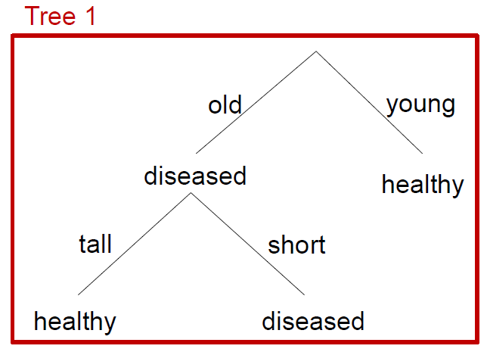
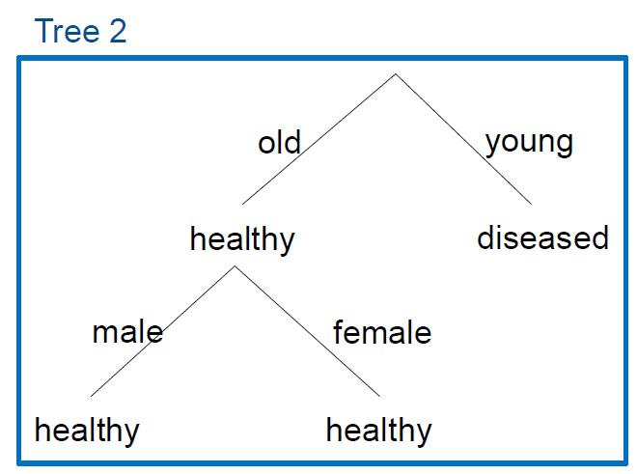
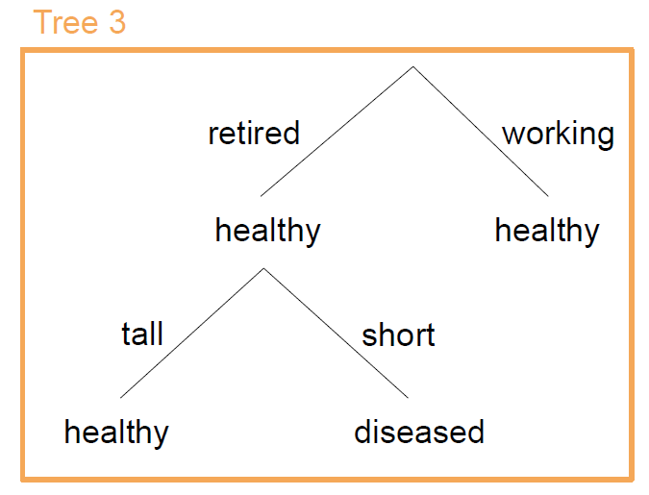
Supervised Learning
2.4 Random Forests
2.4.1 Intuition of Random Forest
New sample:
old, retired, male, short
Tree predictions:
diseased, healthy, diseased
Majority rule:
diseased
Source https://stat.ethz.ch/education/semesters/ss2012/ams/slides/v10.2.pdf

Slide 14
Supervised Learning
Note
Bootstrap resample of data set with N samples:
Make new data set by drawing with replacement N samples; i.e., some samples will probably occur multiple times in new data set
2.4 Random Forests
2.4.2 Algorithm
Source https://stat.ethz.ch/education/semesters/ss2012/ams/slides/v10.2.pdf

Slide 15
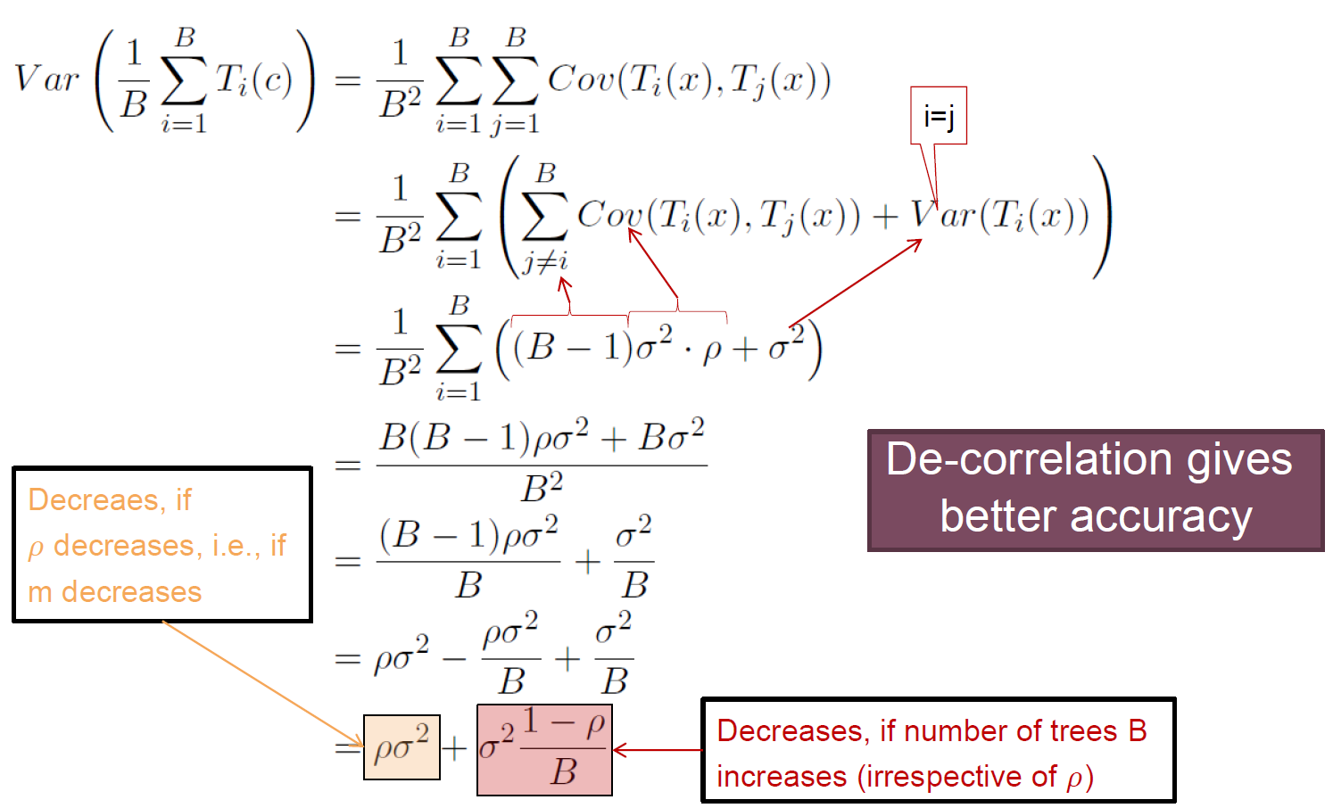
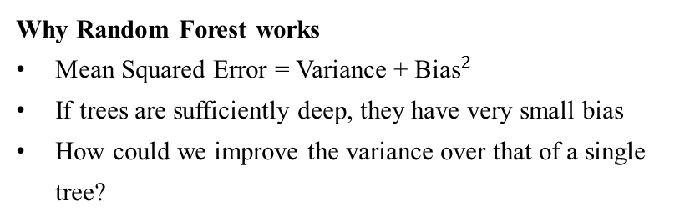
Supervised Learning
2.4 Random Forests
2.4.3 Some Understanding
Differences from standard tree
Train each tree on bootstrap resample of data
For each split, consider only m randomly selected variables.
Don’t prune.
Fit B trees in such a way and use average or majority voting to aggregate results.
Why Random Forest works
Mean Squared Error = Variance + ${\text{Bias}}^{2}$
If trees are sufficiently deep, they have very small bias
How could we improve the variance over that of a single tree?
Source https://stat.ethz.ch/education/semesters/ss2012/ams/slides/v10.2.pdf

Slide 16
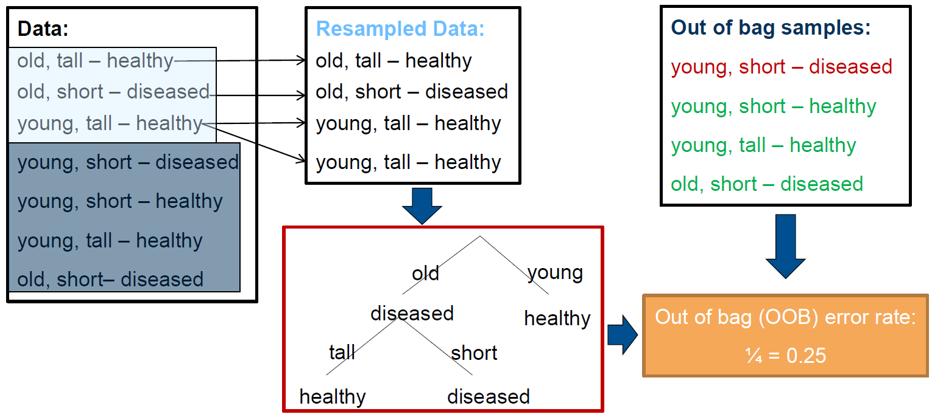
Supervised Learning
2.4 Random Forests
2.4.4 Estimating generalization error: Out of bag (OOB) error
Similar to leave-one-out cross-validation, but almost without any additional computational burden
OOB error is a random number, since based on random resamples of the data
Source https://stat.ethz.ch/education/semesters/ss2012/ams/slides/v10.2.pdf

Slide 17
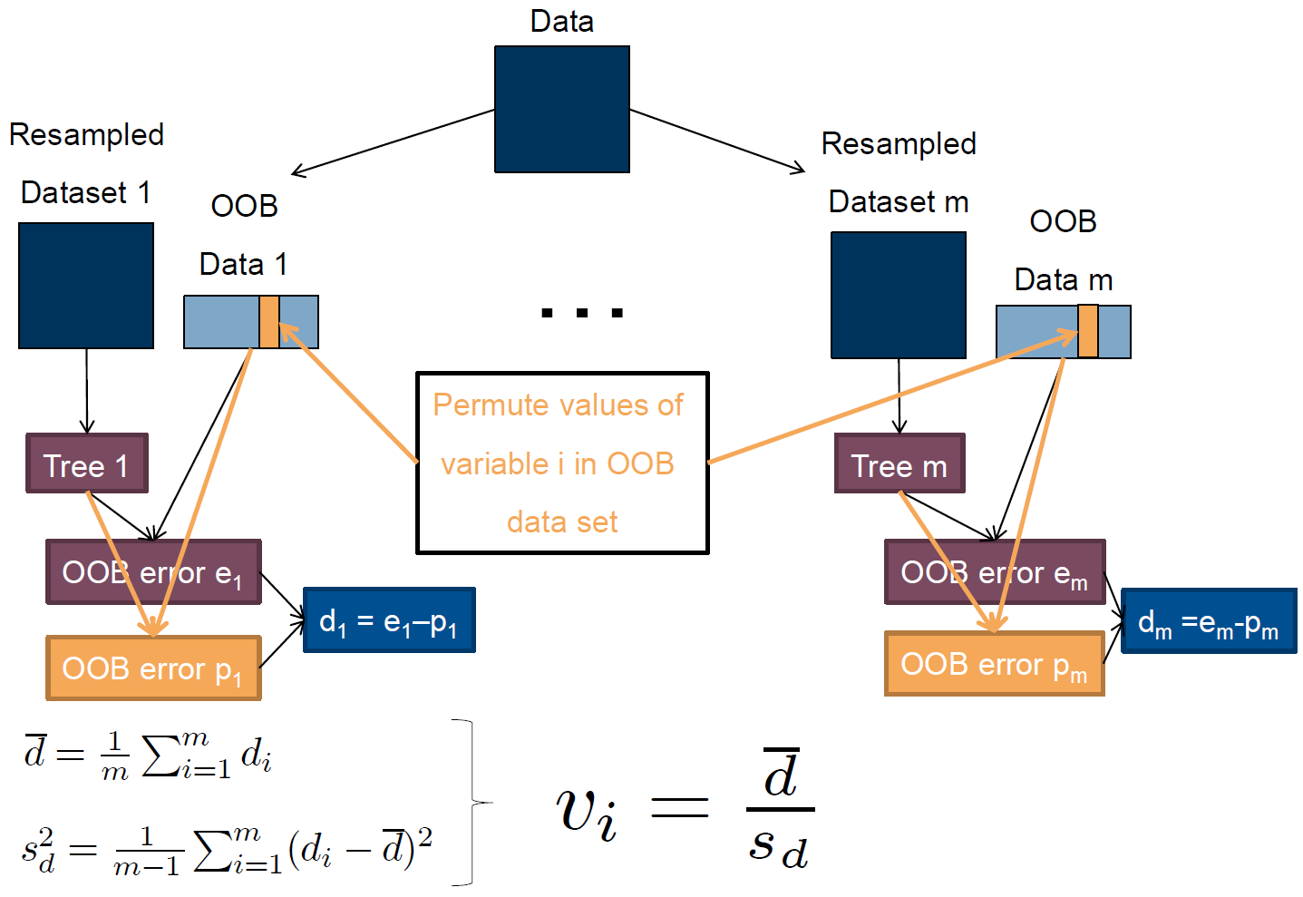
Supervised Learning
2.4 Random Forests
2.4.5 Property: Variable importance
To measure the importance of the feature after training, the values of the feature are permuted among the training data and the out-of-bag error is again computed on this perturbed data set. The importance score for the feature is computed by averaging the difference in out-of-bag error before and after the permutation over all trees. The score is normalized by the standard deviation of these differences.
Features which produce large values for this score are ranked as more important than features which produce small values.
This method of determining variable importance has some drawbacks. For data including categorical variables with different number of levels, random forests are biased in favor of those attributes with more levels. If the data contain groups of correlated features of similar relevance for the output, then smaller groups are favored over larger groups.
Source1 https://stat.ethz.ch/education/semesters/ss2012/ams/slides/v10.2.pdf
Source2 https://en.wikipedia.org/wiki/Random_forest

Slide 18
Supervised Learning
2.4 Random Forests
2.4.6 Advantage and Disadvantage
Advantages
Easy to tune parameters
Can model nonlinear class boundaries
OOB error “for free” (no CV needed)
Works on continuous and categorical responses (regression / classification)
Gives variable importance
Very good performance
Disadvantages
Rather slow
“Black Box”: Rather hard to get insights into decision rules
Source https://stat.ethz.ch/education/semesters/ss2012/ams/slides/v10.2.pdf

