Slide 1
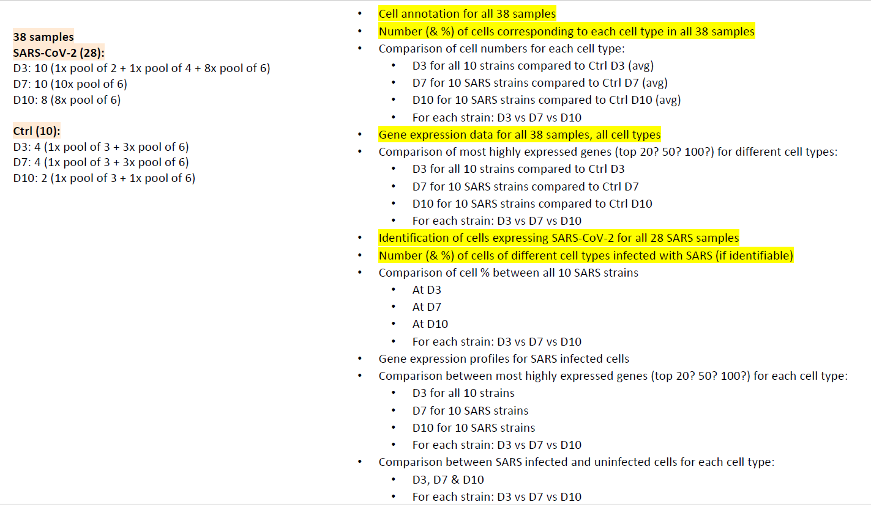

Slide 2
New task on Jan2024
For the single-cell analysis, following is the list that I had shown in the Genomics meeting last week. You can work on this when you get back:
Cell counts:
All viruses: SARS-pos vs SARS-neg for each cell type for each day done 20240119
For each strain: SARS-pos vs SARS-neg for each cell type for each day done on infected samples 20240119
Differential gene expression analysis:
D3 vs D7: all viruses together, for each cell type separately done 20240120; redid on 20240223 allvirus/DE_compareDays/byCelltype
D3 vs D10: all viruses together, for each cell type separately done 20240120 redid on 20240223 allvirus/DE_compareDays/byCelltype
D7 vs D10: all viruses together, for each cell type separately done 20240120 redid on 20240223 allvirus/DE_compareDays/byCelltype
D3 vs D7: all ctrls together, for each cell type separately done 20240123 allctrl/DE_compareDaysOnCelltype
D3 vs D10: all ctrls together, for each cell type separately done 20240123 allctrl/DE_compareDaysOnCelltype
D7 vs D10: all ctrls together, for each cell type separately done 20240123 allctrl/DE_compareDaysOnCelltype
All viruses D3 vs all ctrls D3, for each cell type separately skyline: /data/irf/gn/Lirong/flex_20240220/all
All viruses D7 vs all ctrls D7, for each cell type separately skyline: /data/irf/gn/Lirong/flex_20240220/all
All viruses D10 vs all ctrls D10, for each cell type separately skyline: /data/irf/gn/Lirong/flex_20240220/all
For each strain: D3 vs D7 vs D10, for each cell type separately: 20240123 allvirus/DE_compare_days/byStrainCelltype
D3 vs D7: SARS pos (from all viruses), for each cell type separately done 20240122 redid on 20240223 allvirus/ DE_compare_days/ splitSars/POS/byCelltype
D3 vs D10: SARS pos (from all viruses), for each cell type separately done 20240122 redid on 20240223 allvirus/ DE_compare_days/ splitSars/POS/byCelltype
D7 vs D10: SARS pos (from all viruses), for each cell type separately done 20240122 redid on 20240223 allvirus/ DE_compare_days/ splitSars/POS/byCelltype
For each strain: D3 vs D7 vs D10: SARS pos cells, for each cell type separately 20230124 allvirus/ DE_compare_days/ splitSars/POS/byStrainCelltype
D3 vs D7: SARS neg (from all viruses), for each cell type separately done 20240122 redid on 20240223 allvirus/ DE_compare_days/ splitSars/NEG/byCelltype
D3 vs D10: SARS neg (from all viruses), for each cell type separately done 20240122 redid on 20240223 allvirus/ DE_compare_days/ splitSars/NEG/byCelltype
D7 vs D10: SARS neg (from all viruses), for each cell type separately done 20240122 redid on 20240223 allvirus/ DE_compare_days/ splitSars/NEG/byCelltype
For each strain: D3 vs D7 vs D10: SARS neg cells, for each cell type separately 20230124 allvirus/ DE_compare_days/ splitSars/NEG/byStrainCelltype
All SARS pos D3 vs All SARS neg D3, for each cell type separately on 20240223 allvirus/DE_compareSarsSTatus/allStrainTogether_byDayCelltype/D3
All SARS pos D7 vs All SARS neg D7, for each cell type separately on 20240223 allvirus/DE_compareSarsSTatus/allStrainTogether_byDayCelltype/D7
All SARS pos D10 vs All SARS neg D10, for each cell type separately on 20240223 allvirus/DE_compareSarsSTatus/allStrainTogether_byDayCelltype/D10
For each strain D3: SARS pos cells vs SARS neg cells, for each cell type separately done 20240122 redid on 20240223 allvirus/ DE_compareSarsSTatus/byDayStrainCelltype/D03
For each strain D7: SARS pos cells vs SARS neg cells, for each cell type separately done 20240122 redid on 20240223 allvirus/ DE_compareSarsSTatus/byDayStrainCelltype/D07
For each strain D10: SARS pos cells vs SARS neg cells, for each cell type separately done 20240122 redid on 20240223 allvirus/ DE_compareSarsSTatus/byDayStrainCelltype/D10
Avg gene expression by strains and days – for all samples including controls (for heatmap) – separate for each strain (including Delta and Omicron strains)
skyline: /data/irf/gn/Lirong/flex_20240220/all
Jan20 2024

Slide 3
outputs/allvirus
├── cell_counts
│ ├── allvirus_sars_cellType_day_strain.csv
│ ├── allvirus_sars_cellType_day_strain.txt
│ └── allvirus_sars_cellType_day.txt
├── DE_compareDays
│ ├── byCelltype
│ └── splitSars
└── DE_compareSarsStatus
├── allStrainsTogether_byDayCelltype
└── byDayStrainCelltype

Slide 4
pengl7@cn1048 20240119-integrate]$ tree outputs/allvirus -L 3
outputs/allvirus
├── cell_counts
│ ├── allvirus_sars_cellType_day_strain.csv
│ ├── allvirus_sars_cellType_day_strain.txt
│ └── allvirus_sars_cellType_day.txt
├── DE_compareDays
│ ├── byCelltype
│ │ ├── AlveolarMacrophages
│ │ ├── AT1
│ │ ├── AT2
│ │ ├── Bcells
│ │ ├── Ciliated
│ │ ├── Endothelial
│ │ ├── Fibroblasts
│ │ ├── InterstitialMacrophages
│ │ ├── MacrophagesTreml4+
│ │ ├── MonocyticMacrophages
│ │ ├── MyeloidDendritic
│ │ ├── Myofibroblast
│ │ ├── Neutrophils
│ │ ├── PlasmacytoidDendritic
│ │ ├── SmoothMuscle
│ │ ├── Tcells
│ │ └── Unclear
│ └── splitSars
│ ├── NEG
│ └── POS
└── DE_compareSarsStatus
├── allStrainsTogether_byDayCelltype
│ ├── D03allStrainTogether
│ ├── D07allStrainTogether
│ └── D10allStrainTogether
└── byDayStrainCelltype
├── D03
├── D07
└── D10

Slide 5
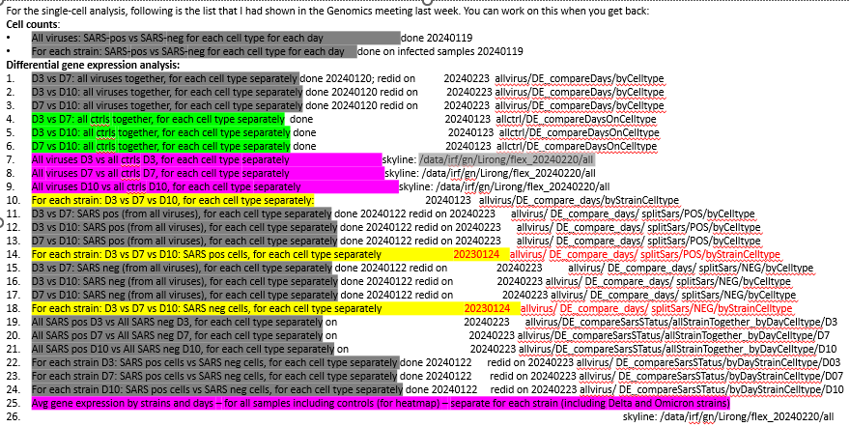
The analytic results of the last part (purple highlighted) are already in Skyliner: /data/irf/gn/Lirong/flex_20240220/all. Let me know should you have any questions. Feb20 2024

Slide 6
Organize DGE folder:
Move the folder of flex_20240220 and unclear_cells_20240402 from secondary_analysis_sinceFeb2024/LP/sc-seq/ into the folder of secondary_analysis/LP/FLEX/20240124-20240220-DEG, AND change the folder name as “all”
secondary_analysis/LP/FLEX/20240124-20240220-DEG contains all the comparisons tables generated as the previous comparisons
The DEG analysis of this set table were generated using default logfc.threthold=0.1 and min.pct=0.01. So the total number of genes in the table varies among different comparisons.
To include all genes which not matter differentially expressed or not, use the logfc.threthold=0 and min.pct=0 which were done on 20240424

Slide 7
20230425: regenerate the DEG csv files for all comparasions by adjusting the logfc.threthold and min.pct to 0 output
All gene information so this list could be used for background gene list for signal pathways analysis.
This set of tables all contain 12943-12335 genes including SARS genes; but I didn’t export top 50 an bottome 50
The results were transferred from Biowulf 20240424-re-DGE to Skyline on Aug 22th 2024

