Slide 1
# about seurat versions
To maintain compatibility with previous workflows, new Seurat objects will use the previous object structure by default
To use new Seurat v5 assays in older version seurat, e.g., v4.3 : Please run: options(Seurat.object.assay.version = 'v5')
my current r4seurat conda env in biowulf already installed v5, so no need to define the options
Most functions are compatiable to v5, including Azimuth, SCTranform
# about seurat object: a s4 object
rows: gene
columns: cell
obj[genes, cells] #for slice a subset
# about seurat meta.data: a dataframe
rows: cell
columns: attributes

Slide 2

Color meaning in DoHeatmap from Seurat:
In the DoHeatmap function of the Seurat package in R, the colors used in the plot output represent different levels of expression for the genes in the heatmap. The colors can vary depending on the color palette chosen, but I'll describe the general conventions for the default palette, which is commonly used.
Purple/Dark Blue: In the default palette, purple or dark blue colors generally represent lower expression levels. This color is used for cells where the gene of interest has lower expression values. The darker the color, the lower the expression.
Yellow/Light Yellow: Yellow or light yellow colors represent higher expression levels. Cells with higher expression of the gene will be shown in these colors. The intensity of the yellow color corresponds to the level of expression, with brighter yellow indicating higher expression.
Black/Gray: Black or gray colors are typically used for cells where the gene is not expressed or has very low expression levels. These cells are often denoted as having low or zero expression values for the gene in the heatmap.

Slide 3
Normalizations: std vs SCTransform

Slide 4
Seurat performs data normalization as part of its preprocessing pipeline to address technical variation and to ensure that gene expression values are comparable across cells. Seurat offers various normalization methods, with LogNormalize being the default method. Here's how LogNormalize works:
Library Size: Seurat first computes the total expression (library size) for each cell, which is the sum of expression values for all genes in that cell. This step is important because cells with a higher total number of transcripts might show higher raw gene expression values just due to having more RNA.
Normalize: Seurat divides the expression value of each gene in each cell by the total expression of that cell. This operation results in the proportion of expression contributed by that gene in that cell relative to the total expression of the cell.
Scale.factor: multiple the above number by 10000 to bring the values within a more manageable range
Log Transformation (log1p) : Seurat performs a log transformation on the above (value+1). This transformation helps stabilize the variance and normalizes the scale of expression values across cells. Log transformation is often used to make the data more symmetrical and to mitigate the effects of extreme outliers.
The LogNormalize function in Seurat is typically applied to the raw count matrix of genes in cells.
Currently, a widely-used normalization approach is to divide the raw UMI count by the total detected RNA counts in each cell, multiply by a scale factor (usually 10,000), add a pseudo-count (typically 1), and then perform a log transformation of the result.

Slide 5
sctransform normalization
By default, Seurat implements a global-scaling normalization method “LogNormalize” that normalizes the gene expression measurements for each cell by the total expression, multiplies this by a scale factor (10,000 by default), and log-transforms the result.
In Hafemeister and Satija, 2019 we introduce a modeling framework for the normalization and variance stabilization of molecular count data from scRNA-seq experiment. This procedure omits the need for heuristic steps including pseudocount addition or log-transformation and improves common downstream analytical tasks such as variable gene selection, dimensional reduction, and differential expression.
Note that this single command replaces NormalizeData(), ScaleData(), and FindVariableFeatures().
Transformed data will be available in the SCT assay, which is set as the default after running sctransform
During normalization, we can also remove confounding sources of variation, for example, mitochondrial mapping percentage

Slide 6
SCTransform v2 and FindAllMarkers on a single sample (non-integrated dataset)
https://github.com/satijalab/seurat/discussions/5605
With v2, we recommend using the SCT assay for finding markers. You can see an example in this vignette
You can also normalize and scale data for the RNA assay. There are numerous resources on this, but Aaron Lun describes why the original log-normalized values should be used for DE and visualizations of expression quite well here:
https://www.biostars.org/p/395951/
In addition, the normalized values in SCT and integrated assays don't necessary correspond to per-gene expression values anyway, rather containing residuals (in the case of the scale.data slot for each).

Slide 7
Integrate

Slide 8
The difference between merge and integration with Seurat objects
https://www.biostars.org/p/9493216/#:~:text=You%20should%20only%20use%20merge,strong%20batch%20in%20the%20manifolds.
https://github.com/satijalab/seurat/issues/1787
https://github.com/satijalab/seurat/issues/4161
You should only use merge for technical replicates, and in theory for a group of samples with a low batch effect. Integration in Seurat (and related) was developed because there tends to be a relatively strong batch in the manifolds. By this I mean that even if two cell populations are the same between two samples, they will appear as two partially or fully separate clusters. Integration tries to "smooth out" the differences in batches so that cells that are likely similar will cluster together. As with anything single-cell related I would suggest exploring and validating the results from both merging and integration to get a better feel for your data.
https://github.com/satijalab/seurat/issues/3631
Thanks for your question. In general, we recommend integrating when origin or preparation of your samples is sufficiently different so as to produce inter-sample variation that is "irrelevant" and that you wish to remove. For instance, you may want to remove variation caused by the use of different technologies, different donors, or even different disease states (i.e, for the purposes of looking at cell type distribution in a common subspace, annotating in a common subspace, or computing a dimensional reduction with greater signal-to-noise by taking advantage of all the cells in your data). In most cases, it is relatively clear whether an undesired batch effect is present - simply merge your samples and check whether cells of the same known cell type (defined by well-known "relevant" variation) are clustering separately. As for your second question, QC preprocessing should be done prior to integration.

Slide 9
How to integrate biological replicates across different conditions #4753
https://github.com/satijalab/seurat/issues/4753
In our experience, we usually run integration for all samples together, but set the control replicates as reference. You can follow our reference-based integration vignettes: https://satijalab.org/seurat/articles/integration_large_datasets.html
Setting your control samples as reference mainly means that you integrate your control samples first, and then integrate samples from the treated group.
In our seurat v4 paper, we divided samples by individual donors and time points. When we do integration across all donors and time points, we set the samples from time_0 as reference.
we recommend using the raw (non-corrected) data for differential expression analyses, and including batch as a latent variable.

Slide 10
How to integrate datasets which have been subjected to SCTransform

Slide 11

How to integrate after SCTransform:
SCTransform: why use Normalize data from RNA assay for visualization purposes?
https://github.com/satijalab/seurat/issues/2023
I also have the exact same question, so I am commenting on this one in the hopes it will be answered and more clearly explained in the vignette. It seems that if the SCTransform's normalized and scaled data are better, why do you go back to the regular normalization in the integration vignette? And would we also use ScaleData to get values for heatmaps?
One problem I can see with using the SCT assay after integration is that the SCT normalization was done separately for each sample, which is likely to introduce batch effects down the line. We are using the RNA assay, normalized after integration. Yes, @CodeInTheSkies, we switch back to the RNA assay, run NormalizeData() and ScaleData(), then proceed with visualizations (Heatmaps, violin plots, shading expression values on tSNE/UMAP. Anywhere you want to see the expression differences) and marker detection. The data slot is the default used for FeaturePlot, VlnPlot, FindConservedMarkers and the scale.data slot is the default for DoHeatmap, and we use the defaults.
Typically scaled data (mean-centered, sd-adjusted) is only used for heatmaps and the rest, especially differential expression, you want to do on normalized count values. In #1836 (linked above) they say explicitly not to re-run SCTransform on the integrated data, but running it on the RNA assay should be fine. I have not tried that yet...
For integration, after integration, go back to RNA assay, perform normalize and scale again

Slide 12
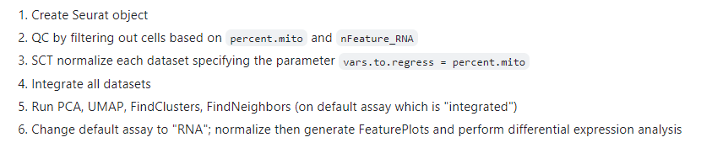
https://github.com/satijalab/seurat/issues/1836
SCT assay after integration workflow
SCT@scale.data is empty after integration!
Correct
Do not run a second round of SCTransform on the integrated assay.
The only additional point I would make is that for point 6, you can also use the SCT assay instead of the RNA assay (this represents the SCT normalized values for each dataset, prior to integration).

Slide 13
Which assay to use

Slide 14
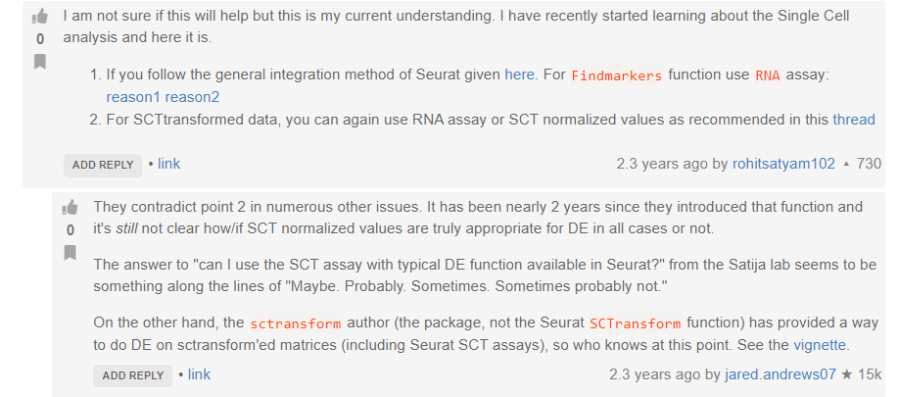
RNA
counts: Stores unnormalized data such as raw counts or TPMs
data: Normalized data matrix
scale.data: Scaled data matrix
SCT
counts: corrected counts
data: log1p(counts)
scale.data: pearson residuals
So SCTransform's GetAssayData(obj, slot="data") is not equal to RNA's NormalizeData(obj).

Slide 15
RNA Assay vs SCTAssay for visualization?
https://github.com/satijalab/seurat/issues/4082
Apologies that this is confusing. The answer requires some nuance, so I'll do my best to explain. It depends on the context. Let's suppose you have just one dataset, and you SCTransform on it. The data slot of the SCTassay represents the log of the corrected counts. Its fine to use these values for visualization, and we do this routinely in the lab.
However, let's suppose you have two datasets, one sequenced very shallow, and one very deep. You could run SCTransform on these datasets individually, and then merge them (or integrate them) together. In this case, the values in the data slot would be much lower for the shallow sequenced dataset, and higher for the deeply sequenced dataset. This could lead to misleading visualizations.
This is not as much of an issue for the RNA assay, because we divide the counts by 10,000 uniformly across datasets. This number is somewhat arbitrary, but it does impose a uniform standard across datasets, which can be useful when visualizing multiple experiments at different sequencing depths.
We often get questions like yours : Can I use the SCTAssay for visualization. Because it depends on the context (which we don't always know), and we prefer to be conservative and not accidentally encourage users to do something misleading, we tend to answer conservatively with a safe option ('i.e. we recommend using the RNA assay for visualization').
That doesn't mean that it would inappropriate or wrong to use the SCT counts in some cases, and thats why there sometimes appear to be inconsistent responses to questions like this.

Slide 16
Integrated assay vs RNA assay
https://github.com/satijalab/seurat/issues/1717
You should use the integrated assay when trying to 'align' cell states that are shared across datasets (i.e. for clustering, visualization embeding, learning pseudotime, etc.)
You should use the RNA assay when exploring the genes that change either across clusters, trajectories, or conditions.
Our best example is here: https://satijalab.org/seurat/v3.0/immune_alignment.html .
We use the integrated assay to jointly define cell types in stimulated/control cells, and the RNA assay to define markers and cell-type specific responses.

Slide 17
Conclusions about Assays and integration
use integrated for integration/aligning, mapping, visualize embedding or other dimension related coordinates, e.g., Dimplot
Use “RNA” for calculating and visualization gene expression, FeaturePlot, ViolinPlot, Heatmap (scaled slot), DE, find markers and etc.,
Use “SCT” for normalization, find markers????
Do not run a second round of SCTransform on the integrated object if the pre-integrated objects have subjected to SCT before integration
After integration, need to switch back to RNA assay to perform Normalize() and scale() which are required to gene expression exploration
https://github.com/satijalab/seurat/issues/4753
How to integrate biological replicates across different conditions #4753

Slide 18
Confusion about FindMarkers(), FindVariableFeatures(), RunTSNE(), and RunUMAP() in seurat package
https://www.biostars.org/p/406388/
the top few thousand most variable genes have been shown to be plenty sufficient for marker identification
RunTSNE and RunUMAP do not perform clustering, that is performed by FindClusters. Clustering is performed by FindClusters after constructing a shared nearest neighbor graph on the output of RunPCA via FindNeighbors, which uses the PCA embeddings to determine similarities between cells. The clustering function then groups cells based on these similarities into clusters with an adjustable resolution that defines how granular the distinctions between clusters should be.
FindMarkers uses the data slot by default (normalized counts) - it would make no sense to use the scaled.data slot, as those are basically just z-scores (or residuals if using SCTransform or one of the integration methods). Depending on the test used, it may make more sense to use the counts slot at times.

Slide 19
DE differential gene expression

Slide 20
Slot usage for differential testing (DE) seurat
https://www.reddit.com/r/bioinformatics/comments/spyzfw/slot_usage_for_differential_testing_seurat/
"We store log-normalized versions of these corrected counts in pbmc[["SCT"]]@data, which are very helpful for visualization. You can use the corrected log-normalized counts for differential expression and integration. However, in principle, it would be most optimal to perform these calculations directly on the residuals (stored in the scale.data slot) themselves. This is not currently supported in Seurat v3, but will be soon."
However looking through biostars/satijalab GitHub some people seem to be running normalisation on their counts in the RNA assay and using that instead (and some even using raw counts, which to me doesn't make sense unless you are incoporating a model based approach in your DE testing?). As far as I can read using the Pearson residuals is not yet supported. There looks to be a lot of confusion on forums about the "best" way to do it. Is the SCT data slot correct to use? What do you use and why?
Call me old fashioned, but DE should be run on the counts. You in theory can use Wilcoxon rank sum test (non parametric, Seurat default) which will work on the normalized or raw counts.
However non-parametric tests can have less statistical power. I tend to use tests built for count data, such as EdgeR. This assumes a negative binomial distribution, so it must be run on raw counts, particular UMI based, which most scRNAseq data is. There are also fancier models for scRNAseq data like zero inflated NB models, however I tend to just stick with the simpler ones.
Try both, compare your results, see which you agree with! See here for more options,
https://satijalab.org/seurat/articles/de_vignette.html
https://www.nature.com/articles/nmeth.4612
You should check out their new vignette sctranform v2 which allows for DE testing on sctransformed object. In practice i found rna and sct markers pretty similar. For de testing between phenotypes, I usually use edgeR as well

Slide 21
https://satijalab.org/seurat/archive/v3.0/de_vignette
As a default, Seurat performs differential expression based on the non-parameteric Wilcoxon rank sum test. This replaces the previous default test (‘bimod’).

Slide 22
https://github.com/satijalab/seurat/issues/7313
Should I stick with SCT assay and use PrepSCTFindMarkers() after integrating multiple SCTransformed objects via Harmony

Slide 23
SCTransform is designed to eliminate the influence of sequencing depth. The nCount_RNA is used to construct the sct mode, so you don't need to put it into vars.to.regress. Inside its function
sc <- SCTransform(sc,vars.to.regress = c("percent.MT","percent.ribo“,”S.Score", "G2M.Score"))
https://github.com/satijalab/seurat/issues/3061
Should I stick with SCT assay and use PrepSCTFindMarkers() after integrating multiple SCTransformed objects via Harmony
https://github.com/satijalab/seurat/issues/7313
Based on your analysis if you are happy with harmony's integration you should stick to it (and need not run SCT again). PrepSCTFindMarkers is required in the case where you run SCTransform on individual objects and want to use the corrected data (data slot of SCT assay) for DE analysis. I would recommend using the SCT assay for DE testing here.
https://github.com/satijalab/seurat/issues/7313

Slide 24
pseudobulk
https://hbctraining.github.io/scRNA-seq_online/lessons/pseudobulk_DESeq2_scrnaseq.html
https://bioconductor.org/packages/devel/bioc/vignettes/glmGamPoi/inst/doc/pseudobulk.html#:~:text=3%20Legacy-,1%20Pseudobulk,the%20individual%20mice%20or%20patients).
https://github.com/neurorestore/Libra
After running AggregateExpression with the setting return.seurat = TRUE, you will get a seurat object.
Then you can use any Seurat functions to process the bulk object.
# make a fake individual information for pbmc3k
pbmc3k$donor <- sample(x = c('A', 'B','C'), size = ncol(pbmc3k), replace = TRUE)
pbmc3k <- NormalizeData(pbmc3k)
# pseudo-bulk by per donor per cell type
pbmc3k.bulk <- AverageExpression(pbmc3k, return.seurat = TRUE, group.by = c('donor','seurat_annotations'))
pbmc3k.bulk <- NormalizeData(pbmc3k.bulk) %>%
FindVariableFeatures() %>%
ScaleData()%>%
RunPCA(npcs = 10)
pbmc3k.bulk$celltype <- sapply(strsplit(Cells(pbmc3k.bulk), split = '_'), '[', 2)
DimPlot(pbmc3k.bulk, group.by = 'celltype', label = TRUE, reduction = 'pca')

Slide 25
Vector mem maxiout
https://stackoverflow.com/questions/51295402/r-on-macos-error-vector-memory-exhausted-limit-reached
Solution: generate .Renviron in /home/pengl7 folder
Set the Maxmem to use as 200Gb according to what I allocated for sinteractive
May need to change it when don’t allocate that high in sinteractive
rm(virus.seurat.list)

Slide 26
https://www.biostars.org/p/406388/
https://github.com/satijalab/seurat/issues/1189
FeaturePlot Seurat v3 Blend Function
# Take all cells in cluster 2, and find markers that separate cells in the 'g1' group (metadata # variable 'group') markers <- FindMarkers(pbmc_small, ident.1 = "g1", group.by = 'groups', subset.ident = "2")
https://github.com/satijalab/seurat/issues/1437
How can I change the size of gene names displayed on DoHeatmap?

Slide 27
Use Leiden in clustering
If need Leiden instead of Louvain in FindClusters(), need specify algorithm as 4 instead of 1

Slide 28
How is gene expression scaled in FeaturePlot?
FeaturePlot will display the normalized data (from the @data slot). Please see the documentation for NormalizeData for a description of the normalization procedures.
it is the "normlized data loge-based"

Slide 29
i'm using Seurat v3 and I create a Seurat object of all cells except the 2 clusters using subset function. After that step i'd re-cluster the cell as you suggest using #re-running FindVariableFeatures() and ScaleData()# but i don't understand at this point which assay use? "RNA" assay for both FindVariableFeatures() and ScaleData() or "RNA" for FindVariableFeatures() and "integrated" for ScaleData()?
When you perform DotPlot , you would better confirm that default assay is RNA
You should not be scaling data after performing integration.

Slide 30
https://satijalab.org/seurat/reference/prepsctintegration
Prepare an object list normalized with sctransform for integration.

Slide 31
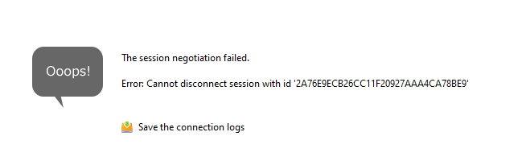
https://www.biostars.org/p/9516696/
Correct method of Merging/Integrating multiple single cell dataset using Seurat

Slide 32
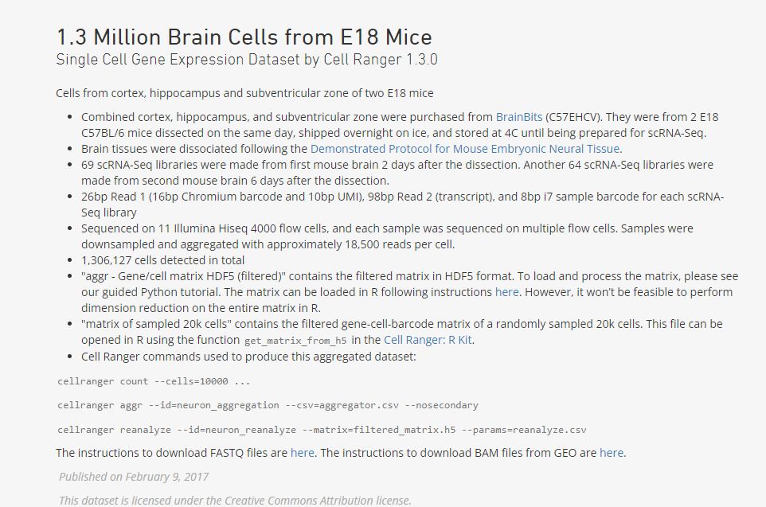
https://support.10xgenomics.com/single-cell-gene-expression/datasets/1.3.0/1M_neurons?

Slide 33
https://github.com/satijalab/seurat/issues/3009
Merge multiple objects

Slide 34
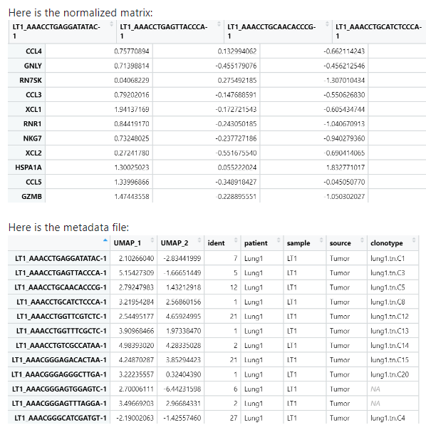
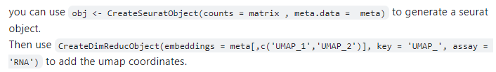
Separate count matrix and meta data
https://github.com/satijalab/seurat/issues/5757
I've downloaded GSE139555_all_integrated.rds.gz and GSE139555_all_metadata.txt.gz
obj[['umap']] <- CreateDimReducObject(embeddings = metamat[,c('UMAP_1','UMAP_2')], key = 'UMAP_', assay = 'RNA')

Slide 35
https://github.com/satijalab/seurat/issues/8044
https://github.com/satijalab/seurat/issues/8058
Hi, thank you for getting back to me so quickly. I am interested in integrating the data, i.e. the counts, data and scale.data of two datasets. If JoinLayers after IntegrateLayers, does not integrate the counts, then how do I integrate the count data for downstream analysis? I do not only want to have an integrated reduction plot.
Hi, I have read your previous issue as well, and if I understand it correctly, JoinLayers will merge the original 'counts' and 'data' from multiple layers back together. The Seurat v5 will NO longer return you an "integrated layer" anymore (I suppose this is what you want). This is because "integrated layer/assay" should only used for integration of multiple datasets and finding clusters. It should not be used for other downstream analyses like DE test.
If you really want the "integrated layer/assay", you can compute it by yourself in V5 using the reduction, or you can use downgrade to Seurat v4 (https://satijalab.org/seurat/articles/install_v5) and use the previous integration workflow (https://satijalab.org/seurat/archive/v4.3/integration_mapping).

Slide 36
https://azimuth.hubmapconsortium.org/#Should%20I%20map%20my%20batches%20separately%20or%20combined%3f
Azimuth FAQ
Should I map my batches separately or combined?
We have observed that the results (both for visualization and annotation) are very similar when mapping individual batches separately, or combined together. This is because Azimuth can successfully remove batch effects between query and reference cells, even when there are multiple query batches. However, as discussed further below, the results of QC metrics may change. For example, cells from certain batches sometimes receive high mapping scores when the batches are mapped separately but receive low mapping scores when batches are mapped together, as the batch effect represents a source of heterogeneity in the query that is removed by Azimuth.

Slide 37
What optimizations are in the app that are not default in Seurat?
To optimize the web app time and resource consumption, we made several changes to the base Seurat mapping workflow.
SCTransform
When fitting generalized linear models, we use a representative set of 2000 genes and 2000 cells
To further speed up GLM model fitting, we use the recently developed glmGamPoi package from Constantin Ahlmann-Eltze and Wolfgang Huber.
Mapping
For many references, we leverage a downsampled reference. Downsampling is done to ensure good representation of all datasets and celltypes present in the full reference.
We leverage a previously computed and cached neighbor index and neighbor list for the reference. This speeds up the neighbor-finding steps in the mapping algorithm.
For the approximate nearest neighbor finding steps in the algorithm, we use n.trees = 20, which provides speedup compared to default n.trees = 50 with minimal impact on the quality of downstream results.
Analysis
We leverage the presto package from Ilya Korsunsky and Soumya Rayachauduri, for differential expression
Essentially, we are using the anchor-based integration methodology to remove batch effects and place the new data in the same space as the reference. The main difference here is that we perform this "correction" in the projected low dimensional space as opposed to gene expression space.
https://www.cell.com/cell/fulltext/S0092-8674%2821%2900583-3

Slide 38
https://github.com/satijalab/seurat/issues/2294
Hi all,
I commented about this issue almost 1 year ago and recently found a workaround. I do not think this is a Seurat issue, but a leidenalg issue.
Anyway, in the current version of Seurat, there is a "method" argument for FindClusters. If you set the following:
method = "igraph"
(The default is method = 'matrix', which casts the data as a dense matrix)
With method = igraph, FindClusters will run for larger datasets. Unfortunately, this seems to take an order of magnitude longer. For my dataset of 60,000 cells, it was about 45 minutes.
Ideally, we'd get support for dense matrices for larger datasets, but in the meantime I think this is our only option (other than simply using Louvain).

Slide 39
Azimuth: ! GetAssayData doesn't work for multiple layers in v5 assay.
First, GetAssayData has been superseded by LayerData so suggest moving to that when using V5 structure moving forward.
Second, as pointed out here by dev team in order to pull data from all applicable layers (e.g. raw counts, normalized data, etc) you first need to run JoinLayers (#7985 (comment)). Alternatively, you could extract all relevant layer names from object and then use lapply to pull one matrix for each layer into a list.
please use the new layer-related functions in Seurat v5 to manipulate layer data. If you want to merge them you can do merged = JoinLayers(filtered_seurat) first and then use LayerData(merged, assay = "RNA", slot = "counts") to extract your count data.

