Slide 1
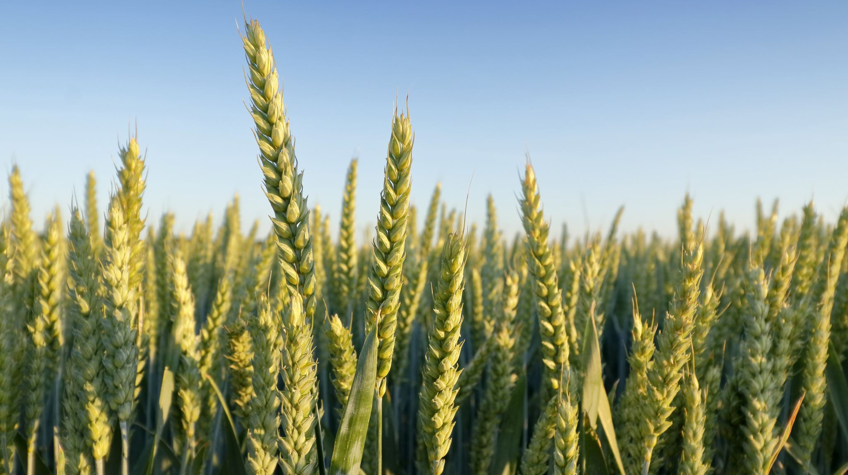
AgriBot: AI Chatbot for Farmers
Witharana Pubudu Lakmal M24W0081

Slide 2
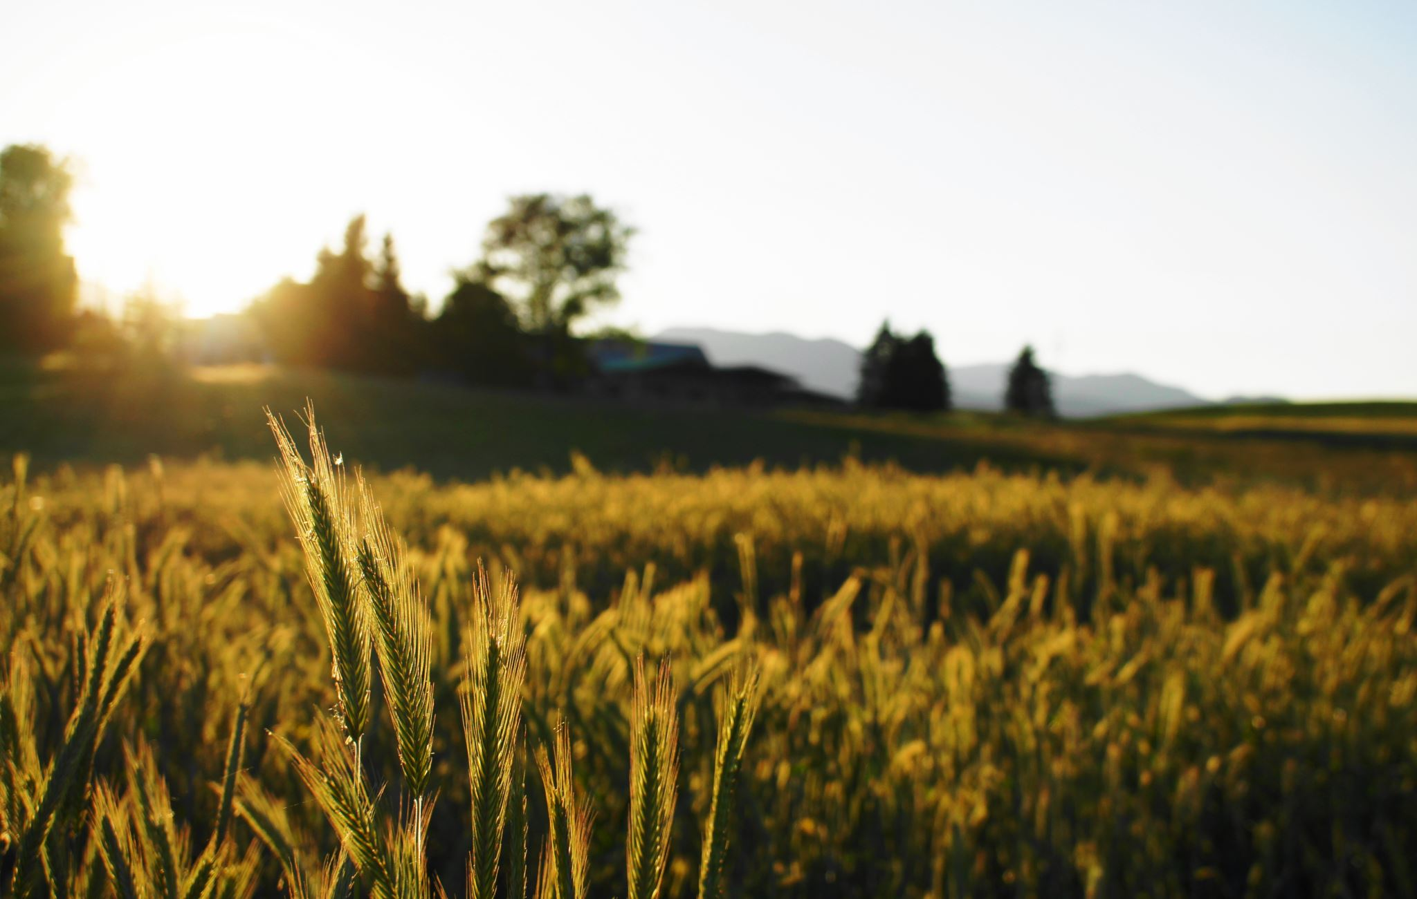
Why AgriBot?
Farmers lack access to reliable, real-time agricultural advice.
Available resources are often complex or outdated.
AgriBot offers a free, AI-powered solution using natural language.
Accessible through any browser via Google Colab and Streamlit.

Slide 3
Technologies Used
FLAN-T5 Large (by Google via Hugging Face)
Transformers Library (NLP)
Streamlit for chatbot UI
Pyngrok to expose Colab app publicly
Runs 100% free on Google Colab

Slide 4
How It Works
1. User asks a farming question in the chat.
2. FLAN-T5 processes and generates a response.
3. Streamlit displays the answer in a user-friendly UI.
4. Ngrok makes it publicly accessible.
No API keys or paid models required.

Slide 5
Live Demo & Next Steps
✅ Ask about fertilizer, crop rotation, pests, and more.
✅ Chat interface works on mobile and desktop.
🔜 Next: Add voice input, Sinhala/Tamil support, and image-based diagnosis.
📌 Demo runs on Google Colab + ngrok.

Slide 6
5 Sample Questions to Ask AgriBot
1. What is the best fertilizer for growing tomatoes?
2. How often should I water vegetable crops?
3. What are the benefits of crop rotation?
4. How can I protect my plants from pests naturally?
5. Which crops grow well in dry soil conditions?

Slide 7
Thank You

