Slide 1

Ironhack WebDev PT6 São Paulo
Projeto Módulo 1 - Paulo Salles

Slide 2

Hello!!!
I’m Paulo Salles, lives in São Paulo and I’m passionate by Technology
Bacharel in Computer Engineering
Experience Infrasctructure and UC Solutions
Tricolor by heart

Slide 3
Project goals
Create a truco game with all rules
Use all the knowledge learned at modulo 1
Use DOM to give a better experience to the players

Slide 4
Challengers
Define the best sequence of the cards for each round
Class definitions and how structure the game code based on OOP
Time
Truco feature

Slide 5
Big Mistakes
Typos
Variable names
Using the wrong class for specific functions
Functions with too many functions

Slide 6
How it works
Start the Game
Shuffle and Distribute cards
Define the best card sequence
Players select the card
Compare cards
Define the winner of the Round
Define the winner of the game Score 12

Slide 7
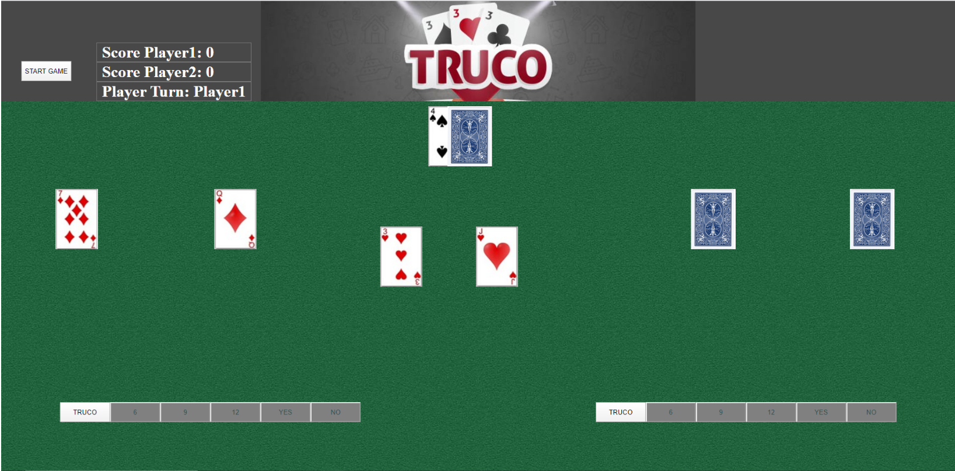
Game board

Slide 8
Thank you!
I would like to give my thank you to my TA’s and teacher, as without their help I would not be capable to achieve the results I got
Thanks also my Family for all the patience

