Slide 1
EECP 0442
V2.0
Computer Network

Slide 2
Week 1 – Introduction to Networking
Overview of Network and Internet

Slide 3
1 Requirement of Internet Connection
Physical Connection
Logical Connection
Application
  Link
    Internet Tutorial
    http://library.albany.edu/internet/
Notes:
A physical connection is made by connecting a specialized expansion card such as a modem or a network interface card (NIC) from a computer (PC) to a network. The physical connection is used to transfer signals between PCs within the local network and to remote devices on the Internet.
The logical connection uses standards called protocols. A protocol is a formal description of a set of rules and conventions that govern how devices on a network communicate. Connections to the Internet may use multiple protocols. The Transmission Control Protocol/Internet Protocol (TCP/IP) suite is the primary protocol used on the Internet. TCP/IP is a suite of protocols that work together to transmit data.
The application that interprets the data and displays the information in an understandable form is the last part of the connection. Applications work with protocols to send and receive data across the Internet. A web browser displays Hypertext Markup Language (HTML) as a web page. File Transfer Protocol (FTP) is used to download files and programs from the Internet. Web browsers also use proprietary plug-in applications to display special data types such as movies or flash animations

Slide 4
1.1 Physical Connection (NIC)
Network Interface Card
  When selecting a NIC, consider the following factors:
  Protocols – Ethernet, Token Ring, or FDDI
  Types of media – Twisted-pair, coaxial, wireless, or fiber-optic
  Type of system bus – PCI or ISA
  http://www.linfield.edu/~darnett/helpages/NICinstall/NICStart.html (Installing NIC)

Slide 5
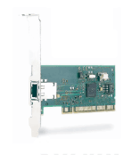
NIC (Cont)

Slide 6
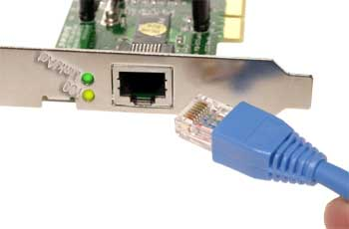
NIC (Cont)

Slide 7
1.2 Logical Connection (TCP/IP) description and configuration
TCP/IP – Transmission Control Protocol/Internet Protocol is a set of protocol developed to allow computer to share resources
TCP/IP can be configure using OS tool

Slide 8
TCP/IP - IP
IP-address:
Each Ethernet board worldwide has a unique Ethernet-address, it is a 48 bit number
(the first 24 bits indicate the manufacturer, the last 24 bits are a unique number for each
Ethernet board/controller-chip assigned by the manufacturer).
This is also called the MAC-address.

Slide 9
TCP/IP -IP
When systems on a local area network ("LAN") are configured with NetBEUI or IPX/SPX protocol, they use these hardware-addresses to identify each other, so there is no need to define manually a network address.
But TCP/IP was designed as a Wide-area-network ("WAN"), able to continue to function, even if part of the network was not operating ( damaged or destroyed).

Slide 10
TCP/IP - IP
TCP/IP uses IP-addresses, which are 32-bit numbers. To make it easier to memorize such IP-addresses, they are usually expressed as 4 8-bit numbers (example: 192.168.10.1), where each of the 4 numbers is within the range of '0' to '255' (there are restriction on using '0' and '255', avoid using them.).
When setting up a small private network, you are free to use ANY IP-address, however, when you are connected to a company network, you need to ask the Network-administrator to assign you an IP-address. And if you are connected to the Internet, your ISP (Internet Service Provider) will assign an IP-address to you.
Even if a network is NOT connected to the Internet, it has become custom to use on private networks a range of IP-addresses, which are reserved for private networks (that makes it later possible to connect your private network to the Internet without having to re-configure everything). The reserved IP-address is: 192.168.x.y, where x=same number on all systems and y=different/unique number on all systems.
A small network of 3 systems would use:

Slide 11
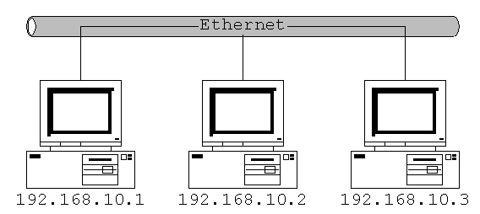
TCP/IP -IP

Slide 12
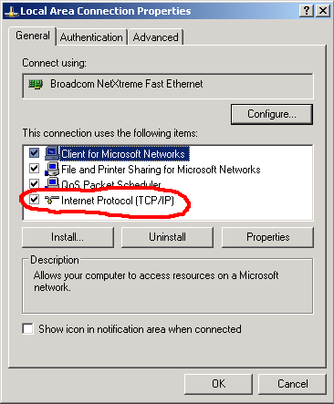
Configure TCP/IP on window based machine

Slide 13
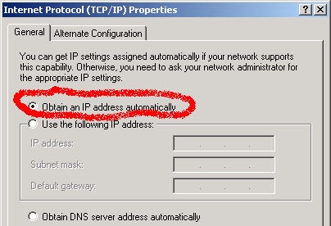
Configure TCP/IP on window based machine

Slide 14
IP- Comfig. Using HDCP
To be able to make this automatic assignment, there needs to be now on the network a database, keeping track of possible IP-addresses and to whom these addresses have been assigned:
DHCP (Dynamic Host Configuration Protocol)

Slide 15
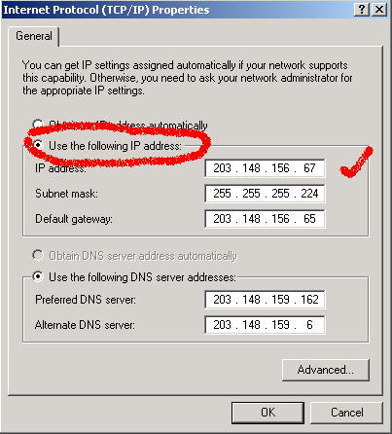
IP config. Usig static config

Slide 16
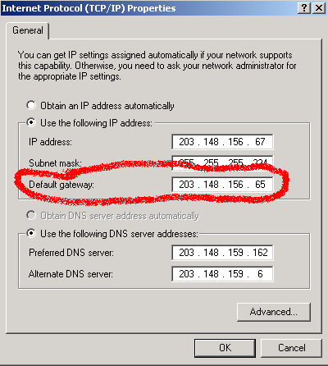
Gateway and Router

Slide 17
Gateway and Router
Gateway/Router:
To connect a TCP/IP local-area-network to another TCP/IP LAN (which could be the complete Internet) or via a Wide-Area-Network (WAN), you need now a device called : Gateway or Router

Slide 18
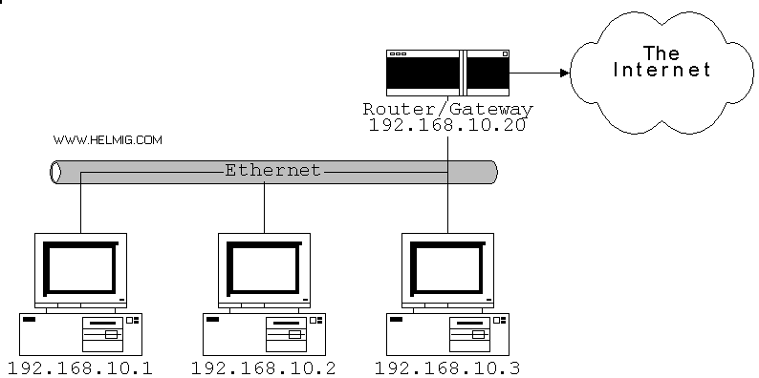
Gateway and Router

Slide 19
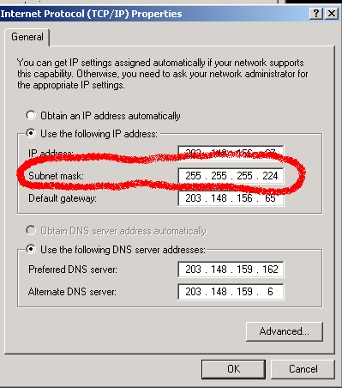
Subnet-mask

Slide 20
Subnet-mask
Now, also the 'Subnet-Mask', which is usually '255.255.255.0', becomes important: if you now like to connect to 207.68.137.53 (which is the Website of Microsoft), TCP/IP checks your own IP-address and the IP-address of the destination against the Subnet-mask.
Subnet-mask basically tell we how may IP address are in the same group.

Slide 21
DNS (Domain Name Service)
DNS:
Too much work to typ these IP-addresses ?
Looks like another item for automation, and exactly that is DNS : Domain Name Service:
it allows to use names instead of IP-addresses, but you need to configure it as part of the TCP/IP-

Slide 22
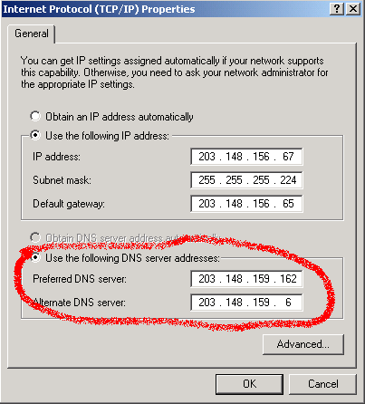
DNS

Slide 23
1.3 Testing Connectivity
Network Configuration
Testing with Ping
  Ping 127.0.0.1
  Ping host IP address
  Ping default gateway
  Ping Internet Host

Slide 24
Troubleshooting Internet connection problems
Defend the problem
Gather the facts
Consider and action plan
Implement the plan
Observe the results
Document the results
Introduce problems and troubleshoot

Slide 25
Network Math

Slide 26
Binary presentation of data
The American Standard Code for Information (ASCII)
  A = 01000001
  B = 01000010
  C = 01000011
  ASCII code chart http://www.jbase.com/knowledgebase/manuals/3.0/30manpages/man/AsciiChart.htm
Notes:
Computers work with and store data using electronic switches that are either ON or OFF. Computers can only understand and use data that is in this two-state or binary format. 1 is represented by an ON state, and 0 is represented by an OFF state. The ones and zeros are used to represent the two possible states of an electronic component in a computer. They are referred to as binary digits or bits.

Slide 27
Bits and bytes
8 bits = 1 bytes
Notes:
A binary 0 might be represented by 0 volts of electricity (0 = 0 volts).
A binary 1 might be represented by +5 volts of electricity (1 = +5 volts).
Computers are designed to use groupings of eight bits. This grouping of eight bits is referred to as a byte. In a computer, one byte represents a single addressable storage location. These storage locations represent a value or single character of data, such as an ASCII code. The total number of combinations of the eight switches being turned on and off is 256. The value range of a byte is from 0 to 255. So a byte is an important concept to understand when working with computers and networks.

Slide 28
Lab and Homework
Find out your machine network connectivity and configuration

