Slide 1
Computer Network
The Data Link Layer

Slide 2
Data Link Layer Design Issues
Node to Node Delivery
Services Provided to the Network Layer
Framing
Error Control
Flow Control

Slide 3
Functions of the Data Link Layer
Provide service interface to the network layer
Dealing with transmission errors
Regulating data flow
  Slow receivers not swamped by fast senders

Slide 4
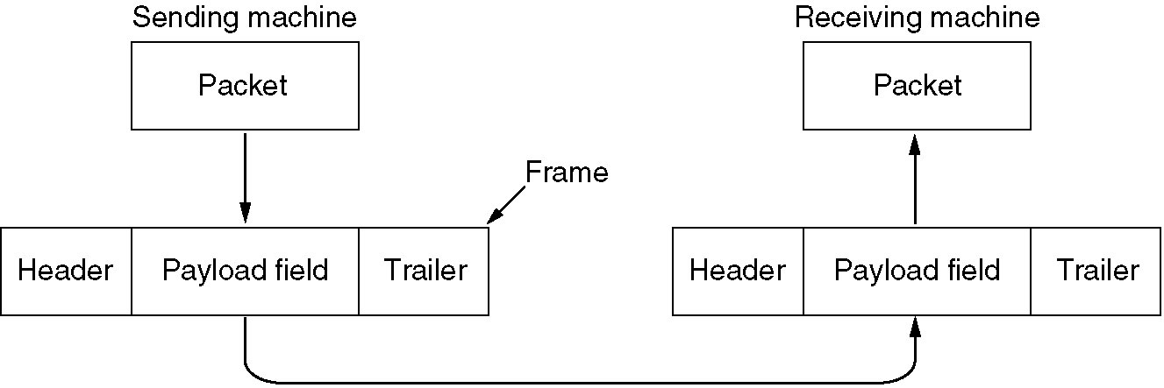
Functions of the Data Link Layer
Relationship between packets and frames.

Slide 5
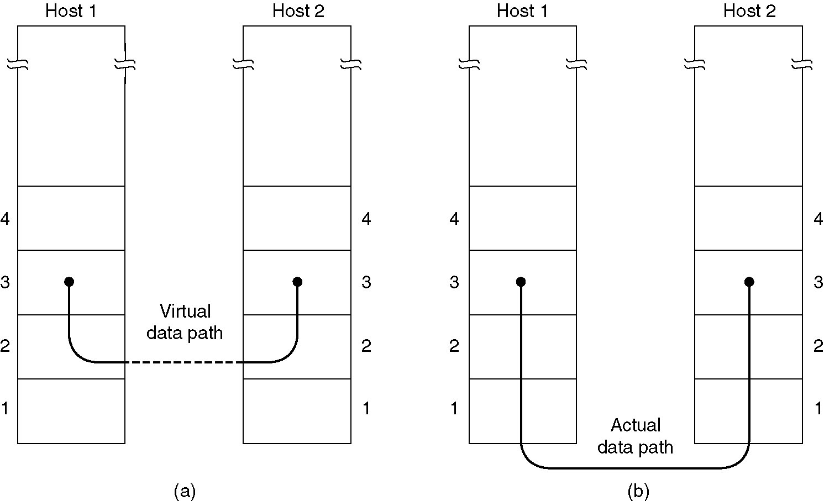
Services Provided to Network Layer
(a) Virtual communication.
(b) Actual communication.

Slide 6
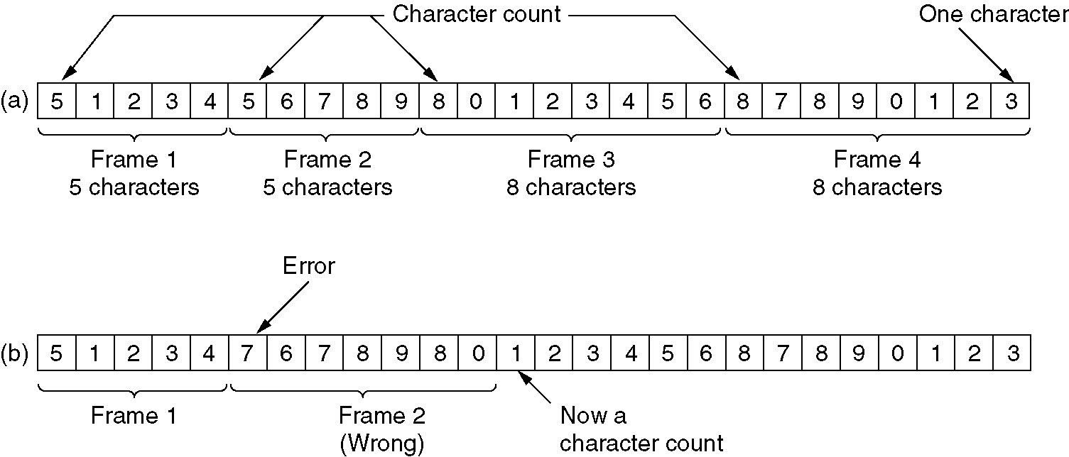
Framing
A character stream. (a) Without errors.
(b) With one error.

Slide 7
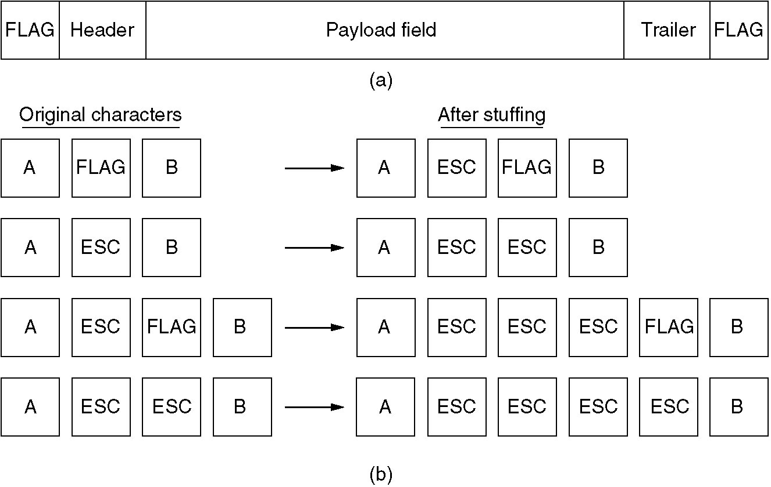
Framing (2)
(a) A frame delimited by flag bytes.
(b) Four examples of byte sequences before and after stuffing.

Slide 8
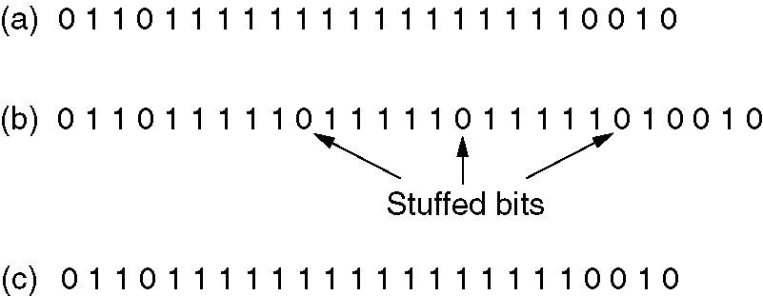
Framing (3)
Bit stuffing
(a) The original data.
(b) The data as they appear on the line.
(c) The data as they are stored in receiver’s memory after destuffing.

Slide 9
Error Detection and Correction
Error-Correcting
Error-Detecting

Slide 10
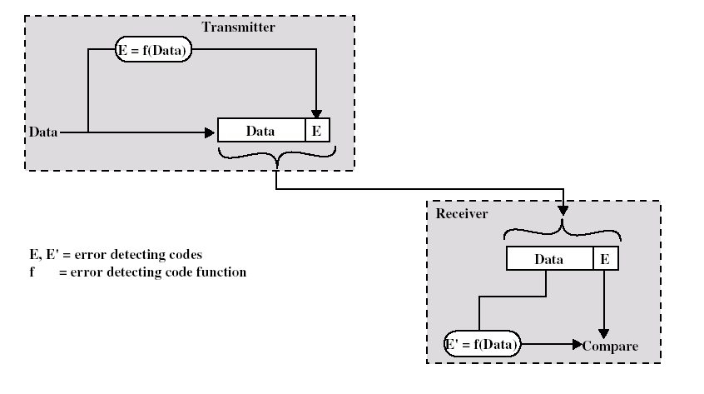
Error Detection

Slide 11
Error-Detecting Codes
Additional bits added by transmitter for error detection code
Parity
  Value of parity bit is such that character has even (even parity) or odd (odd parity) number of ones
  Even number of bit errors goes undetected

Slide 12
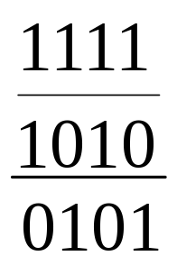
Error-Detecting Codes
CRC – Cyclic Redundancy Check
Modulo 2 Arithmetic
  Binary addition with no carries – Exclusive-OR

Slide 13
T=(k+n)- bit frame to be transmitted, with n<k
M=k-bit message, the first k bits of T
F=n-bit FCS, the last n bits of T
P=pattern of n+1 bits; this is the predetermined divisor

Slide 14
We would like T/P to have no remainder, thus;
  T = 2^{n}M + F
  By multiple m by 2^{n} we have shifted it to the left by n bits and padded out the result with 0s. Adding F yields the concatenation of M and F which is T

Slide 15
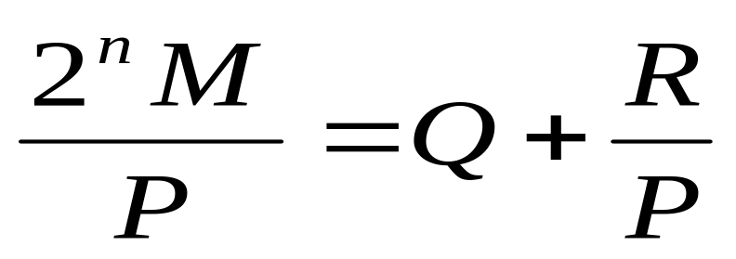
how to get F
By dividing 2^{n}M by P
EQ-1
While R is the remainder

Slide 16
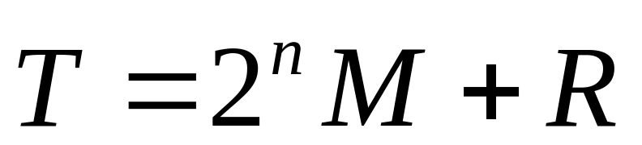
Thus,
While R is the remainder

Slide 17
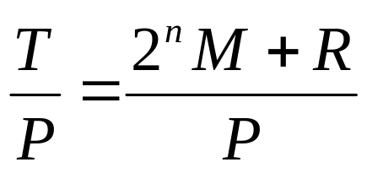
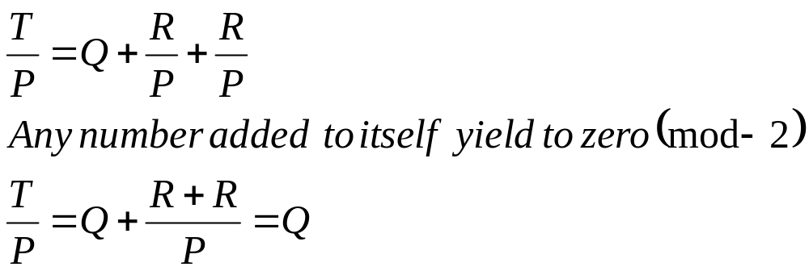
Prove: Divide T by P
Substituting Equation with EQ-1

Slide 18
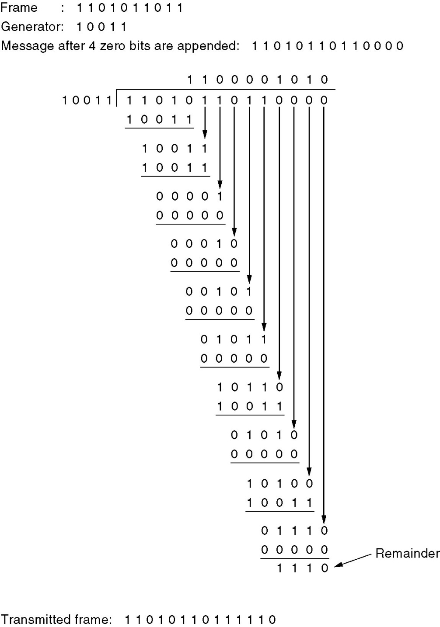
Error-Detecting
Codes
Calculation of the polynomial code checksum.

Slide 19
Flow Control (การจัดการ การไหลของข้อมุล)
ในการส่องข้อมูลระหว่าง 2 Nodes จำเป็นต้องมีการควบคุมการอัตราและจังหวะการส่องผ่านข้อมูลให้ relate กันทั้ง 2 Nodes

Slide 20
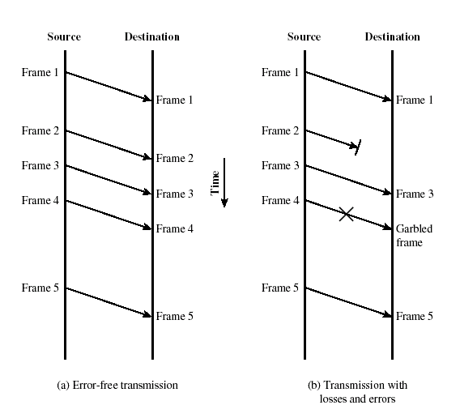
Elementary Flow Control
Model For Frame Transmission

Slide 21
Stop and Wait
Source transmits frame
Destination receives frame and replies with acknowledgement
Source waits for ACK before sending next frame
Destination can stop flow by not send ACK
Works well for a few large frames

Slide 22
Fragmentation
Large block of data may be split into small frames
  Limited buffer size (MTU– Maximum Transfer Unit)
    Ethernet Data Payload MTU = 1500 Bytes
  Errors detected sooner (when whole frame received)
  On error, retransmission of smaller frames is needed
  Prevents one station occupying medium for long periods
Stop and wait becomes inadequate

Slide 23
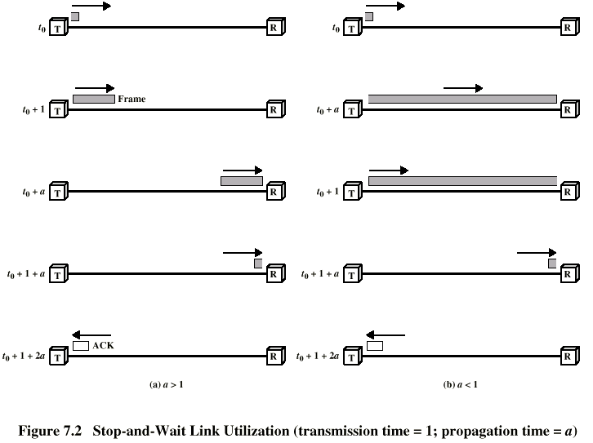
Stop and Wait Link Utilization

Slide 24
Flow and Error Control technique

Slide 25
Sliding Window Protocols
A One-Bit Sliding Window Protocol
A Protocol Using Go Back N
A Protocol Using Selective Repeat

Slide 26
Sliding Windows Flow Control
Allow multiple frames to be in transit
Receiver has buffer W long
Transmitter can send up to W frames without ACK
Each frame is numbered
ACK includes number of next frame expected
Sequence number bounded by size of field (k)
  Frames are numbered modulo 2^{k}

Slide 27
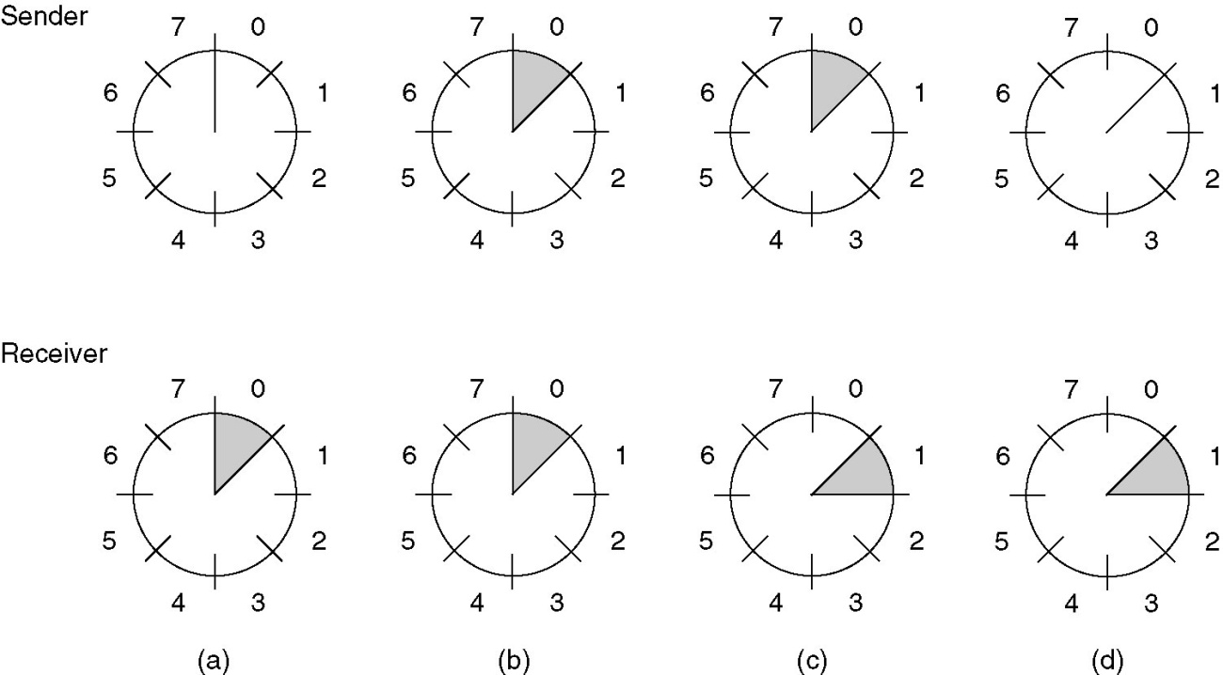
Sliding Window Protocols (2)
A sliding window of size 1, with a 3-bit sequence number.
(a) Initially.
(b) After the first frame has been sent.
(c) After the first frame has been received.
(d) After the first acknowledgement has been received.

Slide 28
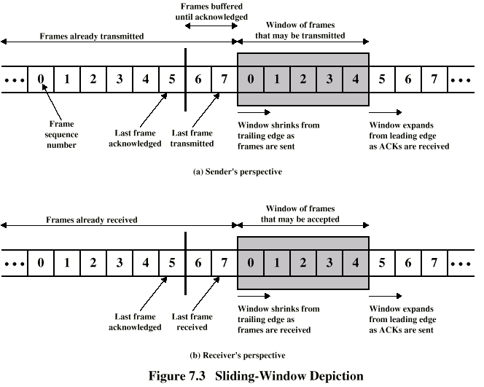
Sliding Window Diagram

Slide 29
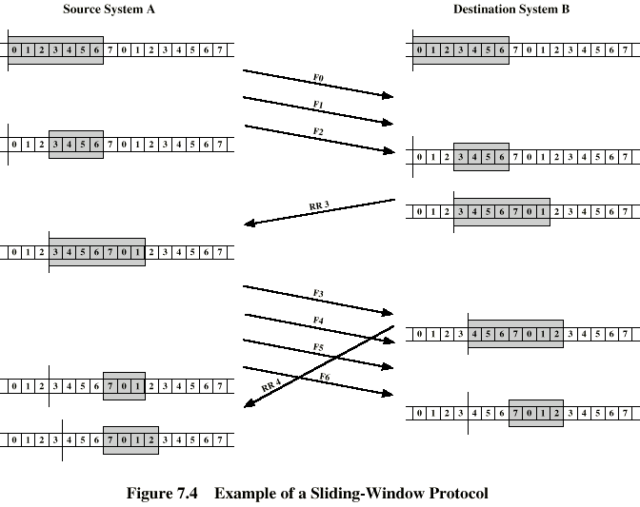
Example Sliding Window

Slide 30
Sliding Window Enhancements
Receiver can acknowledge frames without permitting further transmission (Receive Not Ready)
Must send a normal acknowledge to resume
If duplex, use piggybacking
  If no data to send, use acknowledgement frame
  If data but no acknowledgement to send, send last acknowledgement number again, or have ACK valid flag (TCP)

Slide 31
Flow & Error Control
-- Stop and Wait or
1-Bit Sliding Windows
Source transmits single frame
Wait for ACK
If received frame damaged, discard it
  Transmitter has timeout
  If no ACK within timeout, retransmit
If ACK damaged,transmitter will not recognize it
  Transmitter will retransmit
  Receive gets two copies of frame
  Use ACK0 and ACK1

Slide 32
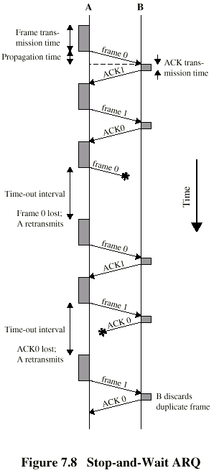
Stop and Wait -Diagram

Slide 33
Stop and Wait - Pros and Cons
Simple
Inefficient

Slide 34
Go Back N (1)
Based on sliding window
If no error, ACK as usual with next frame expected
Use window to control number of outstanding frames
If error, reply with rejection
  Discard that frame and all future frames until error frame received correctly
  Transmitter must go back and retransmit that frame and all subsequent frames

Slide 35
Go Back N - Damaged Frame
Receiver detects error in frame i
Receiver sends rejection-i
Transmitter gets rejection-i
Transmitter retransmits frame i and all subsequent

Slide 36
Go Back N - Lost Frame (1)
Frame i lost
Transmitter sends i+1
Receiver gets frame i+1 out of sequence
Receiver send reject i
Transmitter goes back to frame i and retransmits

Slide 37
Go Back N - Lost Frame (2)
Frame i lost and no additional frame sent
Receiver gets nothing and returns neither acknowledgement nor rejection
Transmitter times out and sends acknowledgement frame with P bit set to 1
Receiver interprets this as command which it acknowledges with the number of the next frame it expects (frame i )
Transmitter then retransmits frame i

Slide 38
Go Back N - Damaged Acknowledgement
Receiver gets frame i and send acknowledgement (i+1) which is lost
Acknowledgements are cumulative, so next acknowledgement (i+n) may arrive before transmitter times out on frame i
If transmitter times out, it sends acknowledgement with P bit set as before
This can be repeated a number of times before a reset procedure is initiated

Slide 39
Go Back N - Damaged Rejection
As for lost frame (2)

Slide 40
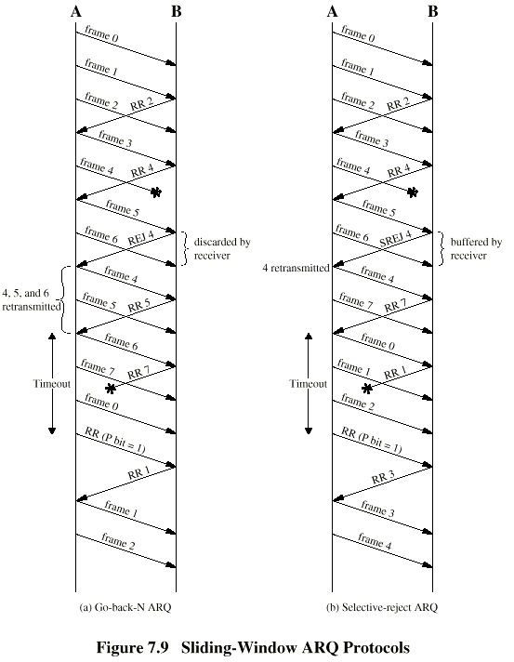
Go Back N -
Diagram

Slide 41
Why Quota Win = 2^k -1
Eliminate the confusion of go-back-n or move to the next frame sequence
T
R
Frame 0
7
0
Frame 6
Go back N (Frame 0)
Or
Go to the Next Frame (Frame 0)
Frame 7
Error at Frame 0
RR 0

Slide 42
Selective Reject
Also called selective retransmission
Only rejected frames are retransmitted
Subsequent frames are accepted by the receiver and buffered
Minimizes retransmission
Receiver must maintain large enough buffer
More complex login in transmitter

Slide 43
Selective Reject -
Diagram

Slide 44
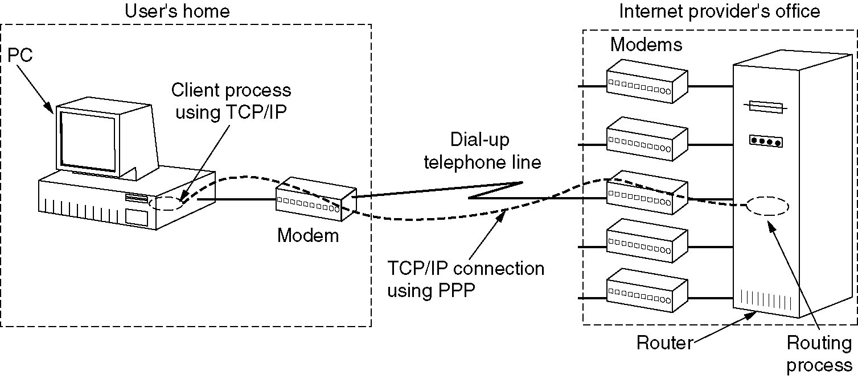
The Data Link Layer in the Internet
A home personal computer acting as an internet host.

Slide 45
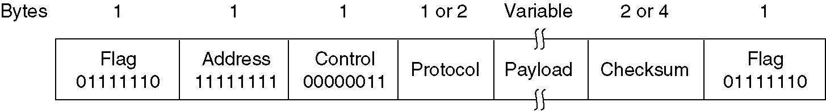
PPP – Point to Point Protocol
The PPP full frame format for unnumbered mode operation.

Slide 46
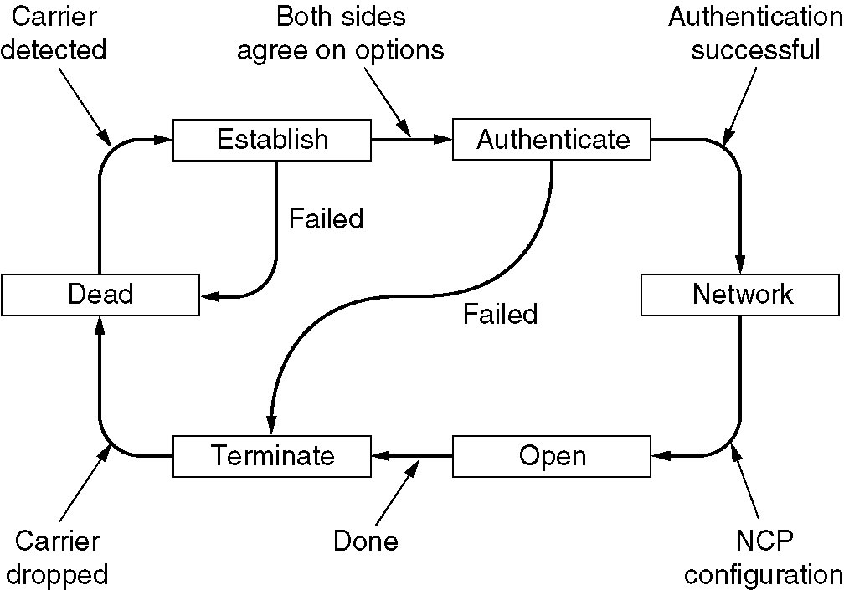
PPP – Point to Point Protocol (2)
A simplified phase diagram for bring a line up and down.

