Slide 1
Week 2
V2
Computer Network

Slide 2
1 Line Configuration
Two categories of line configuration
  Point-to-Point
  Multipoint
  Point-to-point provides a dedicate link between two devices
  Multipoint (also called multidrop) is one in which more than two specific devices share a single link

Slide 3
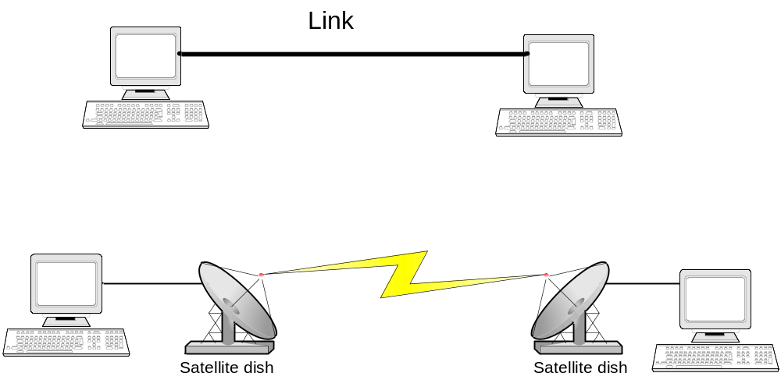
Point-to-Point configuration

Slide 4
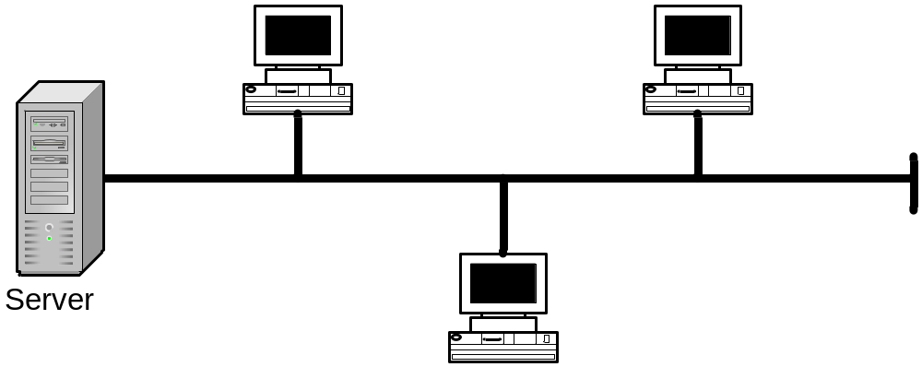
Multipoint

Slide 5
2. Network Topology
Mesh
Star
Tree
Bus
Ring

Slide 6
Mesh Topology
A Mesh topology Provides each device with a point-to-point connection to every other device in the network. These are most commonly used in WAN's, which connect networks over telecommunication links. Mesh topologies use routers to determine the best path.
Mesh networks provide redundancy, in the event of a link failure, meshed networks enable data to be routed through any other site connected to the network. Because each device has a point-to-point connection to every other device, mesh topologies are the most expensive and difficult to maintain.

Slide 7
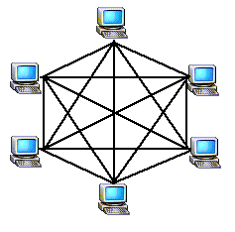
Mesh Topology

Slide 8
Star Topology
Computers in a star topology are connected by cables to a hub. In this topology management of the network is made much easier (such as adding and removing devices), because of the central point. However because it is centralized more cable is required.
Because most star topologies use twisted-pair cables, the initial installation of star networks is also easier.
If one computer fails the network will continue to function, but if a hub fails all computers connected to it will also be affected.
Star topologies are, or are becoming the topology of choice for networks.

Slide 9
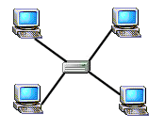
Star Topology

Slide 10
Tree Topology (Hierarchy)
Some books reference as Hierarchical or cascading star or Extended Star

Slide 11
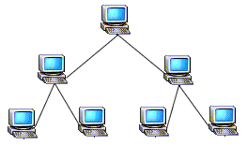
Tree Topology

Slide 12
Bus Topology
In bus topologies, all computers are connected to a single cable or "trunk or backbone", by a transceiver either directly or by using a short drop cable. All ends of the cable must be terminated, that is plugged into a device such as a computer or terminator. Most bus topologies use coax cables.
The number of computers on a bus network will affect network performance, since only one computer at a time can send data, the more computers you have on the network the more computers there will be waiting send data. A line break at any point along the trunk cable will result in total network failure.
Computers on a bus only listen for data being sent they do not move data from one computer to the next, this is called passive topology.

Slide 13
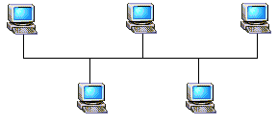
Bus Topology

Slide 14
Ring Topology
In a ring topology network computers are connected by a single loop of cable, the data signals travel around the loop in one direction, passing through each computer. Ring topology is an active topology because each computer repeats (boosts) the signal before passing it on to the next computer.
One method of transmitting data around a ring is called token passing. The token is passed from computer to computer until it gets to a computer that has data to send.
If there is a line break, or if you are adding or removing a device anywhere in the ring this will bring down the network. In an effort to provide a solution to this problem, some network implementations (such as FDDI) support the use of a double-ring. If the primary ring breaks, or a device fails, the secondary ring can be used as

Slide 15
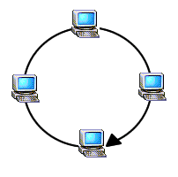
Ring Topology

Slide 16
Wireless
Wireless
A wireless network consists of wireless NICs and access points. NICs come in different models including PC Card, ISA, PCI, etc. Access points act as wireless hubs to link multiple wireless NICs into a single subnet. Access points also have at least one fixed Ethernet port to allow the wireless network to be bridged to a traditional wired Ethernet network, such as the organization’s network infrastructure. Wireless and wired devices can coexist on the same network.

Slide 17
Wireless
A wireless network consists of wireless NICs and access points. NICs come in different models including PC Card, ISA, PCI, etc. Access points act as wireless hubs to link multiple wireless NICs into a single subnet. Access points also have at least one fixed Ethernet port to allow the wireless network to be bridged to a traditional wired Ethernet network, such as the organization’s network infrastructure. Wireless and wired devices can coexist on the same network.

Slide 18
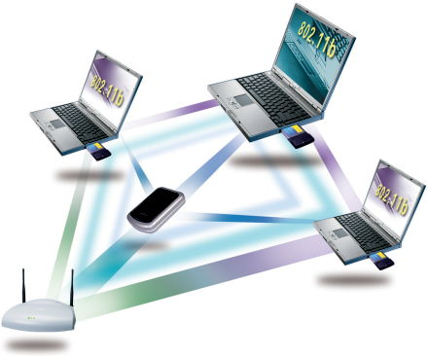
Wireless LAN

Slide 19
2. Transmission Mode
Simplex
Half-Duplex
Full-Duplex

Slide 20
Simplex
In simplex mode, the communication is unidirectional, as on a one-way street. Only one of the two stations o a link can transmit; the other can only receive

Slide 21
Half-Duplex
In half-duplex mode, each station can both transmit and receive, but not al the same time. When one device is sending, the other can only receive, and vice versa.

Slide 22
Full Duplex
In full duplex mode, both stations can transmit and receive simultaneously

Slide 23
4 Categories of Networks
Local Area Network (LAN)
Metropolitan Area Network (MAN)
Wide Area Network (WAN)
Internet

Slide 24
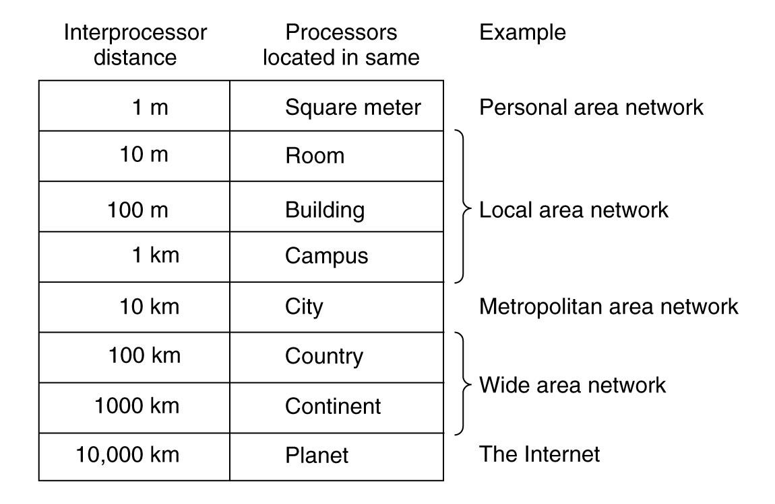

Slide 25
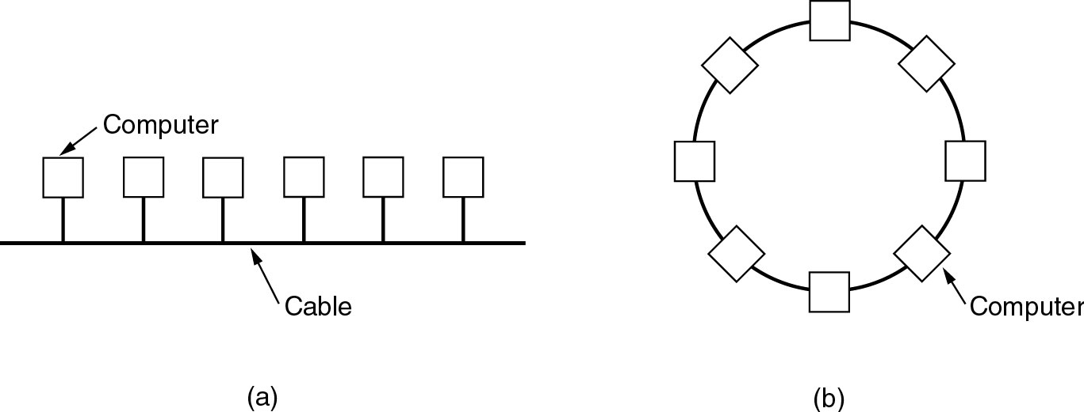
Local Area Networks
Two broadcast networks
(a) Bus
(b) Ring

Slide 26
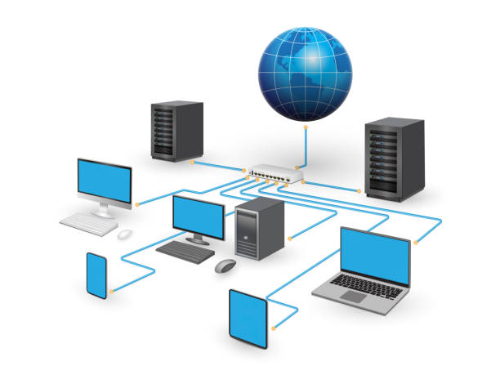
LAN

Slide 27
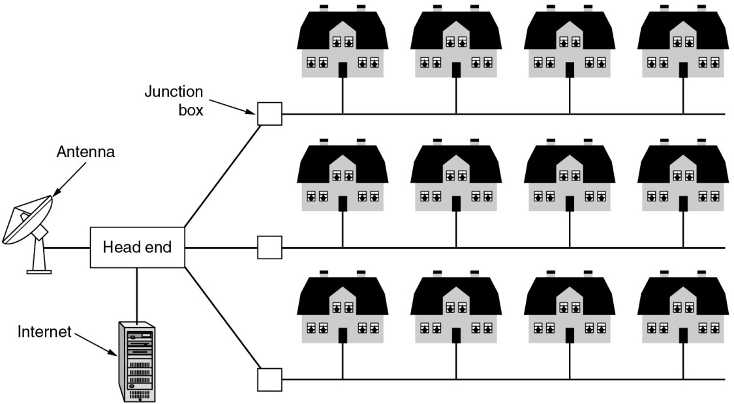
Metropolitan Area Networks
A metropolitan area network based on cable TV.

Slide 28
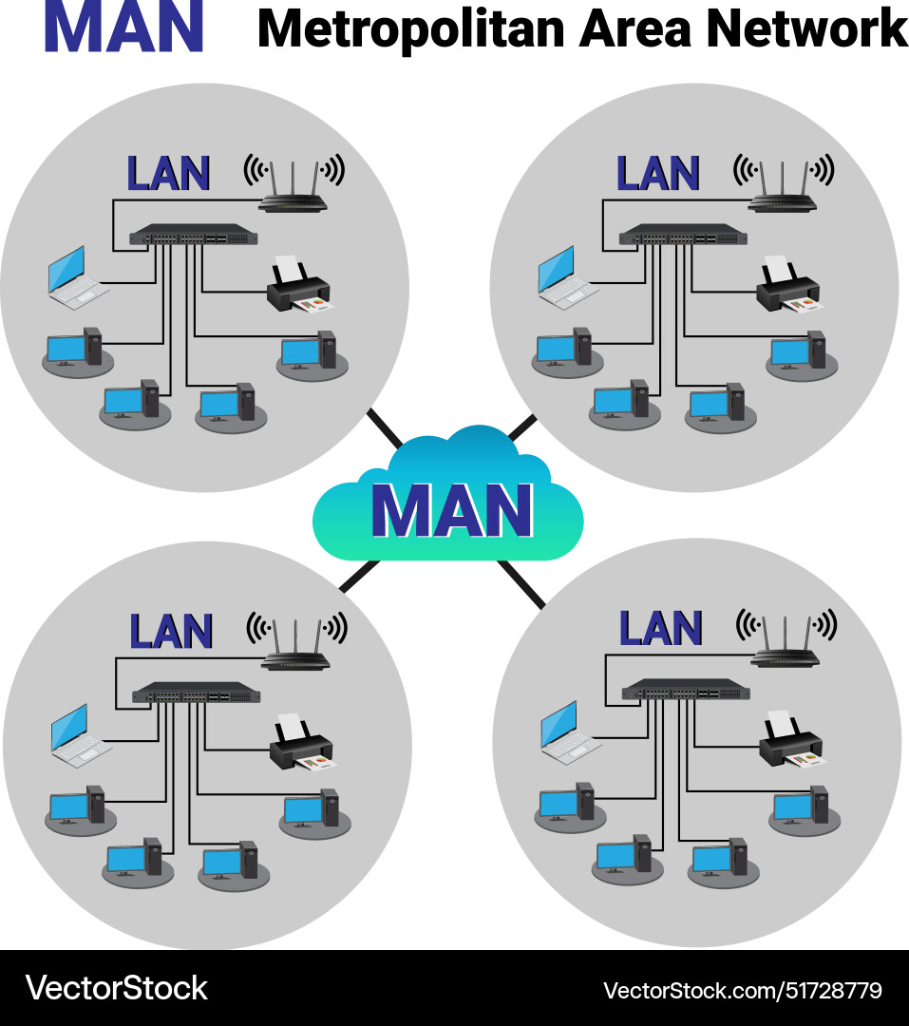

Slide 29
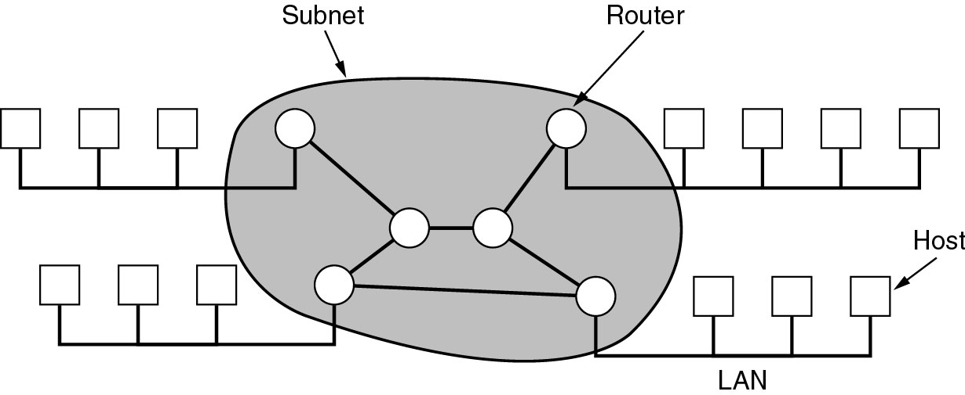
Wide Area Networks
Relation between hosts on LANs and the subnet.

Slide 30
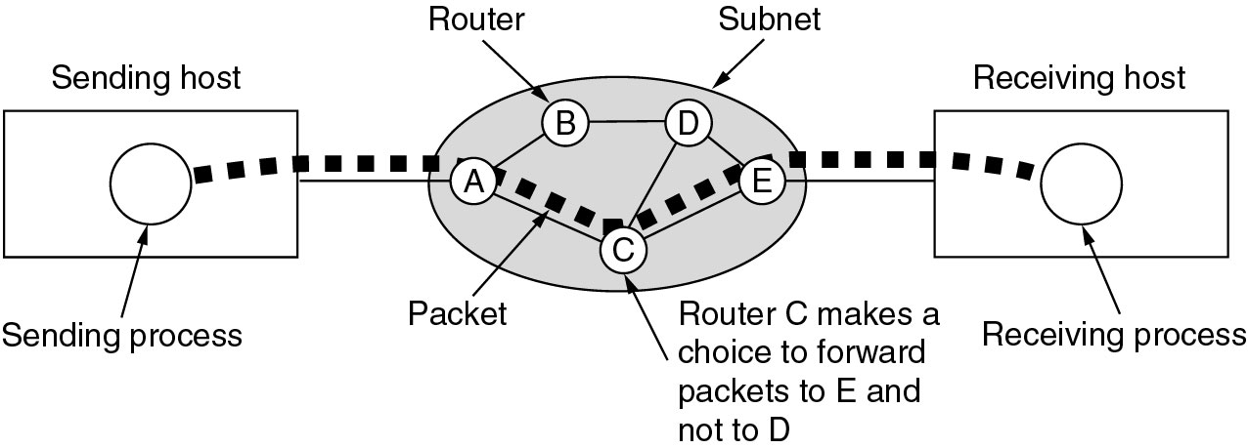
Wide Area Networks (2)
A stream of packets from sender to receiver.

Slide 31
Wireless Networks
Categories of wireless networks:
System interconnection
Wireless LANs
Wireless WANs

Slide 32
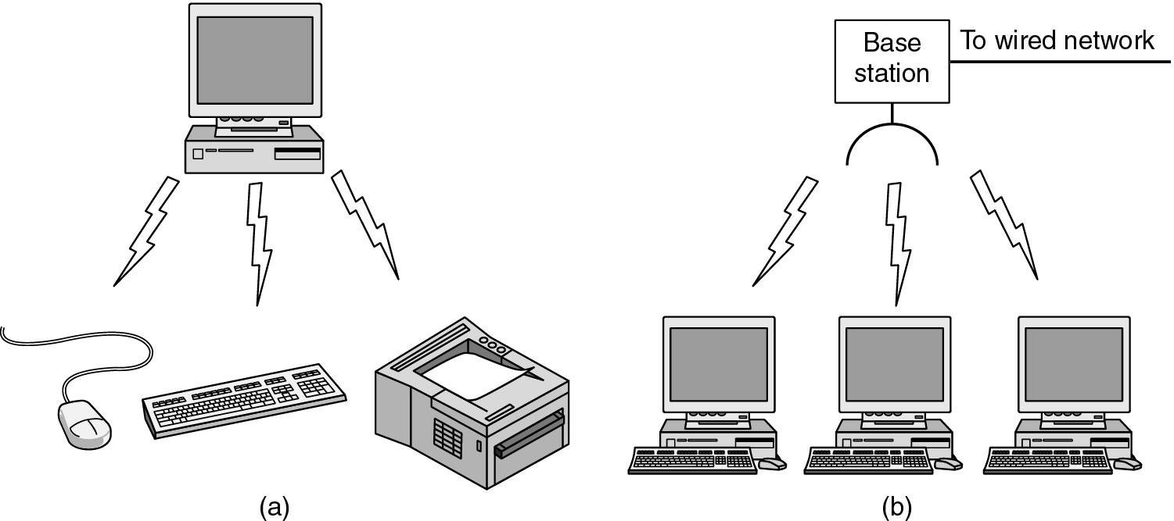
a) Bluetooth configuration
(b) Wireless LAN

Slide 33
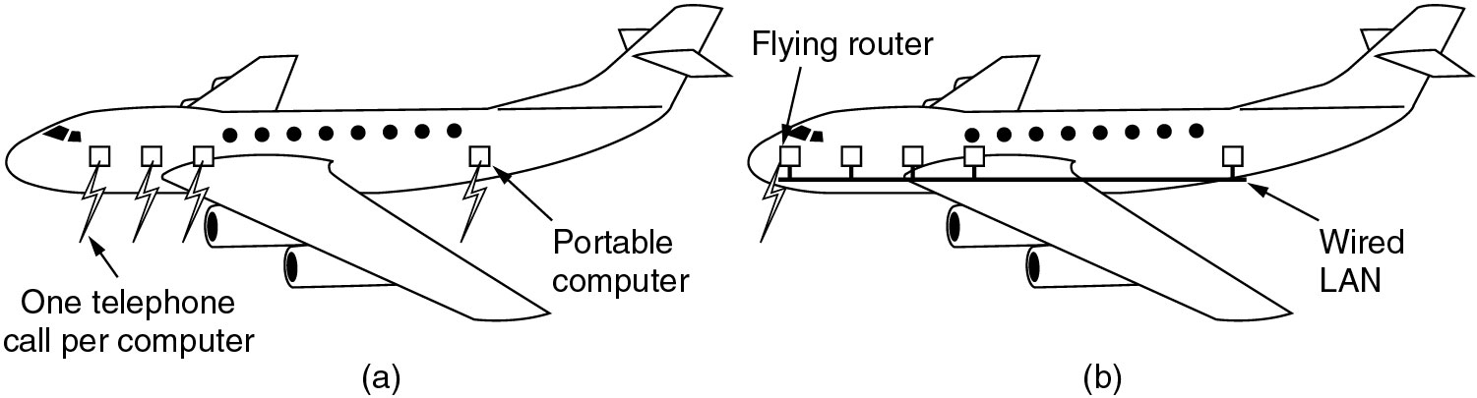
Wireless Networks (3)

Slide 34
Connection-Oriented and Connectionless Service
Layer can offer two different types of service to the layers above them:
  Connection-oriented service
  Connectionless service

Slide 35
Connection-Oriented Service
Is modeled after the telephone system
Establishes a connection
Use the connection
Release the connection

Slide 36
Connectionless
Is modeled after the postal system
Data are sent along the connection

Slide 37
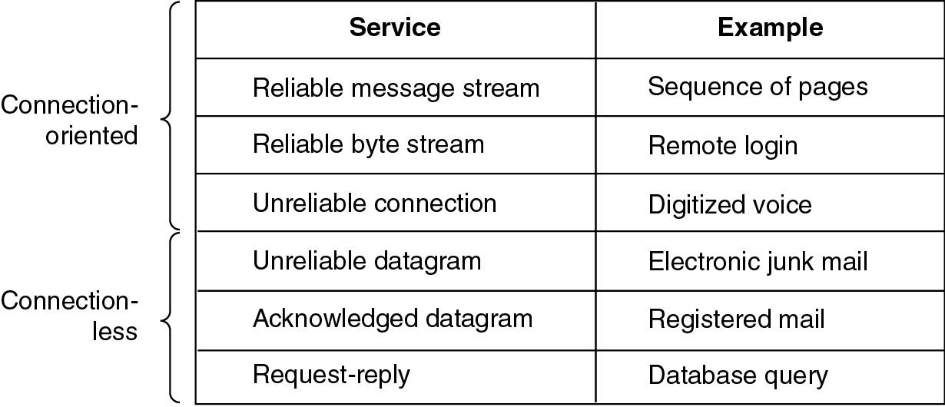
Connection-Oriented and Connectionless Services

Slide 38
Protocol Hierarchy
To reduce design complexity, most network are organized as a series of Layers or Levels
The concept of layers is used to describe communication from one computer to another.

Slide 39
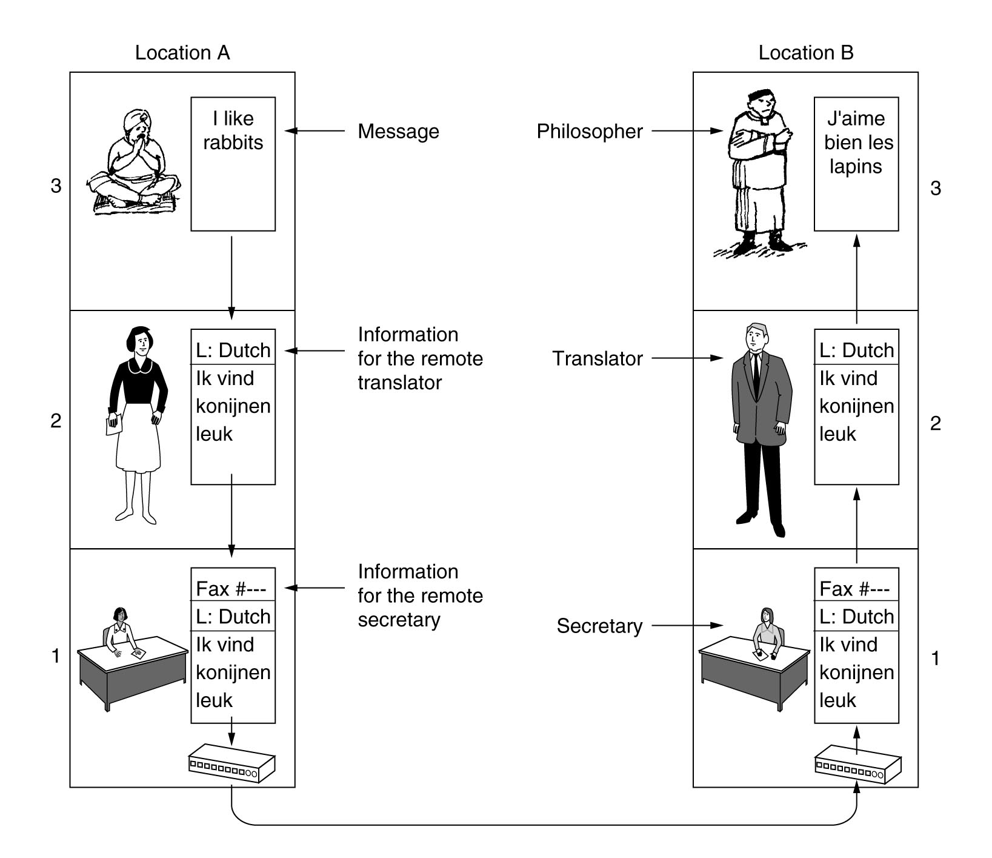
The philosopher-translator-secretary architecture

Slide 40
Protocol Layers
This process can be broken into separate layers that may be applied to all conversations. The top layer is the idea that will be communicated. The middle layer is the decision on how the idea is to be communicated. The bottom layer is the creation of sound to carry the communication.

Slide 41
Protocol Layers
In order for data packets to travel from a source to a destination on a network, it is important that all the devices on the network speak the same language or protocol. A protocol is a set of rules that make communication on a network more efficient. For example, while flying an airplane, pilots obey very specific rules for communication with other airplanes and with air traffic control.

Slide 42
Protocol Layers
A data communications protocol is a set of rules or an agreement that determines the format and transmission of data.

Slide 43
Reference Models
The OSI Reference Model
Open System Interconnection (OSI)

Slide 44
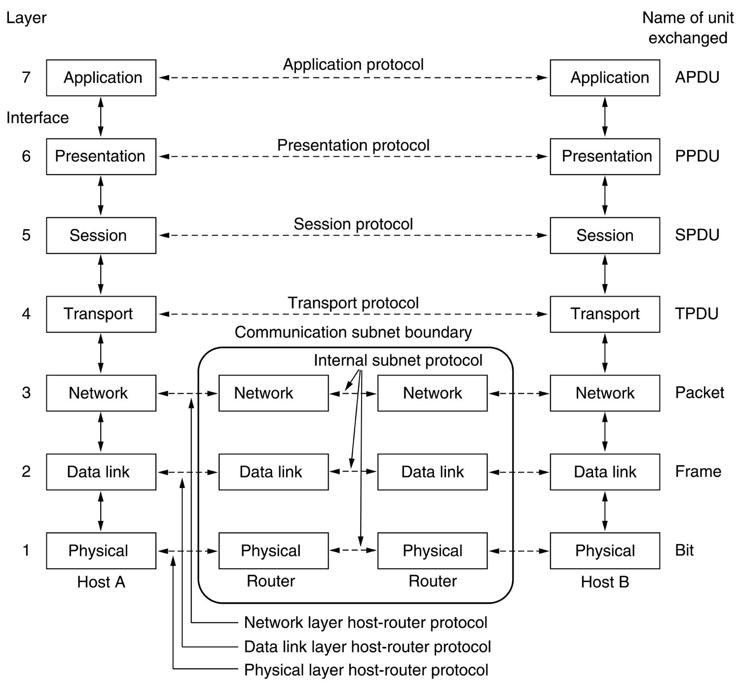

Slide 45
Function of the layers
Physical Layer (P)
Data Link Layer (D)
Network Layer (N)
Transport Layer (T)
Session Layer (S)
Presentation Layer (P)
Application Layer (A)

Slide 46
Physical Layer
Line configuration (Bit transmission)
Data transmission mode
Signal
Encoding
Interface
Medium

Slide 47
Data Link Layer
Node-to-node delivery
Addressing
Access control
Flow control
Error control
Synchronization
(Frame)

Slide 48
Network Layer
Source-to-destination delivery (Best effort)
Logical Addressing
Routing
Address Transformation logical←→physical
Multiplexing
(Packet)

Slide 49
Transport layer
End-to-End message Delivery Control
Service-point (port) addressing
Establish, maintain, terminate virtual circuit

Slide 50
Session Layer
Session management (Form and session huge data)
Dialog controller, it establishes, maintains and synchronizes the interaction between application

Slide 51
Presentation Layer
Translation
Format data
Data structure
Encryption, compression and security

Slide 52
Application Layer
Application, i.e. mail, web, etc.

Slide 53
Application | Gives user applications access to network. This layer represents the services, that directly support the user applications such as software for file transfers, database access, and e-mail. | Gateway | SNMP, SMTP, FTP, TELNET, HTTP, NCP, SMB, AppleTalk
Presentation | Encodes and converts user information into binary data. Provides protocol conversion, encryption, and compression. | Gateway and redirectors | NCP, AFP, TDI

Slide 54
Session | Opens manages, and closes conversations between two computers. It performs name recognition and the functions such as security, needed to allow two applications to communicate over the network, also provides error handling. | Gateway | NetBIOS
Transport | Sequences data packets, and requests retransmission of missing packets. It also repackages messages for more efficient transmission over the network. | Gateway | NetBEUI, TCP, SPX, NWlink

Slide 55
Network | Routes data packets across network segments. Translates logical addresses and names into physical addresses. | Router, Brouter | IP, IPX, NWlink, NetBEUI
Data Link | Transmits frames of data from computer to computer on the same network segment. | Switch, Bridge, and Brouter | None
Physical | Defines cabling and connections. Transmits data over the physical media. | Repeaters, Hubs, Transceivers, Amplifiers | None

Slide 56
Network Devices
Examples of devices that perform these functions are repeaters, hubs, bridges, switches, and routers.

Slide 57
Repeater
A repeater is a network device used to regenerate a signal. Repeaters regenerate analog or digital signals distorted by transmission loss due to attenuation. A repeater does not perform intelligent routing like a bridge or router.

Slide 58
Repeater
A repeater is used to connect two similar LAN networks, for example Ethernet to Ethernet. The nodes still believe themselves to be on a single LAN. Therefore, in the case of Ethernet, the nodes are in the same collision domain. Repeaters are not capable of connecting together two networks of different technology, for example, Ethernet to Token Ring.

Slide 59

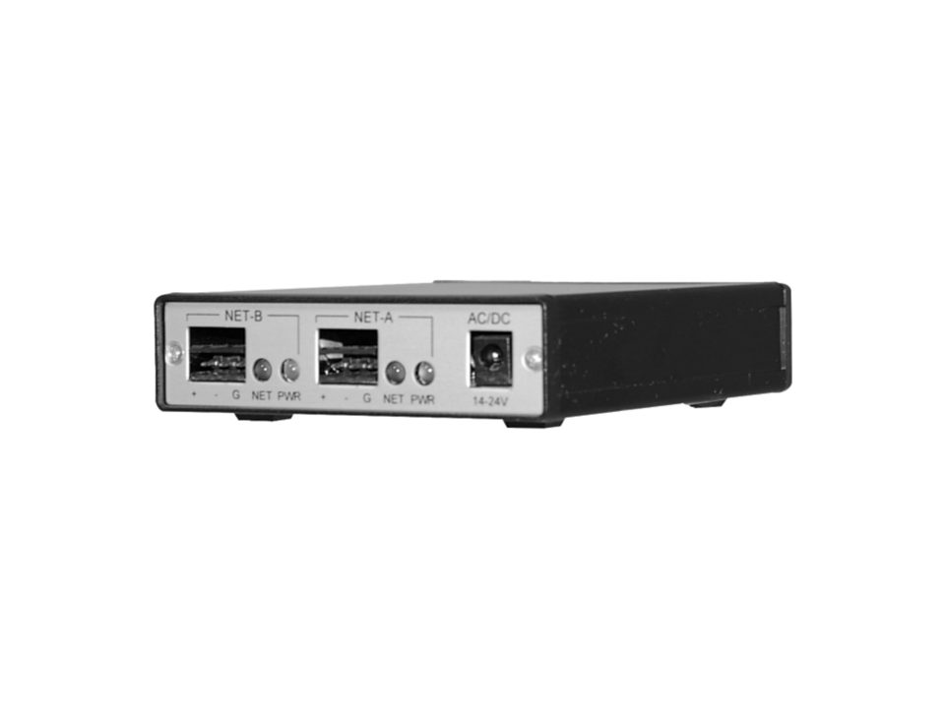
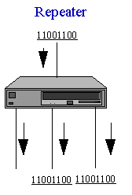
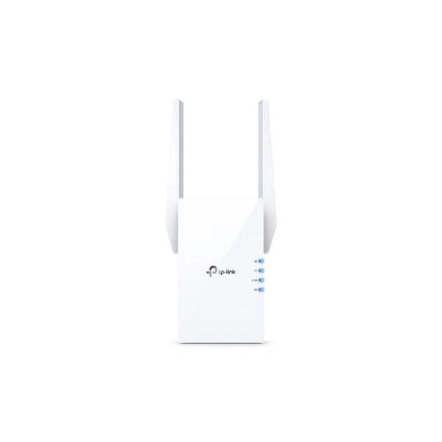
Repeater

Slide 60
HUB (Obsoleted)
A Hub is a component that provides a common connection point for computers, printers, and other network devices in a star topology network. Allowing them to be managed from a central location. Also, hubs allow you to connect and disconnect an individual computer/device without disrupting the network. Hubs operate at the physical layer of the OSI Model

Slide 61


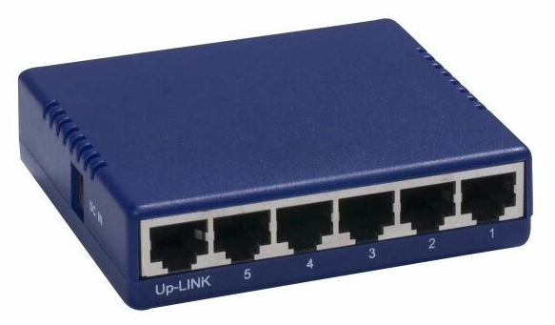


HUB
Stackable hubs
Small hub

Slide 62
HUB
There are two basic types of hubs,
Passive
Active

Slide 63
Passive Hub
Passive hubs simply provide a junction point, to send the data signal on to other devices on the network

Slide 64
Active Hub
Active Hubs, regenerate and retransmit the data signal, because they repeat the signal they can, increase the diameter of the network. In an Ethernet hub the signal is regenerated to all devices at the same time, while a Token Ring hub will only regenerate the signal to the next to the next device in line. You can tell if a hub is active because it requires electricity

Slide 65
Switch
Switches are a special type of hub that offers an additional layer of intelligence to basic, physical-layer, repeater hubs. A switch must be able to read the MAC address of each frame it receives.

Slide 66

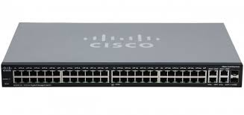
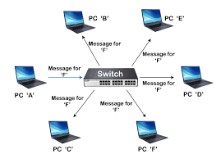
Switch

Slide 67
Switch
This information allows switches to repeat incoming data frames only to the computer or computers to which a frame is addressed. This speeds up the network and reduces congestion.
Switches operate at both the physical layer and the data link layer of the OSI Model

Slide 68
Bridge
A bridge is used to join two network segments together, it allows computers on either segment to access resources on the other. They can also be used to divide large networks into smaller segments. Bridges have all the features of repeaters, but can have more nodes, and since the network is divided, there is fewer computers competing for resources on each segment thus improving network performance.

Slide 69
Bridge
Bridges can also connect networks that run at different speeds, different topologies, or different protocols. But they cannot, join an Ethernet segment with a Token Ring segment, because these use different networking standards.

Slide 70
Bridge
Bridges operate at both the Physical Layer and the MAC sublayer of the Data Link layer. Bridges read the MAC header of each frame to determine on which side of the bridge the destination device is located, the bridge then repeats the transmission to the segment where the device is located.

Slide 71

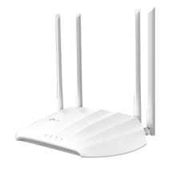
Bridge
The difference between a bridge and switch is that a switch does not convert data transmission formats.

Slide 72
Router
A device used to connect networks of different types, such as those using different topologies and protocols. They can operate at the first three layers of the OSI Model. This means they can switch and route packets across multiple networks. Routers determine the best path for sending data.

Slide 73
Router
You can use routers, to segment a large network, and to connect local area segments to a single network backbone that uses a different physical layer and data link layer standard. They can also be used to connect LAN's to a WAN's.

Slide 74

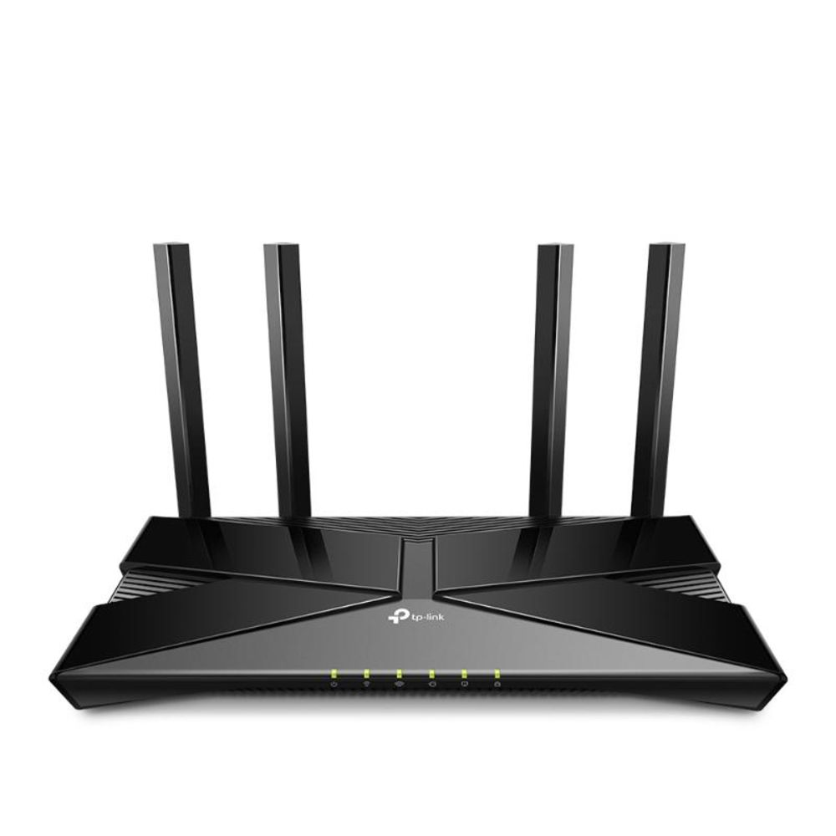
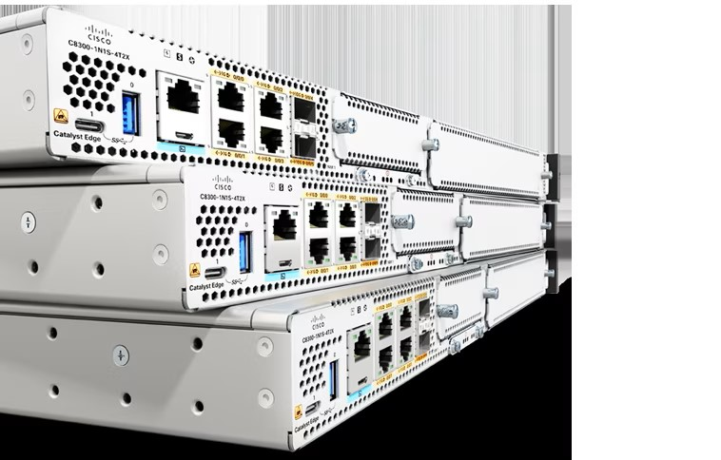
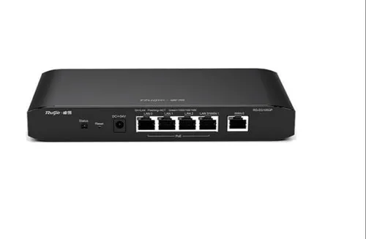
Router (Gateway)
Router
ISP Router
WiFi Router

Slide 75
Network Standardization
Who’s Who in the Telecommunications World
Who’s Who in the International Standards World
Who’s Who in the Internet Standards World

Slide 76
ITU
Main sectors
  Radiocommunications
  Telecommunications Standardization
  Development
Classes of Members
  National governments
  Sector members
  Associate members
  Regulatory agencies

Slide 77
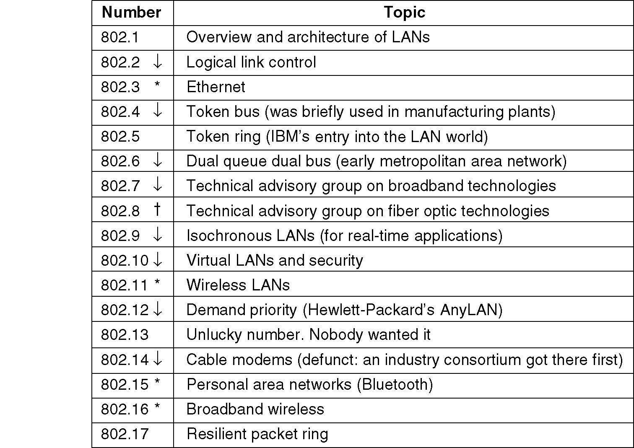
IEEE 802 Standards

Slide 78
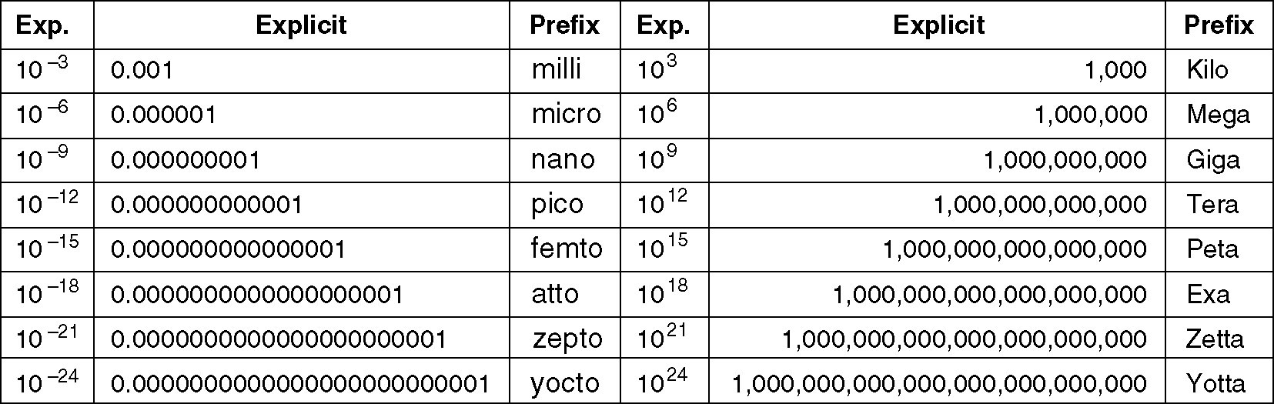
Metric Units

