Slide 1
The Media Access Control
Sub-layer

Slide 2
The Channel Allocation Problem in Multi-access or random-access
Static Channel Allocation in LANs and MANs
Dynamic Channel Allocation in LANs and MANs

Slide 3
Dynamic Channel Allocation in LANs and MANs
Station Model.
Single Channel Assumption.
Collision Assumption.
(a) Continuous Time.
(b) Slotted Time.
(a) Carrier Sense.
(b) No Carrier Sense.

Slide 4
Multiple Access Protocols
ALOHA
Carrier Sense Multiple Access Protocols
Collision-Free Protocols
Limited-Contention Protocols
Wavelength Division Multiple Access Protocols
Wireless LAN Protocols

Slide 5
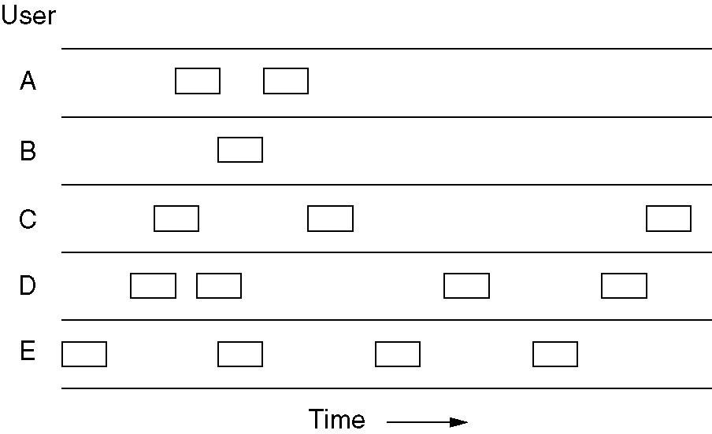
Pure ALOHA
In pure ALOHA, frames are transmitted at completely arbitrary times.

Slide 6
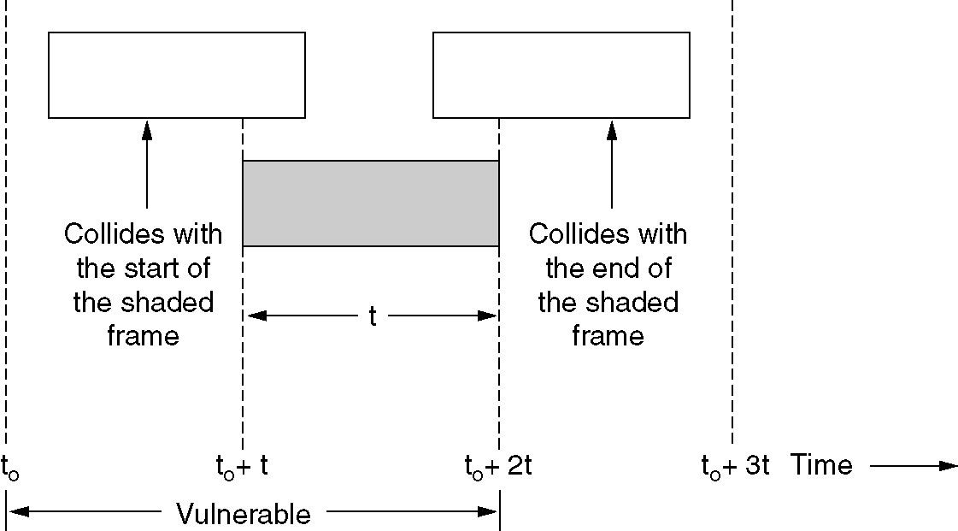
Pure ALOHA (2)
Vulnerable period for the shaded frame.

Slide 7
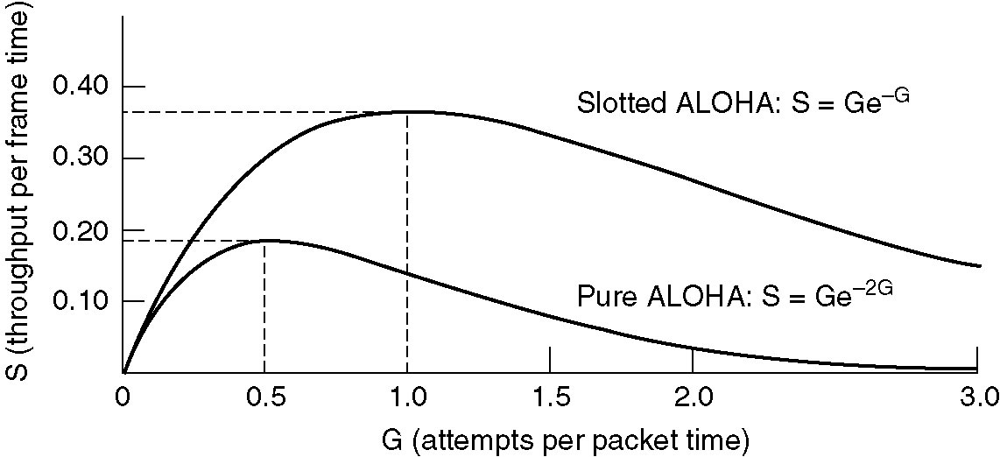
Pure ALOHA (3)
Throughput versus offered traffic for ALOHA systems.

Slide 8
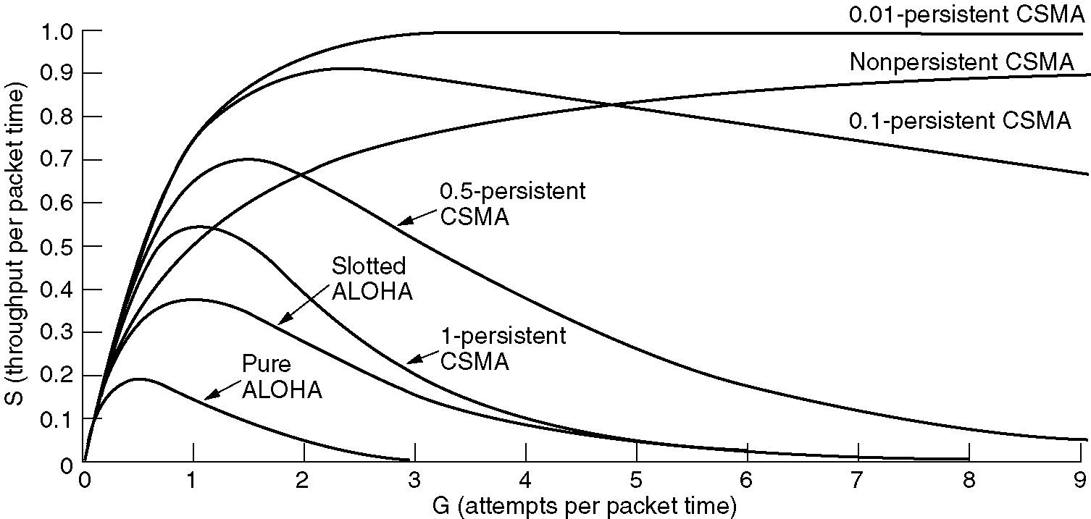
Persistent and Nonpersistent CSMA
Comparison of the channel utilization versus load for various random access protocols.

Slide 9
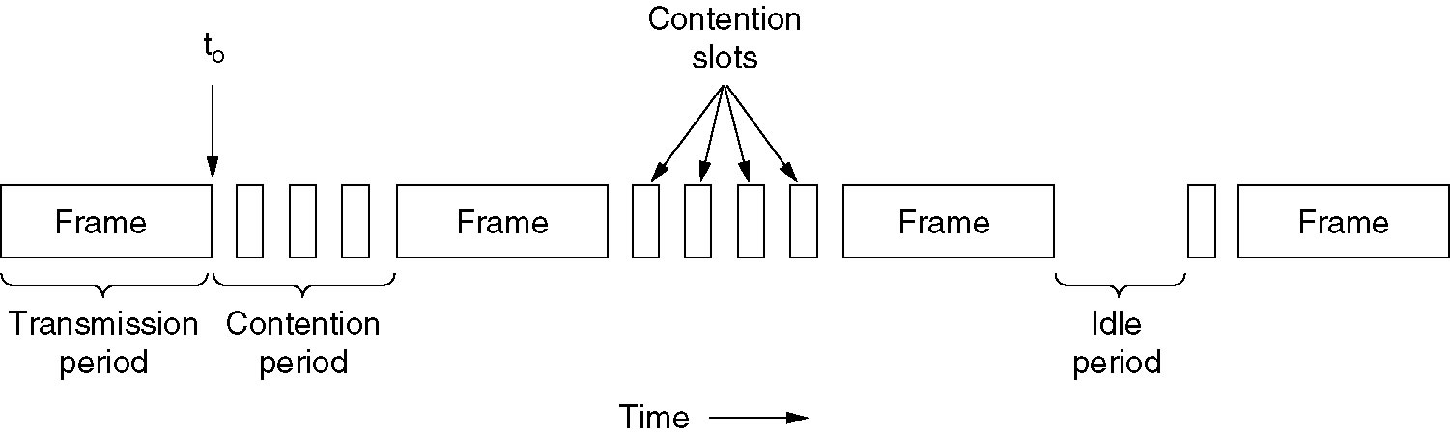
CSMA with Collision Detection
CSMA/CD can be in one of three states: contention, transmission, or idle.

Slide 10
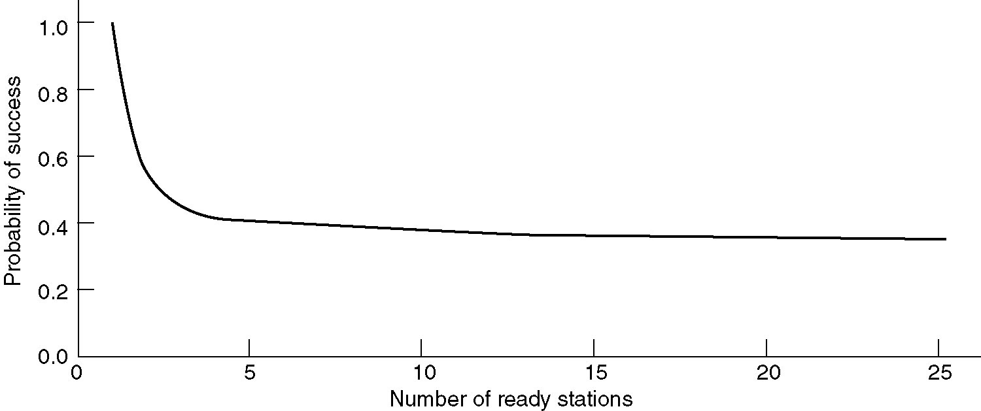
Limited-Contention Protocols
Acquisition probability for a symmetric contention channel.

Slide 11
Ethernet – IEEE 802.3 (CSMA/CD)
Ethernet Cabling
Manchester Encoding
The Ethernet MAC Sublayer Protocol
The Binary Exponential Backoff Algorithm
Ethernet Performance
Switched Ethernet
Fast Ethernet
Gigabit Ethernet
IEEE 802.2: Logical Link Control
Retrospective on Ethernet

Slide 12
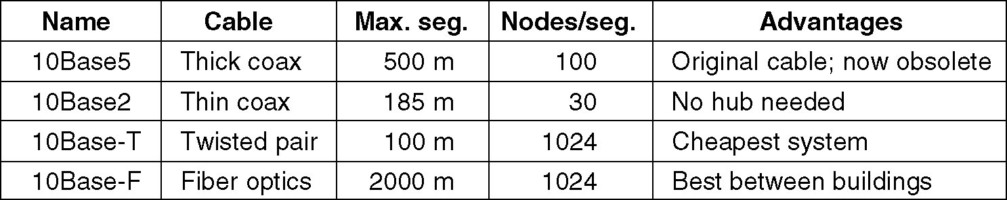
Ethernet Cabling
The most common kinds of Ethernet cabling.

Slide 13
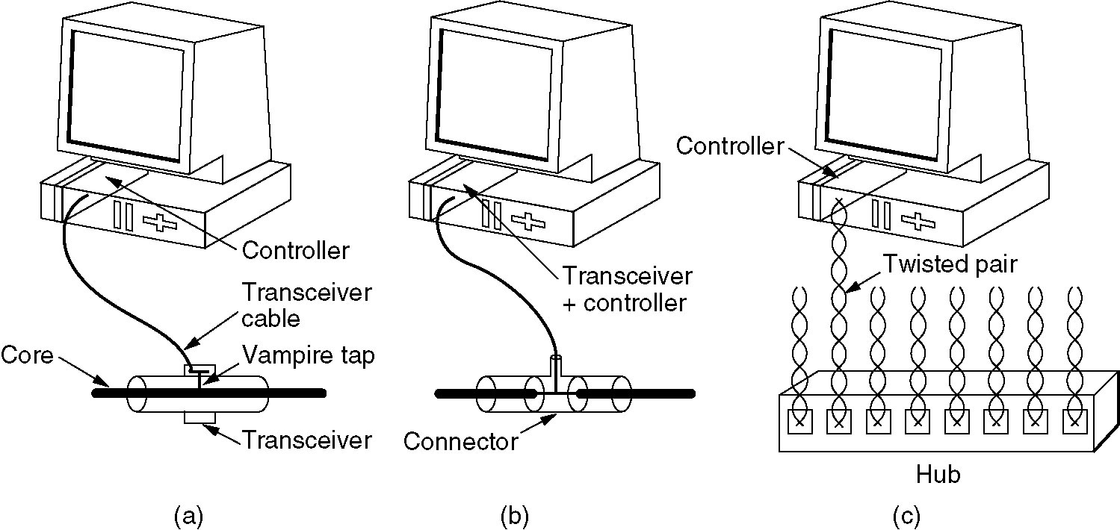
Ethernet Cabling (2)
Three kinds of Ethernet cabling.
(a) 10Base5, (b) 10Base2, (c) 10Base-T.

Slide 14
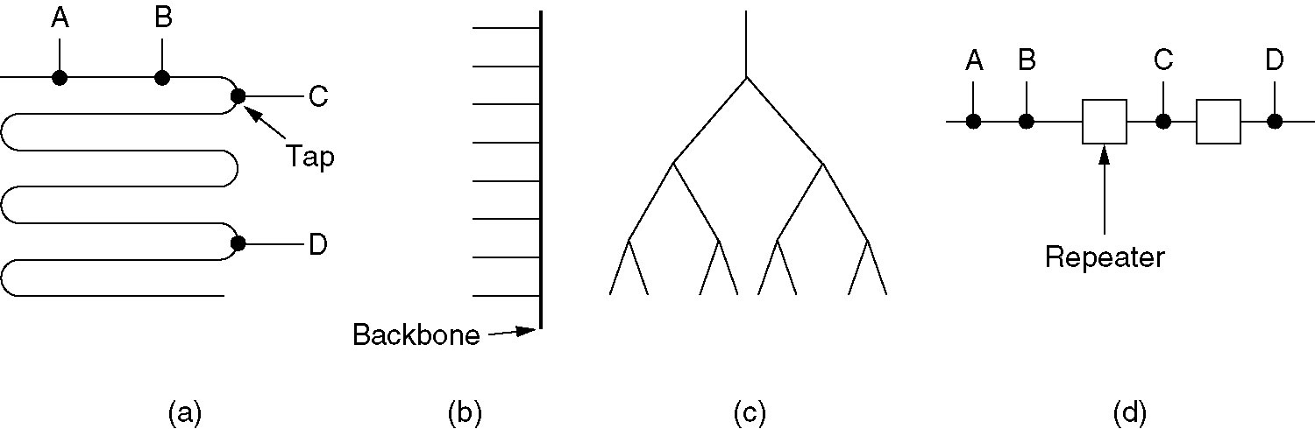
Ethernet Cabling (3)
Cable topologies. (a) Linear, (b) Spine, (c) Tree, (d) Segmented.

Slide 15
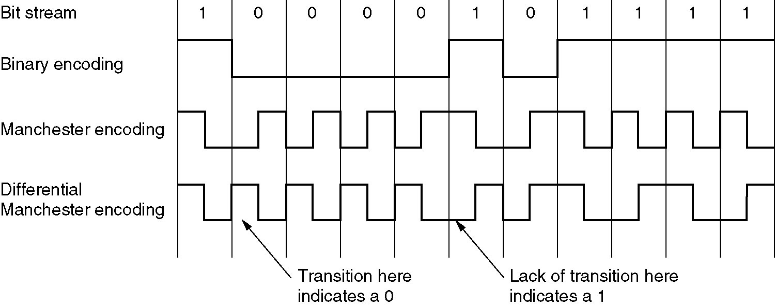
Ethernet Encoding (4)
(a) Binary encoding, (b) Manchester encoding,
(c) Differential Manchester encoding.

Slide 16
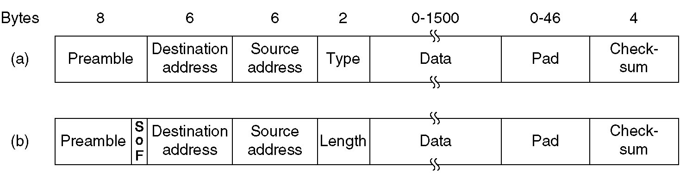
Ethernet MAC Sublayer Protocol
Frame formats. (a) Ethernet, (b) IEEE 802.3.

Slide 17
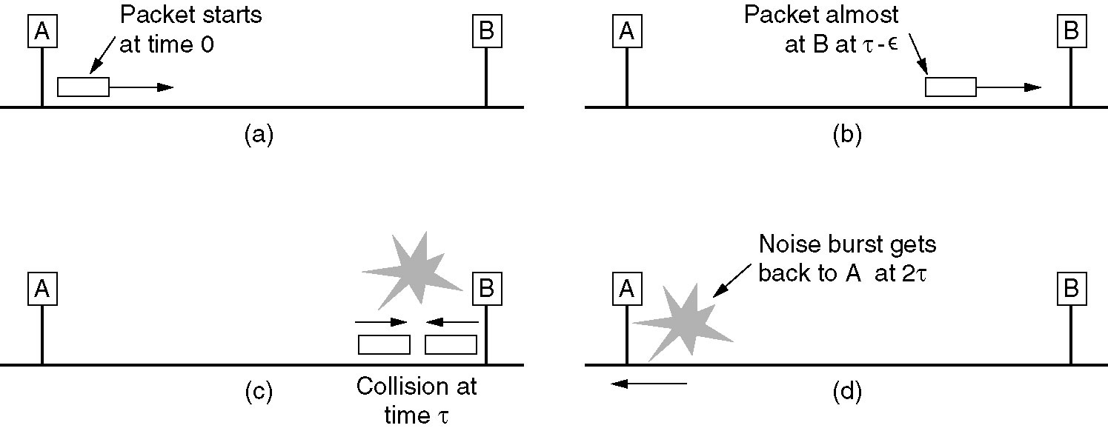
Ethernet MAC Sublayer Protocol (2)

Slide 18
The Binary Exponential Backoff Algorithm (Random)
Collision
  Station A and B want to sent data at the same time.
X communicate with Y … A and B trying to access the medium

Slide 19
Binary Exponential Backoff
  Time slot = 2^n
    n = number of collision
  Station random itself to access to the medium at the random slot

Slide 20
LAN Topology
Ethernet 802.3
Token Ring 802.4
Token Bus 802.5

Slide 21
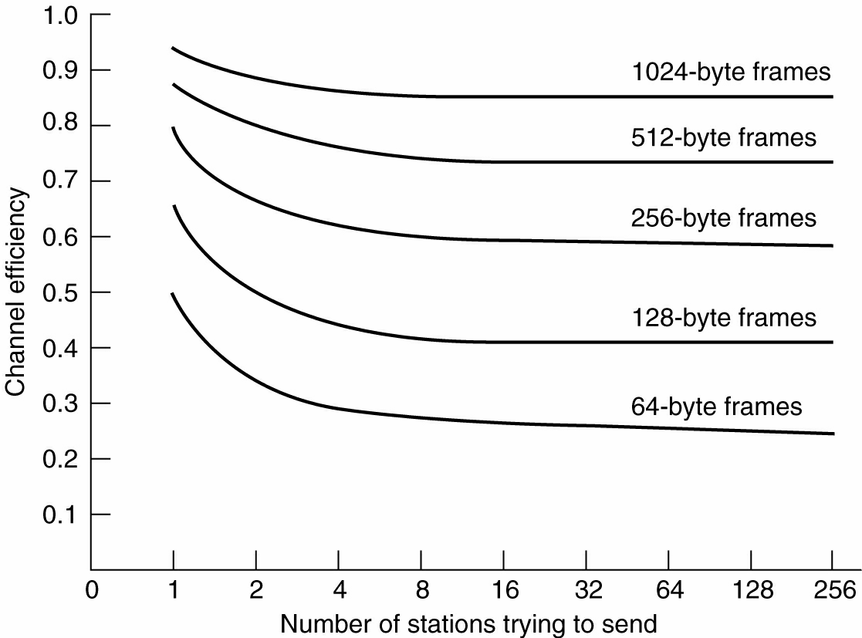
Ethernet Performance
Efficiency of Ethernet at 10 Mbps with 512-bit slot times.

Slide 22
Ethernet Performance
Decrease collision domain, Increase Performance … use switch.

Slide 23
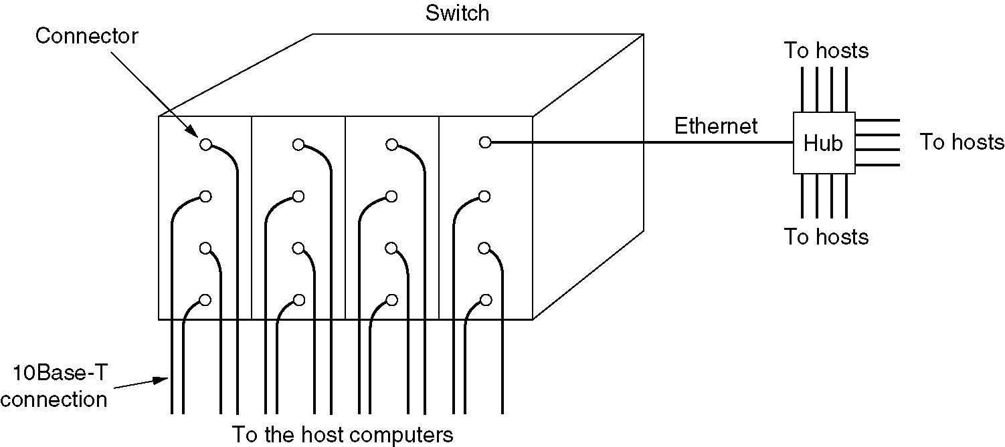
Switched Ethernet
A simple example of switched Ethernet.

Slide 24
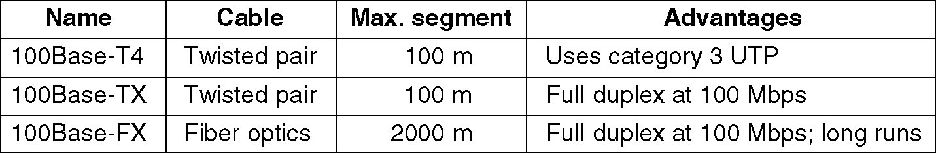
Fast Ethernet
The original fast Ethernet cabling.

Slide 25
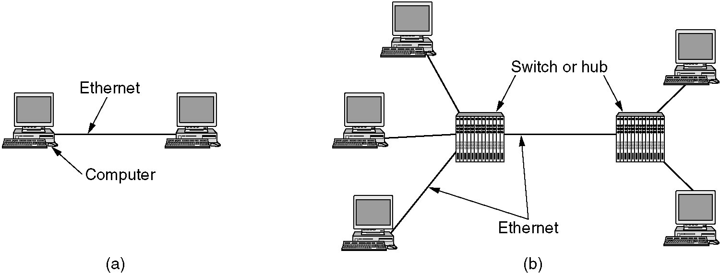
Gigabit Ethernet
(a) A two-station Ethernet. (b) A multistation Ethernet.

Slide 26
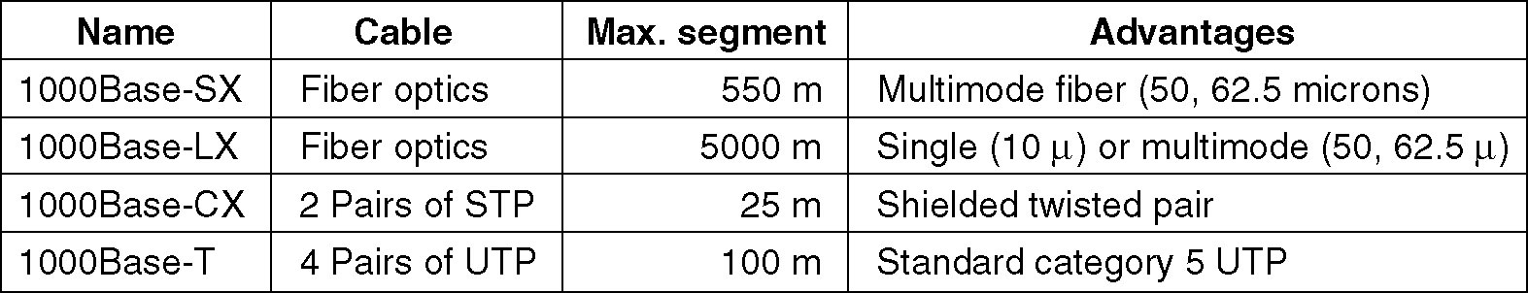
Gigabit Ethernet (2)
Gigabit Ethernet cabling.

Slide 27
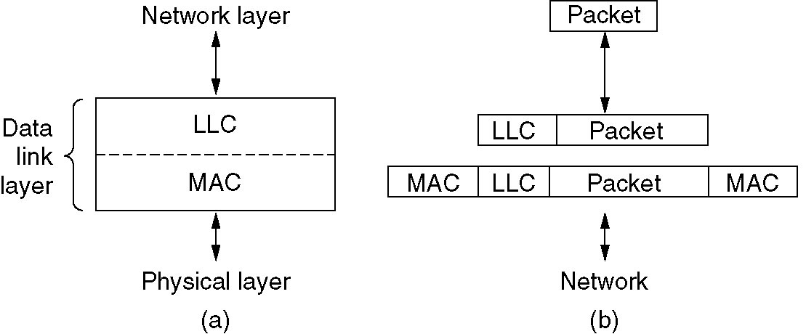
IEEE 802.2: Logical Link Control
(a) Position of LLC. (b) Protocol formats.

Slide 28
Bluetooth
Bluetooth Architecture
Bluetooth Applications
The Bluetooth Protocol Stack
The Bluetooth Radio Layer
The Bluetooth Baseband Layer
The Bluetooth L2CAP Layer
The Bluetooth Frame Structure

Slide 29
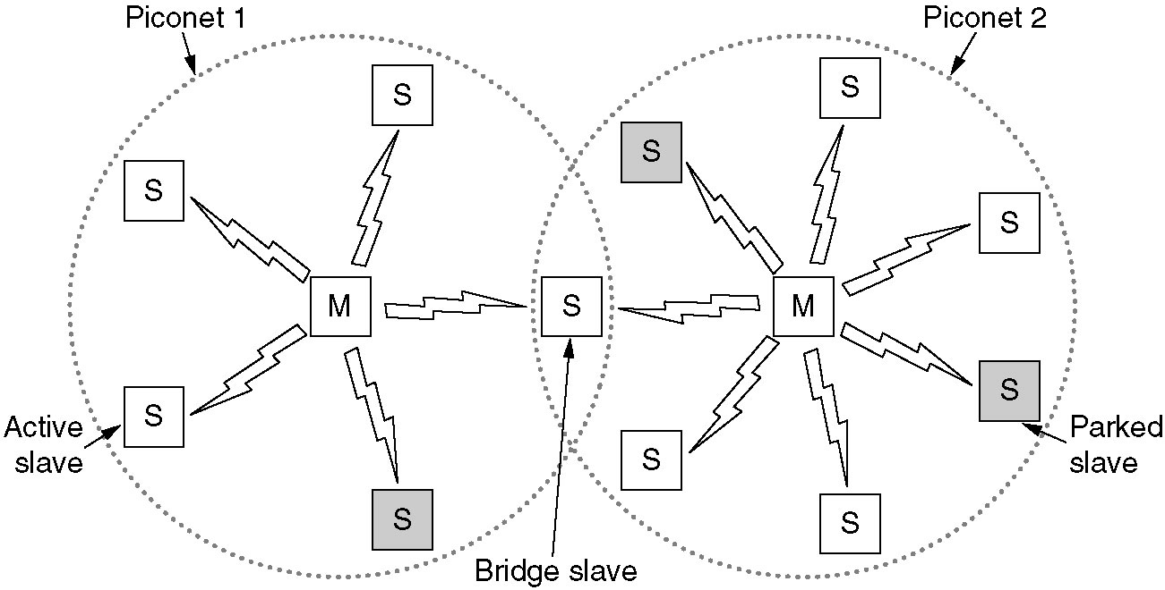
Bluetooth Architecture
Two piconets can be connected to form a scatternet.

Slide 30
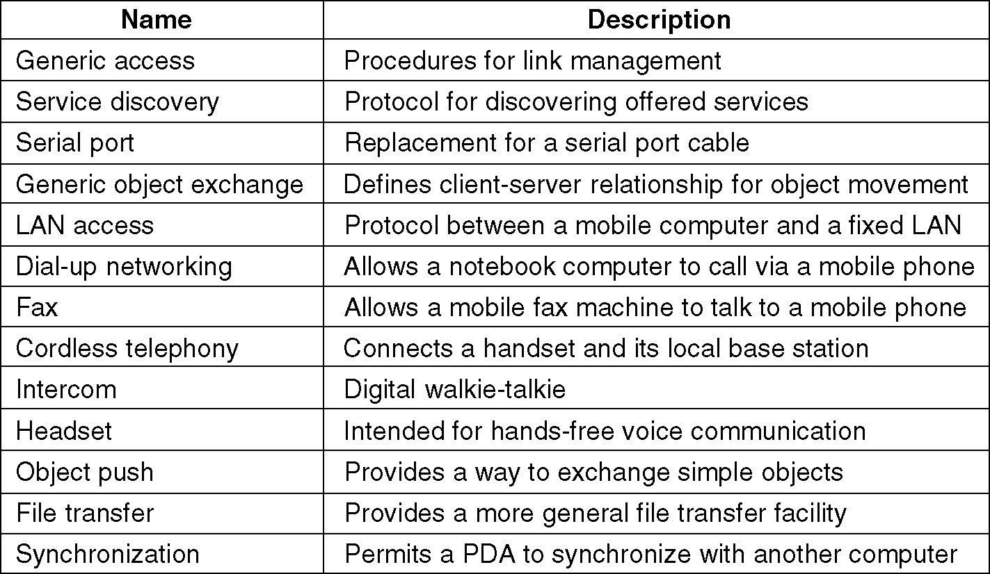
Bluetooth Applications
The Bluetooth profiles.

Slide 31
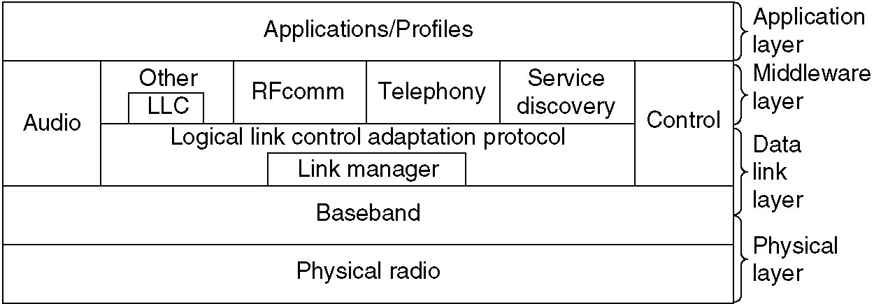
The Bluetooth Protocol Stack
The 802.15 version of the Bluetooth protocol architecture.

Slide 32
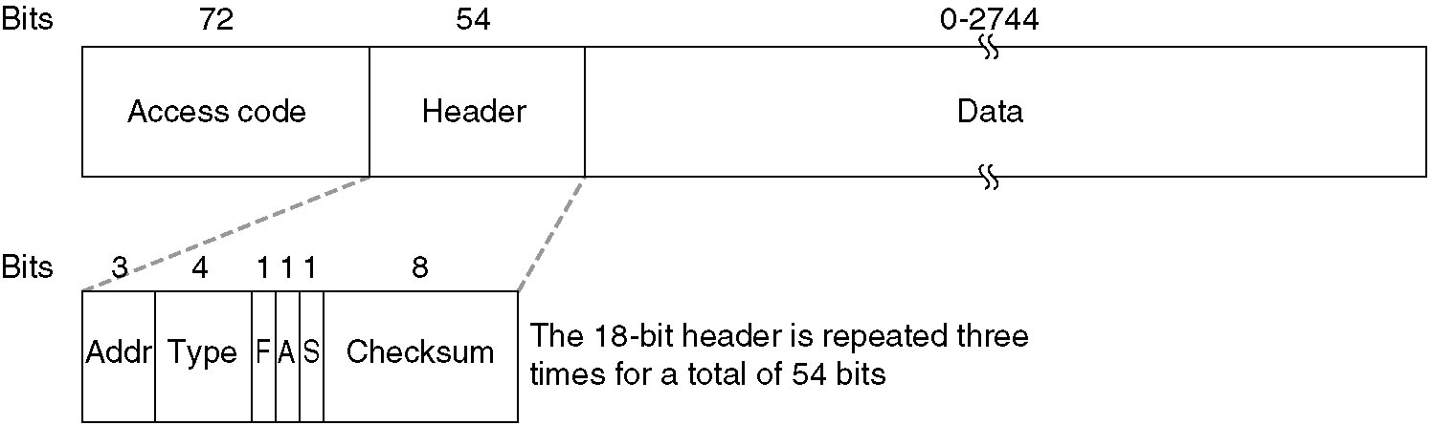
The Bluetooth Frame Structure
A typical Bluetooth data frame.

Slide 33
Data Link Layer Switching
Bridges from 802.x to 802.y
Local Internetworking
Spanning Tree Bridges
Remote Bridges
Repeaters, Hubs, Bridges, Switches, Routers, Gateways
Virtual LANs

Slide 34
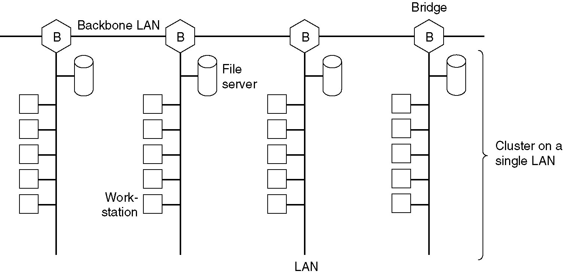
Data Link Layer Switching
Multiple LANs connected by a backbone to handle a total load higher than the capacity of a single LAN.

Slide 35
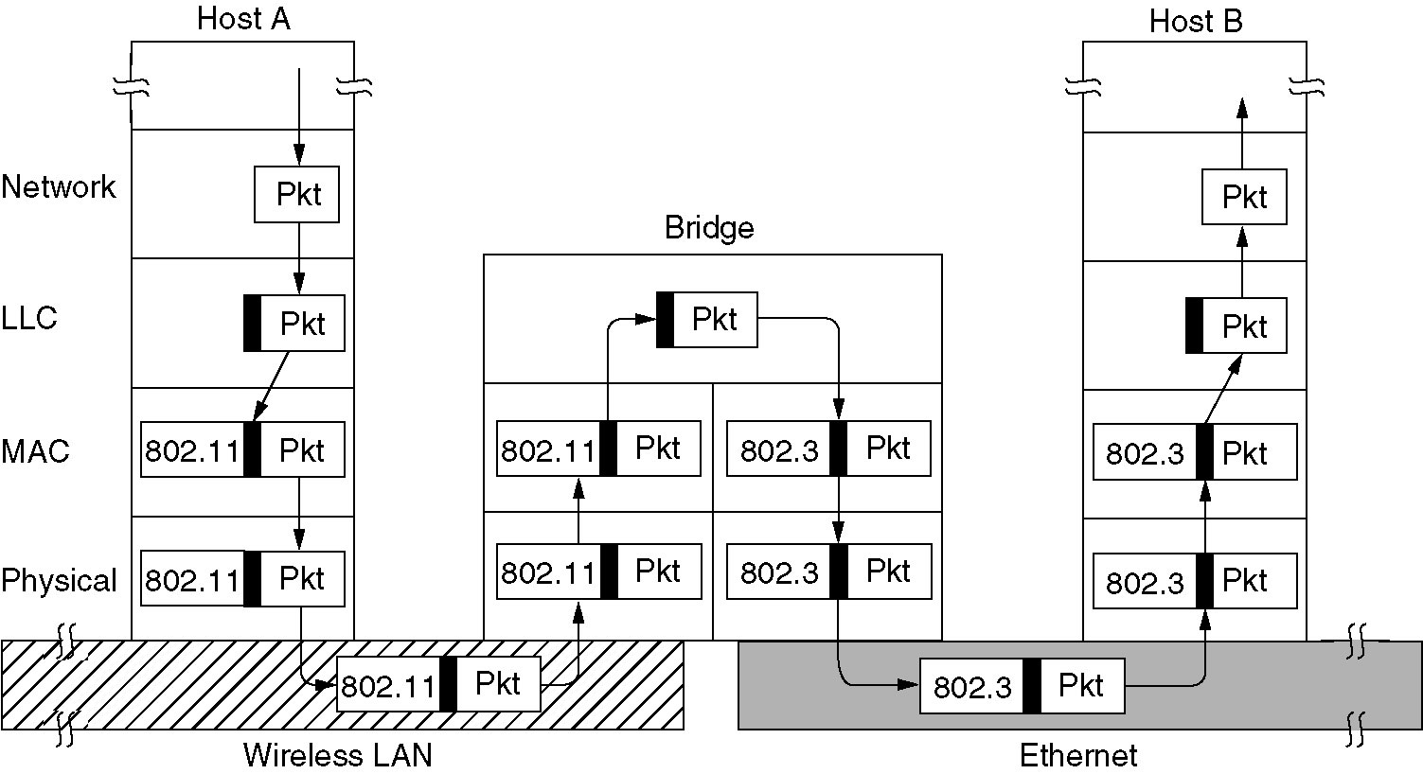
Bridges from 802.x to 802.y
Operation of a LAN bridge from 802.11 to 802.3.

Slide 36
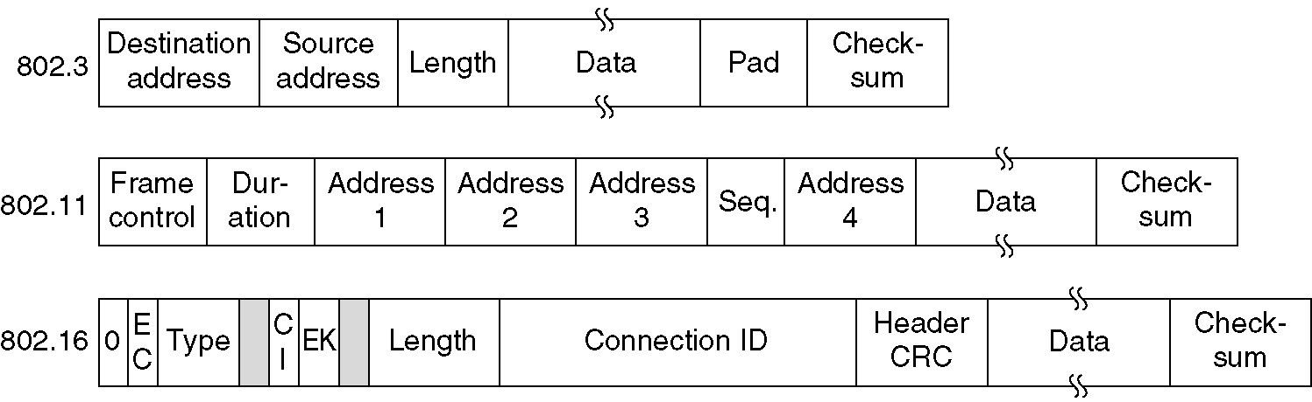
Bridges from 802.x to 802.y (2)
The IEEE 802 frame formats. The drawing is not to scale.

Slide 37
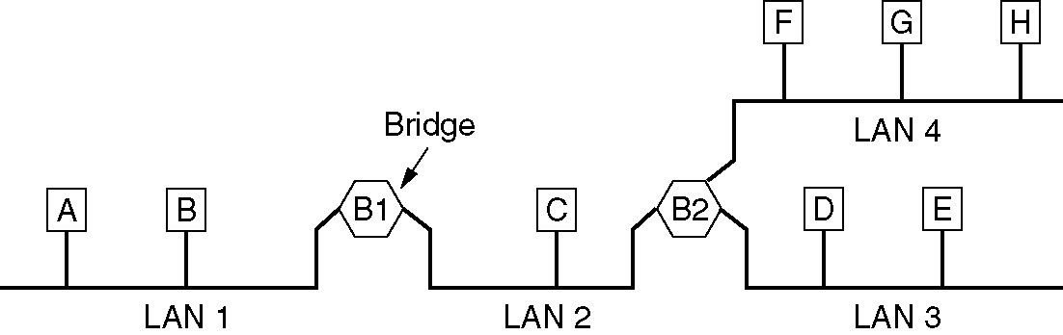
Local Internetworking
A configuration with four LANs and two bridges.

Slide 38
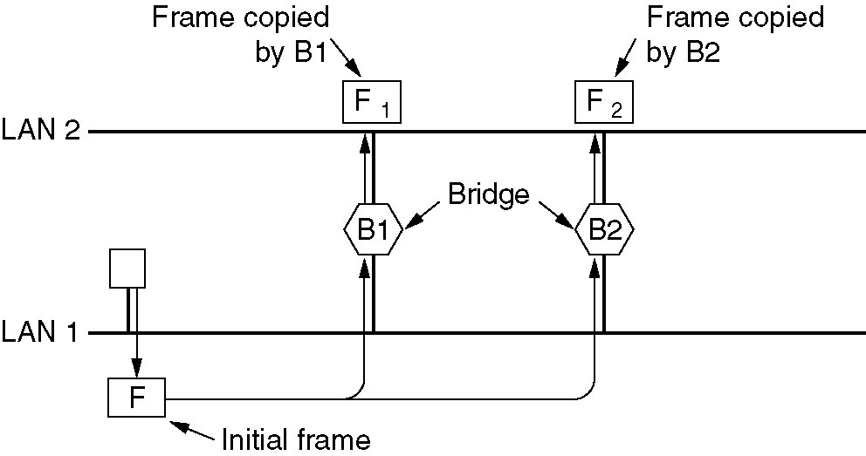
Spanning Tree Bridges
Two parallel transparent bridges.

Slide 39
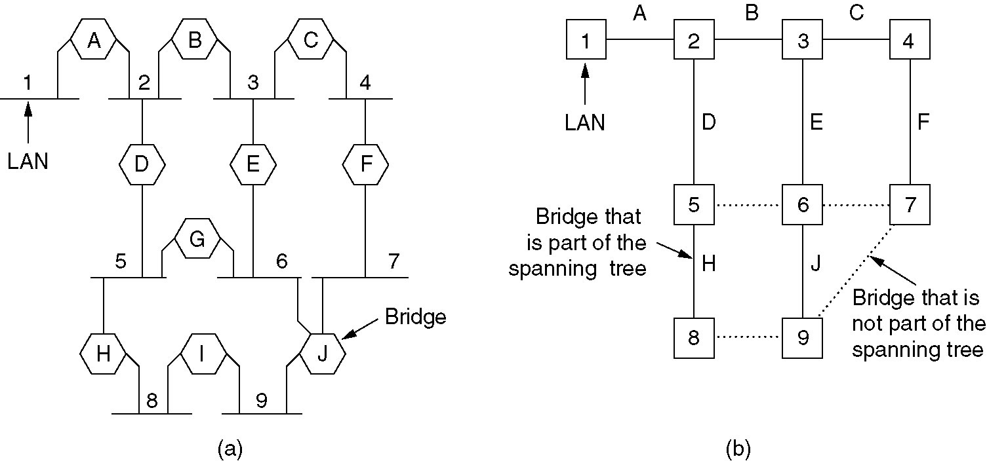
Spanning Tree Bridges (2)
(a) Interconnected LANs. (b) A spanning tree covering the LANs. The dotted lines are not part of the spanning tree.

Slide 40
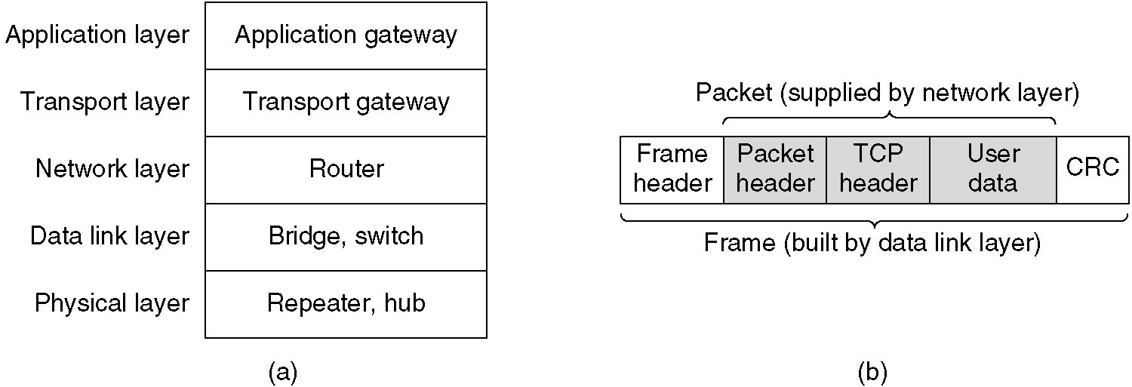
Repeaters, Hubs, Bridges, Switches, Routers and Gateways
Which device is in which layer.
Frames, packets, and headers.

Slide 41
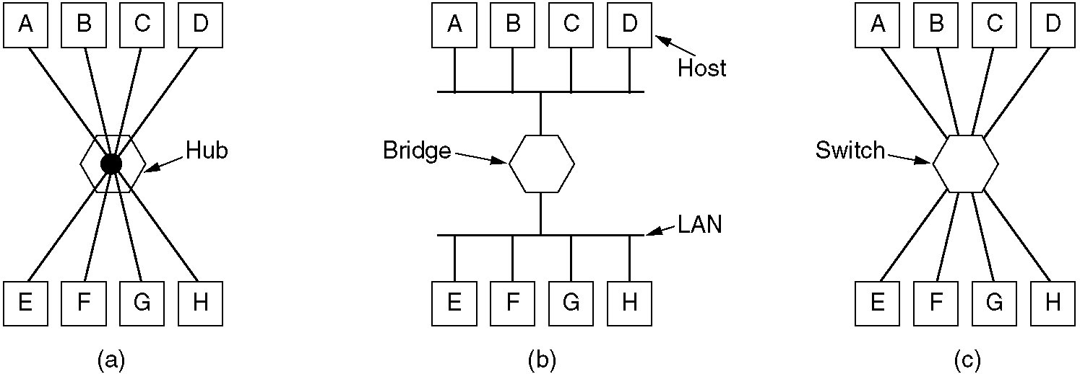
Repeaters, Hubs, Bridges, Switches, Routers and Gateways (2)
(a) A hub. (b) A bridge. (c) a switch.

Slide 42
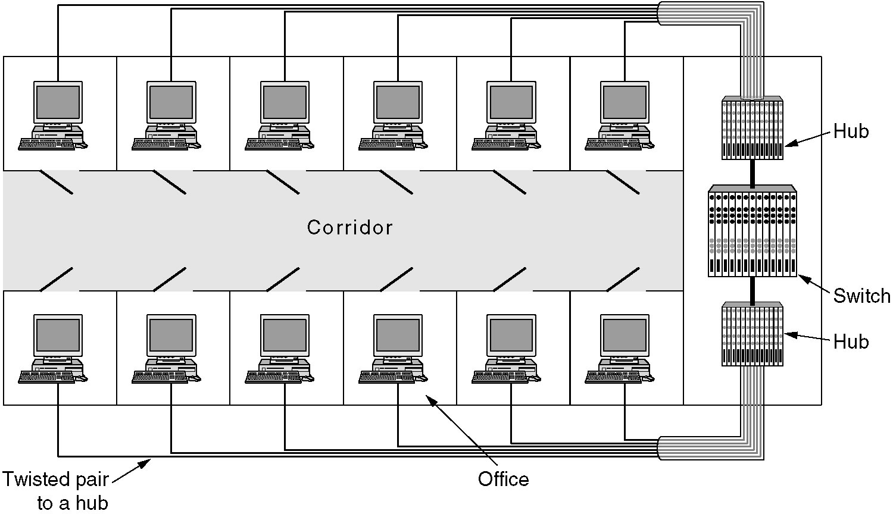
Virtual LANs
A building with centralized wiring using hubs and a switch.

Slide 43
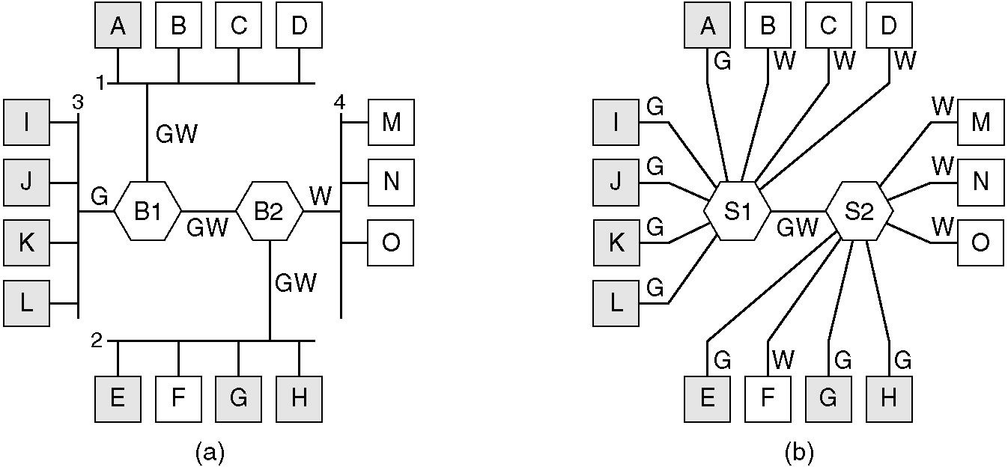
Virtual LANs (2)
(a) Four physical LANs organized into two VLANs, gray and white, by two bridges. (b) The same 15 machines organized into two VLANs by switches.

Slide 44
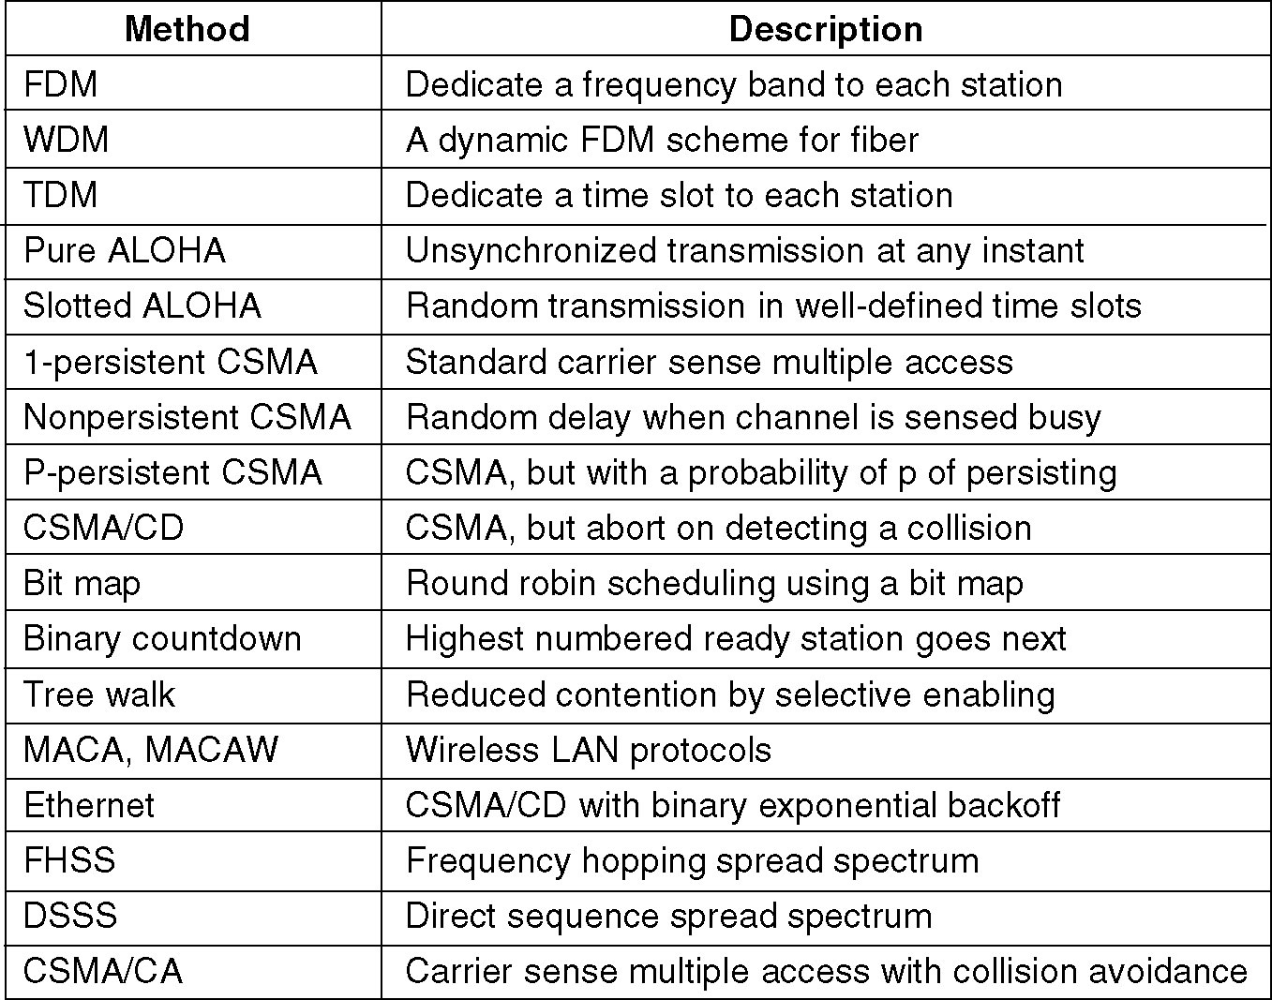
Summary
Channel allocation methods and systems for a common channel.

