Slide 1
Classical Statistics for Scientific Data Analysis
Monte Carlo methods
Pueh Leng Tan, plt2120@columbia.edu
14 February 2026

Slide 2
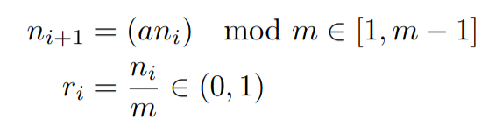
Random number generators
Starts with random seed, for some fixed a and m
(And then some magic to add it 0 and 1)
Random numbers →Uniform distribution→Any distribution

Slide 3
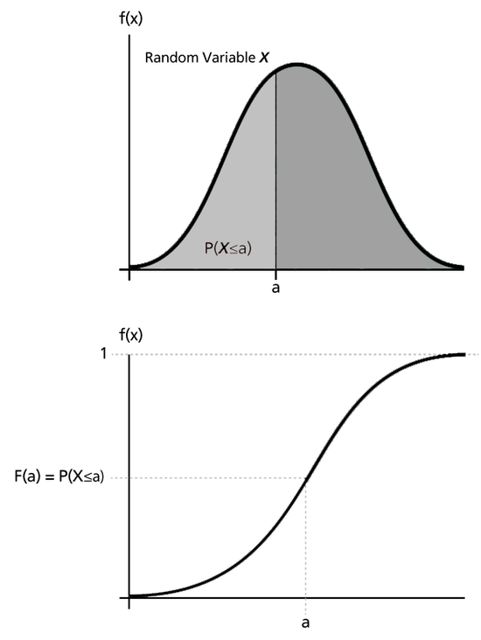
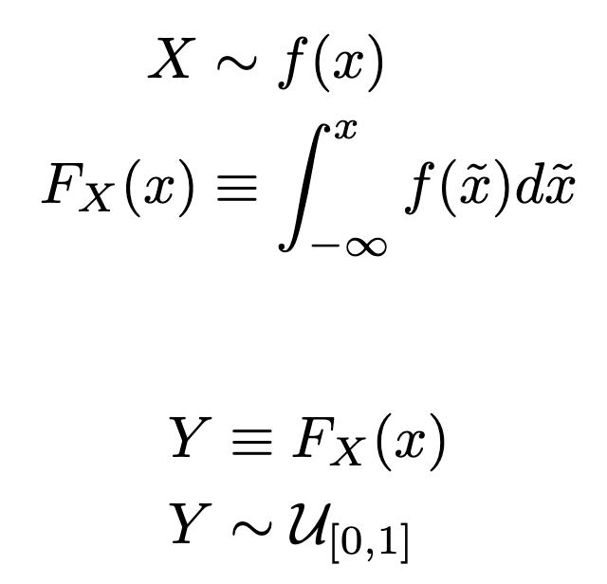
Probability Integral Transform
PDF
CDF
CDF is r.v. with standard uniform distribution

Slide 4
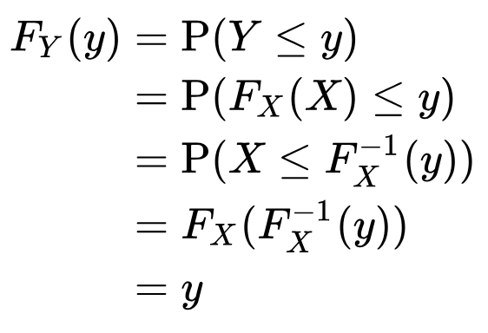
Probability Integral Transform
Definition of CDF of Y
Definition of Y
Apply inverse CDF on both sides
Definition of CDF of X
CDF of y = CDF of standard uniform
Hence y ~ standard uniform

Slide 5
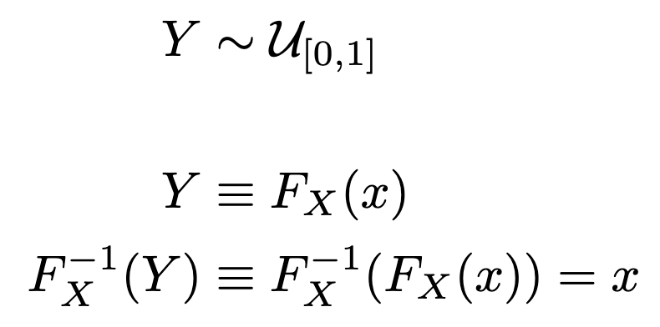
Inverse transform sampling

Slide 6
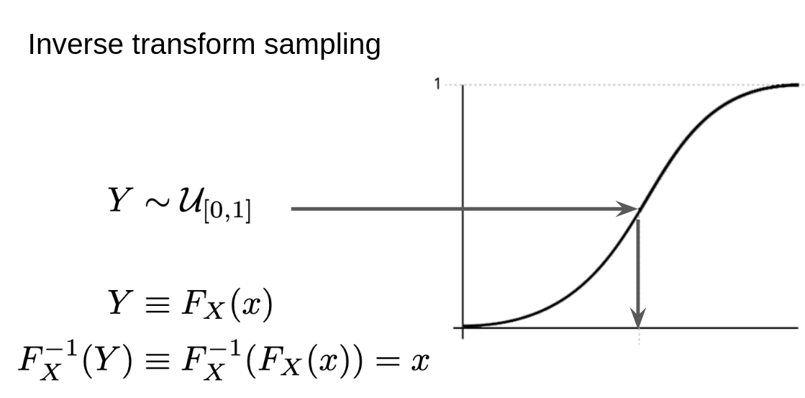
Coding exercise
Use the inverse transform sampling to sample from Gaussian(mu=1.1, sigma=0.3)
Coding exercise after break
Back 10:50 am
Inverse transform sampling (15 mins)
Clues:
Inverse CDF = Percent point function
Inverse CDF = sps.norm.ppf(loc=mu, scale=sigma)

Slide 7
Break (15 mins)
Coding exercise after break
Back 10:50 am

Slide 8
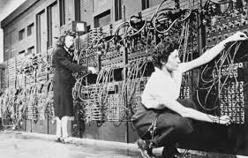
Monte Carlo methods
Broad class of computational algorithm
  Solve problems numerically via repeated random sampling
Stanisław Ulam, late 1940s
  Monte Carlo Casino in Monaco
  ENIC to simulate probability of winning solitaire
  H-bomb
Uses
  Generating samples from distribution
  Numerical integration
  Optimization
Electronic Numerical Integrator and Computer (ENIC)

Slide 9
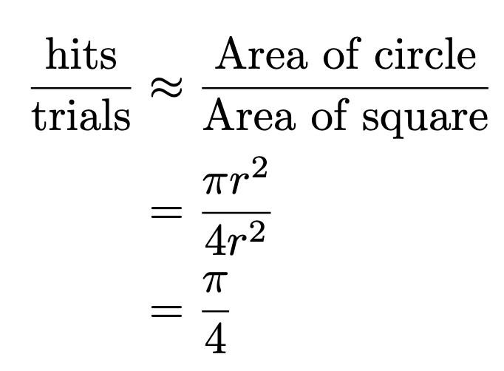
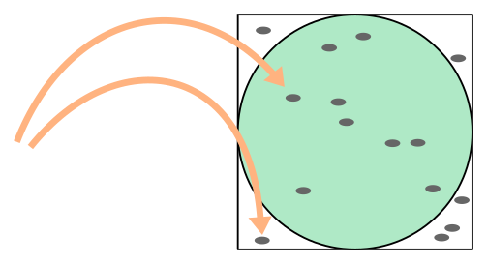
Estimating π
https://hef.ru.nl/~tbudd/mct/lectures/introduction_to_the_monte_carlo_method.html

Slide 10
Coding exercise
Estimate Pi (15 mins)

Slide 11
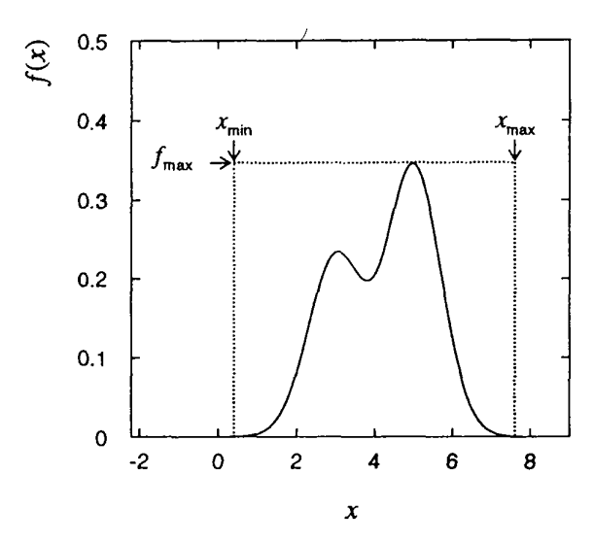
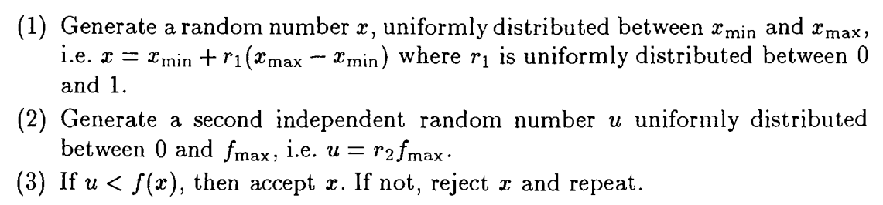
Accept-Reject algorithm (Rejection sampling)
MCMC
Back 11:50 am

Slide 12
Break (15 mins)
MCMC
Back 11:50 am

Slide 13
Coding exercise
Rejection sampling (20 mins)

Slide 14
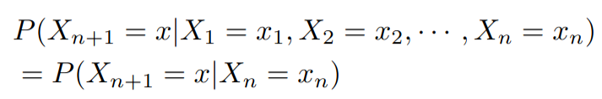
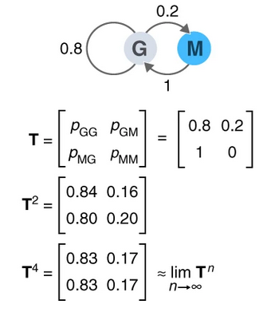
Discrete time Markov Chain
Markov state diagram
Sum of outward going arrows = 1
But sum of inward going arrows not necessarily = 1
Nat Methods 16, 663–664 (2019)

Slide 15
Transition matrix and equilibrium distribution
Directed graph
Probability of G→M
Transition matrix
After 2 steps
After 4 steps
Equilibrium distribution
Nat Methods 16, 663–664 (2019).

Slide 16
Monte Carlo Markov Chains (MCMC)
Class of sampling algorithm
  Random walk given some initial position
  Markov chain’s equilibrium distribution = Target distribution
Advantages
  More efficient in higher dimensions than other sampling methods
Disadvantages
  Potentially slow convergence
  Autocorrelation
  Difficult diagnostics
Random walk MCMC
  Metropolis
  Metropolis-Hastings
  Hamiltonian Monte Carlo
  etc..

Slide 17
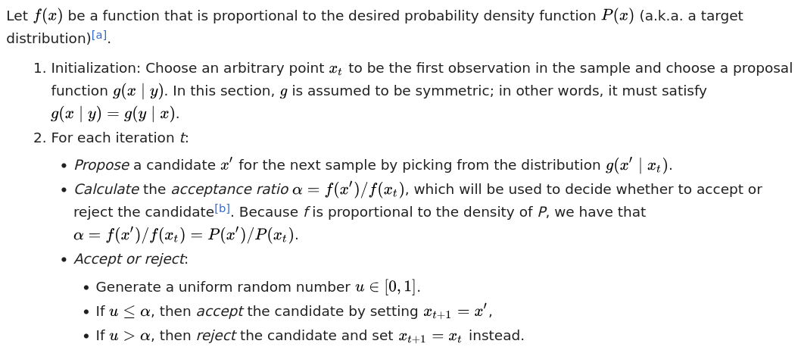
Metropolis Algorithm

Slide 18
Coding exercise
Metropolis algorithm

Slide 19
Questions?

Slide 20
Thanks!

