Slide 1
Classical Statistics for Scientific Data Analysis
Maximum Likelihood Estimates (MLEs)
Pueh Leng Tan, plt2120@columbia.edu
7 March 2026

Slide 2
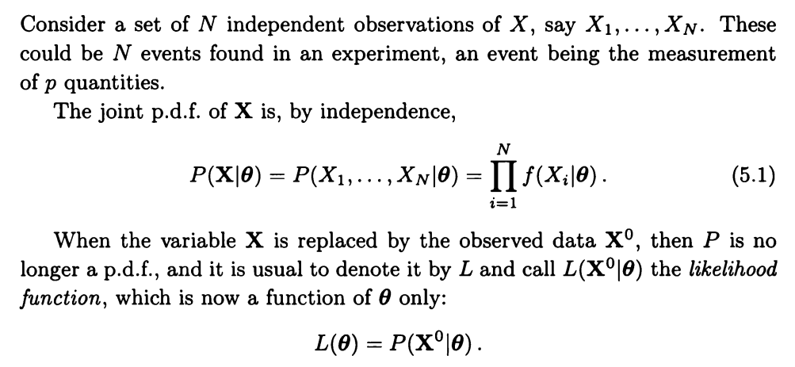
Recap: Likelihood
Model parameters
X: Variable
X₀: Observed data

Slide 3
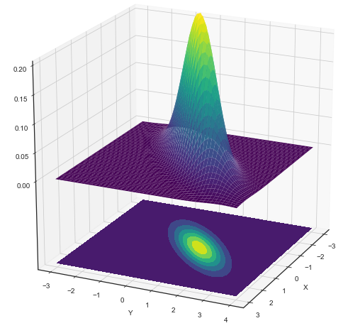
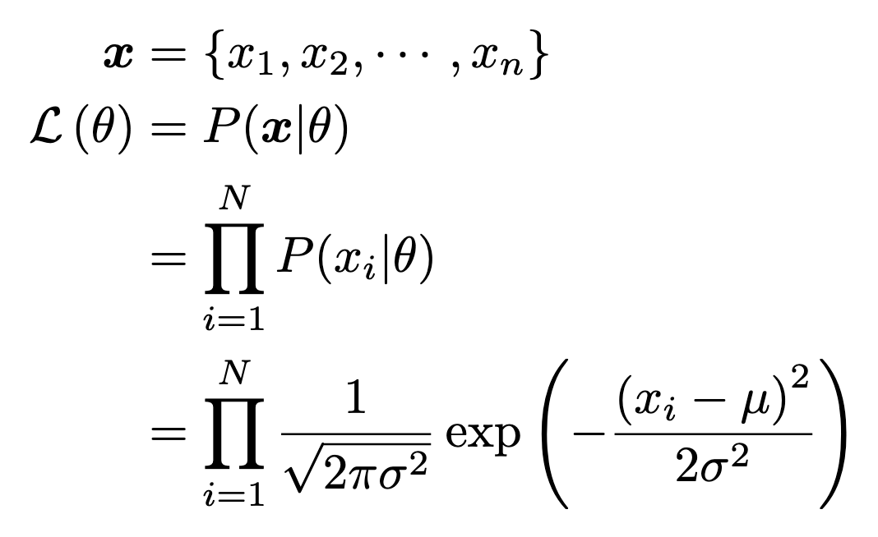
Recap: Likelihood example
Likelihood surface/function
1 number per (μ,σ)
𝜇
σ

Slide 4
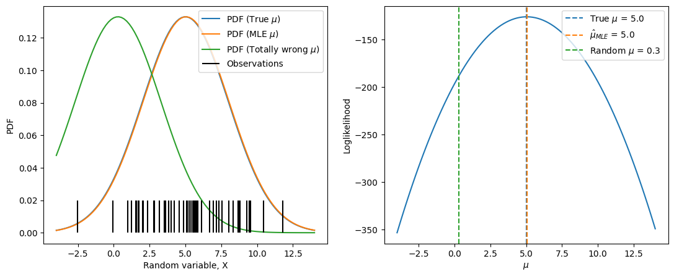
Likelihood intuition
Fixing 𝝈 at true value
Notes:
MLE for param (mu in this case) is the value of the param that will maximise the chances of you observing that set of data you’ve observed, P(data | theta). I wouldn’t have guessed that the mu is at ~0 because that’ll give me that green PDF, but it’ll be unlikely that that green PDF will give me data like the set that i’ve observed (short vertical black lines).

Slide 5
Likelihood intuition
Fixing 𝝈 at true value
Easier to handle the loglikelihood instead of likelihood itself

Slide 6
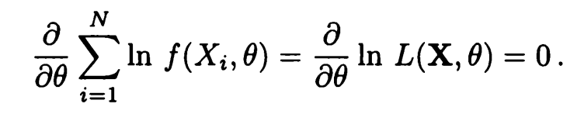
Likelihood equation
Maximum Likelihood Estimate (MLE) is a root of above equation
Assumes
  Likelihood differentiable
  Maximum not at boundaries of parameter
If more than 1 maximum, take higher one

Slide 7
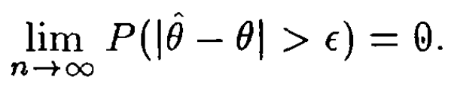

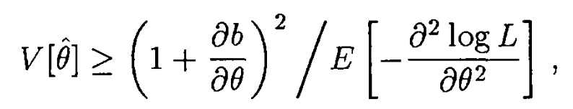
Recap: Desirable estimator properties
Consistent
Unbiased
Efficient
Robust
  Against outliers, mismodelling
= 0
=

Slide 8
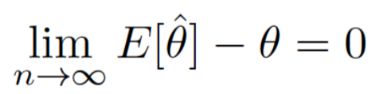
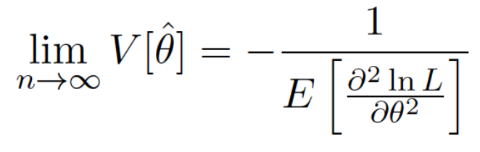
Maximum Likelihood Estimator properties
Consistent
Unbiased
Efficient
Robust
  Against outliers, mismodelling
See orangebook Section 7.2.3 or blog for proof
Asymptotically unbiased.
See orangebook Eq 7.33.
Asymptotically efficient.
See orangebook Section 7.4.5 for proof.
Nope ):
Clean up your data first
Mismodelling studies

Slide 9
Random comments on MLE
Nice properties
  Consistent estimator
  Asymptotically unbiased
  Asymptotically efficient
Irony
  Last two properties hold for large sample size, N→∞
  But likelihood becomes difficult to compute at large N
Machine Learning et al.
  Simulation-based inference (SBI), Likelihood-free inference (LFI), Implicit likelihood inference (ILI)
    Python packages: sbi, pydelfi, lampe
  Train neural network to compute likelihood (or rather, likelihood ratio)
    E.g. Learning likelihood ratios with neural network classifiers, Robust Simulation Based Inference, many more

Slide 10
MLE example: Exponential distribution

Slide 11
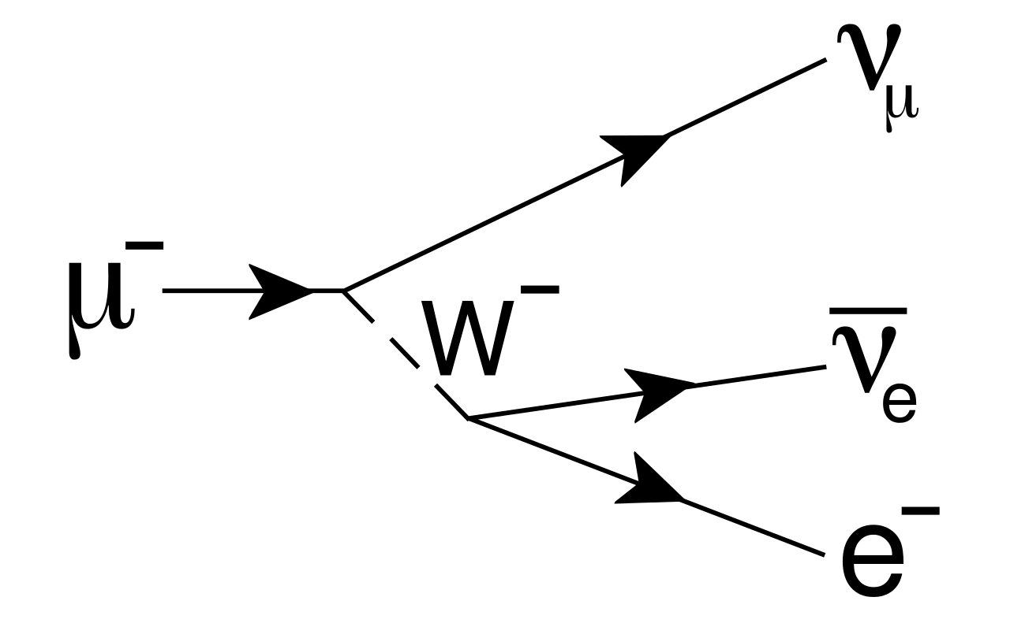

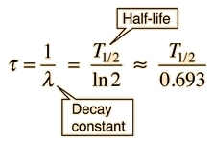
Backstory: muon decay
Muon neutrino
(difficult to measure)
Many particles are unstable
  Decay into other particles
Probability of decay
Goal
  Estimate half-life of muon
Muon
(Unstable, decays)
Anti-electron neutrino
(difficult to measure)
W boson
(mediator particle)
Electron
(easy to measure)
Learn about particle decays here

Slide 12
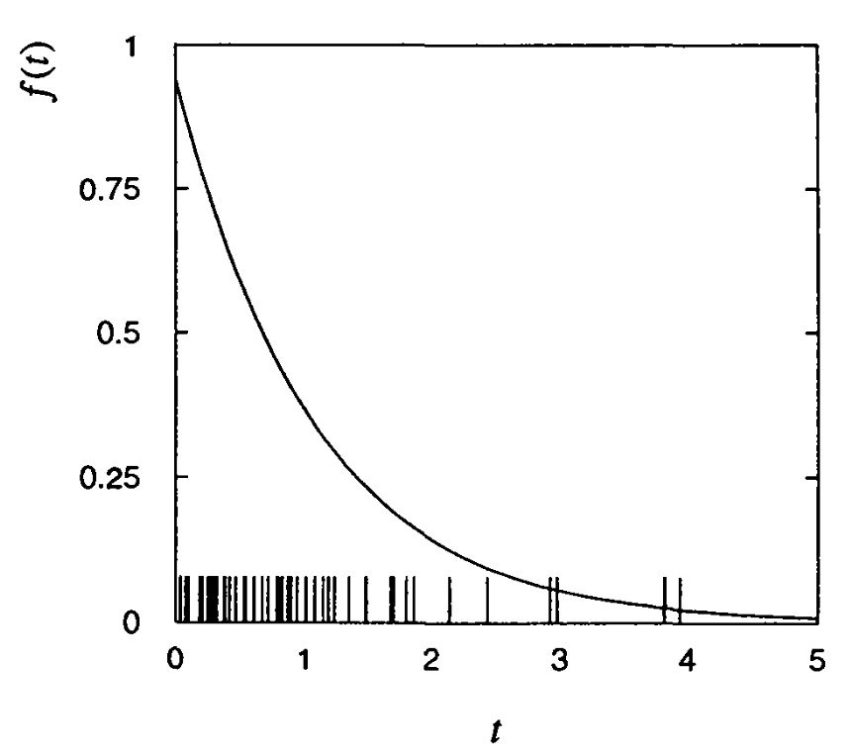
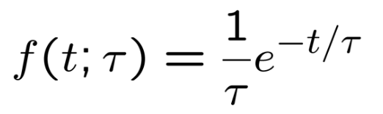

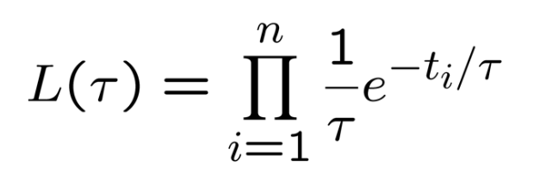
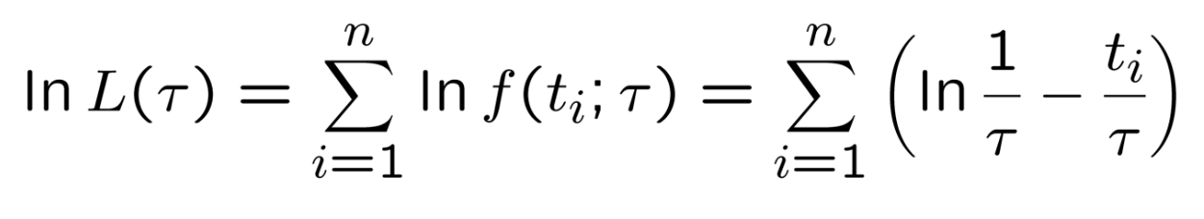
Likelihood for exponential distribution
Consider the exponential distribution
  E.g.: Decay time of muons
  𝝉 would be related to half-life
Suppose we have i.i.d. Data
Likelihood function
Loglikelihood function

Slide 13
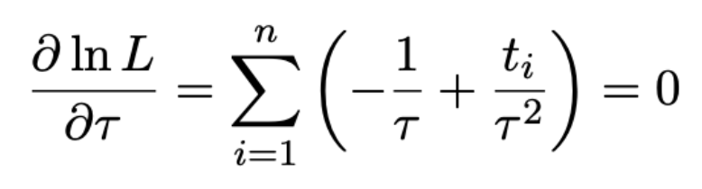
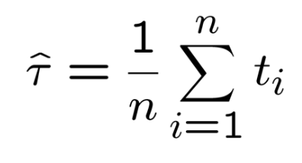
MLE for exponential distribution
Find 𝝉 that maximises loglikelihood
Happens to be sample mean

Slide 14
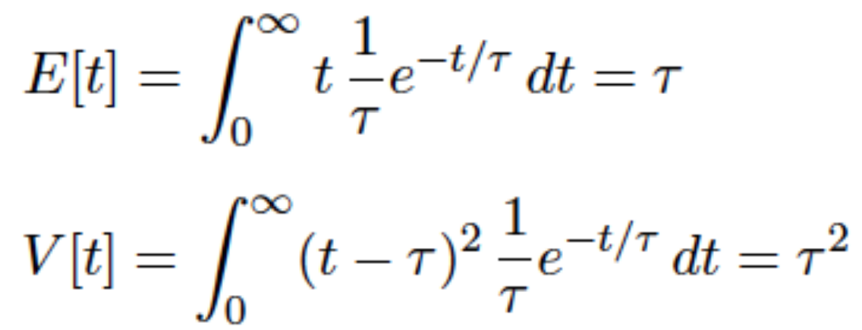
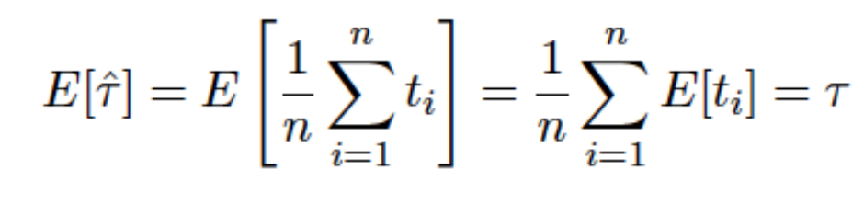
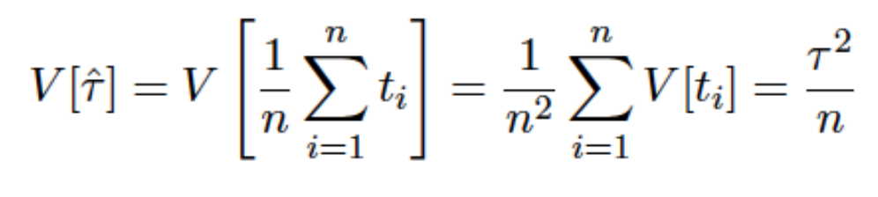
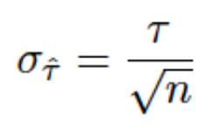
Expectation and Variance of MLE
Mean and variance for exponential distribution
Given MLE
Expectation of MLE
Variance of MLE
Unbiased

Slide 15

But recall..
Just found MLE for this

Slide 16
But what happens if you want to formulate the problem in terms of the decay constant, 𝝀?
Called rate parameter in context of exponential distribution

Slide 17
Break
MLE for lambda instead after break
Back 10:55 am.

Slide 18
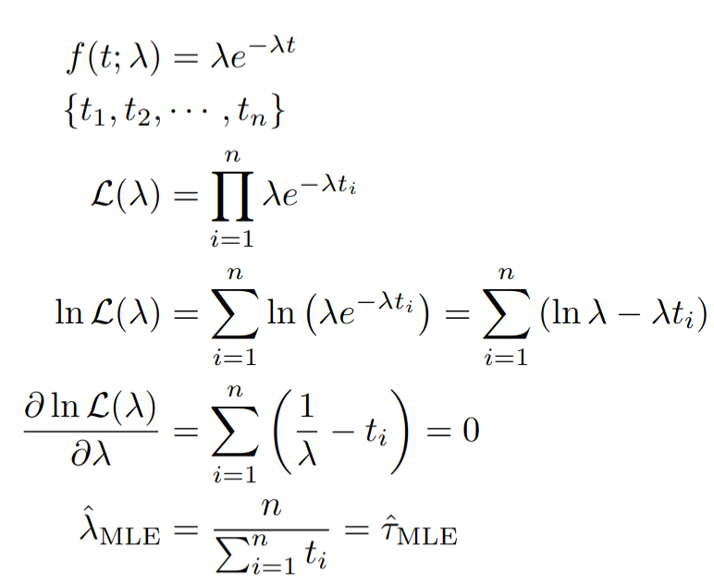
MLE for exponential rate parameter
Given exponential distribution
Given some data
Write down likelihood function
Take log
Differentiate w.r.t. parameter of interest
Set to zero
Find MLE for parameter of interest

Slide 19
MLE for exponential rate parameter
Given exponential distribution
Given some data
Write down likelihood function
Take log
Differentiate w.r.t. parameter of interest
Set to zero
Find MLE for parameter of interest

Slide 20
MLE for exponential rate parameter
Given exponential distribution
Given some data
Write down likelihood function
Take log
Differentiate w.r.t. parameter of interest
Set to zero
Find MLE for parameter of interest

Slide 21
MLE for exponential rate parameter
Given exponential distribution
Given some data
Write down likelihood function
Take log
Differentiate w.r.t. parameter of interest
Set to zero
Find MLE for parameter of interest

Slide 22
MLE for exponential rate parameter
Given exponential distribution
Given some data
Write down likelihood function
Take log
Differentiate w.r.t. parameter of interest
Set to zero
Find MLE for parameter of interest

Slide 23
MLE for exponential rate parameter
Given exponential distribution
Given some data
Write down likelihood function
Take log
Differentiate w.r.t. parameter of interest
Set to zero
Find MLE for parameter of interest

Slide 24
MLE for exponential rate parameter
Given exponential distribution
Given some data
Write down likelihood function
Take log
Differentiate w.r.t. parameter of interest
Set to zero
Find MLE for parameter of interest

Slide 25
MLE for exponential rate parameter
Given exponential distribution
Given some data
Write down likelihood function
Take log
Differentiate w.r.t. parameter of interest
Set to zero
Find MLE for parameter of interest
heh

Slide 26
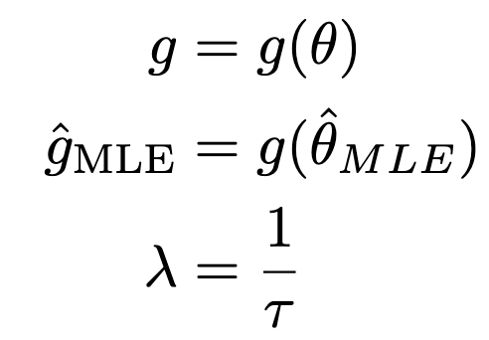
MLE of a function is the function of the MLE.
heh

Slide 27
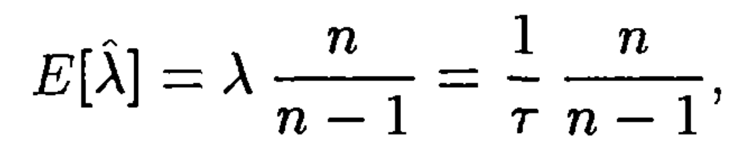
Expectation of MLE for exponential rate parameter
??

Slide 28
Expectation of MLE for exponential rate parameter
See bluebook Section 10.4.1 or work it out yourself

Slide 29
Expectation of MLE for exponential rate parameter
Biased estimator!
See bluebook Section 10.4.1 or work it out yourself

Slide 30
Expectation of MLE for exponential rate parameter
Biased estimator!
𝝀, 𝝉 related (reciprocal of one another)
But unbiased estimators don’t necessarily remain unbiased after transformation
But MLEs are unbiased in large-sample limit
Circled term does go away as n→∞

Slide 31
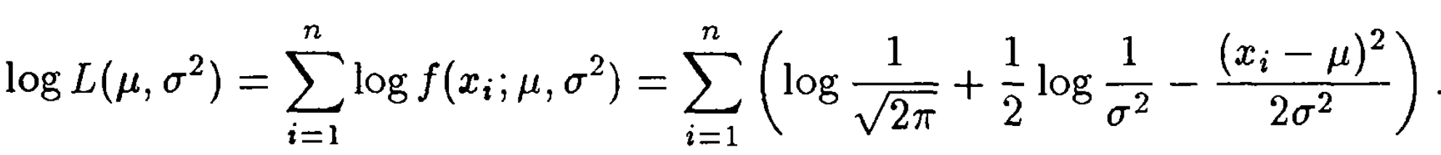
MLE example: Gaussian
2 parameters
  Mean: 𝝁
  Variance: 𝜎²

Slide 32
MLE example: Gaussian
Take partial derivative w.r.t. 𝝁, set derivative to zero, solve for 𝝁

Slide 33
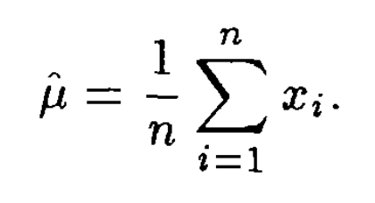
MLE example: Gaussian
Take partial derivative w.r.t. 𝝁, set derivative to zero, solve for 𝝁
Happens to be the sample mean

Slide 34

MLE example: Gaussian
Take partial derivative w.r.t. 𝝁, set derivative to zero, solve for 𝝁
Unbiased

Slide 35
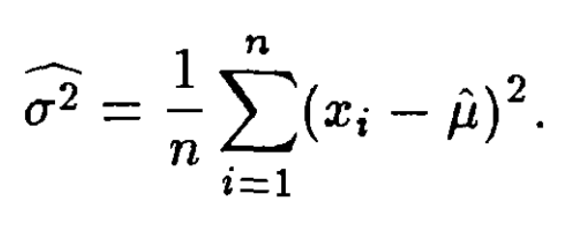
MLE example: Gaussian
Take partial derivative w.r.t. 𝜎, set derivative to zero, solve for 𝜎
Resembles the sample variance
But note the denominator..
Unbiased

Slide 36
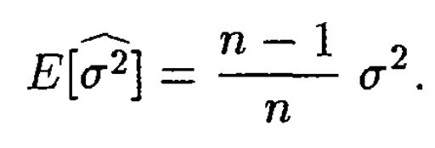
MLE example: Gaussian
Take partial derivative w.r.t. 𝜎, set derivative to zero, solve for 𝜎
Unbiased
Asymptotically unbiased

Slide 37
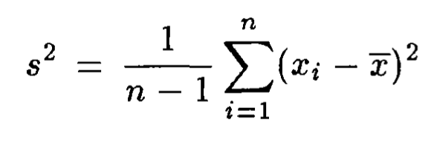
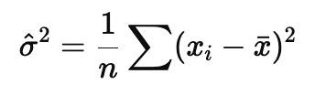
Estimators for Gaussian Variance
Sample variance
MLE
>
Unbiased
Biased but smaller

Slide 38
How to quantify errors on MLEs?
MLE is an estimator, depends on data
What is the spread of the MLE?
Variance on the MLE

Slide 39
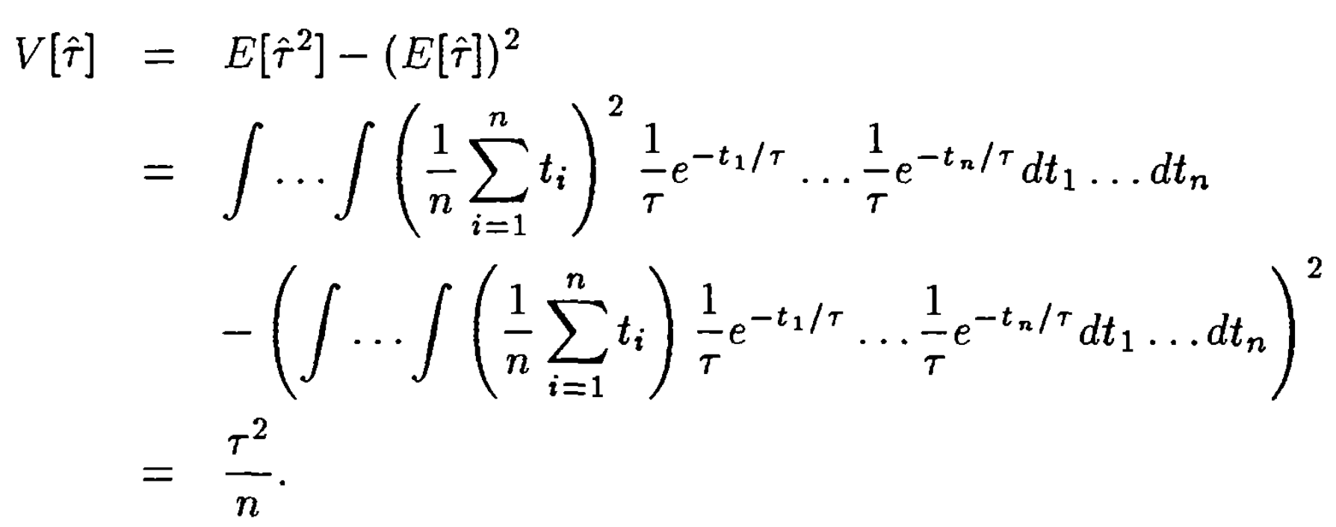
Variance of estimator
Analytic method
  Stick expression for MLE into definition of variance and expand
Monte-Carlo method
  If too difficult to solve analytically, integrate by MC
Cramer-Rao Bound method
  Too difficult to integrate by hand, too expensive to MC
  Only gives lower bound on variance
Likelihood method
  Max loglikelihood and drop 0.5
  Also gives 1𝜎 central confidence interval on parameter
Example using MLE for exponential 𝛕

Slide 40
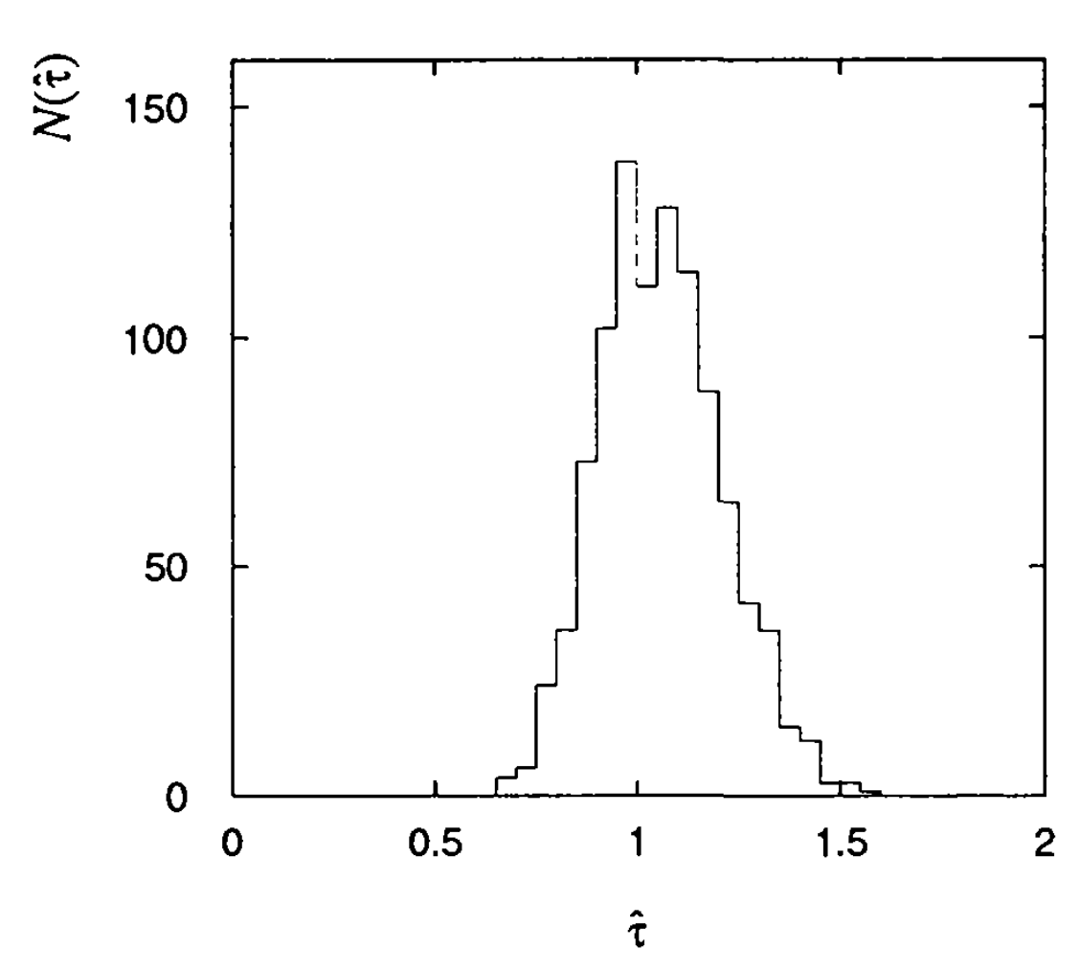
Variance of estimator
Analytic method
  Stick expression for MLE into definition of variance and expand
Monte-Carlo method
  If too difficult to solve analytically, integrate by MC
Cramer-Rao Bound method
  Too difficult to integrate by hand, too expensive to MC
  Only gives lower bound on variance
Likelihood method
  Max loglikelihood and drop 0.5
  Also gives 1𝜎 central confidence interval on parameter

Slide 41
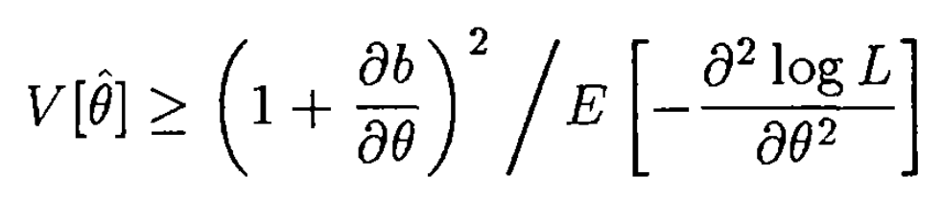
Variance of estimator
Analytic method
  Stick expression for MLE into definition of variance and expand
Monte-Carlo method
  If too difficult to solve analytically, integrate by MC
Cramer-Rao Bound method
  Too difficult to integrate by hand, too expensive to MC
  Only gives lower bound on variance
Likelihood method
  Max loglikelihood and drop 0.5
  Also gives 1𝜎 central confidence interval on parameter

Slide 42
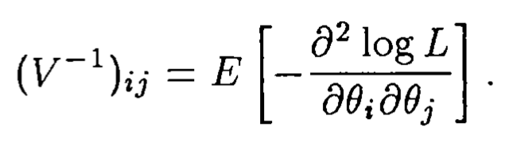
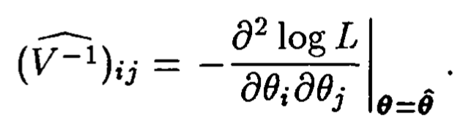
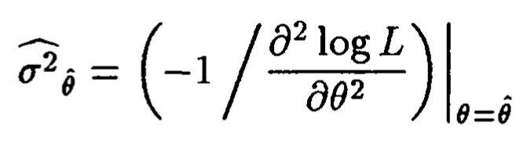
Variance and Hessian
Information inequality
Unbiased estimator
Approximating using Hessian at MLE
Example

Slide 43
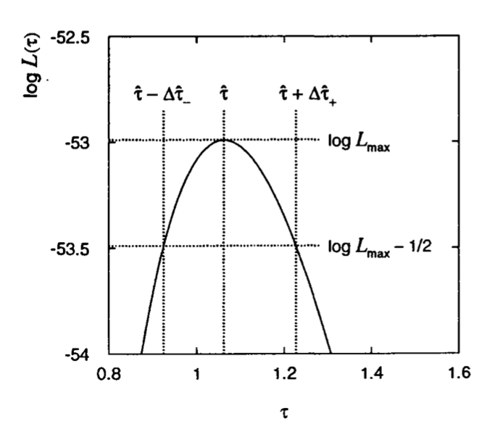
Variance of estimator
Analytic method
  Stick expression for MLE into definition of variance and expand
Monte-Carlo method
  If too difficult to solve analytically, integrate by MC
Cramer-Rao Bound method
  Too difficult to integrate by hand, too expensive to MC
  Only gives lower bound on variance
Likelihood method
  Max loglikelihood and drop 0.5
  Also gives 1𝜎 central confidence interval on parameter

Slide 44
Variance from likelihood
Taylor expand around the MLE

Slide 45
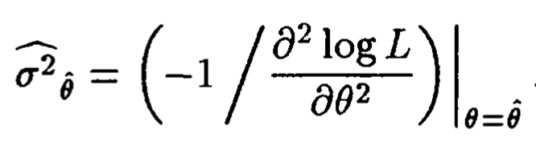

Variance from likelihood
Taylor expand around the MLE
0
Very definition of MLE

Slide 46
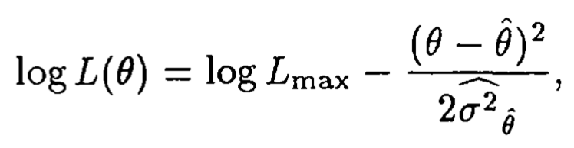
Variance from likelihood
Taylor expand around the MLE
0
Very definition of MLE

Slide 47
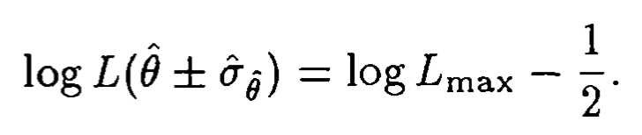
Variance from likelihood
Taylor expand around the MLE

Slide 48
Variance from likelihood
Only approximation (Taylor expansion)
Proper method (interval computation) can give rise to asymmetric errors

Slide 49
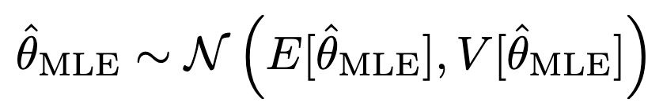
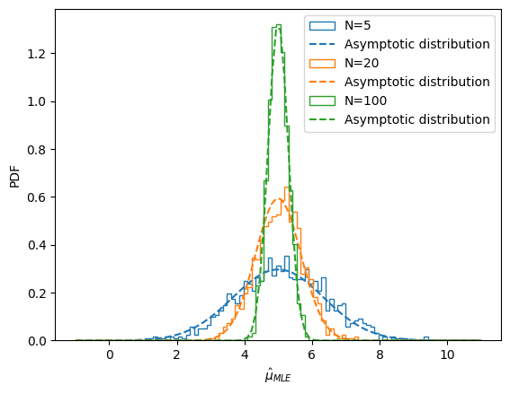
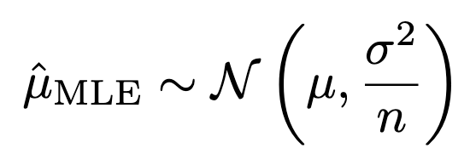
Distribution of MLE →Gaussian in large-sample limit
  True for MLE for params for all distributions
  E.g.: MLE for Gaussian expectation
Stems from central limit theorem
  See orangebook Section 7.3.1 for proof
Good for sanity checks in simulations

Slide 50
Break
Extended Likelihood and code walkthrough
Back 11:40 am.

Slide 51
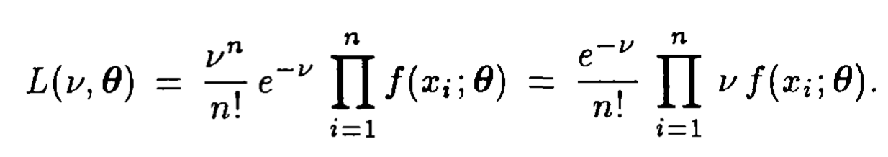
Extended Maximum Likelihood
Multiplication over the samples
Count
Shape
Poisson
Gaussian, some arbitrary shape, etc

Slide 52
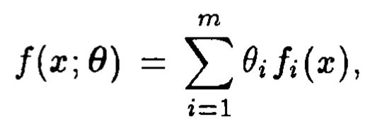
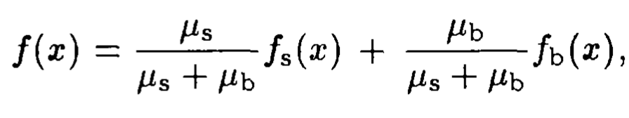
Likelihood can have many components
Sum over the various components
Signal, background, etc
Example

Slide 53
Show code time

Slide 54
Questions?

Slide 55
Thanks!

Slide 56
Backup slides

Slide 57
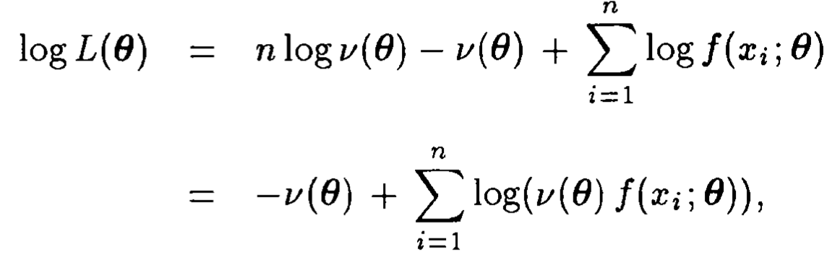
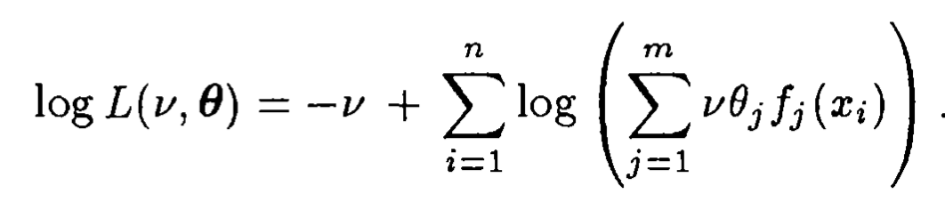
Take log

