Slide 1
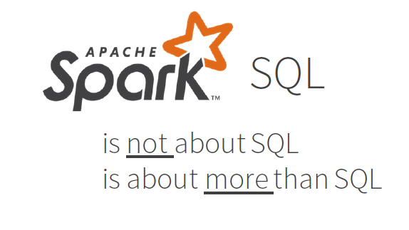
INCEPTEZ TECHNOLOGIES

Slide 2
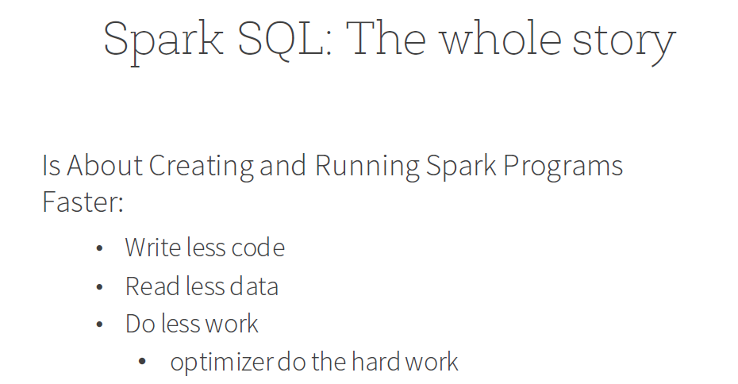
INCEPTEZ TECHNOLOGIES

Slide 3
Why Spark SQL
Coding Complexity is less
Scalability
Let optimizer do the hard work
Integrated
Seamlessly mix SQL queries with Spark programs.
Unified Data Access
Connect to any data source the same way.
Hive Compatibility
Run unmodified Hive queries on existing data.
Standard Connectivity
Connect through JDBC or ODBC.
INCEPTEZ TECHNOLOGIES

Slide 4
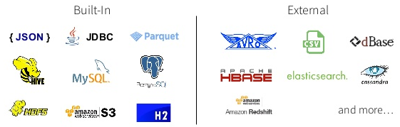
Data Source API
Read and write with a variety of formats
INCEPTEZ TECHNOLOGIES

Slide 5
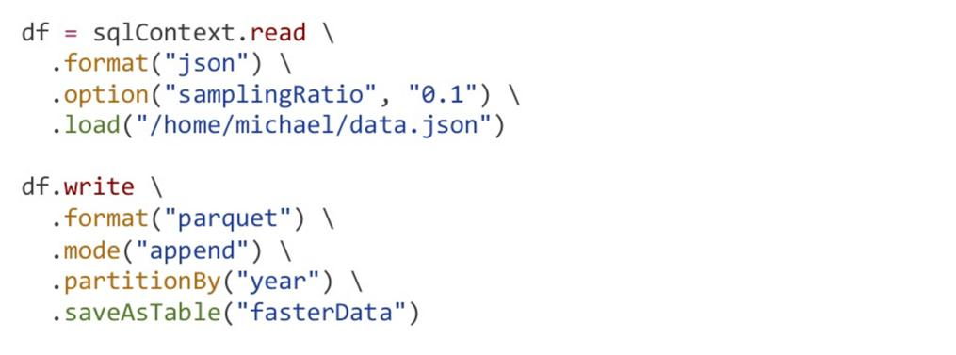
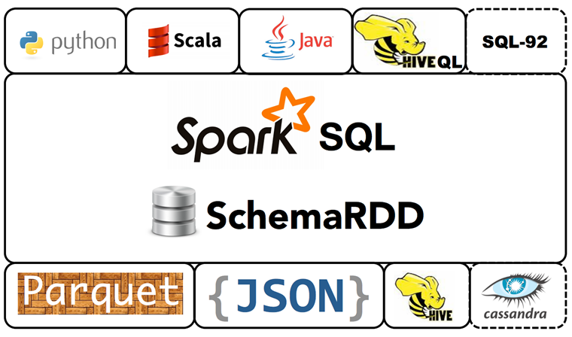
Data Source API
Unified interface to reading/writing data in a variety of formats
INCEPTEZ TECHNOLOGIES

Slide 6
Spark SQL APIs
SQLContext
It’s the entry point for working along structured data (rows and columns) in Spark. Allows the creation of Data Frame objects as well as the execution of SQL queries.
HiveContext
Working with Hive tables, a descendant of SQLContext.
Hive Context is optimized and provides a richer functionality than SQLContext accesses unified metastore.
SparkSession
A new entry point that supersedes SQLContext and HiveContext. For users of the DataFrame API, a common source of confusion for Spark is which “context” to use. Now you can use SparkSession, which subsumes both, as a single entry point, as demonstrated in this notebook. Note that the old SQLContext and HiveContext classes are still kept for backward compatibility.
JDBC Datasource
JDBC data source can be used to read data from relational databases using JDBC API. This is preferred over using the RDD because the data source returns the results as a DataFrame can be handled in Spark SQL or joined beside other data sources.
INCEPTEZ TECHNOLOGIES

Slide 7
DataFrames
Spark SQL uses a programming abstraction called DataFrame. It is a distributed collection of data,organized in named columns.
DataFrame is equivalent to a database table but provides a much finer level of optimization.
Spark Dataframe are lazily evaluated like Transformations in Apache Spark.
A Data Frame is similar to a table in a relational database with richer optimization.
It is a data abstraction and domain specific language (DSL) applicable on structured and semi structured data.
DataFrame contains rows with Schema. The schema is the illustration of the structure of data.
For accessing data frames either SQL Context or Hive Context is needed.
DataFrames can be used to easily filter data, select column, count, average, and join data together from different sources.
INCEPTEZ TECHNOLOGIES

Slide 8
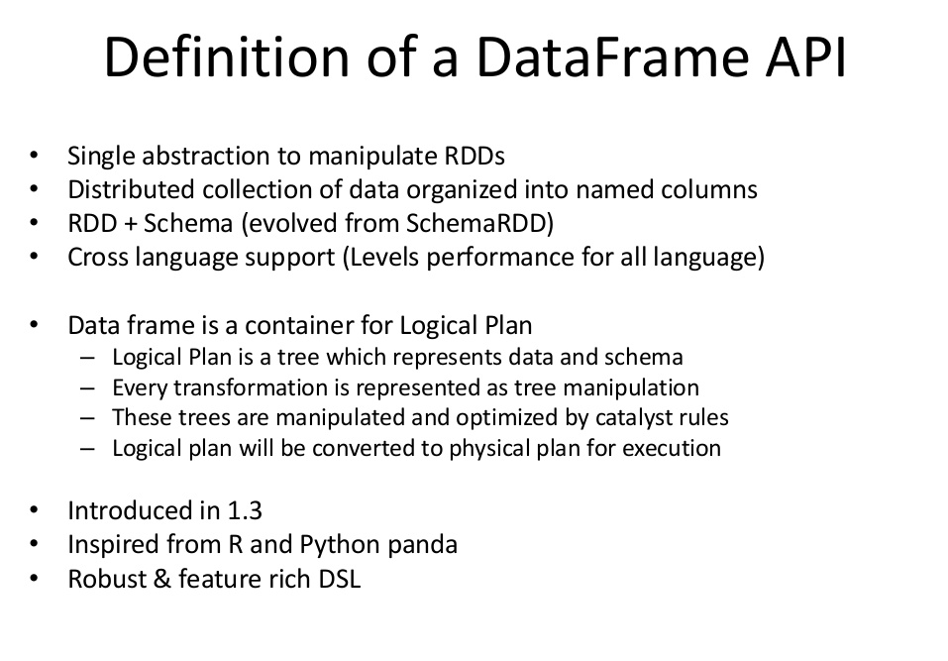
INCEPTEZ TECHNOLOGIES

Slide 9
RDD
RDD(Resilient Distributed Dataset)
Creating an RDD
1. Parallelized Collections
2.External Datasets
RDD Features:
Distributed collection of JVM objects
Immutable
Fault tolerant
Lazy evaluations
Functional transformations
Data processing formats
Programming Languages supported
RDD Limitation
No inbuilt optimization engine
Handling Structured Data
Garbage Collection Overhead
INCEPTEZ TECHNOLOGIES

Slide 10
DataFrames
Creating a Spark Dataframe
1. Creating Dataframe from RDD
2. Creating Dataframe from data source
3. Programmatically Specifying Schema
4. From another Dataframe
Dataframe Features:
Distributed collection of Row Object
Data Processing
Optimization using catalyst optimizer
Hive Compatibility
Tungsten
Programming Languages supported
Dataframe Limitations
Compile-time type safety
Cannot operate on domain Object
INCEPTEZ TECHNOLOGIES

Slide 11
DataSet
A Dataset is a strongly typed collection of domain-specific objects that can be transformed in parallel using functional or relational operations. Each Dataset also has an untyped view called a DataFrame, which is a Dataset of Row.
Datasets provide static-type and runtime-type safety.
Datasets acquire two discrete APIs characteristics; namely, strongly typed and untyped. A DataFrame can be seen as a collection of generic type Dataset [Row], where the Row can be a generic and untyped JVM object.
INCEPTEZ TECHNOLOGIES

Slide 12
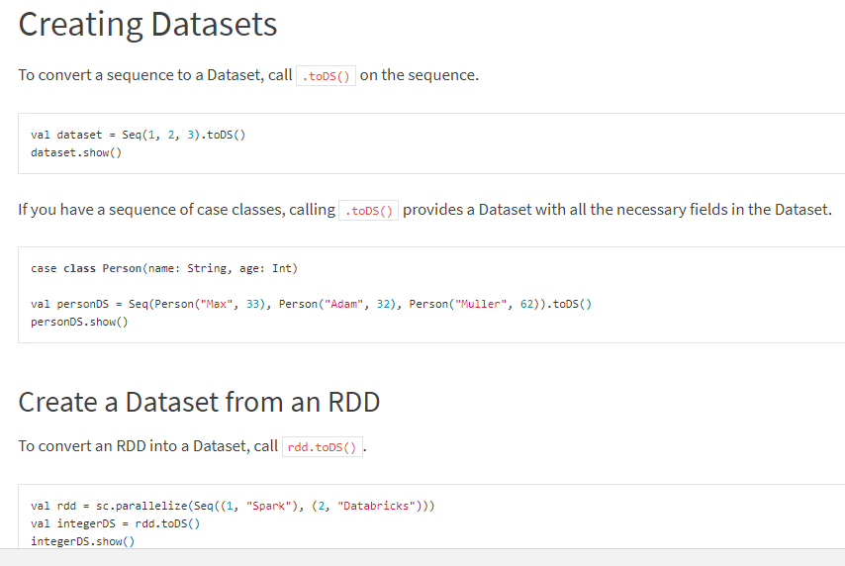
Creating DataSet
INCEPTEZ TECHNOLOGIES

Slide 13
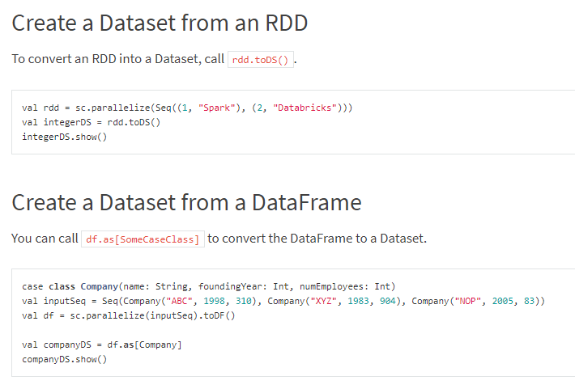
Creating DataSet
INCEPTEZ TECHNOLOGIES

Slide 14
DataSet
Datasets API
Creating a Dataset
1. Creating Dataset from JVM object collection
2. Creating Dataset from datasource
Dataset Features
Provides best of both RDD and Dataframe
Encoders
Programming Languages supported
Type Safety
Interoperable
Datasets API Limitation:
Requires type casting to String
No support for Python and R
INCEPTEZ TECHNOLOGIES

Slide 15
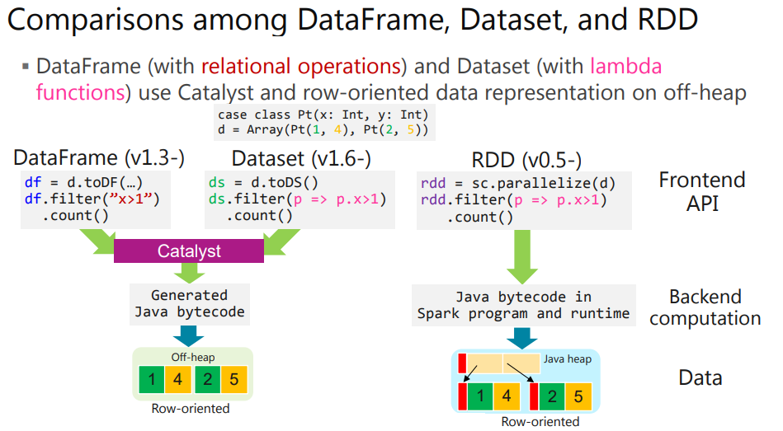
INCEPTEZ TECHNOLOGIES

Slide 16
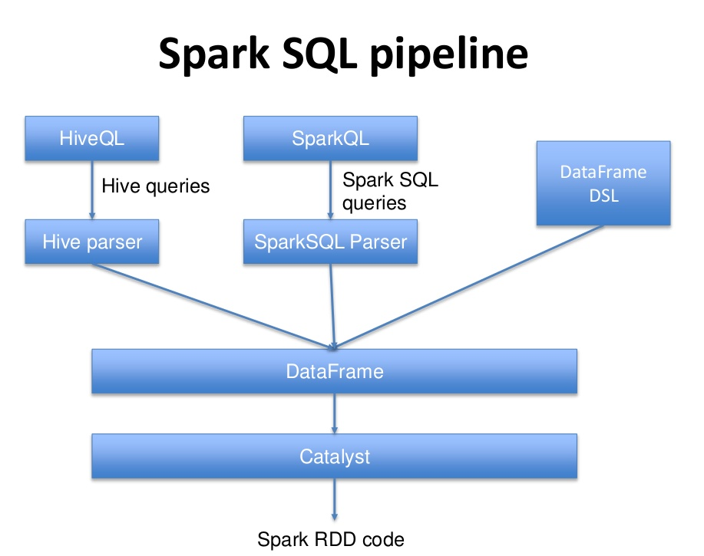
INCEPTEZ TECHNOLOGIES

Slide 17
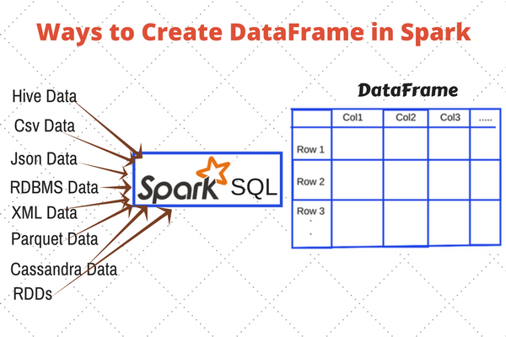
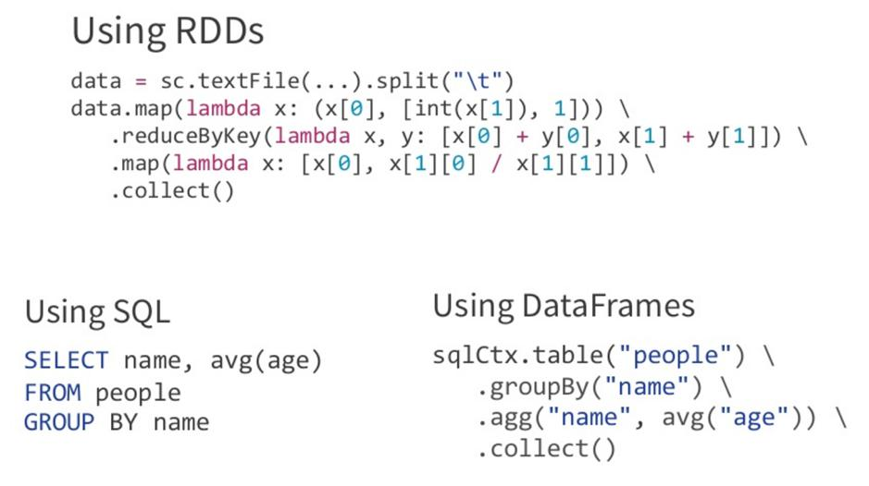
DataFrames
DataFrame can be created using
Raw Data
SQL over JDBC
Hive tables
Writing less code
INCEPTEZ TECHNOLOGIES

Slide 18
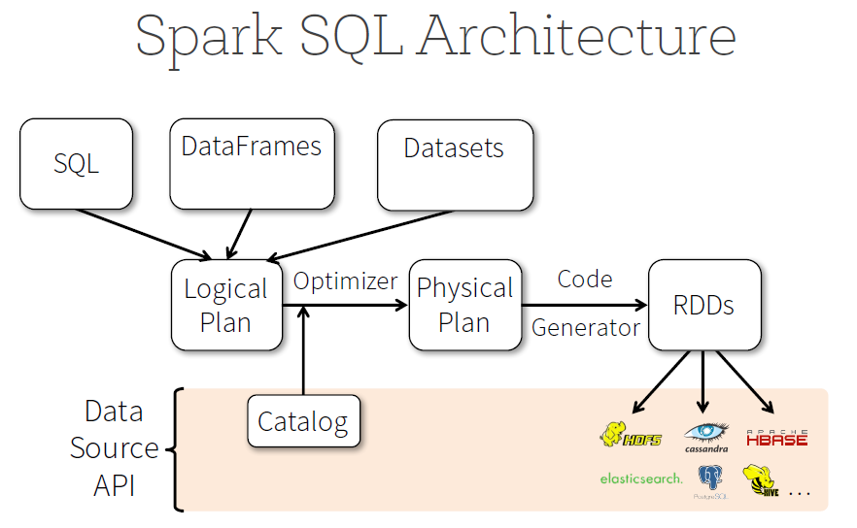
INCEPTEZ TECHNOLOGIES

Slide 19
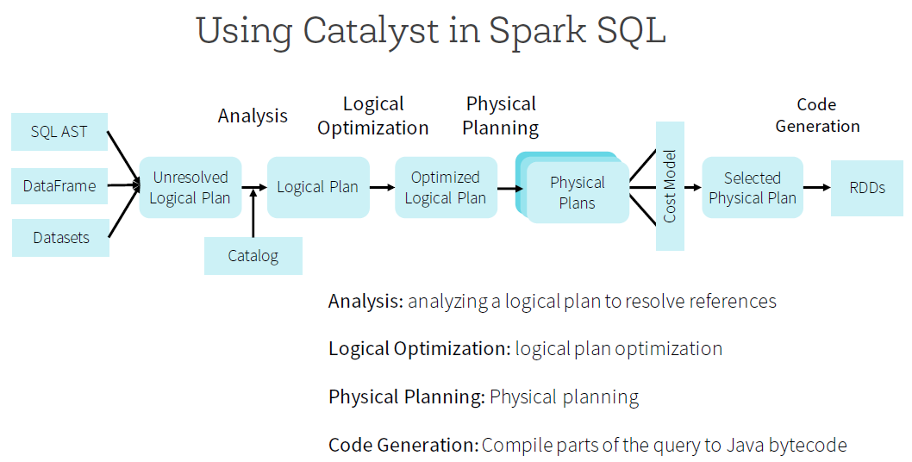
Spark SQL Architecture
Catalyst uses the special feature of Scala language, “Quasiquotes” to make code generation easier because it is very tough to build code generation engines

Slide 20
Spark SQL Architecture

Slide 21
CATALYST OPTIMIZER
Goal: convert logical plan to physical plans
Process:
Logical plan is a tree representing data and schema
The tree is manipulated and optimized by catalyst rules
Optimizing rules
Constant folding
Push Predicate through filter
Project collapsing
INCEPTEZ TECHNOLOGIES

Slide 22
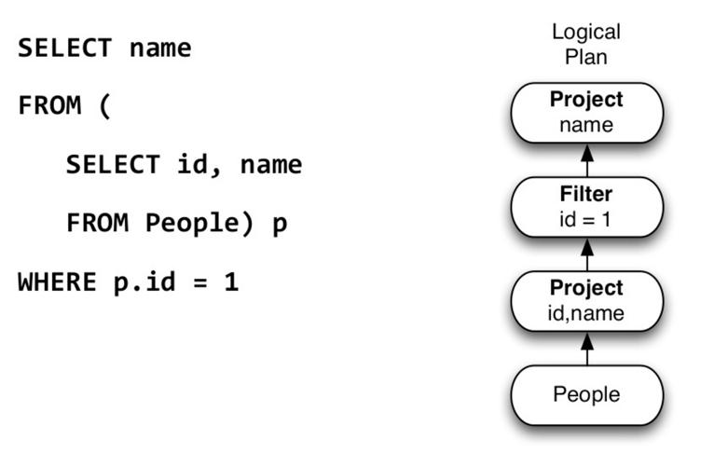
CATALYST OPTIMIZER
An example query:
INCEPTEZ TECHNOLOGIES

Slide 23
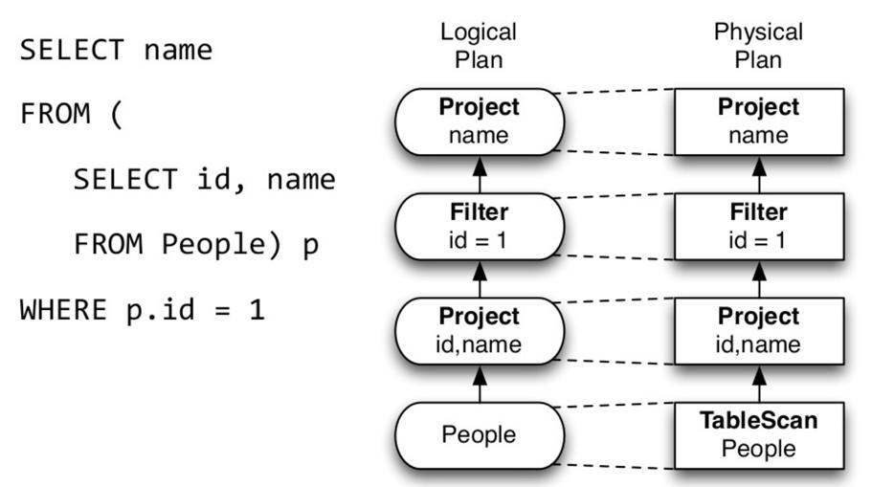
CATALYST OPTIMIZER
Native Query Planning:
INCEPTEZ TECHNOLOGIES

Slide 24
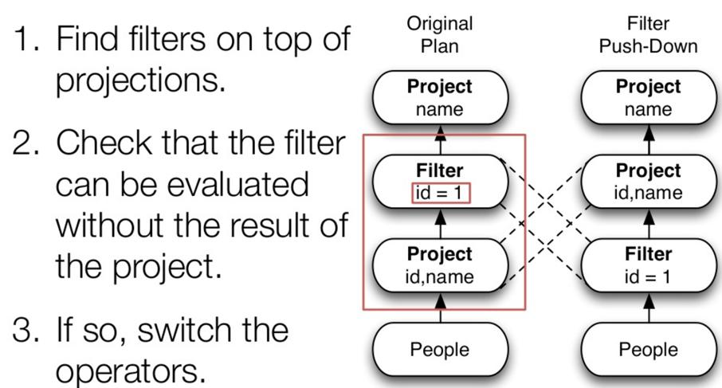
CATALYST OPTIMIZER
Optimization Rule Example:
INCEPTEZ TECHNOLOGIES

Slide 25
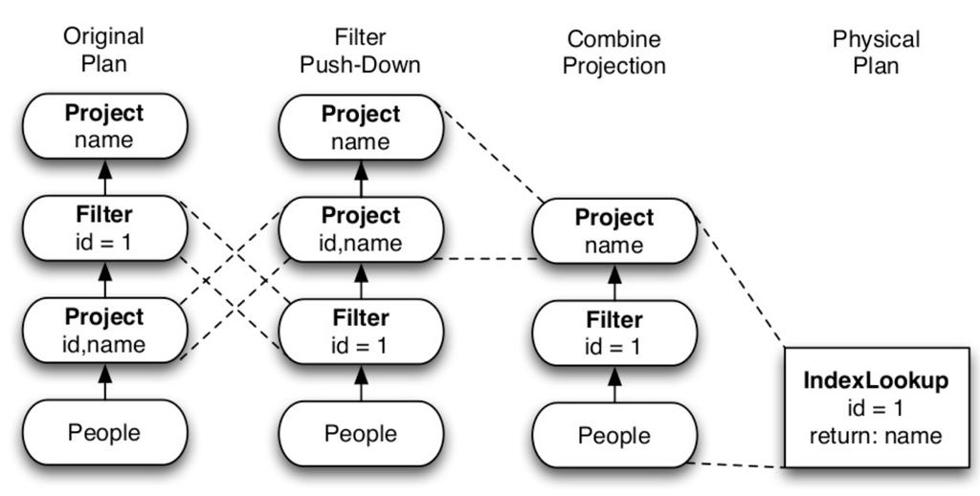
CATALYST OPTIMIZER
Optimization Rule Example:
INCEPTEZ TECHNOLOGIES

Slide 26
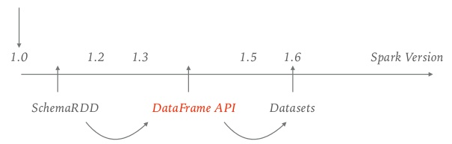
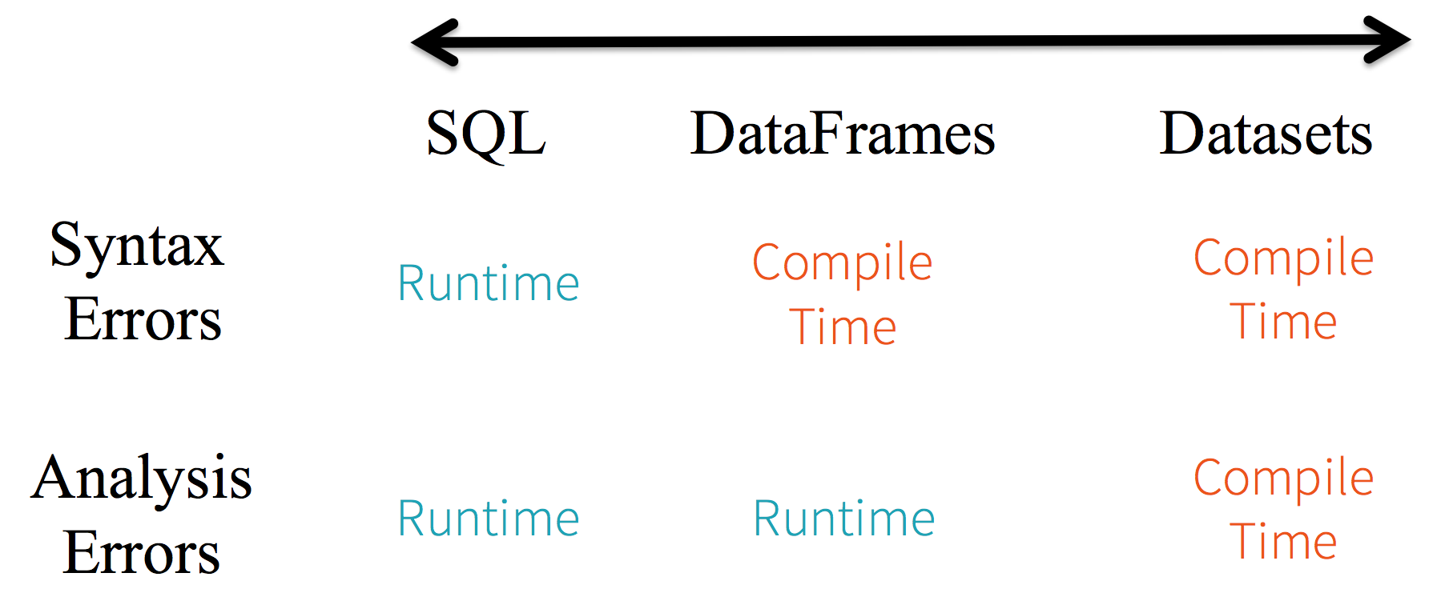
API History & Comparison
INCEPTEZ TECHNOLOGIES

Slide 27

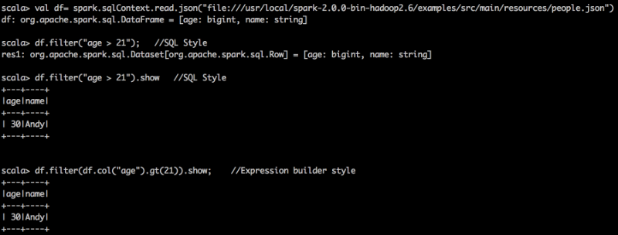
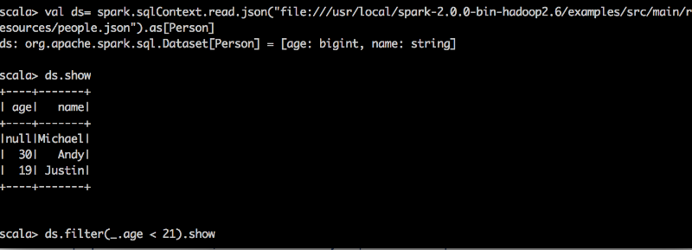
RDDs vs DataFrames vs DataSets
INCEPTEZ TECHNOLOGIES

Slide 28
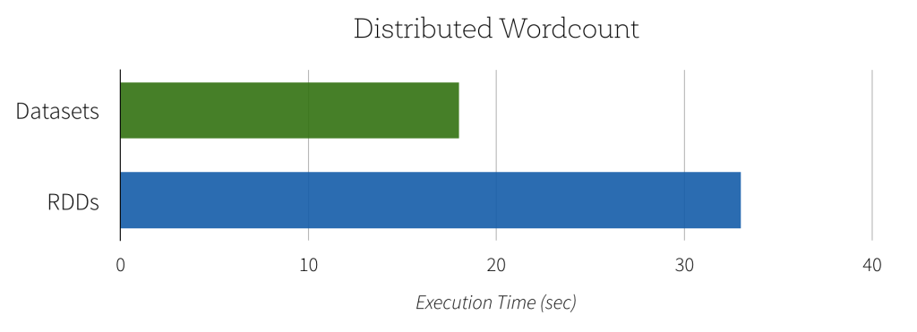
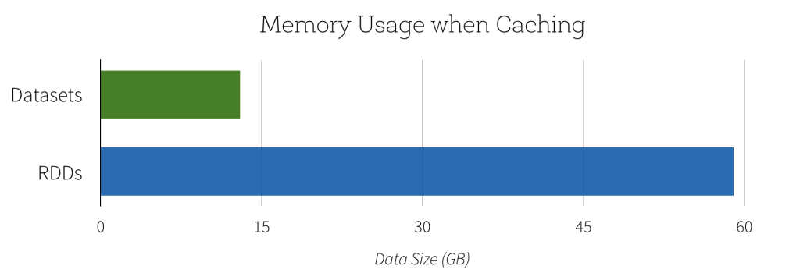
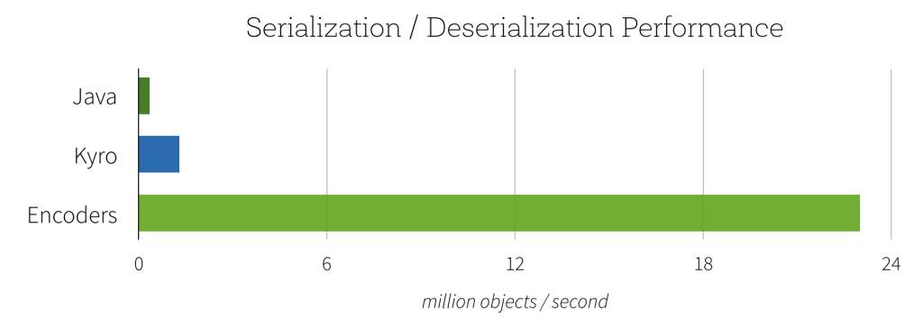
RDDs and DataSets Performance
RDDs val lines = sc.textFile("/wikipedia") val words = lines .flatMap(_.split(" ")) .filter(_ != "")
Datasets val lines = sqlContext.read.text("/wikipedia").as[String] val words = lines .flatMap(_.split(" ")) .filter(_ != "")
INCEPTEZ TECHNOLOGIES

Slide 29
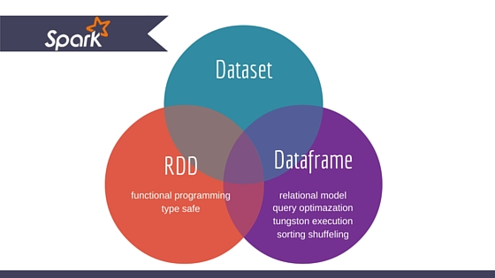
RDDs vs DataFrames vs DataSets
RDDs:
Final Computation on RDDs
Compile Time Safety
Downside of RDD: performance limitations
DataFrame:
Relational Model
offers huge performance improvement
Custom Memory management (aka Project Tungsten)
Optimized Execution Plans (aka Catalyst Optimizer)
Downside of Dataframe : Lack of Type Safety
DataSet :
Latest Abstraction - extension of DataFrame API
Developer friendly compile time safety
It uses Encoders
Convert DataSet to DataFrame at any point of time
objects.DataFrame=Dataset[Row]
INCEPTEZ TECHNOLOGIES

Slide 30
When to Use and What
RDD:
Data is unstructured, for example, binary (media) streams or text streams
Want to control your dataset and use low-level transformations and actions
Data types cannot be serialized with Encoders (an optimized approach that uses runtime code generation to build custom bytecode for serialization and deserialization)
ok to miss optimizations for DataFrames and Datasets for structured and semi-structured data that are available out of the box
Don’t care about the schema, columnar format and ready to use functional programming constructs
DataFrame:
Data is structured (RDBMS input) or semi-structured (json, csv)
Want to get the best performance gained from SQL’s optimized execution engine (Catalyst optimizer and Tungsten’s efficient code generation)
Need to run hive queries
Appreciate domain specific language API (.groupBy, .agg, .orderBy)
Using R or Python
DataSet:
Data is structured or semi-structured
Appreciate type-safety at a compile time and a strong-typed API
Need good performance (mostly greater than RDD), but not the best one (usually lower than DataFrames)
INCEPTEZ TECHNOLOGIES

Slide 31
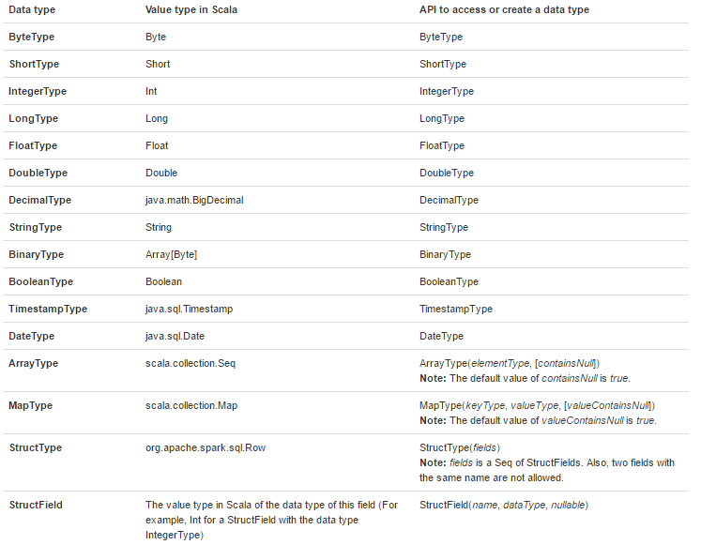
Spark SQL Datatypes
INCEPTEZ TECHNOLOGIES

Slide 32
SPARK SQL Artifacts - MAVEN
<dependency>
<groupId>org.apache.spark</groupId>
<artifactId>spark-sql_2.11</artifactId>
<version>2.2.0</version>
<scope>provided</scope>
</dependency>
<dependency>
<groupId>org.apache.spark</groupId>
<artifactId>spark-hive_2.11</artifactId>
<version>2.2.0</version>
<scope>provided</scope>
</dependency>
INCEPTEZ TECHNOLOGIES

Slide 33
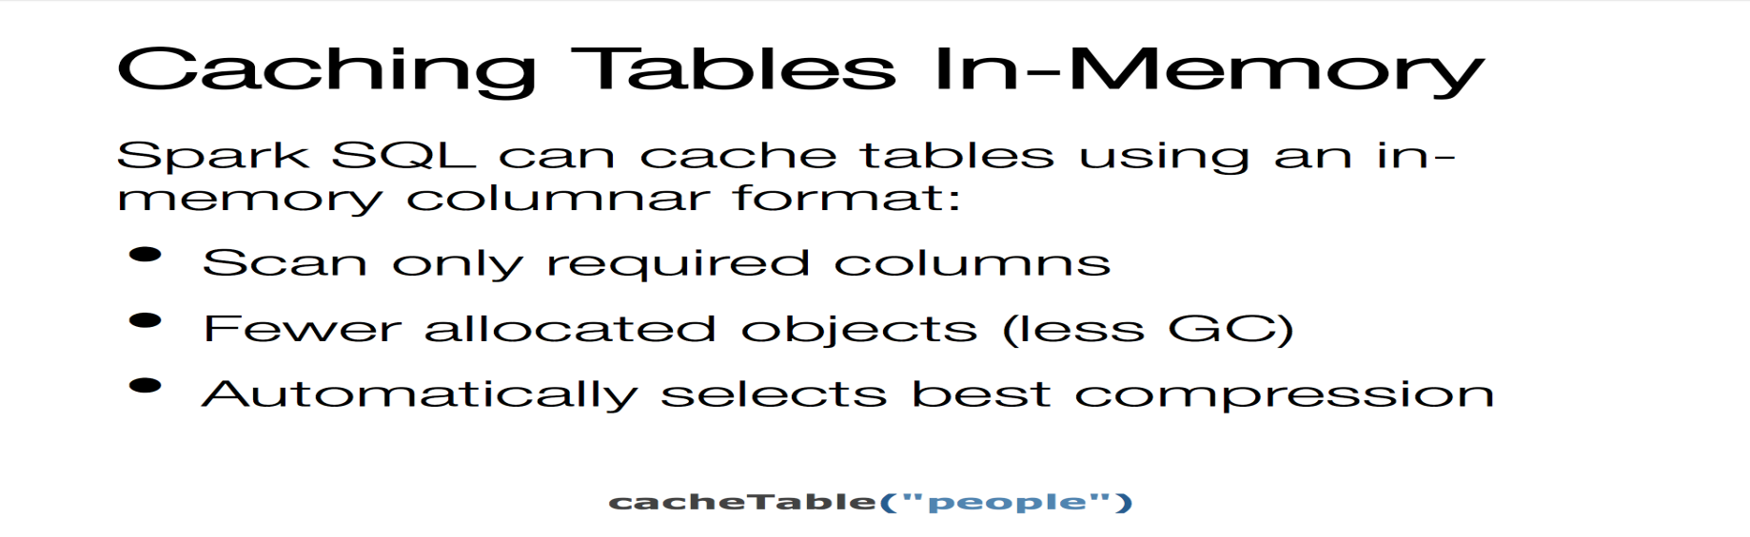
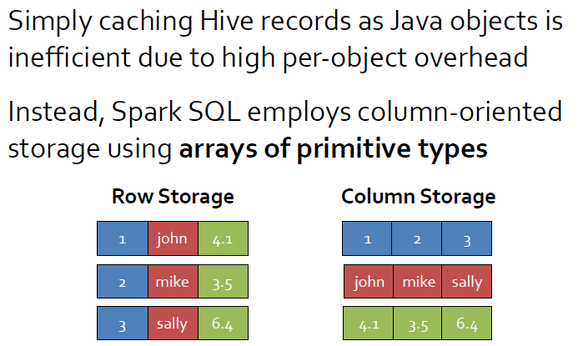
SQL Performance – Caching
INCEPTEZ TECHNOLOGIES

Slide 34
HiveContext
HiveContext is an alternative entry point into the Spark SQL library
HiveContext can do all that SQLContext can do and, on top of that, it can read from Hive meta store and tables, and can access Hive user-defined functions as well.
The only requirement to use HiveContext is obviously that there should be an already existing Hive setup readily available. In this way, Spark SQL can easily co-exist with Hive.
Spark SQL can process the data from Hive tables faster than Hive using its Hive Query Language.
Spark SQL from different versions of Hive, which is a great feature enabling data source consolidation for data processing.
scala> import org.apache.spark.sql.hive._ scala> val hc = new HiveContext(sc)
INCEPTEZ TECHNOLOGIES

Slide 35
Hive Features - Supported and Un Supported
Spark SQL supports the vast majority of Hive features, such as:
Hive query statements, including:
SELECT, GROUP BY, ORDER BY, CLUSTER BY, SORT BY
All Hive operators, including:
Relational operators, Arithmetic operators, Logical operators, Mathematical functions , String functions
User defined functions (UDF)
User defined aggregation functions (UDAF)
User defined serialization formats (SerDes)
Window functions
Joins
JOIN, {LEFT|RIGHT|FULL} OUTER JOIN, LEFT SEMI JOIN, CROSS JOIN
Unions, Sub-queries
Partitioned tables including dynamic partition insertion
All Hive DDL Functions, including:
Unsupported Hive Functionality
Tables with buckets: bucket is the hash partitioning within a Hive table partition. Spark SQL doesn’t support buckets yet.
Column statistics collecting: Spark SQL does not scans to collect column statistics at the moment.
File format for CLI: For results showing back to the CLI, Spark SQL only supports TextOutputFormat.
INCEPTEZ TECHNOLOGIES

Slide 36
Demo
SQL Workouts
INCEPTEZ TECHNOLOGIES

