Slide 1
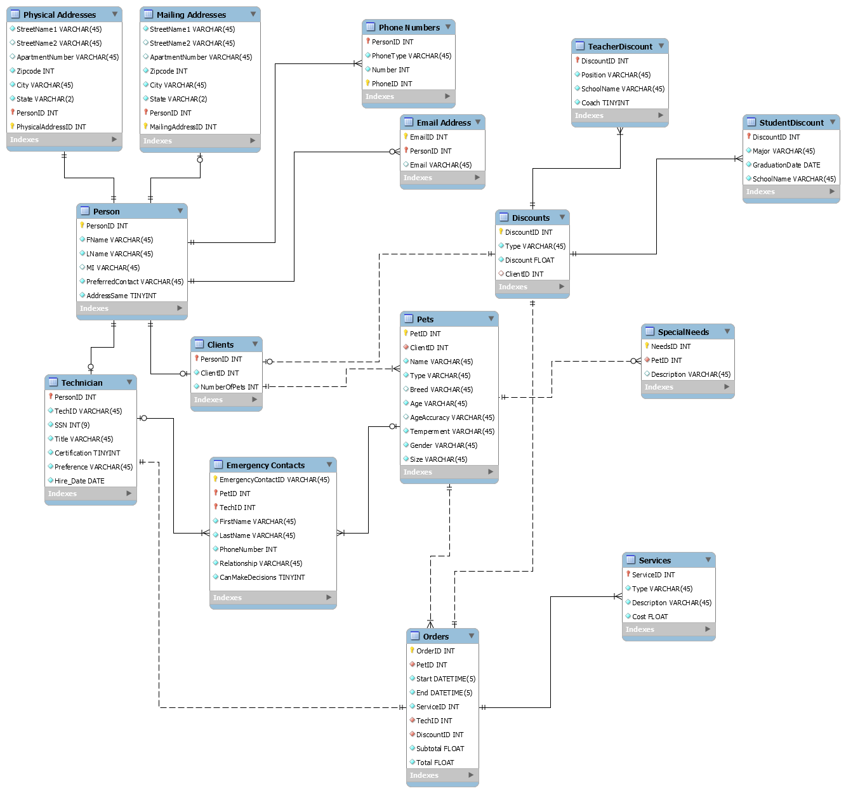

Slide 2
I choose to have a “person” table with a subset for technician and clients. This would be an overlapping subset since techs can also be clients.
I broke up some of the information into separate tables like physical address, mailing address, phone numbers, and emails. The reason I did this is because some people might need things mailed to a different address or have multiple emails and phone numbers.
I made email 0 to many because there are still a few out there that might not have one or cannot use the one they have for private matters. Rare but possible.
D

Slide 3
I have a 1 – M for clients to pets, 1 – 1 for pets to clients.
I have emergency contacts connected to techs and pets. Not sure if I have the right relationship showing. I mean to have it
1 – M for tech to emergency contacts because a tech might input multiple people. Same thought for pets to emergency contacts
0 – 1 for emergency contacts to tech (pets) because some contacts might only be for techs or only for a pet.

Slide 4
I have a Discount table to hold the types of discount, right not its just teacher and student, but things like military, frequent client, and employee might become one so I created a table for each type of discount keeping track of the appropriate info for those.

Slide 5
Orders are connected to techs, pets, and services
There is a 0 – M for special needs because some might not have them.

