Slide 1
Treasurer's Report 2018
PLUG financial position healthy
Net outgoings sustainable for a few more years
Position at the end of: 2017 / 2018
  Current Assets $3,924.57 $3313.34
  Current Liabilities $0.00 $0.00
  Revenue $663.00 $677.10
  Expenditure $1,237.83 $1288.33
  Net Outgoings ($574.83) ($611.23)
Notes:
PLUG finished 2018 with a healthy bank balance and no outstanding debts. Much of this balance is held in our Bendigo Bank Account, and a relatively small amount in the cash box.
It is notable that the outgoings have increased over the last few years. This is attributable to an increase in our expenses; revenue remains stagnant.
Our current reserves will sustain the club for a few more years. However, we need to raise more revenue or reign in expense in the near future, while we still have reserves to spend on initiatives.
In particular, we need to decide how best to use our cash reserves for the future of the club.

Slide 2
2018 Financials - 1

Slide 3
2018 Financials - 2

Slide 4
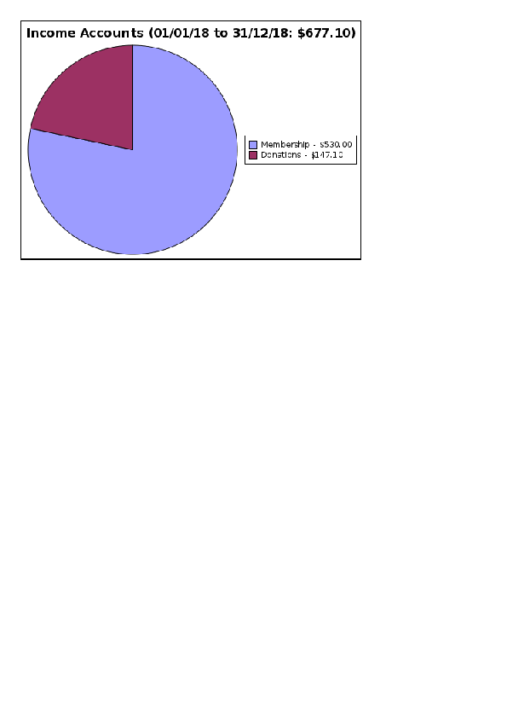
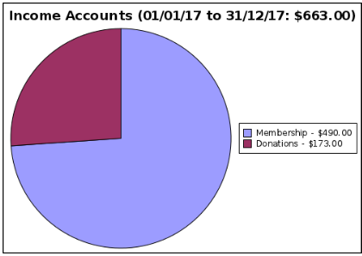
Income 2017 vs 2018
Notes:
This year almost all our income came from membership fees. This includes donations received at events and during membership renewals.
Membership income has risen from that of the previous year, however, it is still below historical levels.
The income stream from providing AV for other organizations has dried up and seems unlikely to return, so future spending needs to be matched to our membership renewal income stream.

Slide 5
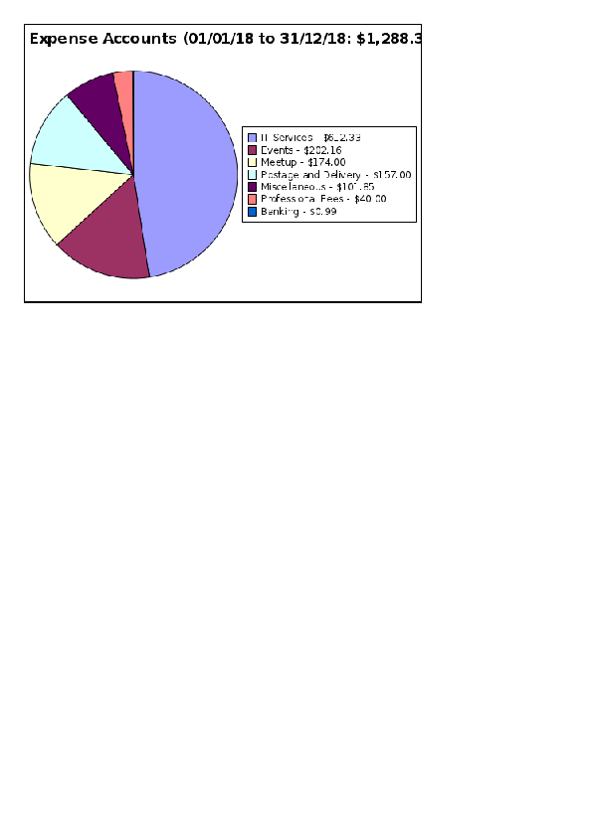
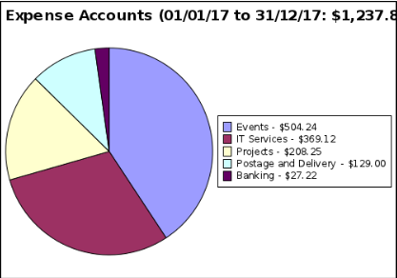
Expense 2016 vs 2017
Notes:
Our largest expense is now our hosting on AWS, making up almost 50% of our yearly spending. We have greatly reduced our spending on event catering, so our total expenses have risen only slightly. However, this does leave us with little leeway in our spending. In particular, we have not spent any significant amount on the AV project.
Some thought needs to be given to methods of reducing our hosting cost as this is the major threat to the club's financial viability. (Absent a revenue increase.
There was a one-off charge for our constitutional changes (“Professional Fees”). The miscellaneous expenses reflected spending on USB keys for a PLUG event. Fixed fees for our meetup group and . post box make up the remainder of our expenses.

Slide 6
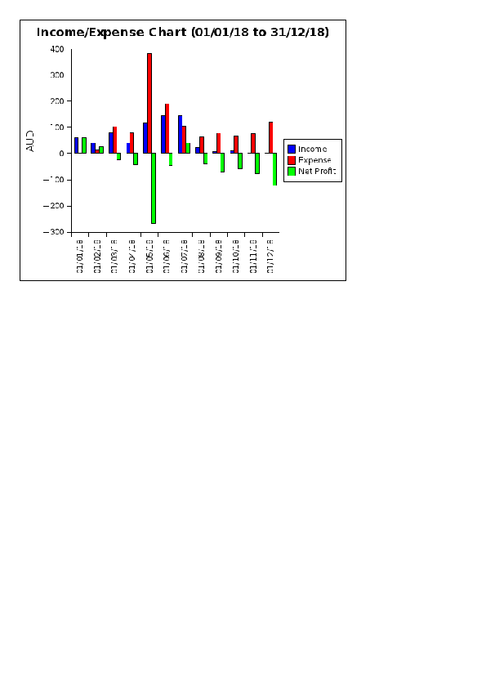
Monthly Chart for 2018
Notes:
Our income tends to be received predominanly during the first half of the year.
While our expenses are more or less distributed evenly throughout the year.
Except for one-off events such as the May Ubuntu Launch party.

Slide 7
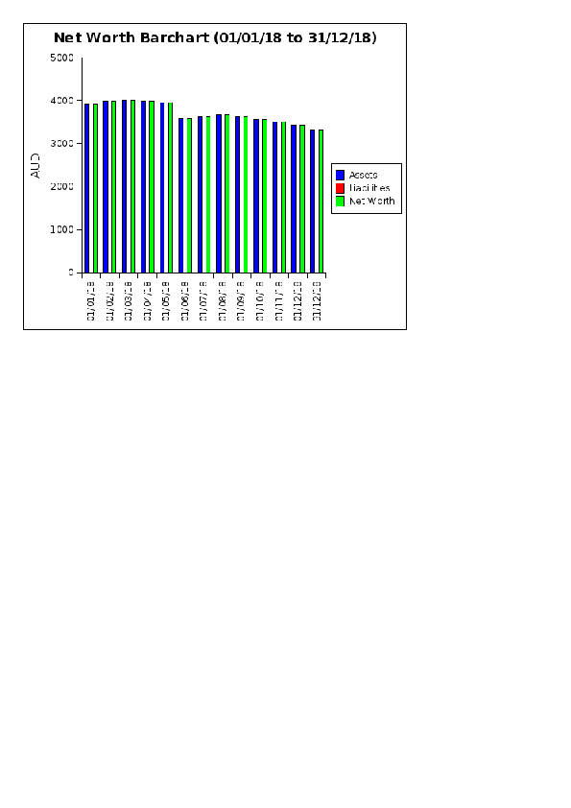
Future
Notes:
Obviously, for the long term we will need to not make a net loss.
While an increase in revenue requires recruiting new members, our expenses are relatively modest. No venue hire fees at the moment, and our event catering expense while substantial in 2018, can scale to the number present.
There is also some scope to reduce AWS hosting cost by securing credits and/or making more efficient use of resources, eg: moving to a reserved instance. But free hosting would be ideal.
However, our AV gear has reached the end of useful life and we have not budgeted for any renewal.

