Slide 1
Treasurer's Report 2019
PLUG financial position healthy
Net outgoings sustainable for a several years
Position at the end of: 2018 / 2019
  Current Assets $3,313.34 $2801.48
  Current Liabilities $0.00 $24.61
  Revenue $677.00 $1005.10
  Expenditure $1,288.33 $1441.27
  Net Outgoings ($611.23) ($436.17)
Notes:
PLUG finished 2019 with a healthy bank balance and a small amount of unpaid reimbursements. Most of this balance is held in our Bendigo Bank Account, and only a small amount in the cash box.
It is notable that the outgoings have levelled off after increasing over the last few years. We have been working on limiting our hosting expense; and while it has increased, our revenue has improved after some years of stagnation.
Our current reserves will sustain the club for several more years. Over the current year we have worked on focusing our expenses better.
Nevertheless, we are still eating into our cash reserves, albeit at a slowing pace.

Slide 2
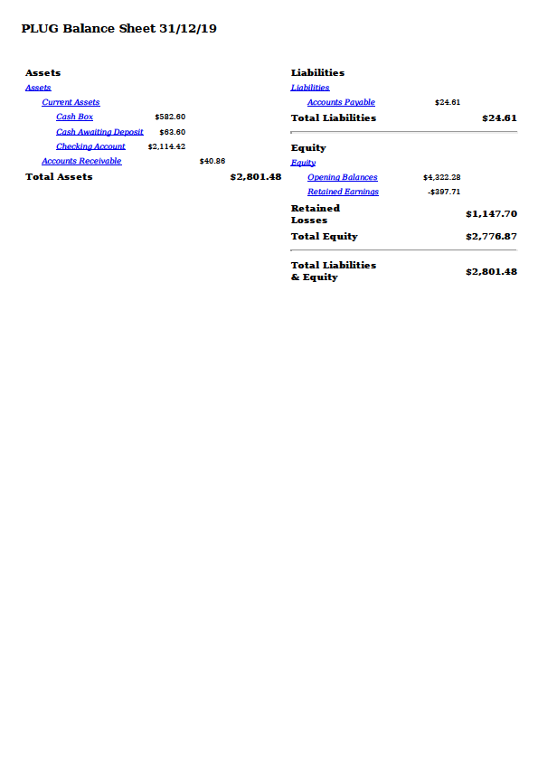
2019 Financials - 1

Slide 3
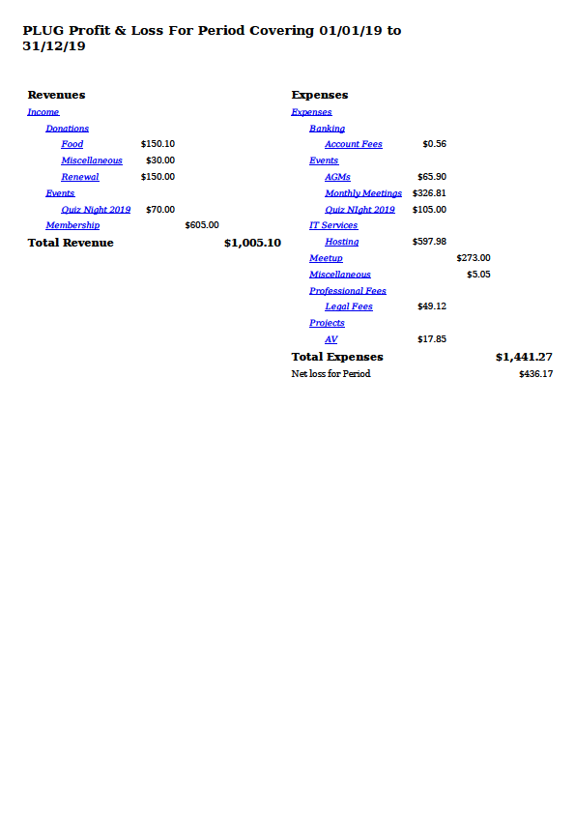
2019 Financials - 2

Slide 4
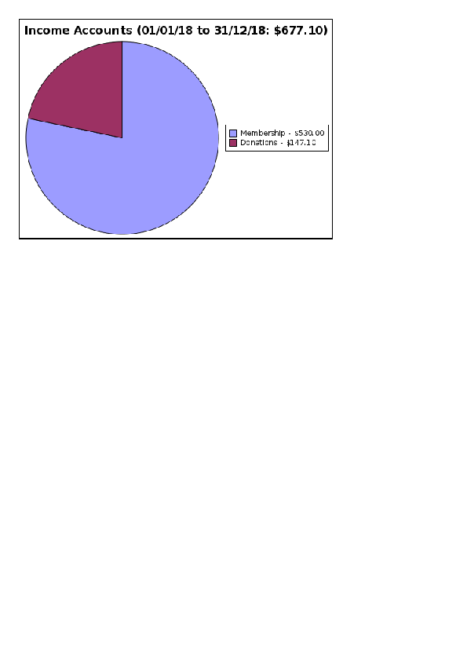
Income 2018 vs 2019
Notes:
This year almost all our income came from either membership fees or donations received during events or membership renewals.
Membership income has again risen from that of the previous year, however, it is still below historical levels.

Slide 5
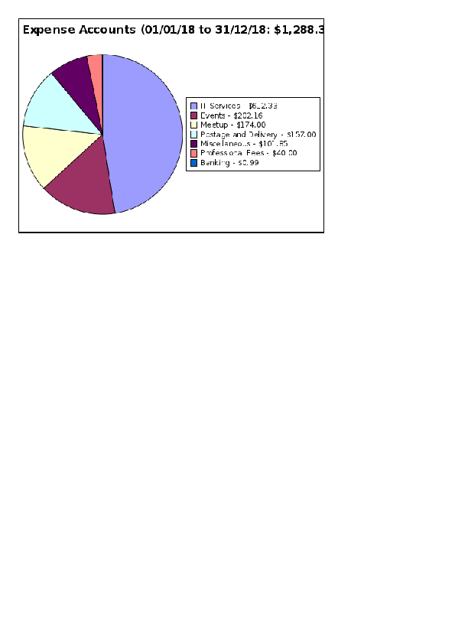
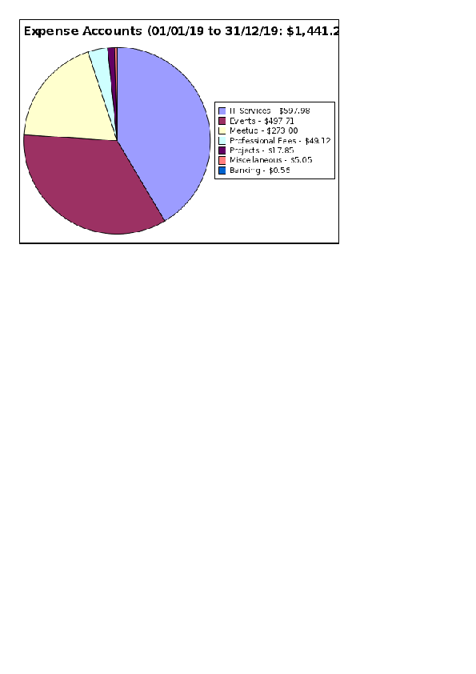
Expense 2018 vs 2019
Notes:
We have made inroads into decreasing out spending on our AWS hosting, though it still is the largest component of our yearly spending.
We spent almost nothing on projects, and eliminated our P.O. Box, though our Meetup fees did increase.
We increased our spending on event catering, and so actually increased our total expenditure. However, this has been more than matched by an increase in our revenue.

Slide 6
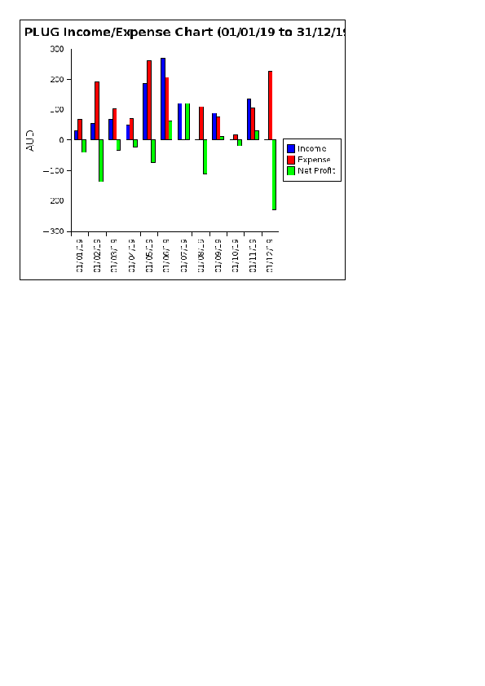
Monthly Chart for 2019
Notes:
While our income has traditionally been mostly received in the first half of the year, this year we have shown spikes around popular events suggesting that this may be a better way of catering to our members.

Slide 7
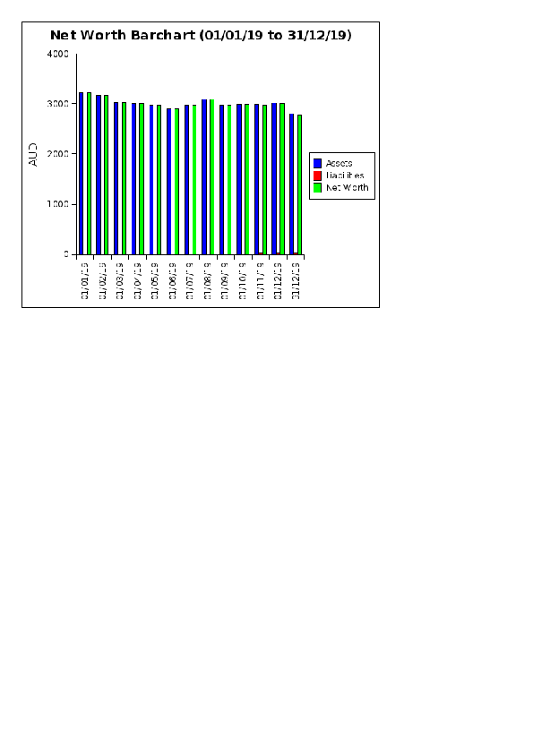
Future
Notes:
Obviously, for the long term we will need to not make a net loss.
While an increase in revenue requires recruiting new members, our expenses are relatively modest. No venue hire fees at the moment, and our event catering expense has been scaled to the number attending.
We have made inroads into reducing AWS hosting cost by securing credits and making more efficient use of resources. While we could make use of reserved instances, we are looking at alternate hosting arrangements for our cost.
Our AV gear has reached the end of useful life.

